Slide 2
Why Project Risk Advisory? Tackling Project Risk
March 2026

Slide 3

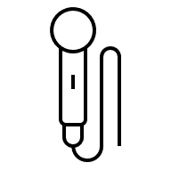


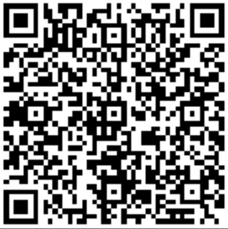
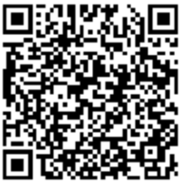
Speakers
Nick Russell
Kyle Roberts
Managing Director
Higher Education
Technology Audit Leader
Associate Director
Technology Audit Practice
Project Risk Advisory
Scan the QR code and connect with us on LinkedIn!

Slide 4
Agenda
01 | What is Project Risk Advisory?
02 | Why Project Risk Advisory?
03 | Developing an Approach
04 | Project Risks and Project Management Methodology
05 | Q&A

Slide 5
What is Project Risk Advisory?

Slide 6

Vision
A Project Risk Advisory engagement model adds an independent risk and controls audit lens to key enterprise projects for management, the audit committee, and applicable external compliance/regulatory entities. This assurance team maintains a separate set of responsibilities from traditional audit teams performing rated audits, and instead serves in a consultative audit role providing real-time risk management and controls implementation guidance by integrating into project teams.
The goal is to become a partner throughout the project life-cycle.

Slide 7








Mission
Identify high risk/impact projects per enterprise mission, financial goals and regulations
Identify and communicate project risk and mitigation solutions
Provide enterprise-wide view to facilitate collaboration opportunities
Perform independent assessments of solution readiness
Assess project governance and documentation
Highlight process and system enhancements/efficiencies
Participate in all phases to ensure effective internal control design
Perform independent assessments of solution readiness

Slide 8


Project Organizational Structure
Developing a successful project team involves the coming together of a variety of stakeholders to create a single integrated team. This ensures that all the appropriate parties are at the table to provide necessary input along the way.
Integrated Project Team
Project Team & Stakeholders
Project Specialists
Internal Audit
+
+
=
Project Leads
Product Owners
Process Owners
IT Teams
Executive Sponsors
Project Management Office
Product Teams
System Integrators
Data Conversion Teams
Subject Matter Experts
Managed Services
Independent Perspective
Risk & Controls Experts
Trusted Advisors
External Stakeholder Shield / Liaison
External Stakeholders
External Auditors
Regulators
Reliant Third Parties

Slide 9
Polling Question 1
Have you used a Project Risk Advisory approach for auditing projects?
A
Yes
B
No
C
Partially

Slide 10
Why Project Risk Advisory?

Slide 11
Project Team Independence & Management
Project Specialists and/or System Integrators are single goal minded: Get a working version of the system implemented on-time and in budget.
Project Risk Advisory teams provide a compliance and operational risk lens to projects with a goal of ensuring risks have been communicated, remediated, mitigated, or accepted by management.
Project Specialist and System Integrator goals can at times be at odds with the Project Risk Advisory team. Embrace it! This is an opportunity to educate and strengthen relationship. Both perspectives are important.
Internal Audit reports to the Audit Committee, “show-stopper” risks can be escalated as needed.
Should be the same as previous system | Controls | Designed to support to-be process and new compliance/regulatory requirements
Make sure the user can perform their job duties | Security | Least Privileged Access
Whatever is defined in the requirements | Reports | Did we identify audit reports for key controls?
Can we do almost everything we promised? | Outstanding Issues | Documented work arounds, target dates, and stakeholder approval?
Do what we can to make it work | Post Go-live/Hypercare | Follow a controlled process
Project Team/System Integrator
Project Risk Advisory

Slide 12
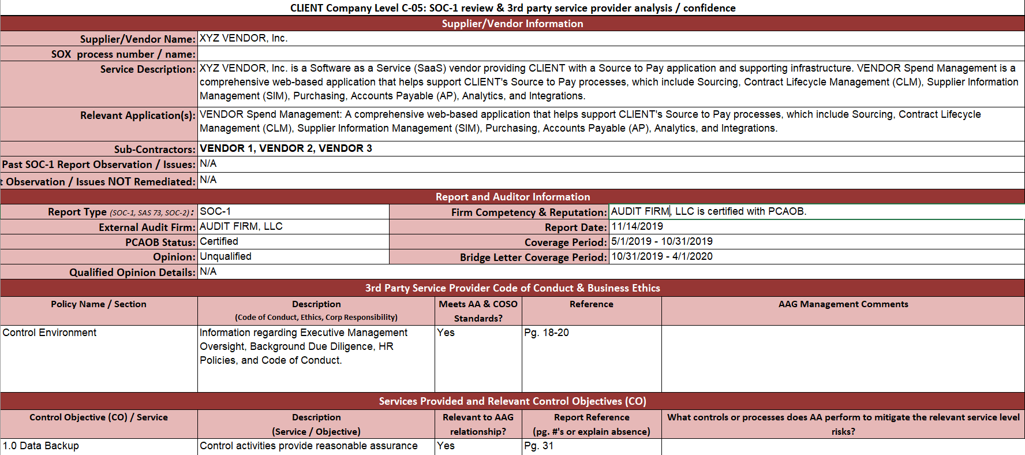
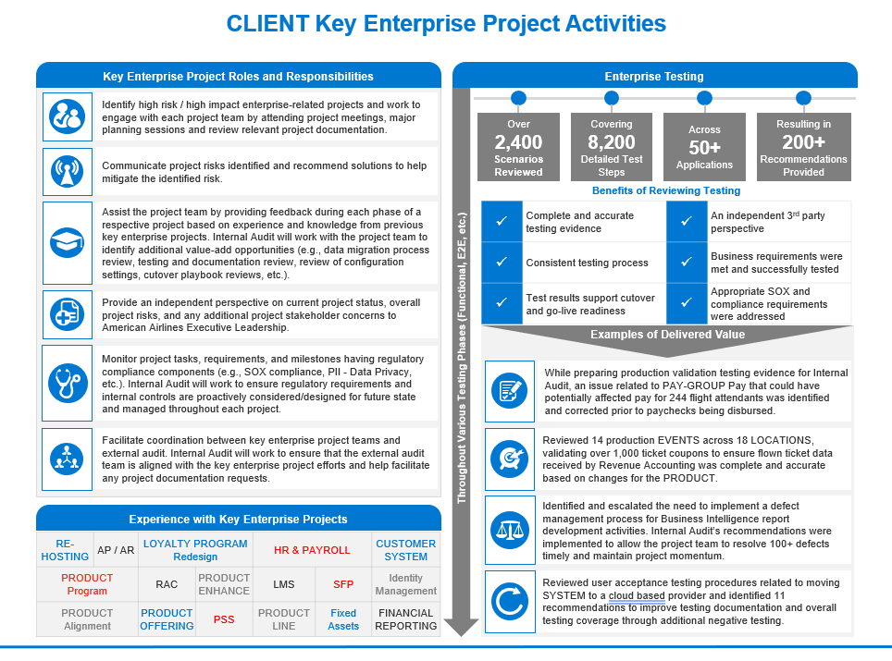
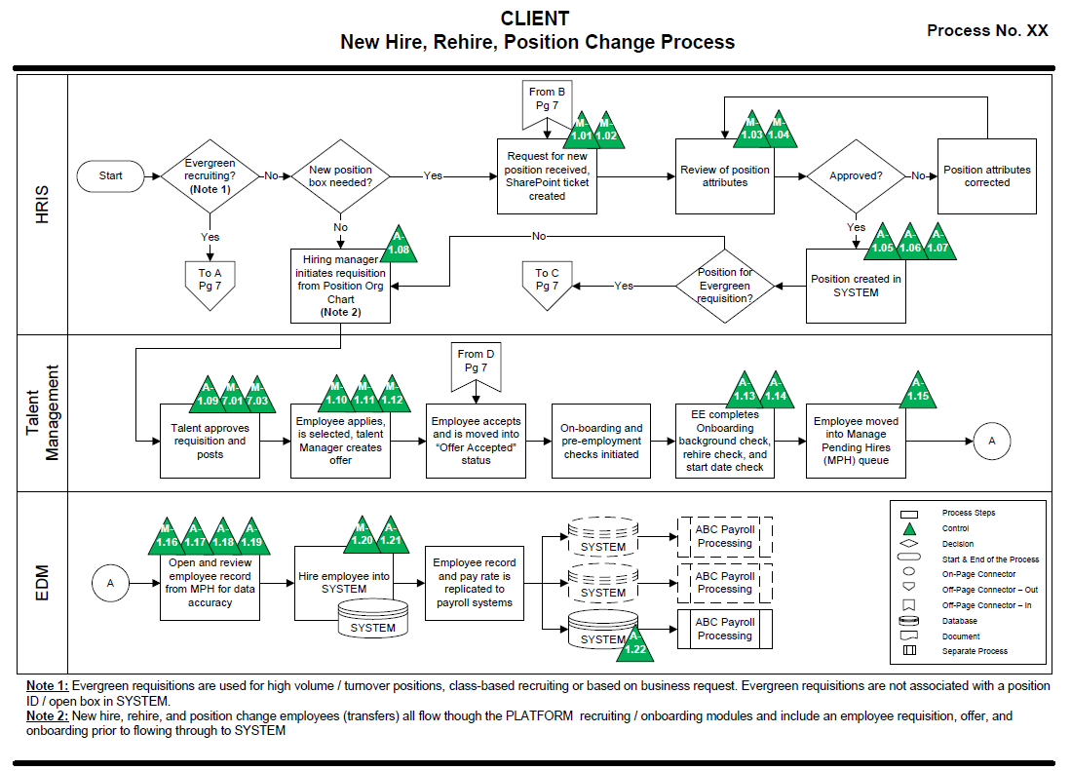
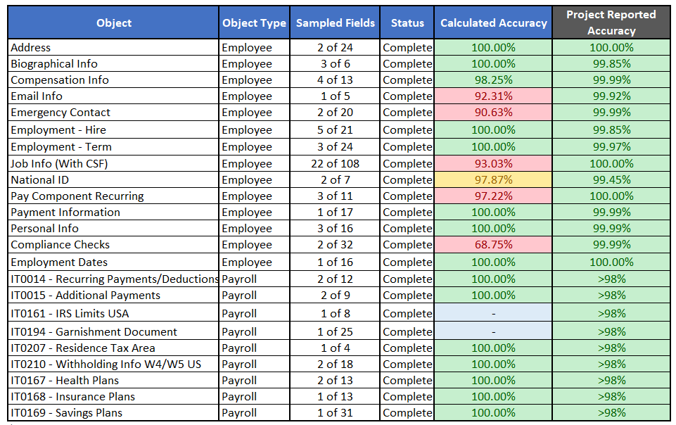
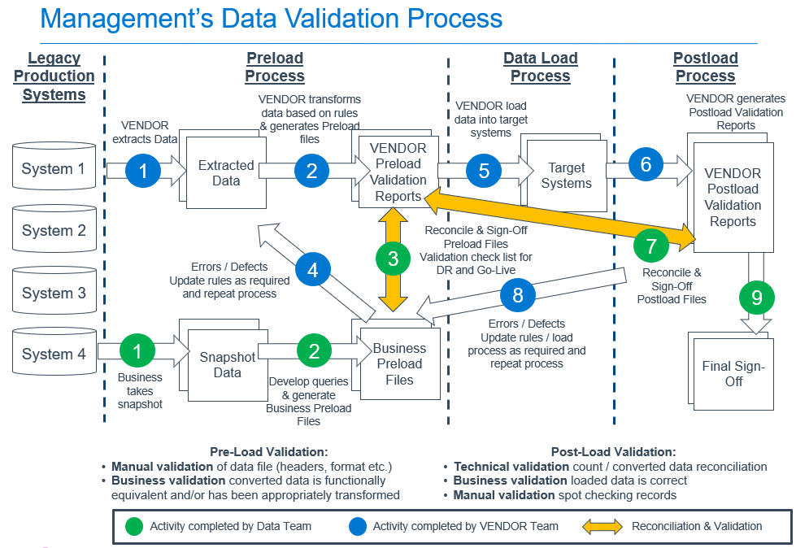
Benefits of Project Risk Advisory
 | Accountability to project governance standards and project charter requirements
 | Increased confidence in comprehensive business requirements
 | Independent validation of system testing results
 | Independent data migration quality assessment
 | Effective, compliant, and comprehensive internal control structure
 | User security assessed for least privilege and SOD
 | Improved Audit Committee and Board visibility
 | Independent assurance on overall solution quality pre-go-live
 | Strong coordination with external audit/regulators
 | Improved enterprise collaboration during the project
Example Deliverables

Slide 13
Value for All
Major projects/implementations often introduce risk across an entire organization which is why the Project Risk Advisory team’s performed activities mirror that impact in the value provided to the enterprise.
Area | Solution | Value Beneficiary*
 |  | Audit | Risk | Corp & Finance | IT & IS | Operations
Project Governance | Project Delivery Methodology Assessment |  |  |  |  | 
 | Project Governance Review |  |  |  |  | 
 | Project Governance Continuous Monitoring |  |  |  |  | 
Solution Readiness | Solution Design Review |  |  |  |  | 
 | Requirements Validation |  |  |  |  | 
 | Defect Management Assessment |  |  |  |  | 
 | Independent Testing Validation |  |  |  |  | 
Data Integrity | Client Data Integrity Process Assessment |  |  |  |  | 
 | Independent Data Integrity Validation |  |  |  |  | 
 | Data Governance Assessment |  |  |  |  | 
Go-Live | Cutover Plan Review |  |  |  |  | 
 | Organizational Change Management |  |  |  |  | 
 | Independent Go-Live Readiness Opinion |  |  |  |  | 
 | Real-time Cutover Support |  |  |  |  | 
 | Hypercare Transition Monitoring |  |  |  |  | 
 | External Audit/Regulator Coordination |  |  |  |  | 
Internal Controls | Controls Mapping |  |  |  |  | 
 | Risk and Controls Process Flow |  |  |  |  | 
 | Controls Design Validation |  |  |  |  | 
 | Third-Party Provider Controls Evaluation |  |  |  |  | 
Collaboration | Collaboration Workshops |  |  |  |  | 
* Mapping based on generic projects, clients, organization size; each project scenario will have its own unique value map across the enterprise.

Slide 14
Developing an Approach

Slide 15
Polling Question 2
How many active transformation projects are going on at your institution?
A
1-5
B
6-10
C
10-20
D
20+

Slide 16





Selecting the Right Project or Product
Identify large enterprise projects the Risk Assessment cycle
Document a Project Inventory of enterprise projects/programs and associated enterprise attributes.
Rank by criticality and Assess Overall Project Risk to the organization
Select Projects to target for a Project Risk Advisory engagement
Approach leadership teams and gain Stakeholder Agreement on an leveraging the Project Risk Advisory approach
Notes:
NICK
Talking Point:
You might be asking yourself, where do I start? The identification of large projects can be baked right into the risk assessment process and interviews with key leaders of the organization. Use these steps to land on the right project or projects to get involved in.
Ranking project risk is a unique blend of evaluating the project’s impact on operationally critical processes, mandatory regulatory/compliance requirements (SOX, GDPR, CMMC, Industry Specific, etc.), public perception and brand reputation risk and upstream/downstream dependencies
Acceptance with project stakeholders and executive leadership is essential to the success of an Project Risk Advisory engagement. Without it, a team cannot gain the necessary traction to truly embed themselves into the project.

Slide 17
Project Methodology Spectrum
Organizations can utilize a variety of project management methodologies when completing major projects and/or implementing new systems. Part of the Project Risk Advisory process includes determining which project methodology is being used so that the appropriate internal audit partnership model can be applied. The Project Risk Advisory approach is adaptable to any project regardless of where it sits on the project management methodology spectrum.
Waterfall
Hybrid
Agile/Dev Ops
Traditional phased approach from initial requirements gathering through go-live and stabilization
Borrowing pieces of both Waterfall and Agile/Dev Ops methodologies to guide projects
Work is parsed out into very small cycles and deployed on a high frequency
Notes:
NICK
Talking Points:
What if we are an Agile shop? Is there still a way to embed internal audit into the product? Yes!
This model can be made to fit any project delivery methodology – the risks are still the same

Slide 18
Waterfall Project Methodology
Controls Mapping
Evaluation of vendor controls (SSAE18 – SOC1/SOC2 Reports)
Identify compliance/regulatory requirements
Control design opinion
Identify automation process opportunities
Participate in design Sessions
Design documentation
Requirements traceability
Documentation supports Go-Live readiness
Defect Management
Consistent process
Evaluate management’s conclusion
Review training and communications to help ensure seamless transition within the organization
Evaluate defect resolution
Monitor preparations for steady-state
Provide first-time control performance guidance
Initial Planning
Project Planning
System Build
Data Conversion
Cutover
Steady State
1
2
3
4
5
6
7
8
9
10
11
Vendor Selection
Requirements/Design
System Testing
Comms & Training
Hypercare
Provide enterprise IA perspective based on enterprise risk, control considerations, risk appetite, and client history
Evaluate project timing and implementation methodology to ensure alignment with other enterprise initiatives and compliance requirements
Internal controls design validation, review, feedback, and gap remediation
Control process flows
Control design narratives
Completeness and Accuracy Validation
Real-time guidance on management’s approach
Defect management
Documentation supports go-live readiness
Data Governance
Cutover Plan Review
“Go”/“No-Go” criteria evaluation
Independent opinion on “Go”/“No-Go” decision
Real-time feedback during cutover process
Liaison with other compliance entities
Continued steady-state support for “fast-follower” changes
Notes:
NICK
Talking Points
Do not drain the slide – focus on a few key sections (e.g., Requirements, Build, Testing Conversion) but take the audience through the lifecycle of a waterfall project.
Describe why the project artifacts will change based on the type of project that is being implemented.

Slide 19






Agile/DevOps Project Methodology
Agile Approach
Initial Planning
Steady-State
QA & Governance
Assess Risk
Plan IA Work
IA Sprint
Sprint
Sprint
Sprint
Sprint
Sprint
Sprint
Tracking/ Reporting
Product Owner/Stakeholder Communication
Delivery
Release 1
Release 2
Sprint/Scrum Planning
Sprint/Scrum Execution
Release Deployment
Backlog & Retrospective
Participate in iteration/release and scrum/sprint planning sessions to provide:
User story requirements: documentation, risk/control considerations, data conversion, testing, etc.
Collaboration with product owners
Identify and raise dependencies between user stories and initiatives
Evaluate use of Agile methodology and provide project management guidance
Teaming
Collaborate with user story owners to provide on-going guidance and support
Provide daily standup participation and on-going project team support
Delivery
Testing Review
Data conversion completeness and accuracy assessment
Internal controls process flows/narratives development, design evaluation, vendor controls mapping
Provide targeted compliance and regulatory guidance to project team
Communications
Present observations, findings, and risks to stakeholders/product owners
Provide on-going involvement updates o the audit committee
Cutover
Release Plan Review
“Go”/“No-Go” criteria evaluation
Independent opinion on “Go”/“No-Go” decision
Real-time feedback during cutover process
Escalation and sounding board for cutover issues/resolutions
Provide perspective on IA observations in lessons learned discussions
Guidance on backlog grooming for “Must-Have” and “Nice-to-Have” compliance/control requirements
Help plan target dates/sprints/releases for IA deliverables to align with the overall project timeline
Notes:
NICK
Talking Points
Agile is probably one of the most intimidating parts of running an Project Risk Advisory engagement because it is less traditional, and generally more unknown from a project delivery perspective. While this is true, it could not be more important given some of the myths around a lack of documentation being generally acceptable in an Agile methodology
IA can continue to operate in their traditional approach but the quarterly audit committee meetings actually line up really nicely with an Agile Quarterly release cadence, so I have seen IA teams adopt and Agile IA model to pair with an Agile project.

Slide 20
Polling Question 3
What project or program delivery methodology does your organization use?
A
Waterfall
B
Agile / DevOps
C
Hybrid “Wagile”
D
I don’t know

Slide 21

Continuous Risk & Value Assessment
The Project Risk Advisory lifecycle follows a pattern of activities that need to be constantly refreshed as the project moves along its own project path. As the project changes and new risks present themselves, the Project Risk Advisory team should be re-assessing priorities, value-add activities, and general support provided to the project team.
Communicating with project stakeholders
Constantly evaluating risk
01
02
Providing updates on observations, value add activities
Agreeing on Activities that Drive Value for Stakeholders
04
03

Slide 22
Level of Effort & Assurance
Programs and projects each take on unique risks which should be evaluated when identifying the right level of assurance support to provide. We tailor our solution offerings to find the appropriate blend of assurance and cost aligned to overall risk.
Project Governance
1 | Project Delivery Methodology Assessment
2 | Project Governance Review
3 | Project Governance Monitoring
4 | Solution Design Review
5 | Requirements Validation
6 | Defect Management Assessment
7 | Independent Testing Validation
8 | Client Data Integrity Process Assessment
9 | Independent Data Integrity Validation
10 | Data Governance Assessment
11 | Cutover Plan Review
12 | Organizational Change Management Review
13 | Independent Go-Live Readiness Opinion
14 | Real-time Cutover Support
15 | Hypercare Transition Monitoring
16 | External Audit/Regulator Coordination
17 | Controls Mapping
18 | Risk and Controls Process Flow
19 | Controls Design Validation
20 | Third-Party Provider Controls Evaluation
21 | Collaboration Workshops
Higher
Solution Readiness
#
#
Data Integrity
#
#
#
#
#
#
Effort
#
#
Go-Live
#
#
#
#
#
#
#
#
#
#
Internal Controls
Lower
Lower
Assurance
Higher
Collaboration
Notes:
Draw three lines – use more general plotting as opposed to specific

Slide 23
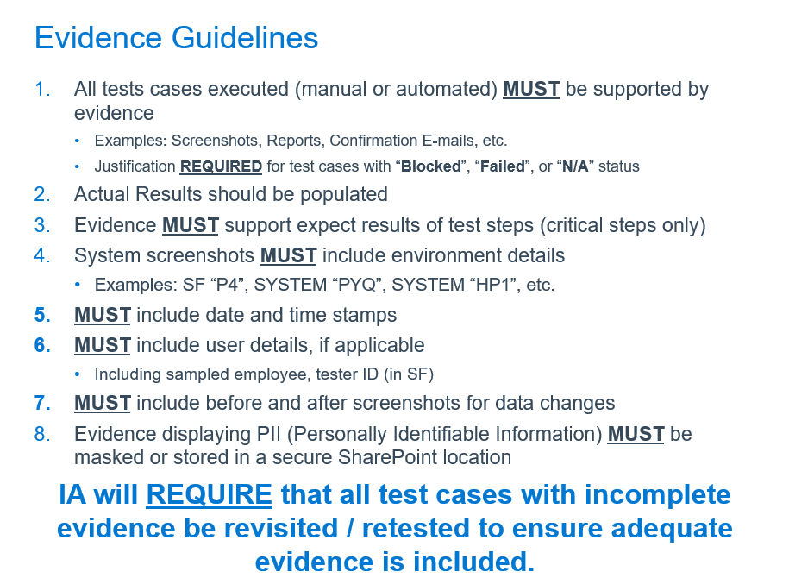
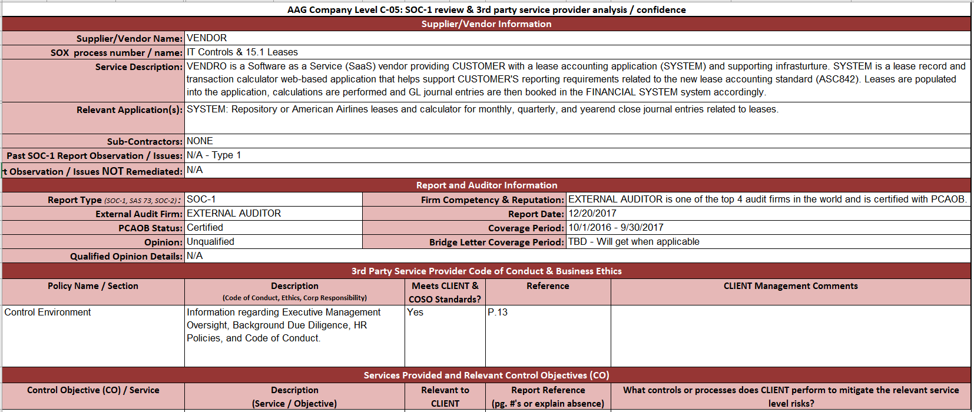
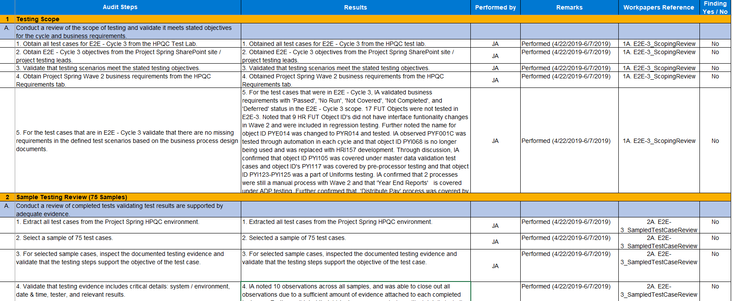
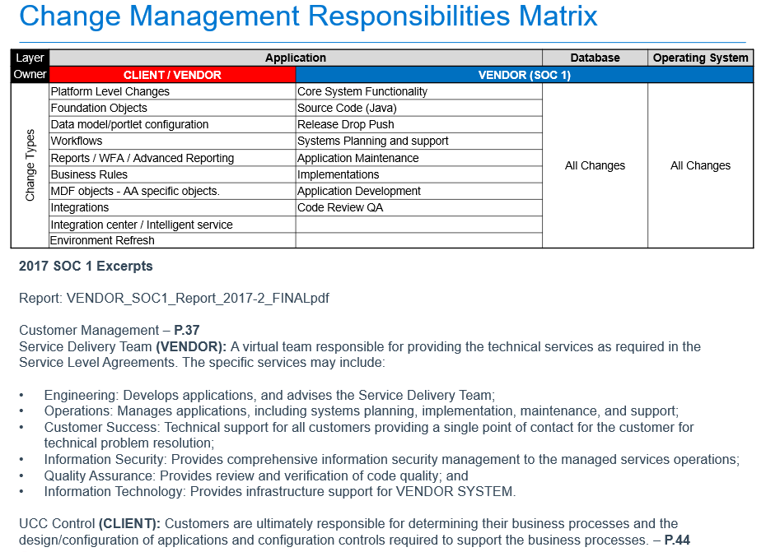
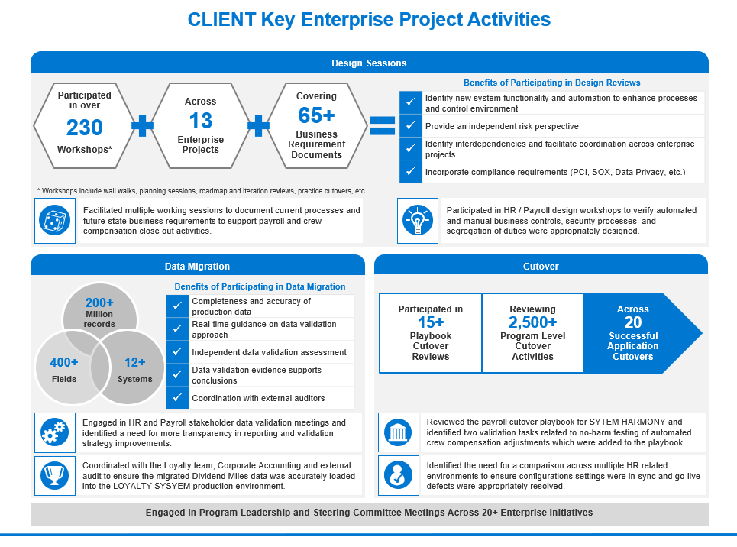
Example Deliverables
Project Risk Advisory Teams deliver a variety of documentation packages to support transformations:
Data Conversion Completeness and Accuracy Assessment
Solution Readiness Testing Review
Service Provider Controls Mapping
Internal Controls Process Flows
Executive Leadership Messaging

Slide 24
Polling Question 4
What are the biggest roadblock to deploying a Project Risk Advisory team?
A
Buy-in from project teams and Management
B
Developing the approach and methodology within the Internal Audit team
C
Lack of system life cycle development and project risk technical skills/knowledge
D
Too many mandatory, compliance related efforts consuming Internal Audit budget

Slide 25
Project Risks and Project Management Methodology

Slide 26
Managing Program & Project Risks
All PMO’s should have a structured framework to enable identification, assessment, tracking, and management of key program/project risks. An effective program/project risk management process should be tailored to each organization and the specific program/project, focusing on specific areas of risk and concern. Protiviti’s Project Risk Advisory solution model is structured around Project Management Institute (PMI) guidelines, takes a comprehensive view of the delivery lifecycle, and is applicable to small projects as well as larger programs.
Project Management is the application of knowledge, skills, tools and techniques to project activities in order to meet or exceed stakeholder needs and expectations.
Project Management Risk
Scope
Time
Cost
Quality
Human Resource
Communication
Risk
Procurement
Project Life-cycle is the defined process used to design, develop, test and implement a product.
Product Life-cycle Support Risk
Planning and Initiation
Requirements Analysis
Design
Development
Testing
Implementation and Rollout
Post Implementation
Project Support is the management and integration framework within which a project operates.
Project Support Risk
Program Office
Integration with Common Business Functions
Project Environment is the internal and external environment within which a project operates.
Project Environment Risk
Strategic Alignment
Corporate Culture
Stakeholders
Business Environment Risk
Process Alignment
Portfolio Management
Notes:
ASH
Talking Points:
Focus on the project/program risk universe and establishing a baseline of auditable units. Just like we do with risk assessments, a more granular view of the areas in play for audit focus should be known and included in IAEA efforts.
Anything else Ash wants to add.

Slide 27
Project Management Methodology
Protiviti's project management methodology (illustrated below) is based on the project lifecycle defined by the Project Management Institute's (PMI’s) Project Management Body of Knowledge (PMBoK), but it builds upon this framework with an expanded set of enabling practices and tools that are designed to facilitate sustained success of the PMO.
Initiating, Planning, Executing, Controlling, Closing – our methodology is aligned to the five Process Groups included within the PMI’s PMBoK, however, we are able to adapt to a client’s unique project management methodologies as needed.
Quality, Cost, Time – project constraints and success criteria underpin the way a project is structured and planned to ensure successful delivery. It is key that these are properly defined for the PMO and metrics and measures are in place to adequately monitor and report on performance
People, Process, Tools – these three key categories of infrastructure will be considered when assessing and designing the PMO and governance structure. Without consideration of each of these elements, there is an increased risk of establishing a deficient PMO function and program governance structure that does not provide the support and monitoring capability needed for the program to achieve its objectives.
Assess, Design, Implement, Educate, Operate, Monitor – this is the typical cycle that we follow when assessing, enhancing and operating a project or program management framework, its governance structure and/or supporting PMO organization.
Project Management, Project Support, Project Environment, Project Life Cycle – this represents our Project Risk Advisory Model. It is key that project risks are appropriately identified, assessed and managed to our clients the best chance of success.
Quality
Assess
Process
Monitor
Design
Project Management
Project Support
Initiating
Planning
Executing
Controlling
Closing
Project Life Cycle
Project Environment
Operate
Implement
People
Tools
Time
Educate
Cost
Notes:
ASH
Talking Points:
Focus on Protiviti recommending that a recognized industry standard program and project risk approach be used and baked into the development of an Project Risk Advisory build out.
Any additional considerations from Ash

Slide 28

Q
A
&

Slide 29
Thank you

