Slide 2


Meet Our Speakers
Brian Parrino
Terry Corcoran
Director,
Internal Audit & Financial Advisory, Tech Audit & Advisory
Protiviti
Director,
Internal Audit & Financial Advisory, Tech Audit & Advisory
Protiviti
2

Slide 3
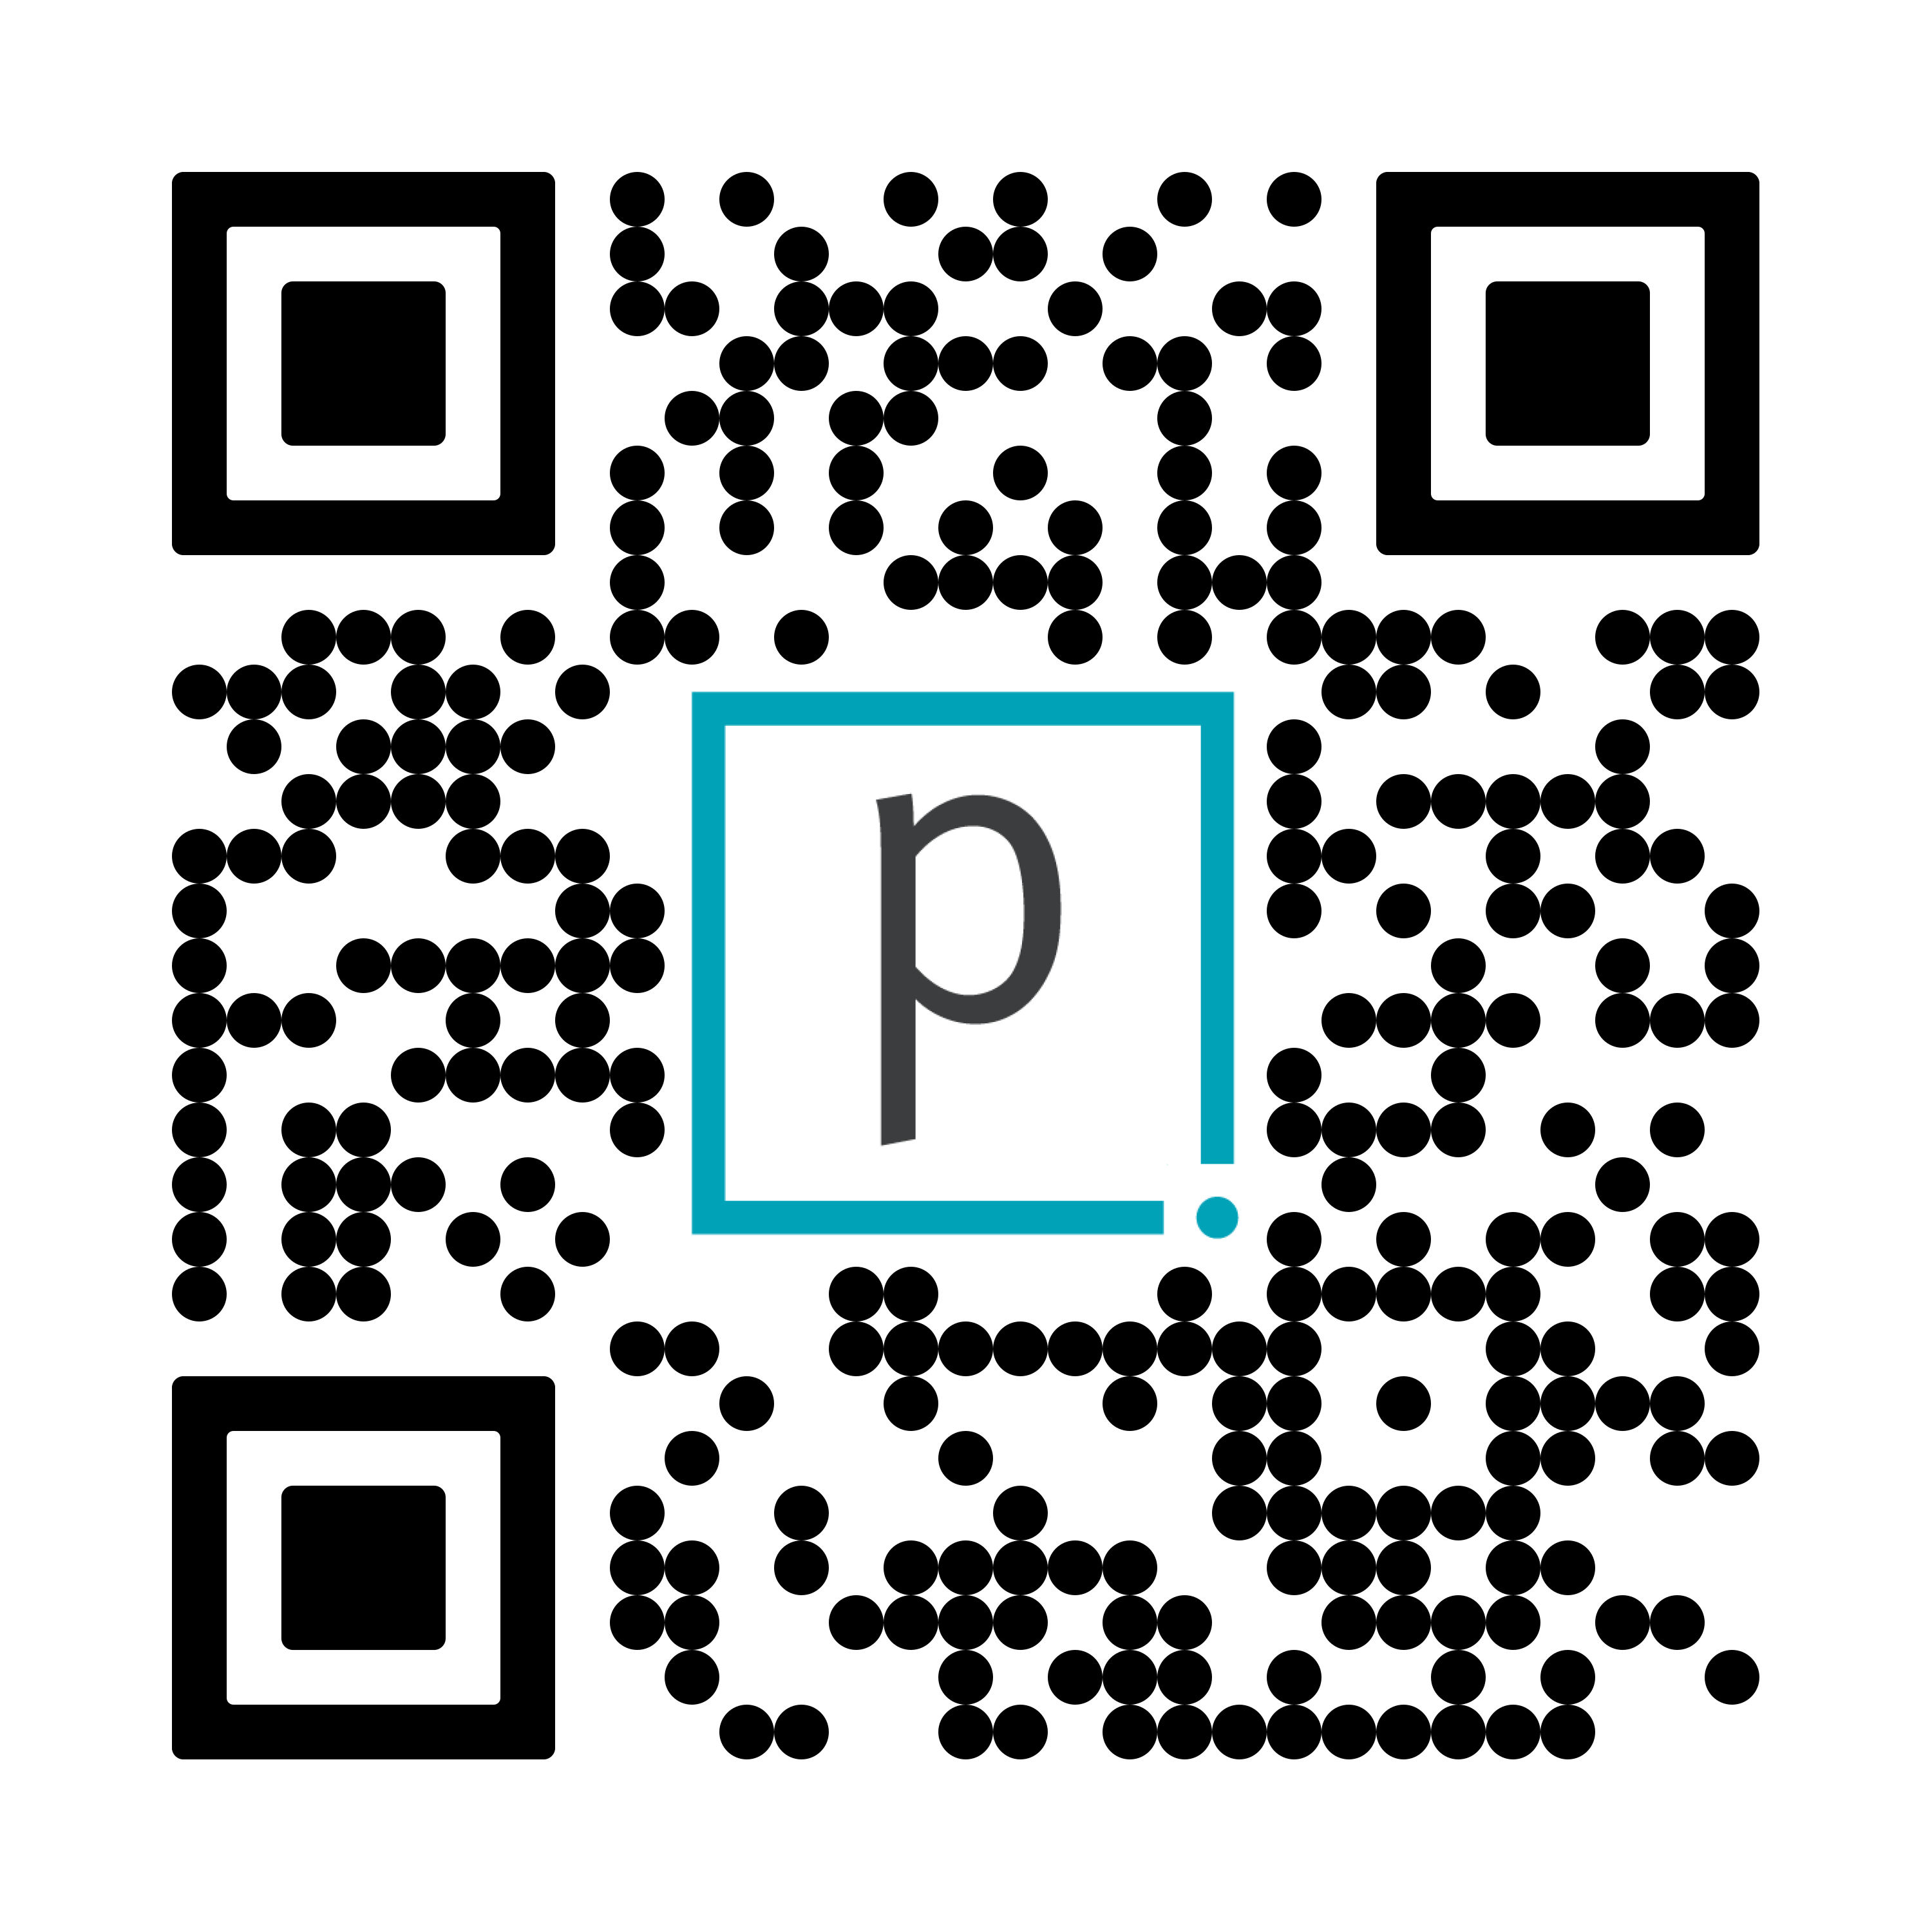
Overview of Today’s Discussion
Unlock the Power of Internal Audit with Microsoft Copilot
01
Adoption Trends
02
Copilot for M365
03
The Art & Science of Prompting
04
The Future of AI
05
Internal Audit Use Cases and Demos
3

Slide 4
Poll Question 1
What is your proficiency level with M365 Copilot?
A. | Expert – I have extensive experience and can leverage its advanced capabilities
B. | Advanced – I’m comfortable using most features effectively
C. | Intermediate – I understand the basics and have some experience
D. | Beginner – I’m new to Copilot and have little to no experience
E. | N/A – I don’t have a license yet.

Slide 5

Adoption Trends
01
Generative AI Maturity
Transition from Hype to Reality: After the initial excitement surrounding generative AI, organizations are moving from experimentation to practical implementation. This shift is characterized by a more nuanced understanding of AI capabilities and limitations, as businesses seek to integrate AI solutions at scale
Key Trends
AI market is expected to reach $17.7 trillion by 2030
02
Integration into Existing Systems
Complementary Tools: Many organizations are embedding AI into existing business applications rather than replacing them. Features like Microsoft’s Copilot and Adobe's Generative Fill illustrate how AI can enhance traditional workflows without overhauling established systems
64% of businesses expect AI to increase productivity
03
Cost Reduction and Automation
Driving Factors: The primary motivations for AI adoption include the need to reduce operational costs and automate processes. Companies are increasingly leveraging AI tools that make these capabilities more accessible, thereby improving efficiency across various functions
Business leaders plan to allocate 5.4% to 7.1% of their functions’ budgets to generative AI.
04
Focus on Multimodal Models
Diverse Data Inputs: The next wave of AI advancements is expected to focus on multimodal models that can process and analyze various types of data simultaneously. This development aims to enhance the versatility and applicability of AI solutions across different sectors
Costs savings expected from generative AI range from 11.3% to 19.7%, with the lowest for finance and highest for marketing and HR.
05
Ethics and Governance
Regulatory Considerations: Organizations are increasingly aware of the ethical implications of AI, leading to a focus on governance and compliance. The evolving regulatory landscape is prompting businesses to adopt more responsible AI practices and ensure that their models are free from bias
Source: Forbes Advisor, Gartner
Source: Forbes, IBM, Gartner
5

Slide 6

Current AI usage in internal audit
As AI advances, Internal Audit should leverage it for greater efficiency and effectiveness. Here’s how other Internal Audit departments are adopting AI, with percentages reflecting usage based on a recent survey.
50%
75%
45%
15%
AI In GRCs
Copilot
Private LLMs
AI + Automation
AI embedded in Audit Management or GRC tools to generate issue, risk wording, and more.
Using Microsoft Copilot for audit use cases within Teams, Word, PowerPoint, and Excel.
Private and secure cloud-based chat applications, akin to ChatGPT, are designed exclusively for corporate use.
Utilizing APIs and agentic AI to facilitate automated usage of AI outside of the chat interface.
Or none
05%

Slide 7
Poll Question 2
What’s your biggest motivator for adopting Copilot in your audit work?
A. | Increasing productivity and reducing manual tasks.
B. | Enhancing audit quality through deeper analytics.
C. | Staying ahead of industry trends and innovation.
D. | Meeting organizational expectations on tech adoption.

Slide 8
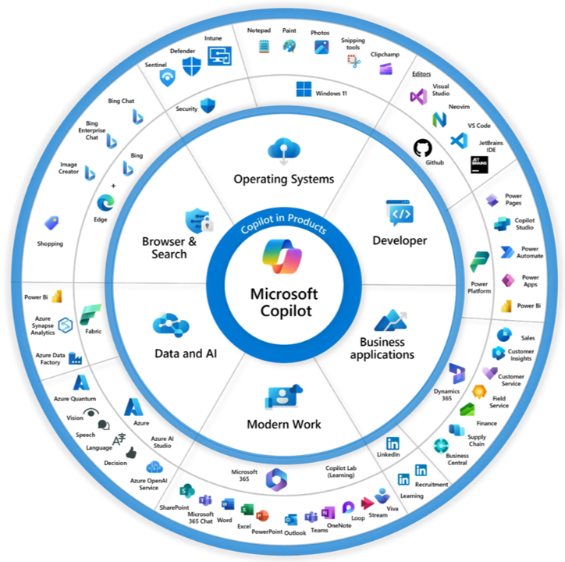
Microsoft’s Copilot Products
Copilot is a brand, a collection of approximately 60 tools and applications leveraging AI.
Microsoft has organized and embedded Copilot across multiple Microsoft products.
Most organizations start with Copilot for M365, which is the suite of Office applications.
From M365 Copilot, companies tend to expand to custom agents, or Data/AI, or Power Platform.
8

Slide 9
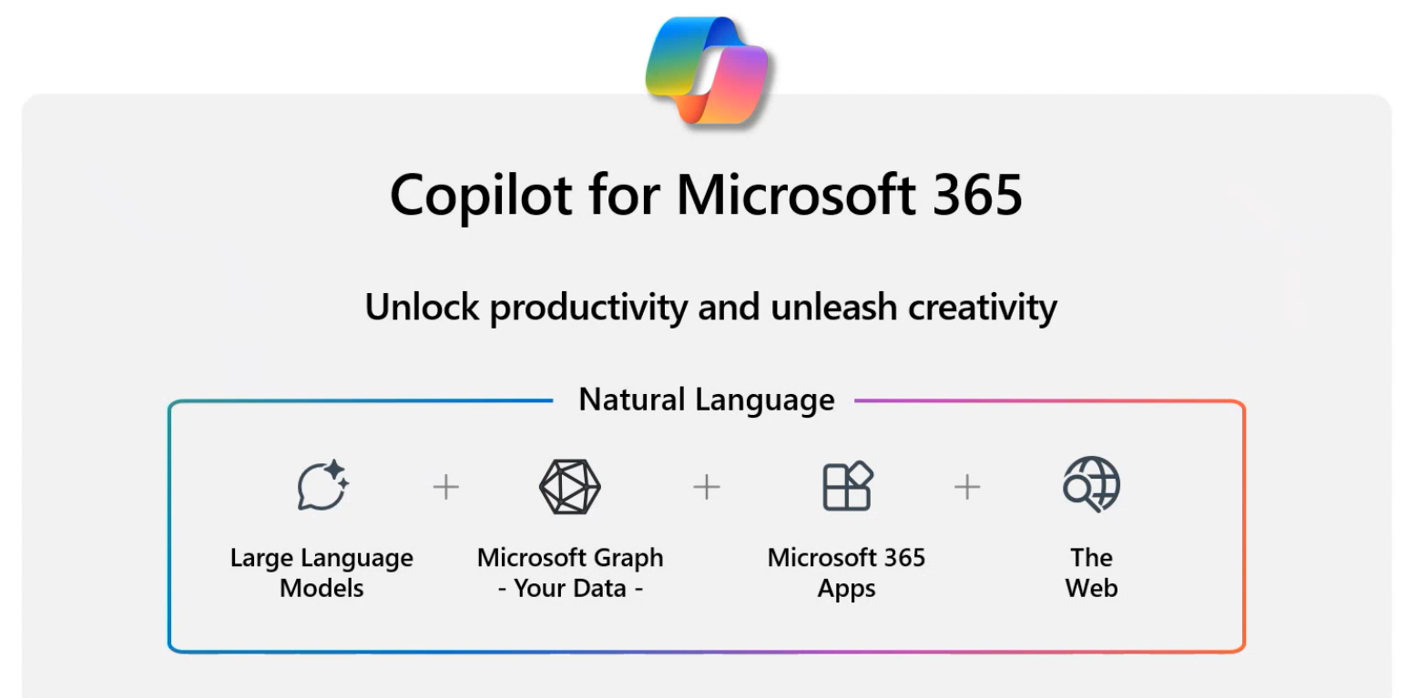




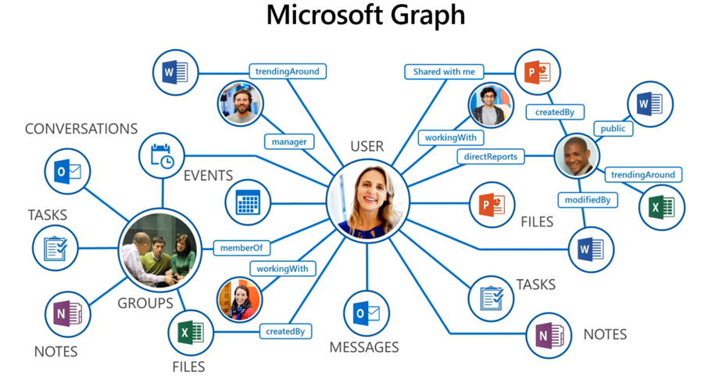
What is Copilot for M365?
Copilot utilizes Generative AI within M365 apps to assist with everyday tasks to help you save time to be able to focus on more important work.
Copilot utilizes Large Language Models (LLM) to;
Understand requests in plain language
Understand and summarize large amounts of information
Generate additional content within the context of provided references
Copilot’s features are directly integrated within the M365 applications, so the interactions and work occur right where you are working
Copilot for M365 with Commercial Data protection ensures your organization’s data is secure and remains safe from risky access
Your requests can only use information on data that you have access to.
Or you can connect Copilot to the web to utilize publicly available information.
Proprietary data and requests are not captured by Microsoft for training data models
Benefits
Improve quality of work
Facilitate creativity
Find information faster
9

Slide 10
Poll Question 3
What’s your biggest concern with using Copilot in Internal Audit?
A. | Data security and confidentiality.
B. | Accuracy of AI-generated responses.
C. | Lack of time to experiment and learn.
D. | Not sure how it applies to audit tasks.

Slide 11














How To Be Successful With Copilot Prompts
WHAT
do I want?
WHY
do I need it?
WHERE
to look?
HOW
do I need it?
Goal
Context
Source
Expectations
What response do you want from Copilot?
Why do you need it and
who is involved?
Which information sources should Copilot use?
How should Copilot respond to meet your expectations?
11
Notes:
Maureen

Slide 12
Structure of Your Prompt Matters
When it comes to prompts, order matters. The order of your instructions can impact the response you are given. Later parts of a prompt are likely to receive more emphasis in the response from Copilot.
Experiment with different orders to understand the impact. Try the following prompt using Copilot Chat and see what responses you get. What differences do you see here?
If you want Copilot to use specific CONTEXT or files or sources, put that information last in your
prompt.
Prompt 1(GCSE): Summarizing Audit Findings for Management
Goal: Provide a concise summary of audit findings for management.
Context: This is for a quarterly meeting with senior leadership, where we’ll present high-level insights on internal controls.
Source: Refer to the Q3 audit workpapers and final reports.
Expectation: Use simple, non-technical language that is easy for non-auditors to understand.
Goal
Context
Source
Expectations
12
Notes:
Maureen

Slide 13
Poll Question 4
How would you rate your confidence level in crafting effective prompts?
A. | Very confident and creative with prompts.
B. | Confident with basic prompts.
C. | Somewhat confident.
D. | Not confident at all.

Slide 14
Prompt Techniques (1/2)
Below are some of the most common prompting techniques to help internal auditors effectively leverage Copilot. The table provides definitions and practical, audit-specific examples to illustrate how each technique can be applied.
Technique | Description | Suggested prompt
Persona Generation | Tailor prompts to reflect distinct roles or responsibilities, ensuring responses align with specific professional contexts or objectives. | As a Senior Internal Auditor specializing in cybersecurity audits, generate a list of key risks related to cloud-based data storage.
The Audience Persona Pattern | Craft prompts that explicitly address the interests, priorities, and informational needs of a clearly defined audience. | As an Internal Audit Manager preparing for an Audit Committee meeting, summarize critical findings from recent audits in a concise, executive-level summary.
Question Refinement Pattern | Iteratively enhance prompts through subsequent clarifying questions to obtain more focused and precise responses. | When I ask a question, suggest a better version of the question to use instead.
14
Notes:
Roel

Slide 15
Prompt Techniques (2/2)
Technique | Description | Suggested Prompts
Cognitive Verifier Pattern | Prompt Copilot to break down complex questions into simpler sub-questions, improving the clarity and comprehensiveness of responses. | When you are asked a question follow these rules: -Generate several additional questions that would help more accurately answer the question -Combines the answers to the individual questions to produce the final answer to the overall question
The Flipped Interaction Pattern | Use Copilot to proactively generate questions to identify additional information needed for comprehensive problem-solving. | My goal is to improve our SOX control testing processes. Ask me questions to clarify our current methods and challenges to better understand potential areas of improvement.
The Recipe Pattern | Clearly articulate an initial and final step or desired outcome and prompt Copilot to detail the intermediate steps required to achieve the goal. | We are planning an audit of our IT disaster recovery process. The first step is risk identification, and the final step is issuing the audit report. Provide the key intermediate steps to complete the audit effectively.
Alternative Approaches Pattern | Request Copilot to identify and list multiple viable methods or approaches to achieve a particular objective or resolve an issue. | We are exploring ways to automate our continuous monitoring of financial transactions. List alternative tools or methods internal audit could leverage to achieve continuous monitoring effectively.
15
Notes:
Roel

Slide 16

Agentic Transfromation in Internal Audit
© 2025 Protiviti – Confidential. An Equal Opportunity Employer M/F/Disability/Veterans. Protiviti is not licensed or registered as a public accounting firm and does not issue opinions on financial statements or offer attestation services. All registered trademarks are the property of their respective owners.

Slide 17
Poll Question 5
Have you experimented with Agentic AI / Agents?
A. | Not at all
B. | I’ve used the Microsoft Agents
C. | I’ve built my own SharePoint Agents
D. | I am building Agents in Copilot Studio or Foundry

Slide 18
Generative AI vs Agentic AI in Microsoft 365 Copilot
Feature | Generative AI (Copilot) | Agentic AI (Copilot Agents)
Primary Role | Assistive | Semi-autonomous
Interaction | User-driven prompts | Goal-driven execution
Scope | Single-task (e.g., summarize, draft) | Multi-step workflows (e.g., reconcile accounts, notify stakeholders)
Examples | Drafting a financial summary in Excel | Reconciling financial data across systems and alerting discrepancies

Slide 19
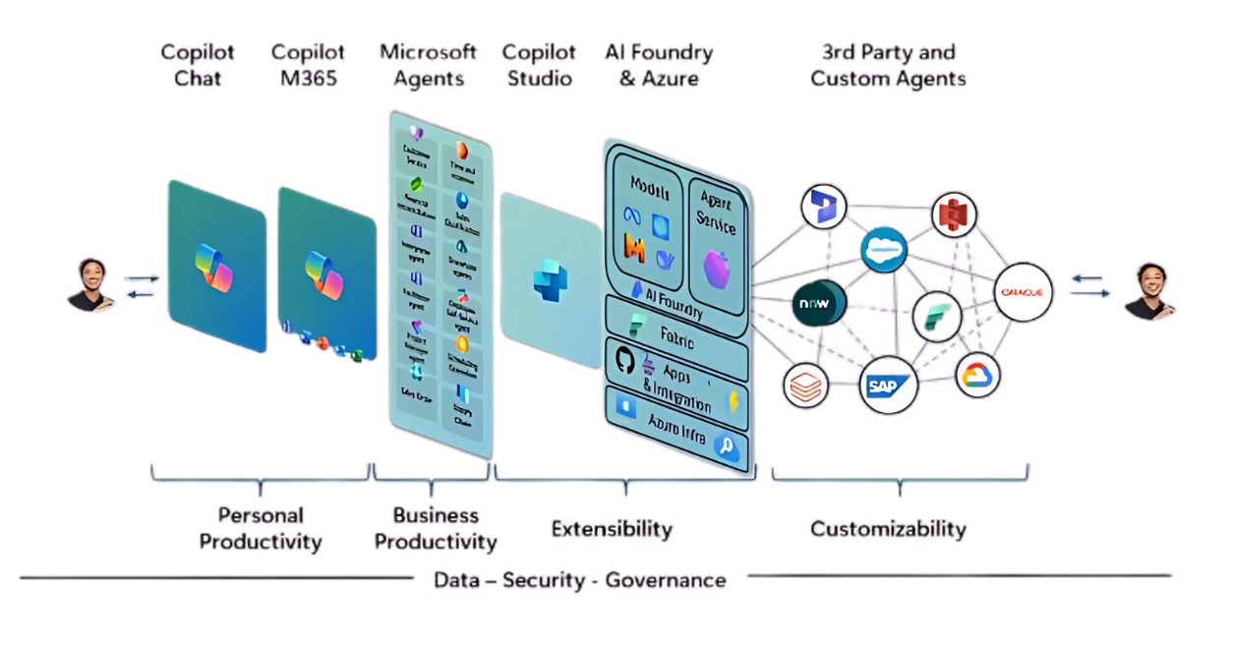
Extending AI
19

Slide 20





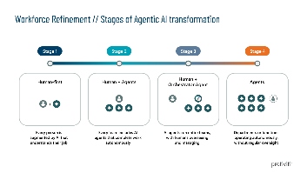






GenAI In The Enterprise
Strategic Decision Support
Custom
Bult
Purpose Built
Targeted
Agentic
AI Transformation
Workforce Refinement
Agent Creation
See Next Slide
 Orchestration and Agent “Wrappers” Grant GenAI to All
Low Code
LLM Supported
Process Automation
Citizen Development w/ AI
Power Automate
Win-
automation
Productivity
All
UI for AI
Copilot
Build You Own

Slide 21
Workforce Refinement / Stages of Agentic AI transformation
Stage 1
Stage 2
Stage 3
Stage 4
Human-first
Human + Agents
Human +
Orchestrator Agent
Agents
+
Every person is augmented by AI that understands their job
Every team includes AI agents that complete work autonomously
AI agents run entire teams,
with humans overseeing and managing
Departments or functions operating autonomously, without regular oversight
21

Slide 22
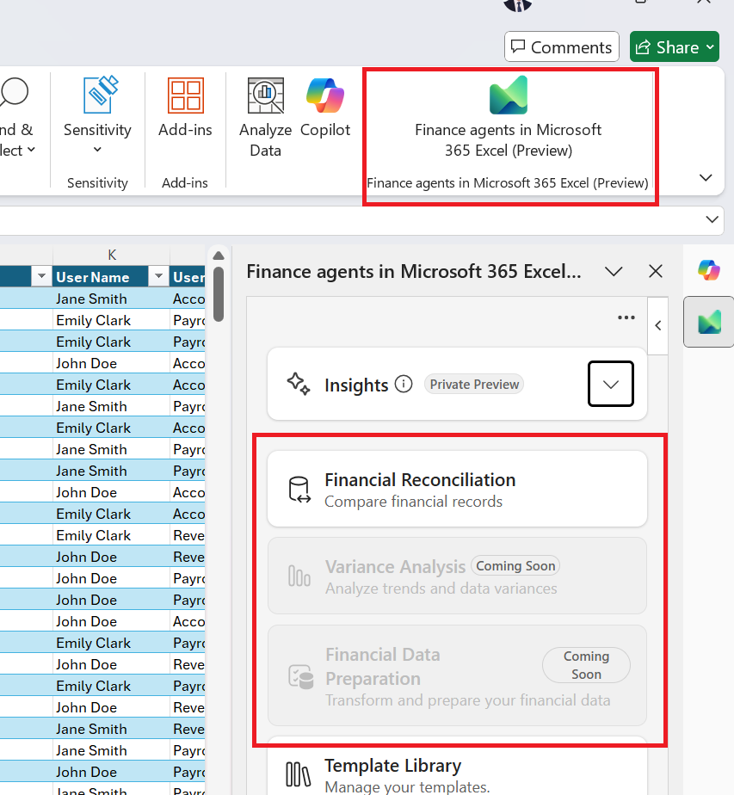
Finance Agents in Microsoft 365 Excel
Finance Agents in Microsoft 365 Excel are intelligent tools designed to assist with:
Financial Reconciliation:
Variance Analysis:
Financial Data Preparation:
Automatically match transactions across multiple data sources.
Identify discrepancies and suggest corrections.
Streamline the reconciliation process to ensure accuracy and compliance.
Compare actual financial outcomes with budgeted or forecasted figures.
Highlight significant deviations and provide insights into root causes.
Enable data-driven decision-making through visual and statistical analysis.
Clean, format, and organize raw financial data for analysis.
Automate repetitive data preparation tasks.
Ensure consistency and readiness of data for reporting and modeling.

Slide 23
Copilot Applications for Internal Audit
Copilot Chat- universal Swiss army knife of Copilot. The base skill all users need to have.
Copilot in Excel App Skills – the Copilot feature to use to do traditional excel tasks (pivot tables, X/V lookups, SumIfs)
Copilot Advanced Analysis via App Skills – a feature that utilizes python to perform more complex analyses.
Copilot Chat in Excel – a tool to garner basic insights from your data in Excel, grounded on your data in Excel.
Copilot Finance Agents in Excel - Purpose built Agents to perform financial reconciliations, data preparation and (coming soon) variance analyses.
Microsoft Researcher Agent – the go-to agent to research accounting standards and other topics in the context of your company.
Microsoft Analyst Agent – a data scientist at your fingertips, can reason over unstructured data and perform consolidations of multiple files.
Agent Mode in Excel - (coming soon) – prompting via natural language, will take multi-step actions letting Excel take a process end-to-end with minimal manual intervention.
Purpose-Built Agents - we’ve built custom agents that connect into AuditBoard to query your data from a Copilot interface.

Slide 24
Poll Question 6
Which audit lifecycle do you believe Copilot could enhance most?
A. | Planning and risk assessment.
B. | Fieldwork and testing.
C. | Audit reporting and documentation.
D. | Follow-up and monitoring.

Slide 25
Use Case Matrix – Gen AI In Internal Audit
Learn
Brainstorm
Build
Write
Perform
Identify potential risks (risk assessment)
Research industry standards, trends, regulations, and best practices
Audit objectives, scope, and risk assessment
Test procedures and analytics
Create risk assessment frameworks and audit planning documents
Build risk profiles & audit programs
Policy, regulation, and controls summaries
Interview Questionnaire
Enhance information requests and reminders
Planning
Data gathering
Contract reviews for conformance to guidelines
Potential issues or areas of concern to focus on during testing
Evidence analysis for insights, trends, and exceptions
Clear and consistent workpapers for testing procedures
Code/scripts to simplify testing of repeatable tasks
Enhance data analysis, transaction testing, and anomaly detection using AI-driven tools
Fieldwork
Study effective regulatory reporting requirements and reporting techniques
Recommendations for control improvements and risk mitigation strategies
Issue criteria and development
Build templates for audit reports, management letters, and executive summaries
Standardize report formats
Evaluate tone on issues drafts
Strengthen findings with industry facts
Generate preliminary findings and recommendations based on analyzed data
Reporting
Research IIA Standards and best practices
Brainstorm strategies for ensuring management implements recommendations
Combine management responses in various audit weaknesses to provide patterns and thematic insights
Follow-up reports and status updates, clearly documenting progress on remediation efforts
Enhance the tracking of remediation efforts and follow-up testing to confirm the implementation of recommendations
Follow-up
Source: IIA
25
Notes:
Maureen

Slide 26





Top Internal Audit & Controls AI Solutions
AI Enabled Audit Reports
Dynamically create audit reports with a scoping memo, work program, and observations logs.
Data Extraction & Tickmarking
Extract data points from unstructured documents into an excel spreadsheet and automatically tickmarking source documents
More Use Cases
Creates a standardized procedures based on a video and audio recording
Connect agents to GRC solutions to chat with risk, control, or issues data.
Uplift control descriptions and generate key insights on the control inventories
Update policies for new IA standards
AI Enabled SOC Reports
Dynamically identify key elements from SOC reports and automatically include them in an assessment template and map controls to CUECs.
AI Enabled Walkthroughs
Standardize delivery of RCM, process narratives, and process flow document from a walkthrough recording.
Control to Framework Mapping
Map controls to control frameworks to identify gaps or misalignment.

Slide 27
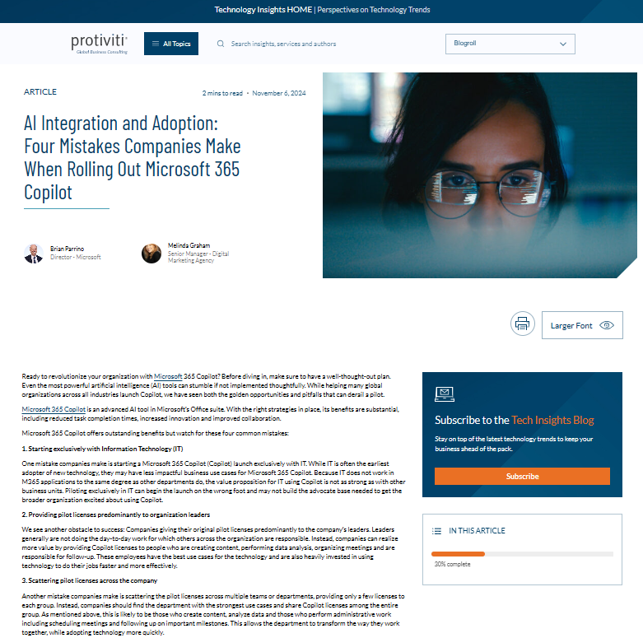
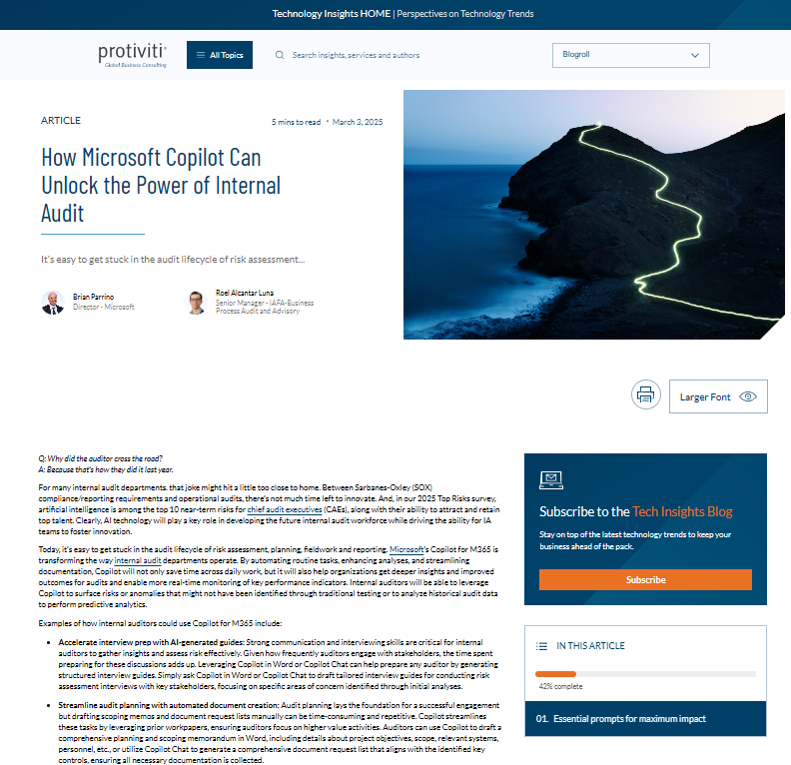
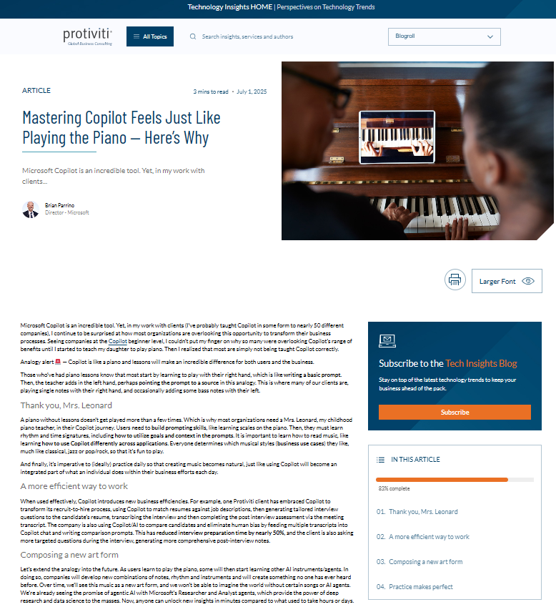
Resources
AI Integration and Adoption: Four Mistakes Companies Make When Rolling Out Microsoft 365 Copilot
How Microsoft Copilot Can Unlock the Power of Internal Audit
Mastering Copilot Feels Just Like Playing the Piano — Here’s Why
Notes:
ROEL

Slide 28
Copilot Demonstrations

Slide 29
Poll Question 7
What would help you most to successfully integrate Copilot into your audit
work moving forward?
A. | Additional hands-on training sessions.
B. | Access to internal prompt libraries.
C. | Dedicated time for experimentation and learning.
D. | Establishing Copilot "champions" within the audit team.

Slide 30
Poll Question 8
Where are you using AI today?
A. | I use for productivity tasks
B. | I use it for audit tasks
C. | I use it for both, productivity and audit tasks
D. | I don’t use it

