Slide 2
METRICS THAT MATTER
HOW KPIs DEFINE AND DEMONSTRATE SUCCESS
BROUGHT TO YOU BY:
ACUA Audit and Accounting Principles (AAP)
Best Practices subcommittee

Slide 3





 | Hollie Andrus Chief Audit Executive University of Utah
 | Lisa Beymer Associate Vice President Chief Audit Officer Indiana University
 | Patty Davidson Director of Internal Audit Binghamton University
 | Kara Hefner Internal Audit Manager University of North Carolina - Chapel Hill

Slide 4
Agenda
Welcome
KPI Requirements
Break-out and debrief
KPI examples
Break-out and debrief
Benefits, challenges, tips, and takeaways
Q&A

Slide 5
Learning Objectives
At the end of this session, you should be able to:
identify the global standards that require performance measurements,
design a KPI process,
provide examples of KPIs,
recognize KPIs that might drive undesired behaviors.

Slide 6
Polling Question
What is your role?
CAE
Audit Manager/Director
Auditor
Investigator
I do it all

Slide 7
IIA GLOBAL STANDARDS
Standard 8.3 - Quality Develop, implement, and maintain a quality assurance and improvement program.
Standard 8.4 - External Quality Assessment (EQA) EQA is required at least once every 5 years to verify the department is meeting the standards.
Notes:
8.3 is the foundation for tracking KPI. It requires the CAE to maintain a program that assesses the efficiency and effectiveness of the internal audit function.
8.4s focus is the “validation portion. An EQA will look at KPIs to see if self-monitoring is taking place. If you aren’t tracking and monitoring, then you are not meeting the “continuous improvement” aspect of the standards

Slide 8
IIA Global Standards
•Standard 9.2 Internal Audit Strategy – Develop & Implement an Internal Audit Strategy
•Standard 12.2 Performance Measurement – Develop Objectives to Measure Performance
**While not specifically stated in standards, the IA Strategy and the Function’s Performance Measurement Methodologies will be reviewed during QARs**
Vision
Strategic Objectives
Supporting Initiatives
Notes:
This IA strategy supports the strategic objectives and success of the organization and aligns with the expectations of the board, senior management, and other key stakeholders.
9.2 - It is a plan of action designed to achieve a long-term or overall objective.
9.2 - It must include a vision, strategic objectives, and supporting initiatives for the internal audit function. And it helps guide the internal audit function toward the fulfillment of the internal audit mandate.
12.2 - Still haven’t used the phrase “KPI” . CAE must consider the input and expectations of the board and senior management when developing the performance objectives.
12.2 - CAE must develop a performance measurement methodology to assess progress toward achieving the function’s objectives and to promote improvement

Slide 9
What the Standards Say about KPI - Considerations for Implementation
Require defining, monitoring, and reporting performance measures that are aligned to the internal audit strategy and audit objectives of the organization.
Connect to QAIP and emphasize outcome-based measures.
Reflect efficiency, effectiveness, stakeholder value, and conformance.
Notes:
C4I: The chief audit executive may identify a set of focused performance objectives that are reported to the board and senior management while maintaining a more comprehensive set of performance objectives for managing the internal audit function
C4I: After identifying the performance objectives, the chief audit executive should establish targets, both quantitative and qualitative, to track progress toward meeting the performance objectives.
The chief audit executive should have a methodology in place to periodically validate the accuracy of the measures being reported and raise performance expectations.

Slide 10
Polling Question
How many KPIs does your department have?
0 - what’s a KPI?
Around 5
Around 10
Too many to count

Slide 11
The “Why” of KPI
Is audit fulfilling its mandate in line w/ board expectations, IIA standards, the charter and the strategy?
Is audit providing quality - the combined result of conformance and performance?
Notes:
8.4 - External Quality Assessment - KPI are critical for concluding on audits performance and continuous improvement.
9.2 - IA Strategy - allows assessment of degree strategy has been implemented
12.1 - Internal Quality Assessment - some KPI allow for ongoing monitoring of IA.

Slide 12
Health Check developed using Gemini
9.2 - Strategy
12.2 - Performance Measurement
8.3 & 8.4 - Quality & EQA
Do you have a formal documented internal audit strategy?
Are your KPIs mapped directly to the University strategic priorities?
Do you currently track and report on:
Audit plan % complete
% of recommendations implemented
Report cycle time (draft to final)
Budget vs. actual hours per audit
Stakeholder Satisfaction Survey
Do you have an internal QAIP that monitors KPI trends QTRLY?
Can you demonstrate to an EQA how your KPIs have led to departmental changes or improvements?

Slide 13
Polling Question
Which standard is the hardest to “prove” with data?
Showing the strategic alignment (9.2)
Proving your own internal efficiency (8.3)

Slide 14
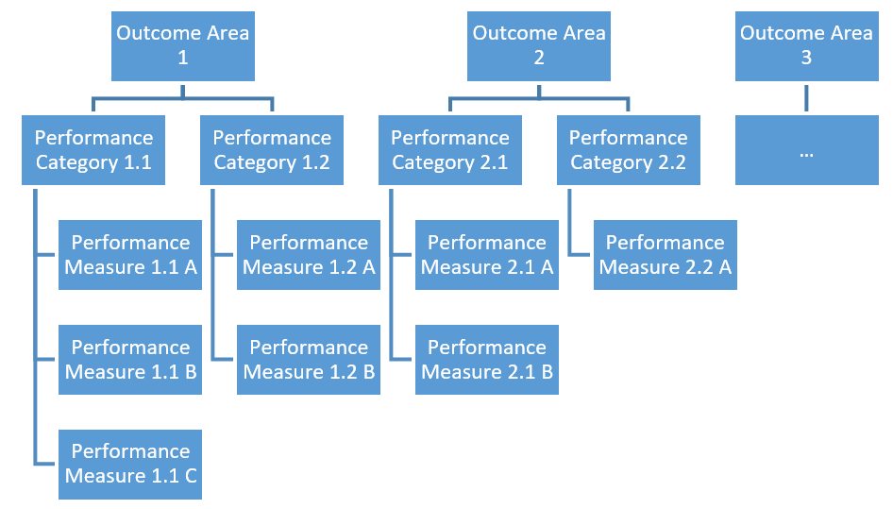
KPI Framework for Internal Audit -
Outcome areas:
Assurance & advisory coverage
Financial and operational efficiency
Stakeholder expectations
Team Capability
human resource needs
learning & development
Source: The Institute of Internal Auditors
Notes:
IIA has published a Performance Measurement tool (link provided at the end). The new Global Standards moved towards a more principle-based structure. By using "performance measures," they allow for a mix of quantitative KPIs (like % of plan completed) and qualitative measures (like stakeholder satisfaction), rather than implying that only numeric "indicators" are sufficient.

Slide 15
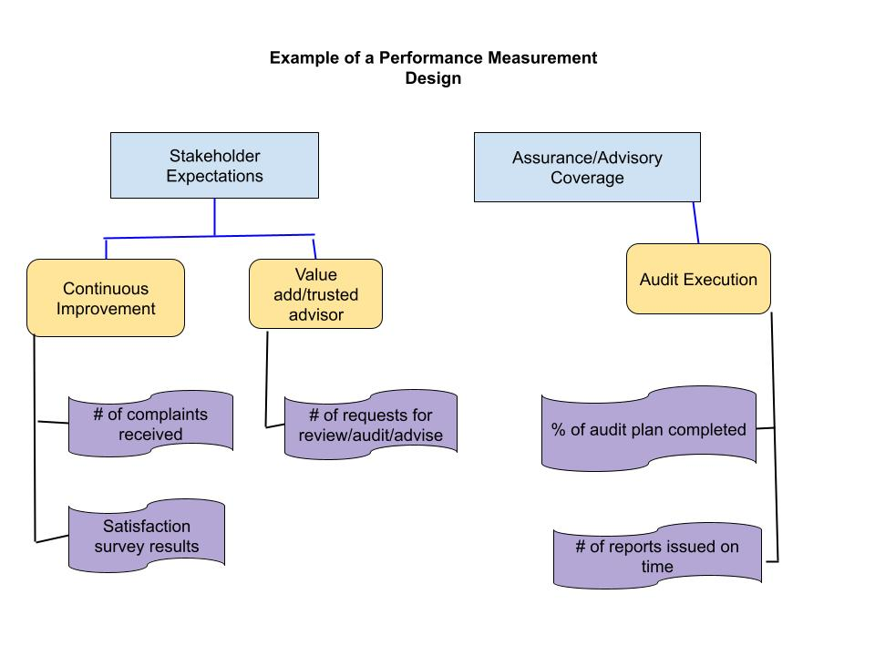

Slide 16
Make KPI “SMART:
Specific, with each measure serving a distinctive informative purpose and relation to an objective.
Measurable, in terms of time, effort, and resources, helping to monitor progress in relation to goals, identify challenges, and enable foresight.
Achievable, with underlying target values that are realistically attainable.
Relevant, in terms of being logically linked to the current and future objectives and producing accurate reporting.
Timely, with a clear reference period that is appropriately close to the reporting date, utilizing frequent updates for tracking the performance of operations and strategies.
Source: The Institute of Internal Auditors

Slide 17
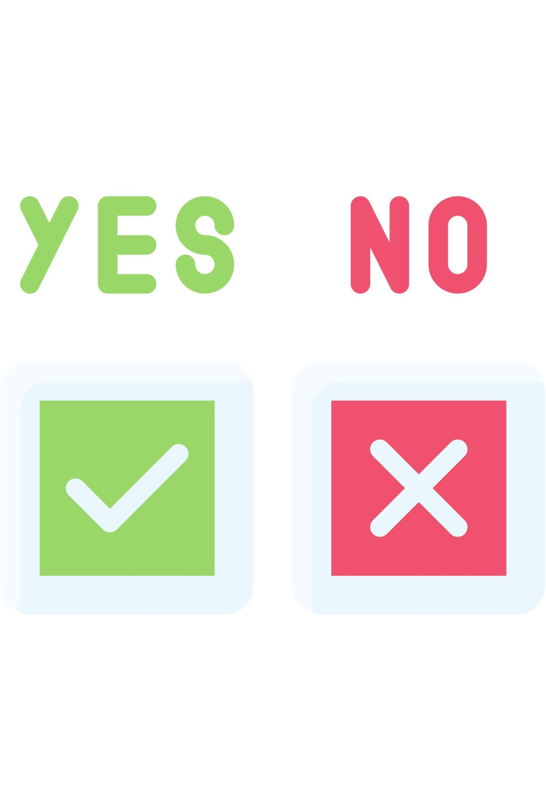
Polling Question
“Improve client satisfaction” is a SMART performance measurement.
Notes:
SMART version: Increase client satisfaction scores by 10% in the annual survey by the end of Q4, through regular feedback sessions

Slide 18

Breakout Session 1
KPI Opportunities and Challenges
Consider the following during your discussion
What are your current KPI Challenges?
Which metrics have been the most/least effective?
How do you monitor your metrics? Has measuring your metrics required significant changes to your operations?
Have you had to eliminate or replace metrics (or think that you should consider it) and why?

Slide 19

Debrief from session 1
What were some common themes and solutions that were discussed?

Slide 20
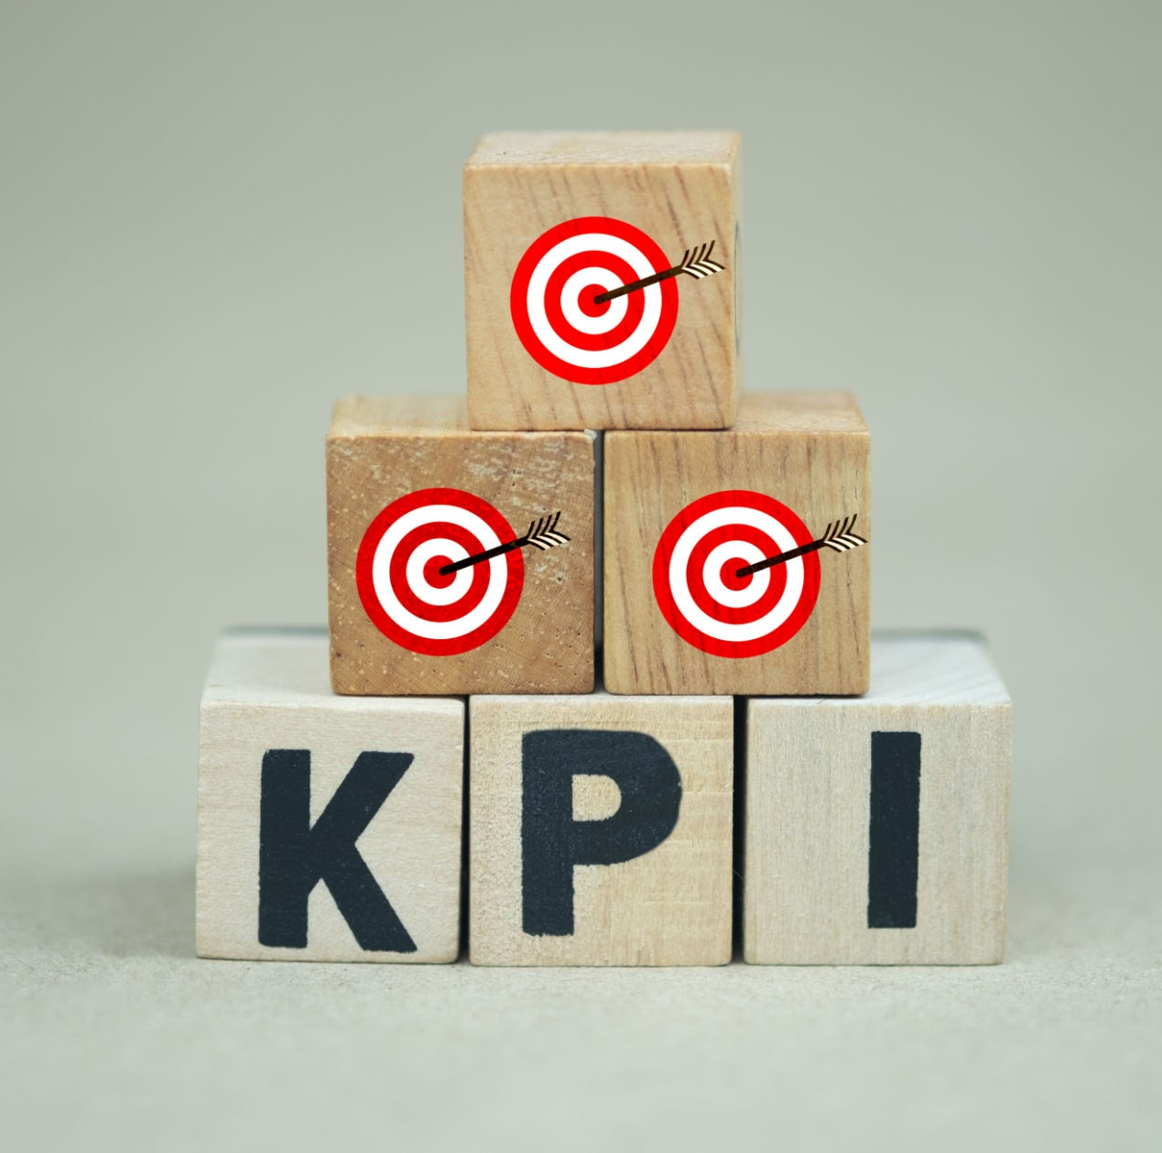
KPI Examples for Internal Auditors
External Metrics: for the board and senior management
Internal Metrics: operating effectiveness and efficiency
Notes:
Download slides and excel
Choose the KPIs that work best for your shop; align with your strategic plan
Incorporate goals with those KPIs
Jot down KPIs that matter to you, KPIs you want to develop, questions for breakout room discussions

Slide 21
External Metrics Audit Plan Completion
By Plan Year | # Audits | # Special Projects
FY26 Planned Engagements | 15 | 6
FY26 Plan Completions | 11 | 9
% FY26 Plan Completed | 73% | 150%
% of Audit Plan Completed
% by Category – Assurance, Consulting, IT, etc.
# Carryovers
# Removed
By Category | Planned | Actual | % Complete
Operational | 7 | 5 | 71%
Financial | 5 | 4 | 80%
Consulting | 1 | 1 | 100%
IT Audits | 2 | 1 | 50%
FY26 Plan Totals | 15 | 11 | 73%
By Reports Issued | # Audits | # Special Projects
FY26 Planned Engagements | 15 | 6
FY25 Carryovers completed | 2 | 0
Added to Plan | 1 | 5
Removed from Plan | (2) | 0
In Process – Carryover FY26 | (3) | (2)
Projects Completed, Issued | 13 | 9
Notes:
Tie to goals. Example 80% of audit plan completed.
Does in progress count?
Can list each engagement in plan with completion

Slide 22
Risk Coverage
% of High, Medium, Low engagements completed
Changes to audit plan reflect risk
Risk Level | Planned | Completed/Add/CF | % Coverage
High Risk | 5 | 4 | 80%
Moderate Risk | 7 | 6 | 86%
Low Risk | 3 | 2 | 67%
Total Engagements | 15 | 12 | 80%
1 high risk added
1 high, 1 mod, 1 low dropped
Notes:
How impactful are the items not completed?
Goal to do all high risk?

Slide 23
Engagement Results
Metrics | Examples
Summarize ratings of completed engagements | 3 effective, 10 needs improvement, 2 ineffective
Summarize ratings of Governance, Risk Management, and Controls | 3 satisfactory, 8 partially satisfactory, 13 needs improvement, 1 unsatisfactory
% of high, medium, low findings identified | 5 high, 7 medium, 13 low
# Repeat issues | 2 repeat issues in 1 engagement
Notes:
Standards call for engagement conclusions, GRC conclusions, list findings by significance
Create your own methodology for ratings
Goal may be to trend over time

Slide 24
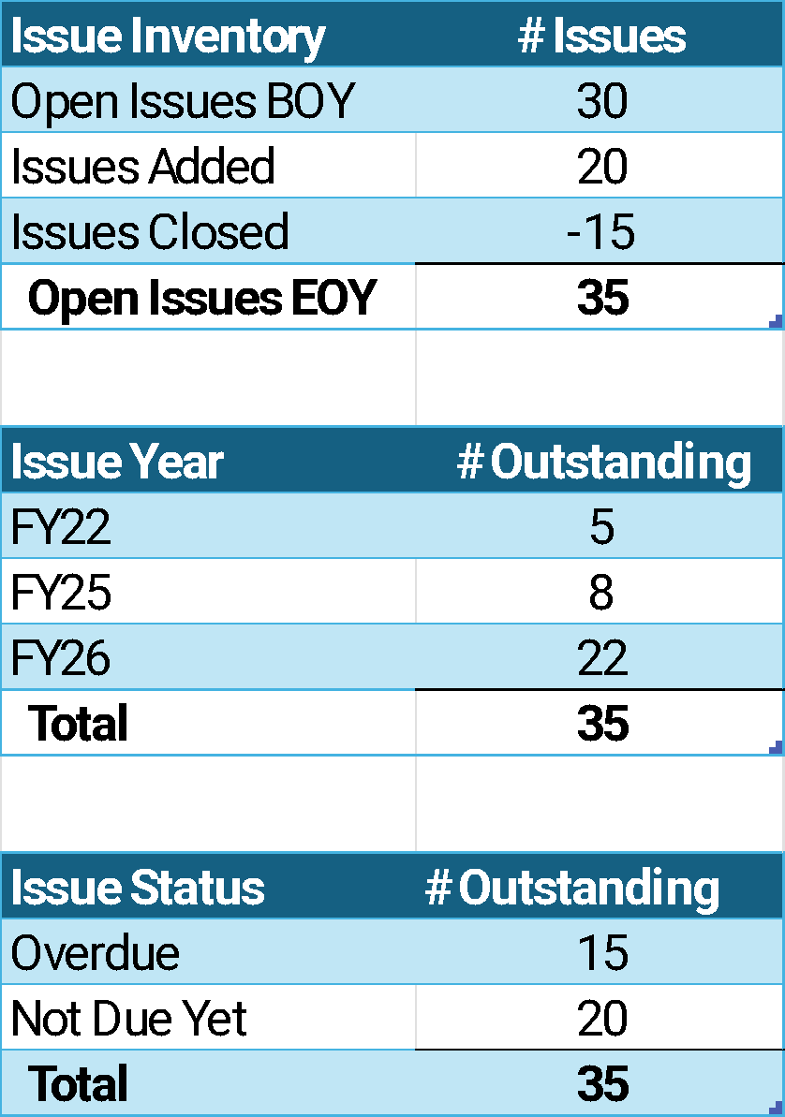
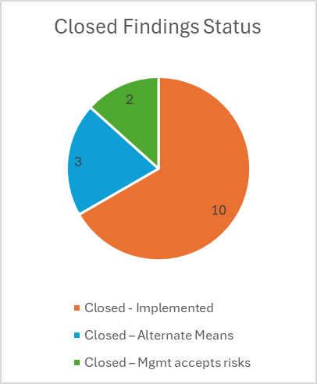
Issue Remediation
# Issues added, resolved, remaining
Aging of outstanding issues
Issue status
Closed timely/extended
Hours spent on follow up activities
# Closed by high/med/low
Notes:
Our board really cares about issue remediation and timeliness
Examples from our annual report
POLLING QUESTION

Slide 25
Polling Question
Which KPI does your Board consider to be the most important?
Audit plan completion
Risk coverage
Engagement results
Issue remediation
Not sure
Notes:
Panel Q: which is most important to their board?

Slide 26
Stakeholder Feedback
E
Engagement Survey Results
Average score
# Complaints
# Positive feedback
Feedback received from Board & Senior Management
Survey Questions | Average Rating
Areas of concern were addressed | 5
Positive communication with staff | 1
Reasonable timeframe | 3
Findings & recommendations discussed | 4
Audit results were fairly and accurately presented | 4
Auditor displayed professionalism | 2
Audit provided value to my area | 3
Overall average score | 3.1
Description | Rating
Strongly Agree | 5
Agree | 4
Neither Agree/Disagree | 3
Disagree | 2
Strongly Disagree | 1
Notes:
Look at average ratings
Does anyone have trouble getting responses back?

Slide 27
Value Add and Quality
Value Add
Quality
Fraud, waste, abuse identified
# High priority findings
$$$ Saved
# Controls enhanced
# Regulatory issues resolved
# Hours saved from process improvements
External QAR results
Internal Self-assessment results
Value provided to stakeholder
# Requests for internal audit assistance
Notes:
This is a hard one to quantify.
Example: keep a spreadsheet to add these “selling” items
Promote your department and the good things that you are doing

Slide 28
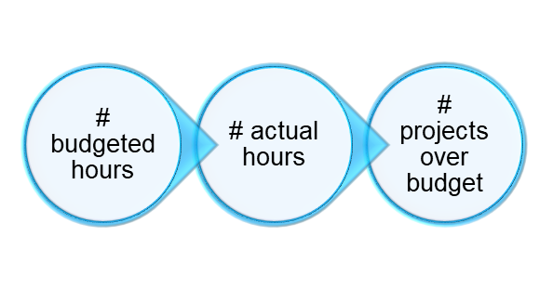

Internal Metrics Time Budgets/Cycle Time
Engagement Budget to Actual
Cycle Time
Notes:
Internal Metrics: Operational effectiveness and efficiency
Can also be reported externally
Look for trends, opportunities to improve
POLLING QUESTION

Slide 29
Polling Question
Which cycle time category goes over budget most often?
Planning
Fieldwork
Reporting
All of them
Notes:
Panel Q: ask panelists how they answer this question

Slide 30
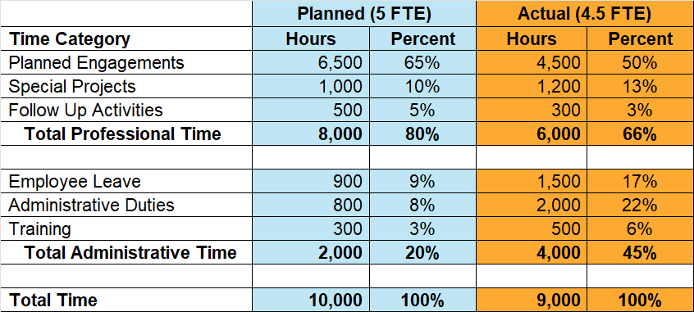
Time Utilization
Budget to Actual Time Projections:
% Engagement work
% Employee Leave
% Training
% Admin duties
Notes:
Planned = goals
Consider changes in FTE
We report this in our annual report

Slide 31
Employee Development & Retention
Training & Development
CPE requirements met
Ethics training met
Certifications, degrees earned
Internal trainings met
Employees with mentors
Staffing
# Staff to desired level
% Planned headcount not filled
Employee turnover
Average # days to fill a position
Notes:
What is required; how incentivize – pay for training, bonus for cert?
What are your staffing goals?

Slide 32
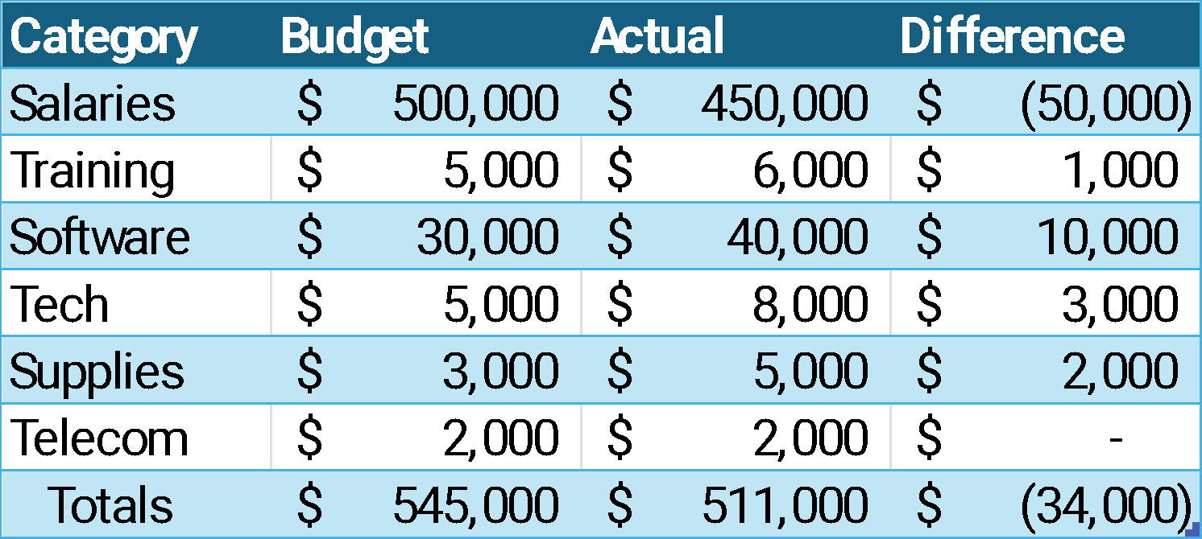
Department Expenses
Internal Audit Department budgeted to actual expenses
Cost per hour of services
Cost of Outsourced resources
# Engagements requiring outsourced resources
$511,000 / 5 employees = $102,200/employee
$511,000 / 10,000 work hours = $51.10/hour
Notes:
Hopefully we are monitoring our departmental expenses
Can break this down to cost per employee, per hour
If high outsourced, better to hire internally, gain expertise?

Slide 33
Department Initiatives
Continuous Auditing
# hours spent on continuous auditing
# controls assessed
# exceptions identified
Data Analytics
# audits using data analytics
# employees trained
Time saved, issues found, $ recovered
A.I.
# projects using AI
# hours saved
How used most effectively
Notes:
Tie to goals
Data Analytics – we ask in planning memo on how to use

Slide 34
Specialty Areas
Hotline Metrics
Compliance Metrics
Department Metrics
# complaints received
#,% compliance items audited
Sponsored Research
# substantiated
# compliance items passed
Athletics
# by department
# open compliance items
HR
$ saved
Finance
Operations
Notes:
These are value add items
Organize your metrics by department?
Helpful for audit coverage, audit planning
BREAKOUT

Slide 35

Breakout Session 2
Designing Meaningful KPIs
Brainstorm
Which KPIs best reflect your team’s strategic value?
How can you improve alignment with executive priorities through KPIs?
Develop some KPIs to share during the debrief

Slide 36

Debrief from session 2
What were your key takeaways?
Image created from ChatGPT

Slide 37

Why KPIs are Powerful
KPIs can drive:
Clarity of Purpose
Transparency
Data-driven resource prioritization
Stronger stakeholder relationships and confidence
Continuous improvement and QAIP Support
Team motivation

Slide 38

KPIs drive change - good OR bad
Good KPIs drive VALUE and QUALITY
Poor KPIs drive SHORTCUTS
Every KPI sends a message:
This is what leadership values
This is how success is defined
This is where effort gets focused
Adobe stock photo

Slide 39
Polling Question
Have you ever seen a KPI drive NEGATIVE behavior?
YES!
No
Gracious, I never thought about it!

Slide 40
The Ups and Downs of KPIs
Benefits | Challenges
Strategic alignment Transparency Stronger QAIP evidence Better resource planning Stakeholder trust | Data reliability Measuring impact vs activity KPI overload Misinterpretation Gaming the system Getting team buy-in

Slide 41

KPI COMMON PITFALLS
Lack of Alignment: KPIs aren't tied to organizational strategy or key risks, making them irrelevant to leadership.
Activity vs. Performance: Measuring outputs (reports issued, hours spent) rather than actual impact or risk reduction.
Ignoring the Big Picture: Focusing solely on compliance or past issues without considering future risks or operational realities.
Stagnant KPIs: KPIs are never reassessed to ensure they’re still focusing on the most important things

Slide 42
Are these classic KPIs always effective?
Number of audit findings per year
Number of follow-ups closed in X months
Number of audits started and finished within X months
Client satisfaction scores > X%
Turnover < X%
Chargeable effort > X%

Slide 43
PRACTICAL TOOLS & IMPLEMENTATION TIPS
Balanced scorecards - choose a complementary spread
Standard data definitions and clean KPI formulas
Easy to read and regularly updated dashboards
Annual KPI refresh: modify, drop, or add
QAIP integration to align with IIA Standards
Align with performance reviews and department updates
Team input, discussion, and documentation

Slide 44
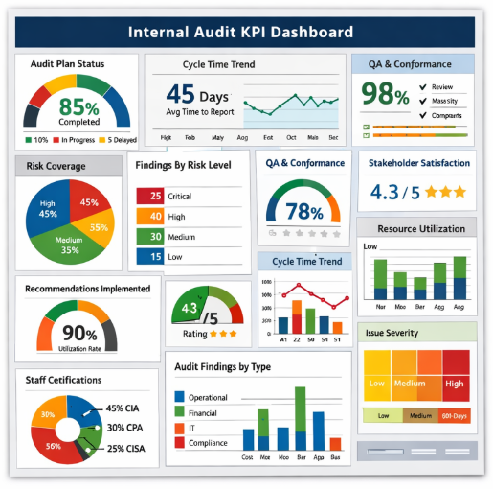
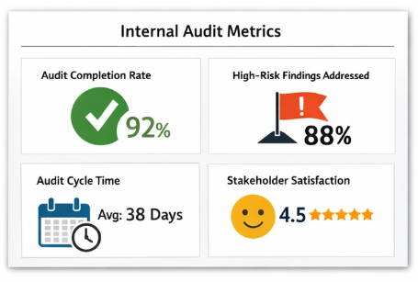
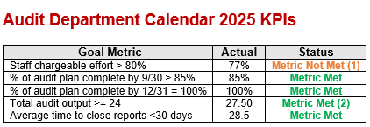
KPI Reporting and Sharing
Top graphs created using ChatGPT

Slide 45
Polling Question
Who cares the most about Internal Audit KPIs?
The Board
The President
The Chief Audit Officer
The Audit Team
Trick question, everyone cares

Slide 46
Discussion and Q&A
How do you phase out a KPI that external stakeholders or the audit team are used to seeing?
What is your department’s biggest pain point or opportunity area? How could you develop a KPI to monitor that metric?
What metric is your team currently using that you would propose to throw out? Why?
When was the last time you reviewed your team’s KPIs? What changed, and why?
Have you ever seen a KPI unintentionally push the wrong behavior?

Slide 47
Debrief from Q&A
What were your key takeaways?
Image created from ChatGPT

Slide 48
Useful links
IIA Performance Measurement Tool
Internal audit performance measures: Aligning metrics with strategy by Wolters Kluwer
KPI audit checklist: Top metrics to track by AuditBoard

Slide 49
Polling Question
Did you pick up at least one thing to take back for your department’s KPIs?
Yes I did!
Nah, our KPIs were already rock solid

Slide 50

 | Hollie Andrus Chief Audit Executive University of Utah
 | Lisa Beymer Associate Vice President Chief Audit Officer Indiana University
 | Patty Davidson Director of Internal Audit Binghamton University
 | Kara Hefner Internal Audit Manager University of North Carolina - Chapel Hill

