Slide 2
Communicating with the Board: Addressing Board Reports
ACUA – Spring 2026
Trip Hillman, CISSP, GPEN, QSA, GSNA, CISA, GCWN, GCFE, CEH, CCSK
Reema Parappilly, CISA, CDPSE

Slide 3
Learning Objectives
Understand the Challenges and Pain-points of Existing Communication by Examining What Doesn’t Work
Determine What Communications Move-the-Needle and How to Filter out the Noise
Be able to Identify Board Expectations of Cyber Program and Interpret Board-level Questions
Notes:
Effectively communicating information to the board is instrumental to the process of communicating risks and the results of internal audit function. Sharing critical data can become challenging when board members have a variety of experience and understanding. Our presentation will offer insight into the reports your board finds most valuable and include information on reporting on IT/cybersecurity risks and IT/cybersecurity projects.

Slide 4
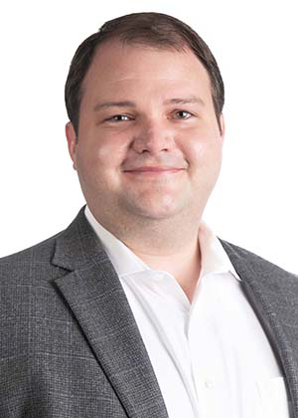
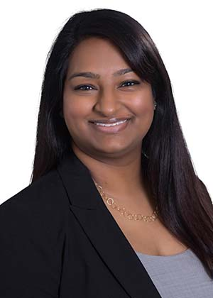
Today’s Presenters
Trip Hillman
CISSP, GPEN, QSA, GSNA, CISA, GCWN, GCFE, CEH, CCSK
Weaver, Partner | Consulting Services
972-448-9276
trip.hillman@weaver.com
Reema Parappilly
CISA, CDPSE
Weaver, Partner | Governance, Risk, and Compliance Services
832-320-3254
reema.p@weaver.com

Slide 5
Risk Universe
Information Security
Information Technology
Investments
Member Services
Finance
Operations

Slide 6
What Drives the Board Conversations
Board members’ background and experience typically drive the areas that they focus on
Entity strategy and major initiatives
Economy, market
Hot topics / current issues

Slide 7

Management vs. Internal Audit
Management’s communications and priorities
Internal Audit’s communications, responsibilities and priorities

Slide 8
Cybersecurity Is Business Risk.
What Boards Need to Hear — and Act On
KEY TAKEAWAY
Boards that treat cybersecurity as an IT problem are exposed. Boards that treat it as enterprise risk - with clear appetite, financial consequence, and measurable resilience - are protected.
The CISO's job is to make that distinction impossible to ignore. << Internal Audit may have to help!
"The board's job is to make sure management is doing its job. My job is to align with management on cyber risk strategy and get their support." — Adam Fletcher, CSO, Blackstone
Prepared for Board Review · Confidential

Slide 9
WHAT THE BOARD NEEDS TO KNOW
01
02
03
Risk Posture,
Not Activity
Signals That
Drive Decisions
What You Need
From Them
Boards don't need to know how many attacks were blocked. They need to know whether risk is rising or falling, and why. Frame every update around org exposure, not security operations.
The metrics that matter: detection speed, containment time, resilience posture, third-party exposure, compliance, and budget. Each one maps directly to financial consequence.
Be explicit. Do you need more funding for an unfunded initiative? Policy cover for a hard tradeoff? Board members can only help if you ask the right questions — make it easy for them to act.

Slide 10
1
Risk Trend — Are We Safer Than Last Quarter?
5 Risk Signals
Boards
Can Act On
Show a directional index, not a count. Rising or falling risk posture vs. peers is what the board can govern.
2
Detection & Containment Speed
Mean time to detect + mean time to contain. "If we can recover in hours, it's a headache. If weeks, it's a disaster." — CSO Online
3
Cyber Budget
% of IT budget on security and spend per employee. Supports the funding conversation.
BOARD ACTION
Third-Party Exposure
4
Ask : "Where are we in the risk trend — and what would change that trajectory?"
How many vendors access our network or sensitive data? What's their monitored risk posture? Supply chain = residual risk.
5
Resilience Posture — Can We Absorb a Hit?
Phishing resistance trend, critical system uptime (MTBF), and unfunded initiatives that leave gaps. AI is amplifying all three.

Slide 11
Polling Question
How frequently is cybersecurity discussed with your Board or Audit Committee?
Quarterly – Standing Agenda
Two (2) or Three (3) times a year – Standing Agenda
Annual Update – Standing Agenda
Ad Hoc – As Requested by the Board or Audit Committee
I’m unsure, but someone is probably doing that

Slide 12
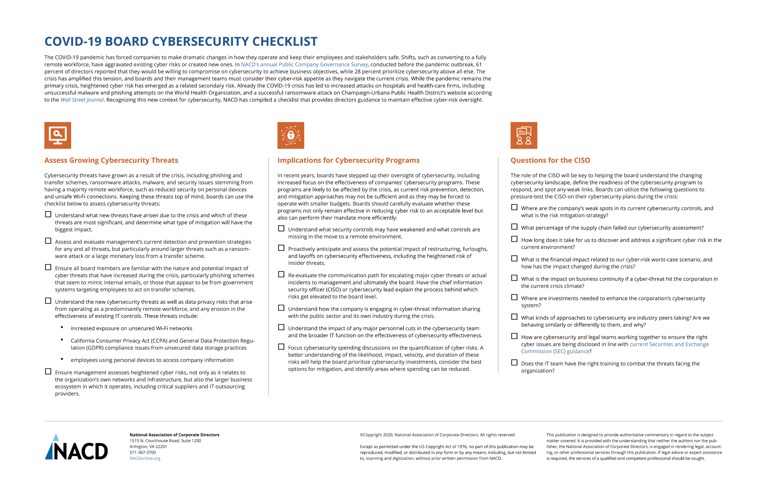
They’re Getting Info…
Your Board is getting information and updates.
Are YOU the one providing it to them?

Slide 13
Board vs. CISO
~33% of BoD members see their CISOs only at board presentations
Fewer than half (47%) of members serve on boards that interact with their CISOs regularly
Just 69% of responding board members see eye-to-eye with their chief information security officers (CISOs)
https://hbr.org/2023/05/boards-are-having-the-wrong-conversations-about-cybersecurity

Slide 14
What Doesn’t Work
Delivered Security Awareness Training to 85% of Employees
Our Firewall Blocked 40,000 Attacks Last Month
We Had No Findings on Our Annual Penetration Test, Security Audit, Third-Party Review, etc…
Following Best Practices
Better than 68% of peers
Quarantined 11,745 Suspicious E-mails
Notes:
Our Firewall Blocked 40,000 Attacks Last Month.
What did the firewall not block? How do we know we’re blocking the right things?
Quarantined 11,745 Suspicious E-mails
What did we ever do about these emails?
Were those inbound or outbound?
Did we stop attacks? Or did we stop business/work?
Following Best Practices
Whose best practices
How many are we following? All of them? Or a subset?
Do these apply to our whole environment or only a portion? PCI, SOC 2, Financially Relevant Systems, etc.
Better than 68% of Peers
Who determined this?
Is this good enough? 32% are better than you!
Does it even matter? If your peers get ‘hacked’ do you improve? Or just not look as bad?
We Had No Findings on Our Annual Penetration Test and Security Audit
While that would be great if it is true and represents risk – However does that line up with expectations?
No findings but are there multiple large ticket items in the IT/Security budget or headcount? How much more security do those initiatives ‘buy’? What unidentified risk from the assessments are those expansions addressing?
Is there any chance that the scope, coverage, metrics, or results skewed in those security assessments?
Delivered Security Awareness Training to 85% of Employees
Was it ‘good’ quality training that covered the bare basics?
Some Training is Better than No Training but this is presented as a positive when really it should be We missed training 15% and we’d really like to have made multiple training attempts in the year.

Slide 15
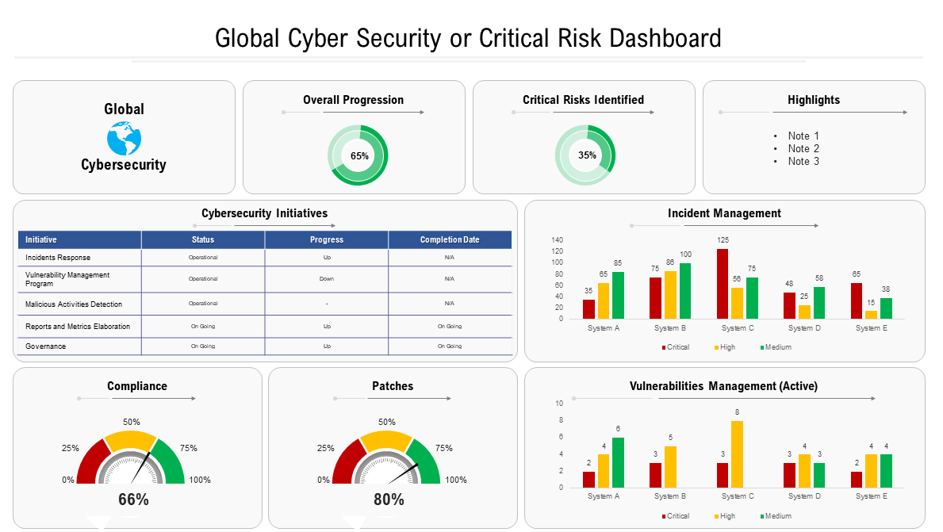
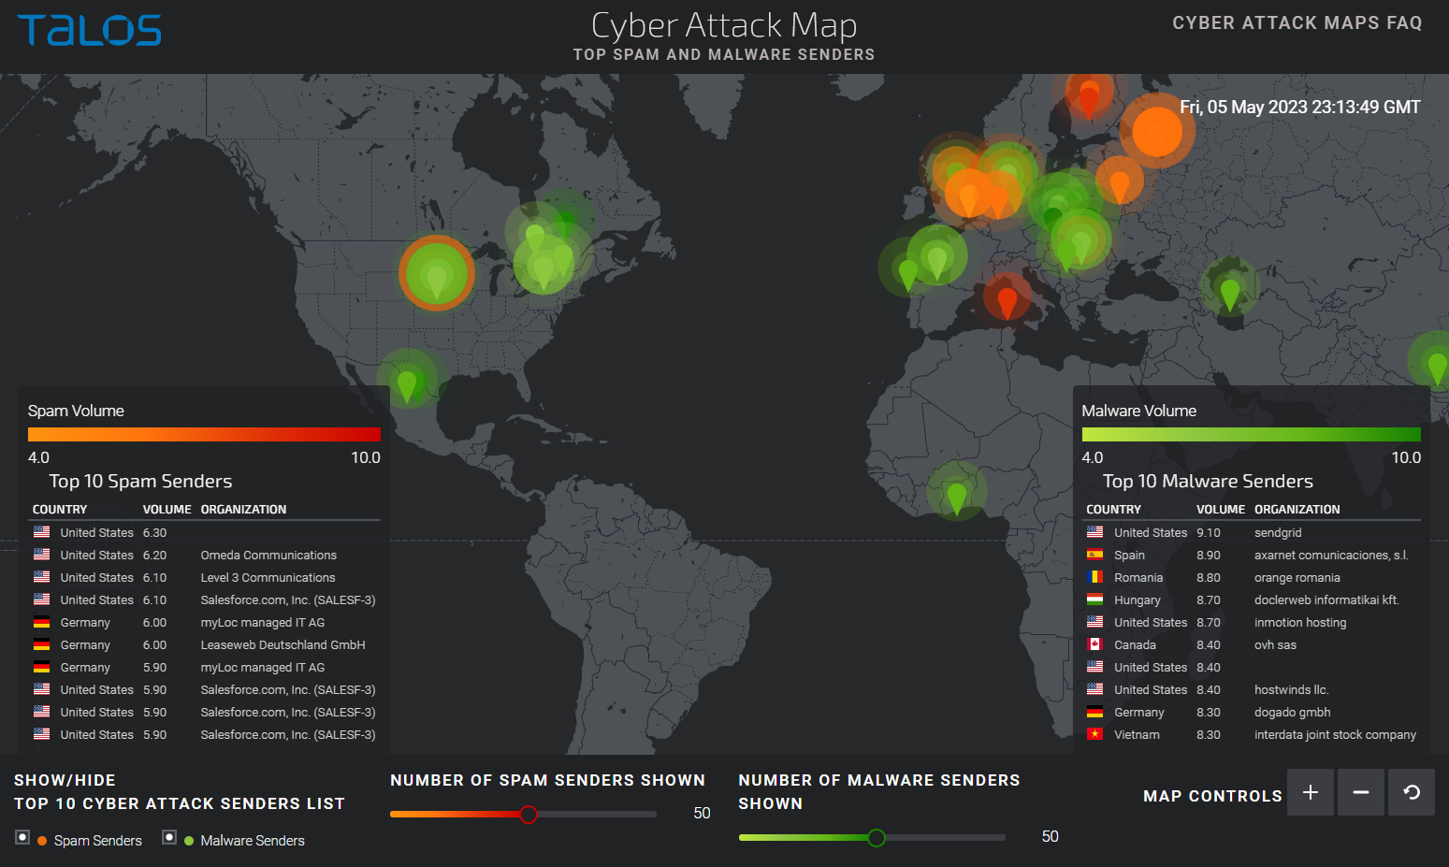
Missing Context
Board Materials are Often Shared Ahead of Meetings and Need Enough Context to Stand Alone without Supporting Verbal Comments
Notes:
Is this everything? Is this good just because it is green?

Slide 16
Steps That Work
Gain Consensus (not just one-way communication) on the Attack Surface & Threat Landscape
What Do We Have (Assets & Resources)?
Tied to Mission / Objectives / Goals
What are the Threats / Risks?
Transparency on Program Capabilities
Current Protections and Gaps of Exposure
Scope & Coverage
How much of our environment (technology landscape) is covered by our cybersecurity program?
Risk Inventory
What Types of Exposure
Roadmap - Show Your Work
What projects are on the horizon (timeline, resources required)
Status – On-Track, Completed, Delayed, Moot
What improvements are tabled
“We’ve had that on our radar, but don’t have budget…”

Slide 17
Are We Sitting at the Same Table?
Cybersecurity is an Organizational Enabler, Not Just a Liability
Cyber Risk to Internal Mission & Objectives not just Systems
View Cyber Risk as Economic Impact/Driver with Operational and Reputational Risk Linked
Expertise (Resources) for the Board
Either available on-demand or confirmed understanding
Relationships and Collaboration
Tone for fostering effective results
Notes:
Cybersecurity can help unlock the potential of technology along with digital transformation activities through an enhanced understanding of capabilities (possibilities) that directly correlated with strategic objectives and plans within the organization. Needed for organizational resilience.

Slide 18
Management is Talking, But Is the Board Listening?
Assumption that quarterly “cyber” presentations are provided to the Board
Are questions asked?
What is the quality or level of connection in the questions?
Is that a feedback loop for improvement in materials or updates shared?
Has the BoD members’ experiences and background been considered, and updates tailored accordingly?
Does the Board have a good ‘backdrop’ of the field of Cyber to exercise meaningful governance?

Slide 19
Polling Question
How confident are YOU that your Board/Audit Committee understands your cybersecurity posture or hygiene?
I feel strongly that they DO understand
I’m saying there’s a chance, but let’s not put a number
We may need to huddle on this
I’m too scared to answer

Slide 20
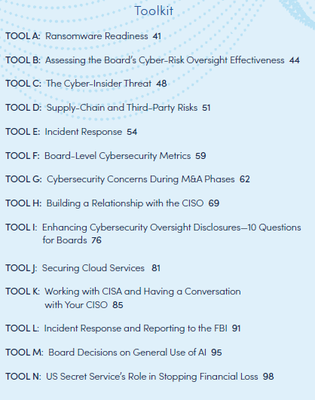
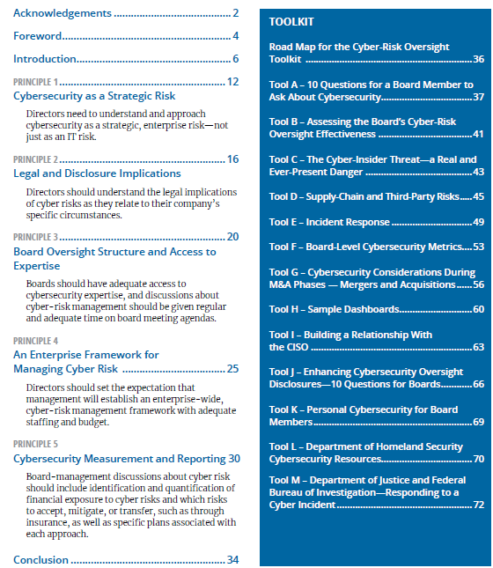
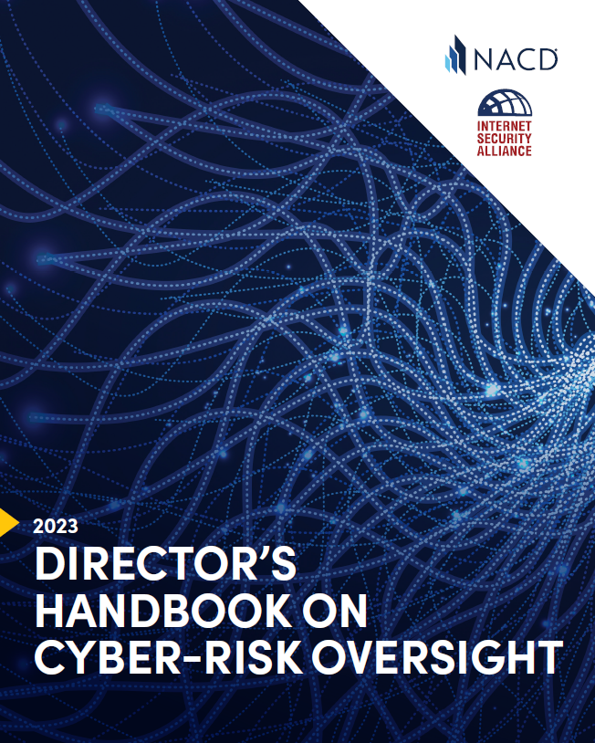
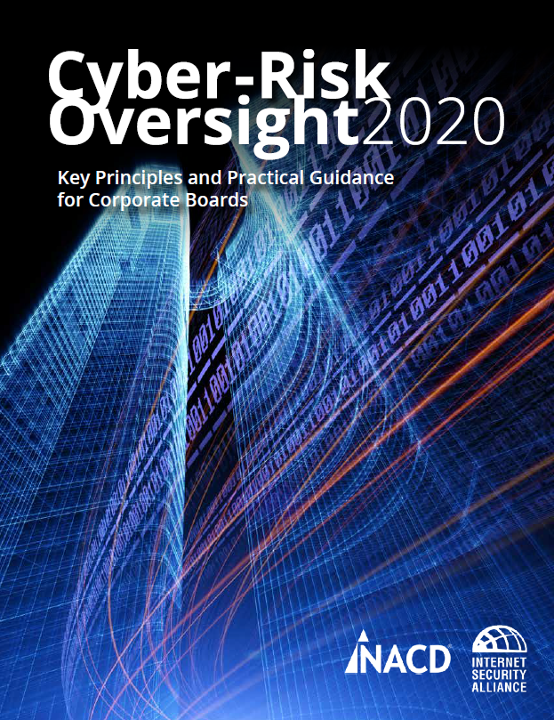
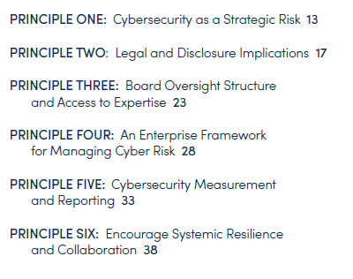
National Association of Corporate Directors

Slide 21
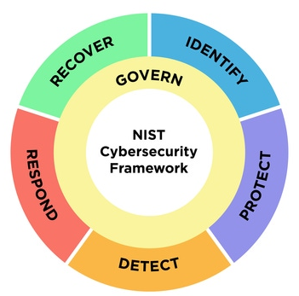
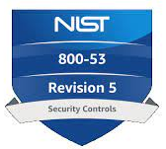


Frameworks Provide Perspective
Cybersecurity is an expanding field
Frameworks for perspective on cybersecurity can help provide the backdrop for additional conversations
How much of ‘cyber’ is there? What is applicable to ‘us’?

Slide 22
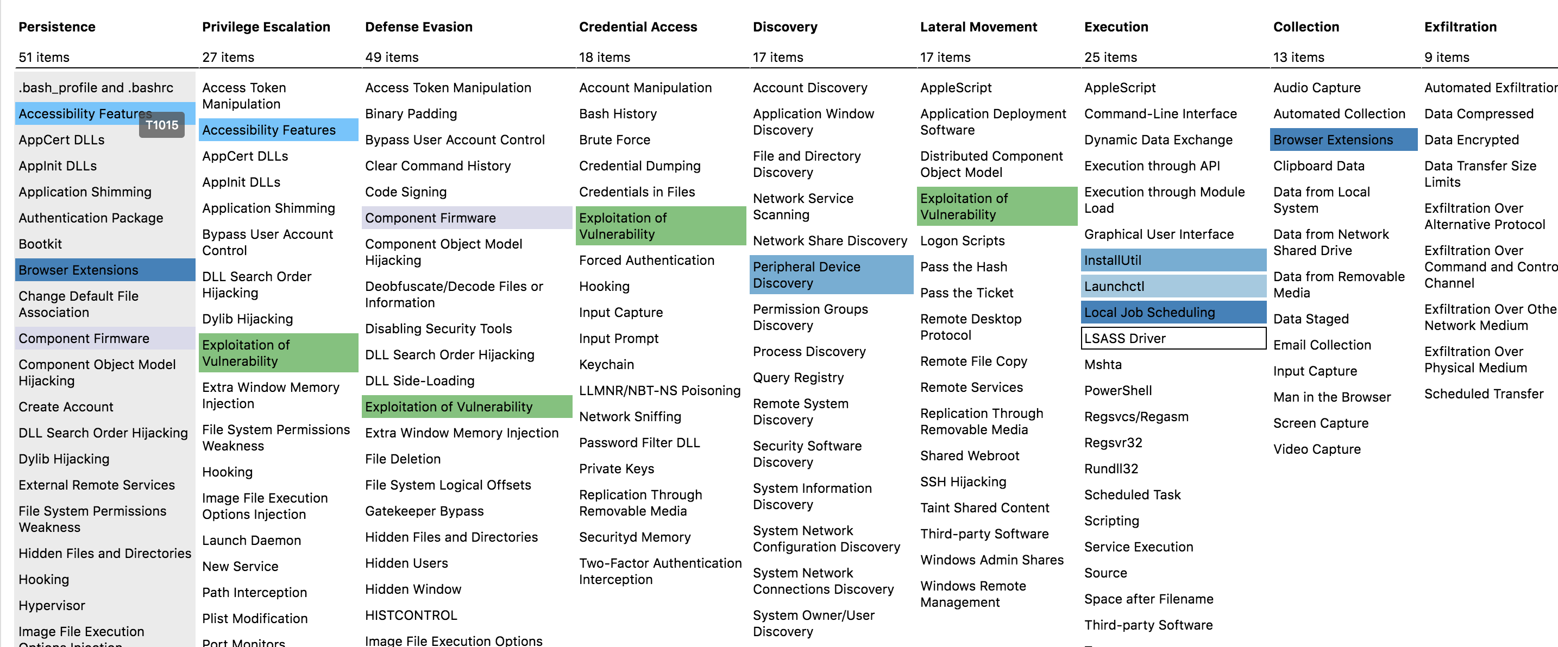
MITRE ATT&CK Framework
https://attack.mitre.org/

Slide 23
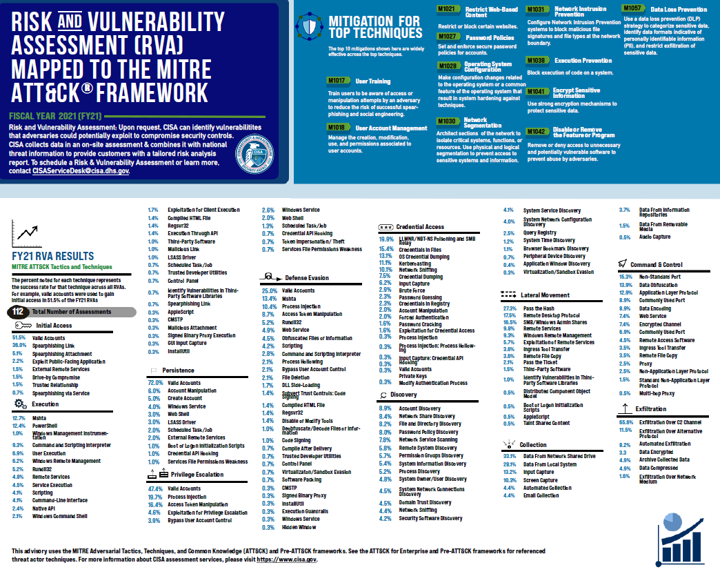
Risk and Vulnerability Assessment Mapped by the MITRE ATT&CK Framework
Mapping of tactics that were successful in DHA CISA Security Assessments
Informs discussion and preparation for “feasibility” and “real-world representation”
Can be used to show what “attack methods” are commonly utilized
https://www.cisa.gov/sites/default/files/publications/RVA_INFOGRAPHIC_508c.pdf

Slide 24
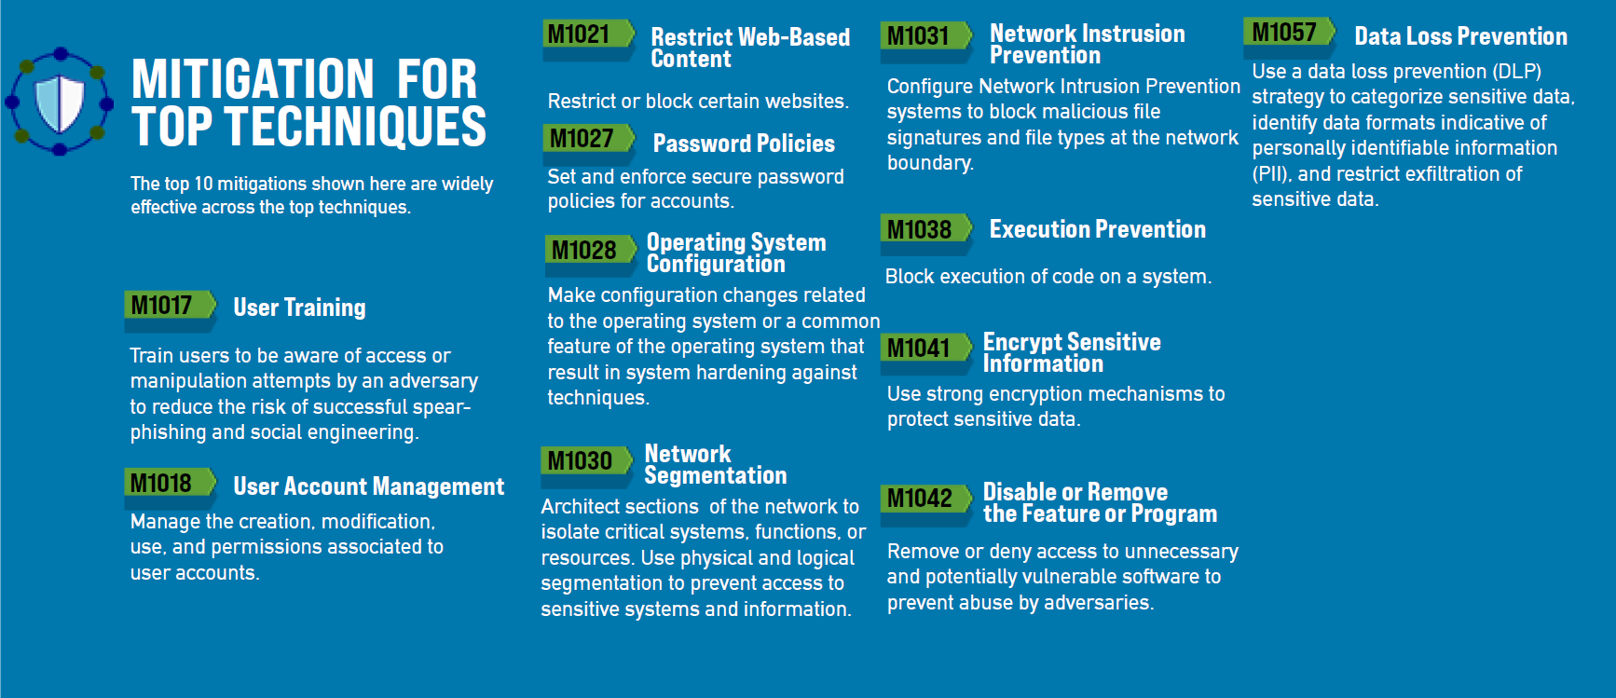
Mitigation for Top Techniques
https://www.cisa.gov/sites/default/files/publications/RVA%20INFOGRAPHIC_508c.pdf

Slide 25
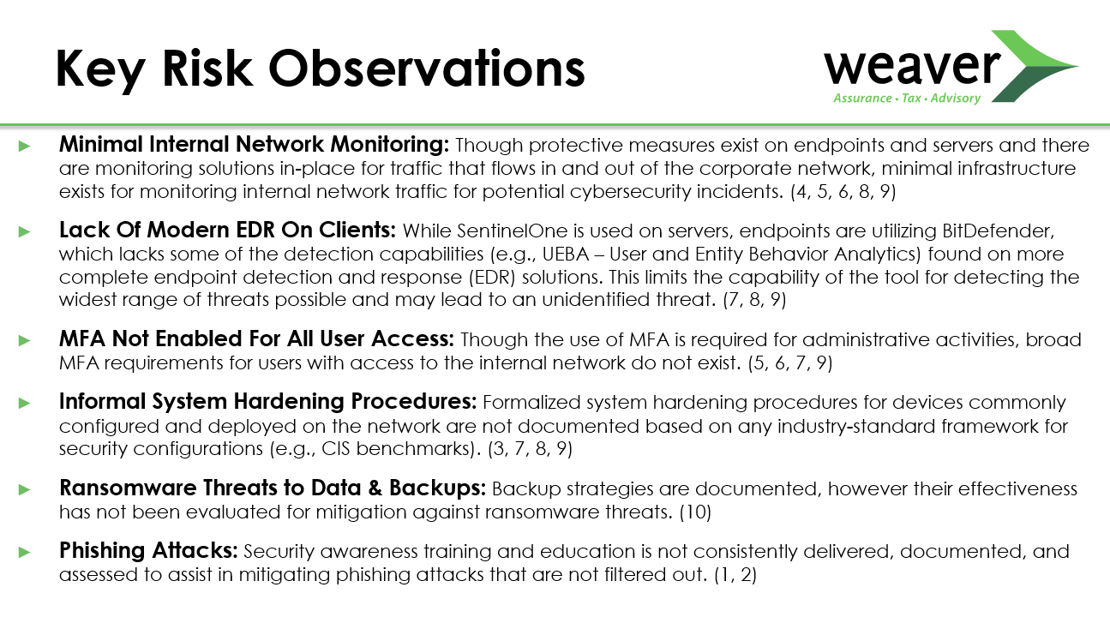
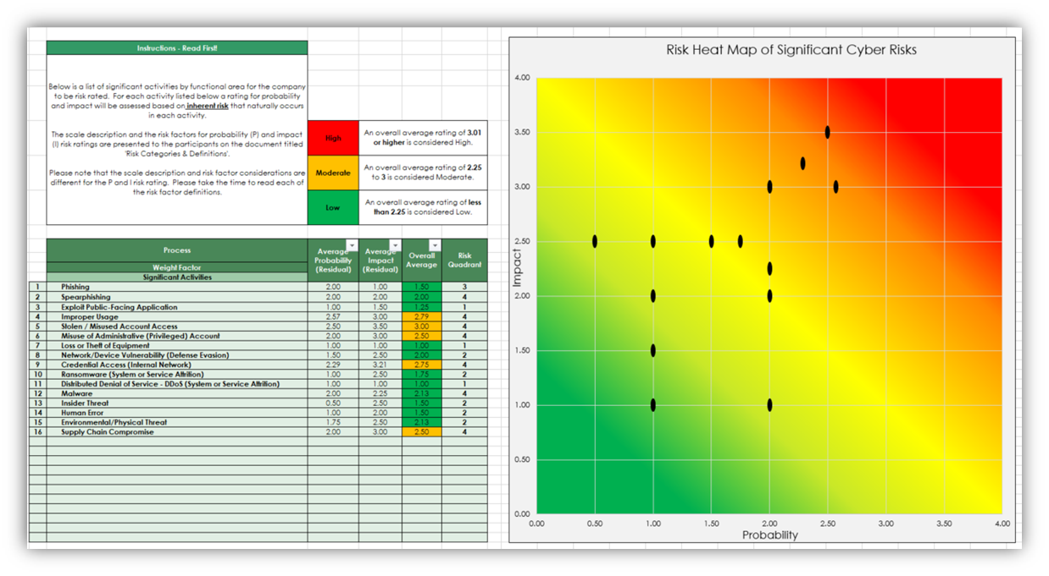
Cyber Risk Assessment
Risk Assessments can Help Assess Current Posture and Prioritize Program Safeguards and Controls

Slide 26
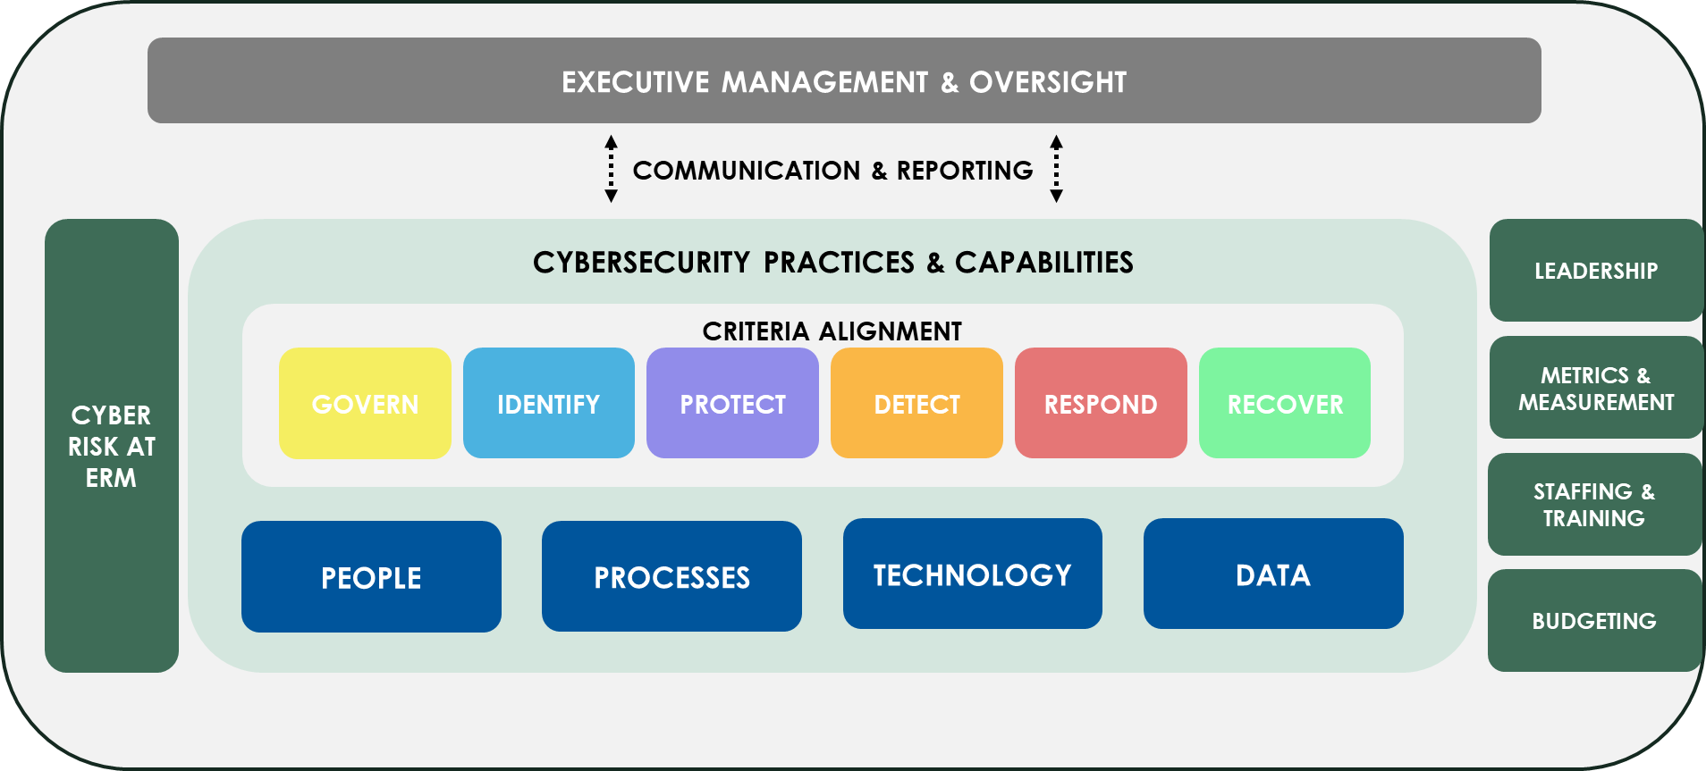
Representing the IS Risk Universe

Slide 27
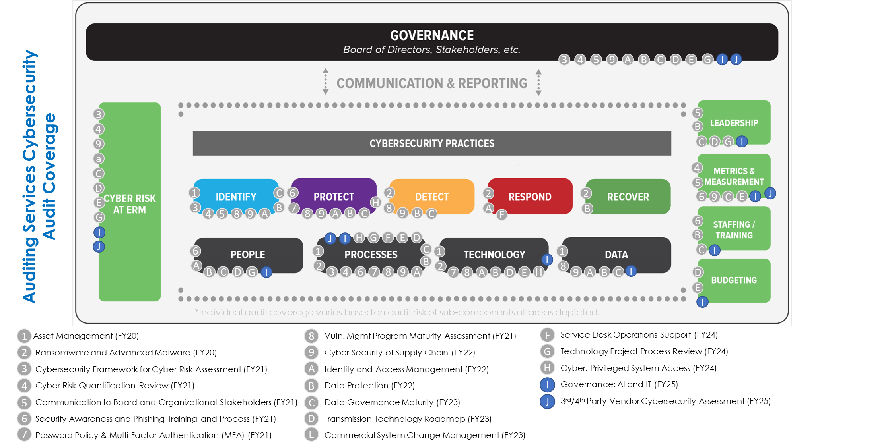
Representing the IS Risk Universe

Slide 28
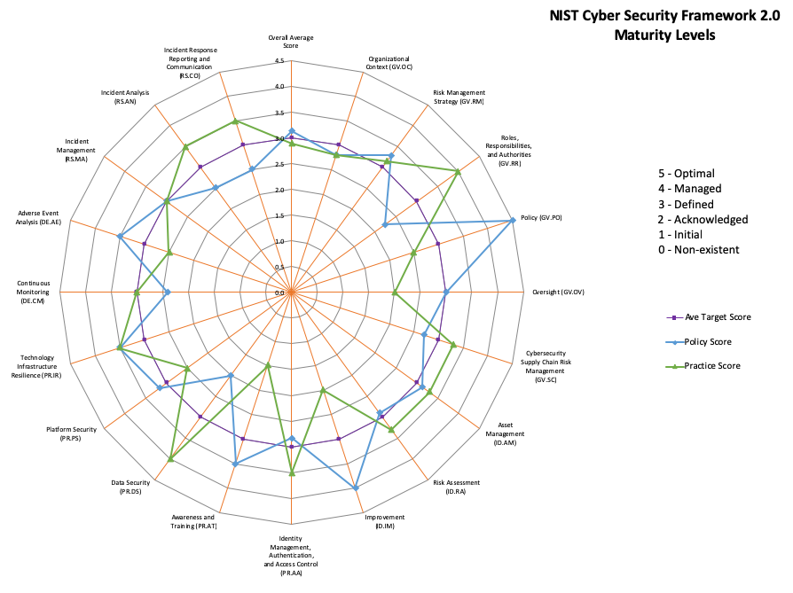
Representing the Risk Universe
Maturity Levels
Current vs. Target

Slide 29
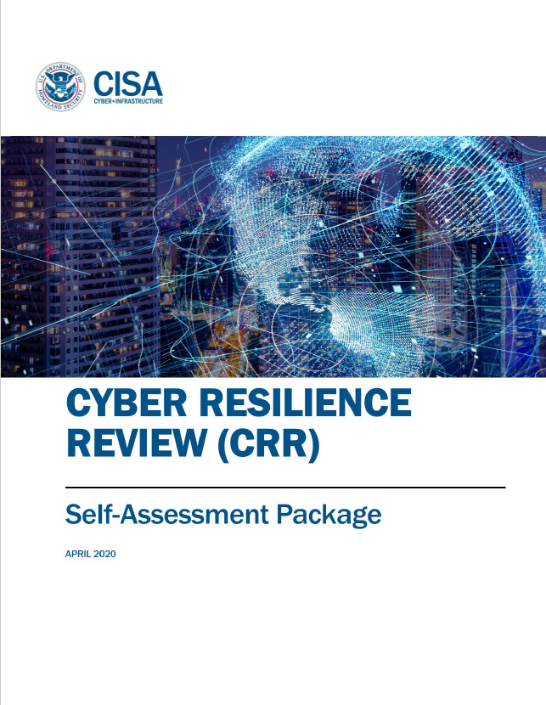
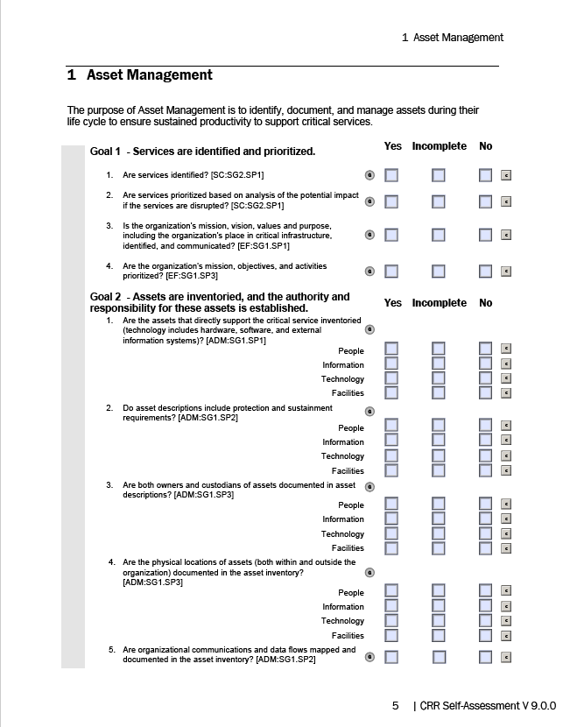
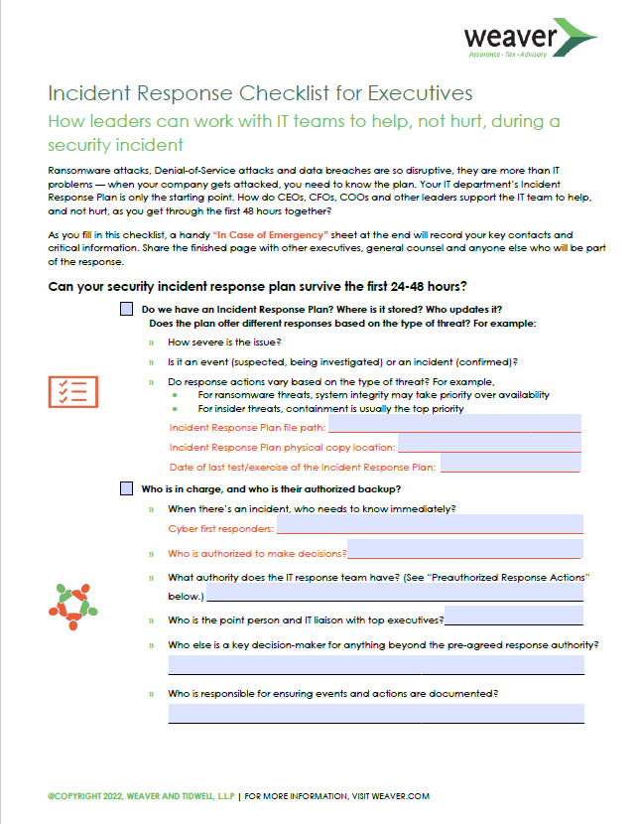
Kick Start a Program & Incident Response

Slide 30
Polling Question
What do you think your Board/Audit Committee could benefit from related to governing cybersecurity?
External educational resources to upskill
More information on our cybersecurity program (Broad, 30,000 foot view)
More information on our cyber capabilities – Protect, Detect, Respond and Recover
Tony the Tiger – They’re Great!

Slide 31
Resources
https://weaver.com/executive-resource/incident-response-checklist-executives
https://attack.mitre.org/
https://www.nacdonline.org/
https://www.cisa.gov/sites/default/files/publications/RVA_INFOGRAPHIC_508c.pdf
https://www.cisa.gov/sites/default/files/publications/RVA%20INFOGRAPHIC_508c.pdf
https://www.csoonline.com/article/3367797/12-tips-for-effectively-presenting-cybersecurity-to-the-board.html
https://www.cisa.gov/resources-tools/resources/cyber-resilience-review-downloadable-resources

