Slide 2
Beyond Compliance: Mastering Cyber Governance and Executive Reporting
Audit Interactive Virtual Summit
March 24 – 26, 2026

Slide 3



Meet your presenters
Morgan Mincy, CISA, CPA
Risk Advisory Manager at Baker Tilly
Boris Lazic
Chief Operating Officer, Suffolk University
Mark Nestor
Chief Information Officer, Suffolk University and Curry College

Slide 4
Agenda
Objectives
Board role and interest
Cyber context
Effective reporting
Framing cybersecurity updates
Examples
Interactive activity
Q&A

Slide 5
Objectives
Identify the essential cybersecurity insights boards need to fulfill their governance responsibilities, including risk posture, resilience strategies, and institutional priorities.
Evaluate the effectiveness of board-level reporting by assessing whether it conveys ongoing IT risk realistically, without overstating threats or creating undue concern.
Demonstrate techniques for framing cybersecurity updates in a way that highlights continuous risk management and institutional resilience, using clear, strategic language that supports informed decision-making.

Slide 6
Objective 1
Identify the essential cybersecurity insights boards need to fulfill their governance responsibilities, including risk posture, resilience strategies, and institutional priorities.

Slide 7
What is the board’s role?
Fiduciary responsibility
Strategic oversight and direction
Risk and institutional health oversight
Stewardship of mission and public trust
Leadership accountability
Ensuring financial responsibility
Acting as advisors and strategic partners
BOARD DOES NOT DIRECT MANAGEMENT ACTIONS

Slide 8
What is the cyber relevance?
Fiduciary responsibility – cyber tools and personnel cost $$
Strategic oversight and direction – disruptive technology (AI)
Risk and institutional health oversight – systems safeguard institutional data
Stewardship of mission and public trust – systems facilitate the mission and administrative responsibilities
Leadership accountability – understanding capabilities and asking the right questions
Ensuring financial responsibility – resources and prioritization
Acting as advisors and strategic partners – all the above!

Slide 9
Why governance matters
Governance
Management
Compliance
Governance: Understanding institutional risk and ensuring appropriate strategic actions are taken.
Management: Implementing controls, running operations and making tactical decisions.
Compliance: Demonstrating adherence to regulatory requirements or standards.

Slide 10
Challenges for audit committee
Default committee responsible for cybersecurity risk oversight given most boards do not have a dedicated technology or cyber committee
Committee members typically have financial or business expertise, not IT expertise
Relies heavily on internal audit, external audit, and independent assessments
Validates cyber risks are integrated into broader enterprise risk management
Supports alignment between cybersecurity investments and institutional risk

Slide 11
Addressing cyber expertise on audit committee
Understand perspectives and backgrounds
Foster open, ongoing conversations
Assess their concerns
Decide how best to address
Update internal audit plan, as needed

Slide 12

Spotlight – Suffolk University

Slide 13
Address board interests – potential paths
Provide education or SME presentations
Leverage board or AC chair to deliver message
Encourage ongoing presentation from management
Agree on targeted sub risks for audit
Utilize advisory reviews to elevate concrete examples of risks
Consider maturity models, benchmarking, etc. to add context

Slide 14
Activity
Find your institution’s cyber board reporting or most recent IT audit report
Identify who is on the board and their cyber background, experience, or expertise
10 minutes

Slide 15
Cyber insights

Slide 16
Cyber threat landscape
Actors
CRIMINAL
NATION STATE
Botnets/DDoS
Supply Chain/Vendors
Internet of Things (IoT)
Vulnerable Software
ATTACKS
Vectors
Credential Compromise
Crypto jacking
Phishing/Social Engineering
Ransomware
BREACHES
Actors
INSIDER
HACKTIVIST/TERRORIST

Slide 17
Why attackers target higher ed
Open access environments
Decentralized technology
Personal data (PII, PHI)
Research
Susceptible, users
Remote operations
Outdated systems

Slide 18
Cyber common challenges
Distributed nature of IT people and systems
Collaboration with internal and external stakeholders
Investment have traditionally been addressed as needed vs. strategically
Addressing compliance across varied portions of the enterprise (e.g., FERPA, HIPAA, GLBA)
Numerous offices involved in implementing, monitoring, governing
Difficult to discuss cyber and IT risks without jargon

Slide 19
Cyber risks
Reputation
Damage to brand/negative publicity
Damage to individual faculty/ researcher professional standing
Operational
Loss of time spent to respond
Loss of ability to operate or continue work
Regulatory
Cost of fines, sanctions
Financial
Cost of response for incidents
Competitive
Loss of intellectual property
Damage to relationships with partners (e.g., research sponsors, other institutions)
Loss of future funding
Effort to address requirements

Slide 20
Activity
Respond in the chat!
What is the toughest cyber question your board has asked?
Alternate: if you were a board member, what would you ask your institution about cyber?
Is audit preparing IT leadership to answer those well? Is audit evaluating those narratives?
5 minutes

Slide 21
Objective 2
Evaluate the effectiveness of board-level reporting by assessing whether it conveys ongoing IT risk realistically, without overstating threats or creating undue concern.

Slide 22
Cyber board reporting

Slide 23
Why cyber board reporting matters
Understand the institution’s cyber risk posture
Evaluate whether investments align with risk priorities
Monitor resilience and incident readiness
Ask informed strategic questions
Effective reporting allows the trustees to:
Bottom line: Cyber reporting should help the board answer:
“Is the institution managing cyber risk appropriately?”

Slide 24
Why internal audit should evaluate
Internal audit helps confirm that cyber reporting supports governance, not just compliance.
Internal audit can assess whether reporting:
Communicate risk clearly
Avoids misleading metrics
Supports strategic oversight
Drives informed decision-making
Aligns with overall institutional enterprise risk management

Slide 25
Examples of cyber board reporting

Slide 26
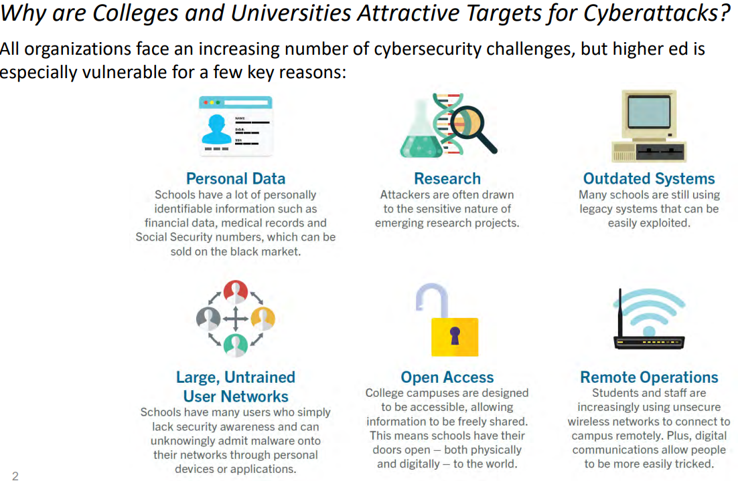

Slide 27
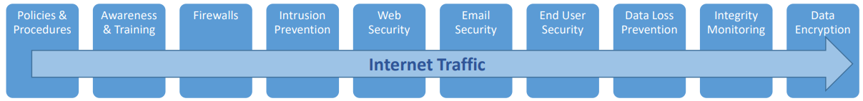
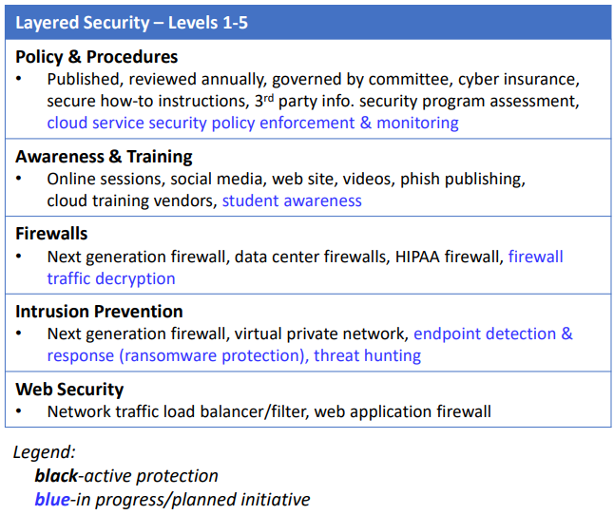
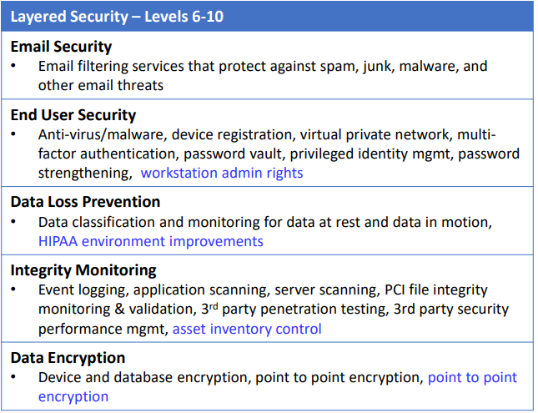
Cyber layers of protections
University Data

Slide 28
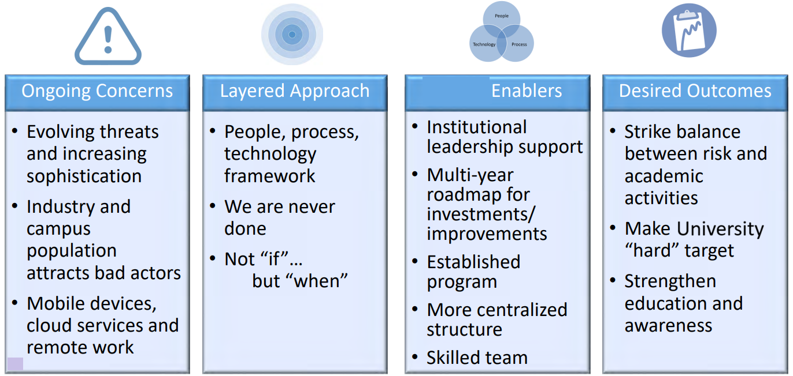
University

Slide 29
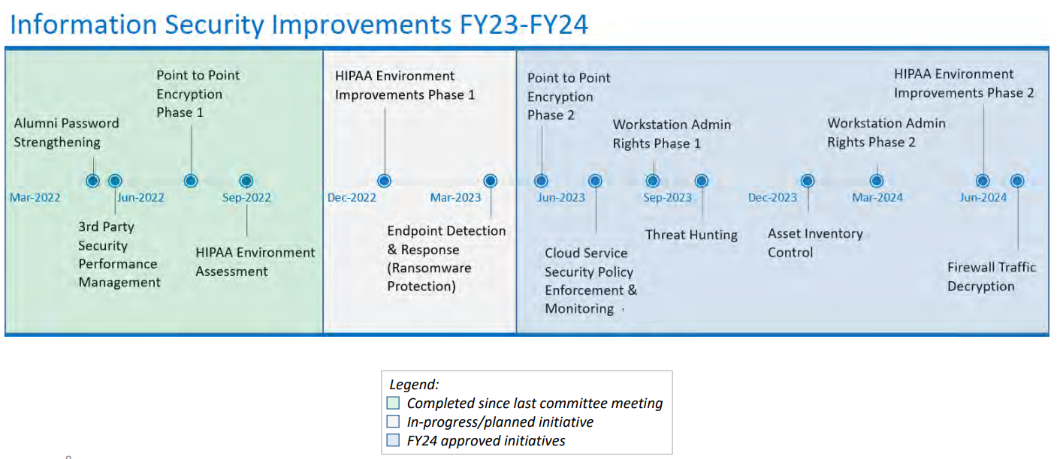
Notes:
Approved = funded

Slide 30
Evaluating board reporting

Slide 31
What to include (or not)
Should include
Should not include
Risk posture
Threat relevance
Institution-specific vulnerabilities
Alignment to mission and strategic priorities
Detailed control inventories
Acronyms, jargon
Raw technical outputs (e.g., vuln scans)
Fear based statistics

Slide 32
Activity: Rapid Poll
Go to https://www.menti.com/alyaqwhdv9jn
Which 3 belong on a board slide?
Which are management noise?
10 min

Slide 33
Key questions to evaluate beyond compliance
Are metrics meaningful?
Are risks prioritized?
Are threats appropriately stated (i.e., not under or overstated)?
Is resilience improving?
Is board info actionable?

Slide 34
How is IT communicating the message?
Use ranges/confidence
Concept-level controls
Avoid jargon
Focus on impact and readiness
Clear prioritization
Balanced tone
Strategic framing
Actionable insights

Slide 35
Spotlight – incident reporting
What happened?
What does it mean for the University?
What were the response actions that occurred?
What is the University’s residual risk level?

Slide 36
Characteristics of useful metrics
Metrics Should Help the Board Answer Three Questions
Are we secure?
Are we improving?
Are we resilient?
Risk-focused and tied to institutional risk
Trend-based showing improvement or deterioration over time
Outcome-oriented and reflect effectiveness, not just activity
Understandable with minimal technical jargon
Actionable to support strategic discussion

Slide 37
Examples of useful metrics
Useful | ….not useful
MFA coverage across critical systems | Number of firewall rules
Mean time to detect incidents | Number of log events processed
Critical vulnerabilities remediated meeting policy requirements | Number of vulnerabilities detected
Third-party vendors with security review completed out of total vendors | Number of vendors inventoried
Phishing simulation failure rate (trend) | Number of phishing emails blocked

Slide 38
Trend metrics
A single number shares very little:
Trend reporting:
17
Critical vulnerabilities
Quarter | Critical Vulnerabilities | Patch Compliance
Q1 | 32 | 81%
Q2 | 24 | 88%
Q3 | 17 | 96%
VS
Insight: Risk exposure is declining due to improved patch management.

Slide 39


Leading vs lagging indicators
Lagging
Number of incidents
Leading
MFA adoption
Data breaches
Policy violations
Patch compliance
Detection time
Phishing resilience

Slide 40
Roadmap and funding
Why should the board see the cyber roadmap?
Shows how cyber risks are actively being reduced
Connects initiatives to institutional risk priorities
Provides visibility into progress and future investments
Demonstrates continuous improvement in resilience

Slide 41
Roadmap and funding
What questions should Internal Audit be asking to evaluate?
Do initiatives align to the institution’s highest cyber risks?
Is progress and timeline clearly communicated to the board?
Do funding decisions align with risk priorities?
Does the roadmap demonstrate measurable risk reduction over time?

Slide 42
Roadmap and funding
Comprehensive reporting ties risk areas to initiatives and funding.
Risk Area | Initiative | Status | Funding
Phishing & credential theft | Expand MFA to privileged users | In Progress | Funded
Third‑party risk | Vendor risk monitoring tool | Planned | Funding Requested
Research data protection | Network segmentation | Phase 2 | Funded
Incident response | Security automation program | Future | Not Yet Funded

Slide 43
Notes:
Example – highlight the roadmap as well as what's been approved and funded

Slide 44
Objective 3
Demonstrate techniques for framing cybersecurity updates in a way that highlights continuous risk management and institutional resilience, using clear, strategic language that supports informed decision-making.

Slide 45
Activity – Cyber board evaluation
Using the discussion questions on the next slide, evaluate the cybersecurity update
Review for flaws and improvements
20 – 25 minutes

Slide 46
Activity – Discussion questions
Questions for discussion
What is unclear or confusing?
What is overstated or potentially misleading?
What is missing?
What questions would a trustee likely ask?
Does this help the board fulfill its governance role?

Slide 47
University Cybersecurity Update – 2
Cyber Risk Overview
Overall Risk Level: Moderate
Threat activity consistent with sector trends
Security monitoring operating effectively
Key Metrics
Phishing emails blocked: 14,287
Security alerts investigated: 318
Critical vulnerabilities identified: 17
Security Initiatives
Expansion of MFA across campus
Continued user security awareness training
Implementation of new monitoring tools
Incidents
One phishing-related credential compromise
No confirmed data exfiltration
Issue contained by IT security team
Notes:
Realistically flawed

Slide 48
University Cybersecurity Update – 1
Threat landscape
Vulnerabilities
Phishing emails increased 37.4%
14,287 emails blocked by secure email gateway
2,114 malware signatures updated
6 brute force attempts detected
4,892 firewall events reviewed
1,248 total vulnerabilities
312 high
17 critical
919 medium/low
Controls
Incidents
Firewall operational
EDR deployed
MFA implemented
Backups running
1 phishing incident
0 ransomware events
3 minor policy violations
Overall risk level: MEDIUM
Notes:
Obviously flawed

Slide 49
Cyber Risk & Resilience Update – 3
Overall Cyber Risk Posture
Residual Risk: Moderate (Stable vs last quarter)
Controls operating effectively
Risk currently within institutional tolerance
Incident & Resilience Indicators
1 phishing credential compromise contained in 22 minutes
No operational disruption
Mean time to detect: 18 minutes
Critical patching within SLA: 96%
Residual impact: Low
Top Cyber Risks
Phishing & credential theft – Increasing volume
Third‑party vendor risk – Stable
Research data protection – Improving
Forward Focus
Expand MFA to remaining privileged users
Enhance vendor risk monitoring
Develop AI governance framework
Notes:
(Improved Example)

Slide 50
Activity Debrief
Respond in the chat!
What changed most dramatically?
Did we reduce information or improve clarity?
Would you feel more confident as a trustee?
What audit procedures would you perform to validate this reporting?

Slide 51
IT audits to align

Slide 52
Cyber/IT areas to address/audit
Information security program maturity
Multi-factor authentication
IT inventories
Incident response / security monitoring
Vulnerability management
Vendor management
Network age, security, funding

Slide 53
Spotlight – Suffolk IT reporting
Notes:
Mark to talk about examples that the board has asked for reporting and special topics that they have worked on

Slide 54
Cyber/IT educational resources
EDUCAUSE Top 10 IT Issues
https://er.educause.edu/articles/2021/11/top-10-it-issues-2022-the-higher-education-we-deserve
AGB
https://agb.org/knowledge-center/trending-topics/technology-2/

Slide 55
IT internal audit board reporting

Slide 56
Auditor’s role
Translate complexity
Strengthen governance
Challenge narratives
Align risk with mission

Slide 57
Spotlight – Suffolk IT and audit alignment
Notes:
Here we can talk about how audit comes in after major IT initiatives like Workday implementation, IAM implementation, how we coordinate to determine what areas are ready based on recent IT activities

Slide 58
Key takeaways
Understand your board
Understand your IT and risks
Clear insights drive governance
Audit supports the full picture and provides context for board, risk, and IT
Balanced reporting builds trust

Slide 59
The end

Slide 60
Metric | Board-Level Metric or Management Noise? | Why
1. Percentage of critical systems protected by MFA | Board-Level | Shows strength of a key preventive control and reduction of credential-based attacks.
2. Number of phishing emails blocked by email gateway | Noise | High volume but not meaningful for governance; mostly reflects background activity.
3. Mean time to detect security incidents | Board-Level | Strong indicator of cyber resilience and monitoring effectiveness.
4. Number of firewall rules configured | Noise | Highly technical and operational; not tied to risk posture.
5. Percentage of critical vulnerabilities remediated within SLA | Board-Level | Demonstrates ability to reduce known exploitable risk.
6. Number of help desk tickets related to security | Noise | Operational workload metric, not meaningful for governance.
7. Phishing simulation failure rate (trend) | Board-Level | Shows human risk exposure and effectiveness of awareness programs.
8. Number of security alerts generated by monitoring tools | Noise | Reflects system activity rather than institutional risk.
9. Percentage of high-risk vendors with completed security assessments | Board-Level | Shows management of third-party cyber risk.
10. Number of malware signatures updated | Noise | Routine operational activity handled by security tools.
Notes:
Key for reference

