Slide 2
Practical Approaches to Communication for Internal Auditors
Wednesday, March 25, 2026
2:00 p.m. – 2:50 p.m. Eastern time

Slide 3
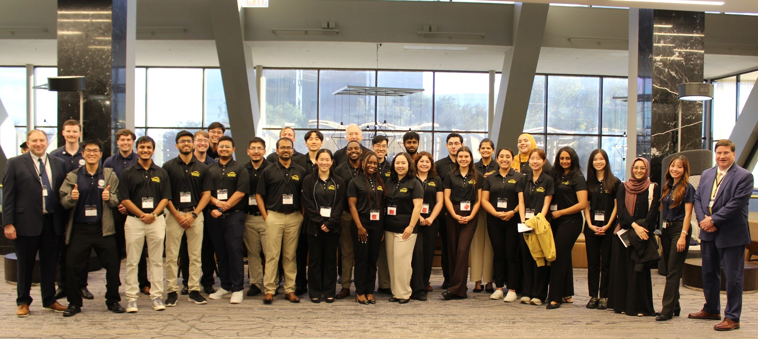


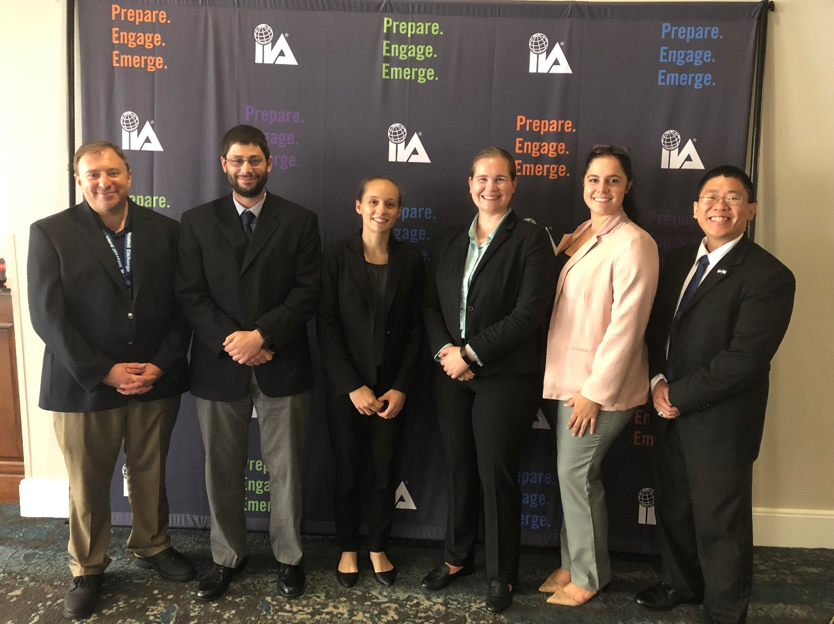
Joseph Mauriello

Slide 4
My Background
Director / Professor, Center for Internal Auditing Excellence, UTD
20+ years Internal Audit experience
Public Accounting / Industry
PhD, MBA, and MS, Accounting – UT Dallas
BA, History, Minor: Int’l Relations – Lehigh University
Dallas IIA Chapter Involvement – Officer / Governor
Dallas IIA Super Conference Chair (2016 – present)
UTD Fraud Summit Chair (2016-present)
IIA International: CREA Committee (2017-2019), GPKG (2020-2026)
Gleim Lead CIA Instructor / CPA ISC Instructor

Slide 5
Session Objectives
Communication skills continue to top the list of requirements for the hiring and development of internal auditors. The absence of effective communication skills can limit not only the performance of an individual internal auditor, but also the internal audit function as a whole. This session will address practical means by which internal auditors can hone their communication skills.
After this session, participants will be able to:
Identify practical communications skills for internal auditors.
Understand relevant professional standards applicable to internal audit communications.
Develop a practical action plan for professional development that promotes improved communications skills.

Slide 6
Agenda
Current Environment
Technical Aspects
Traits of Effective Communication
Communications Mindset

Slide 7
Current Environment

Slide 8
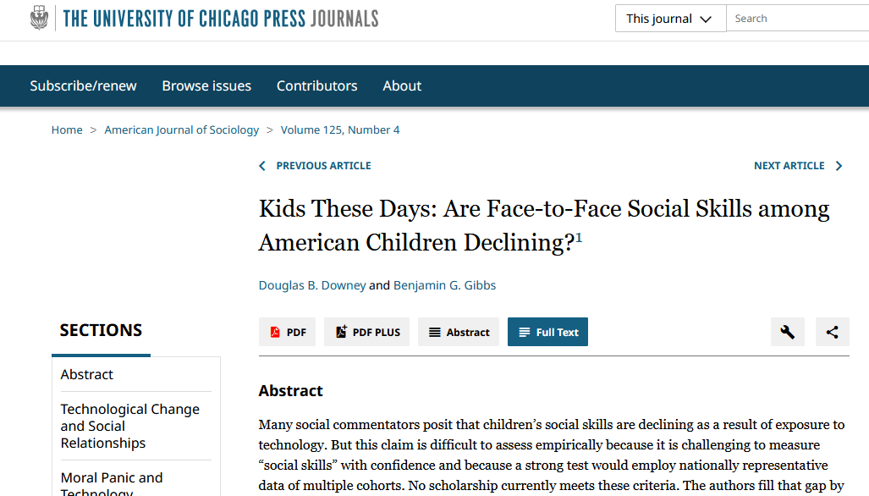
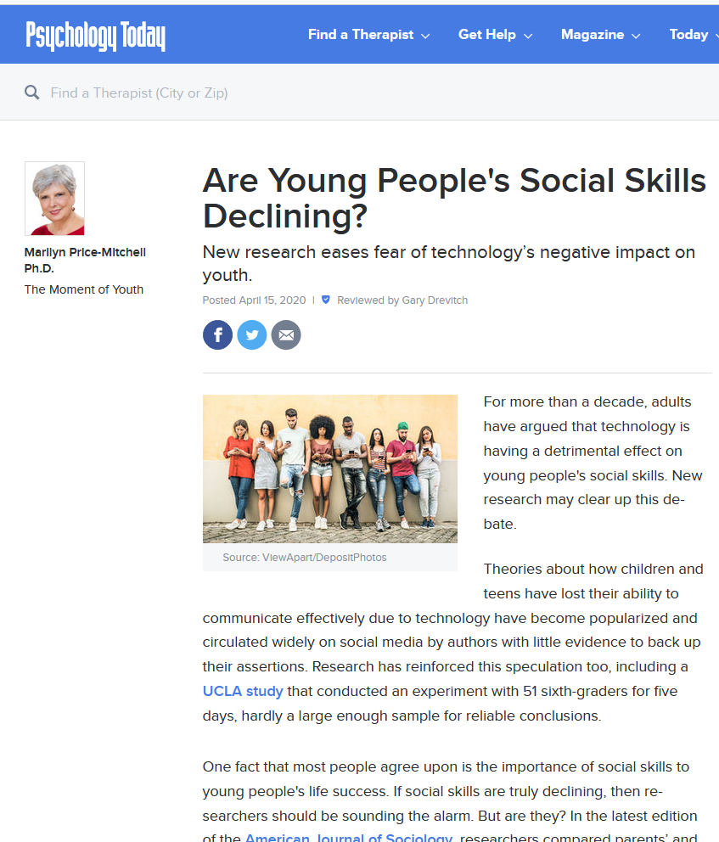
Current Environment

Slide 9
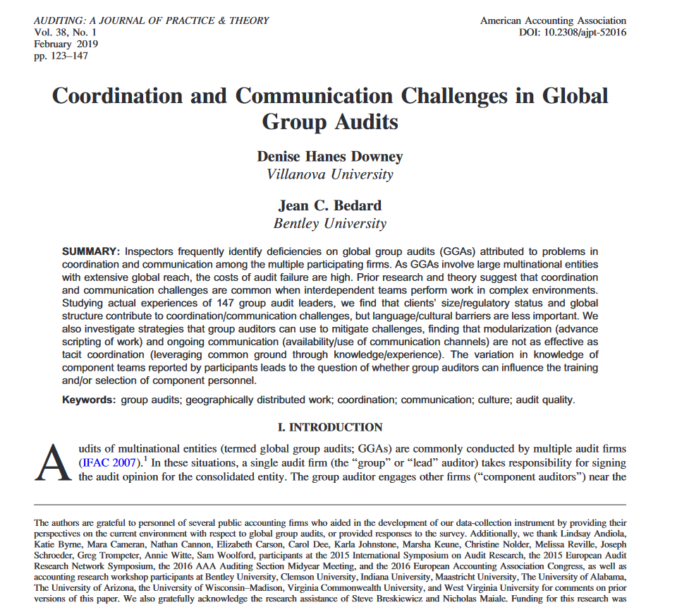
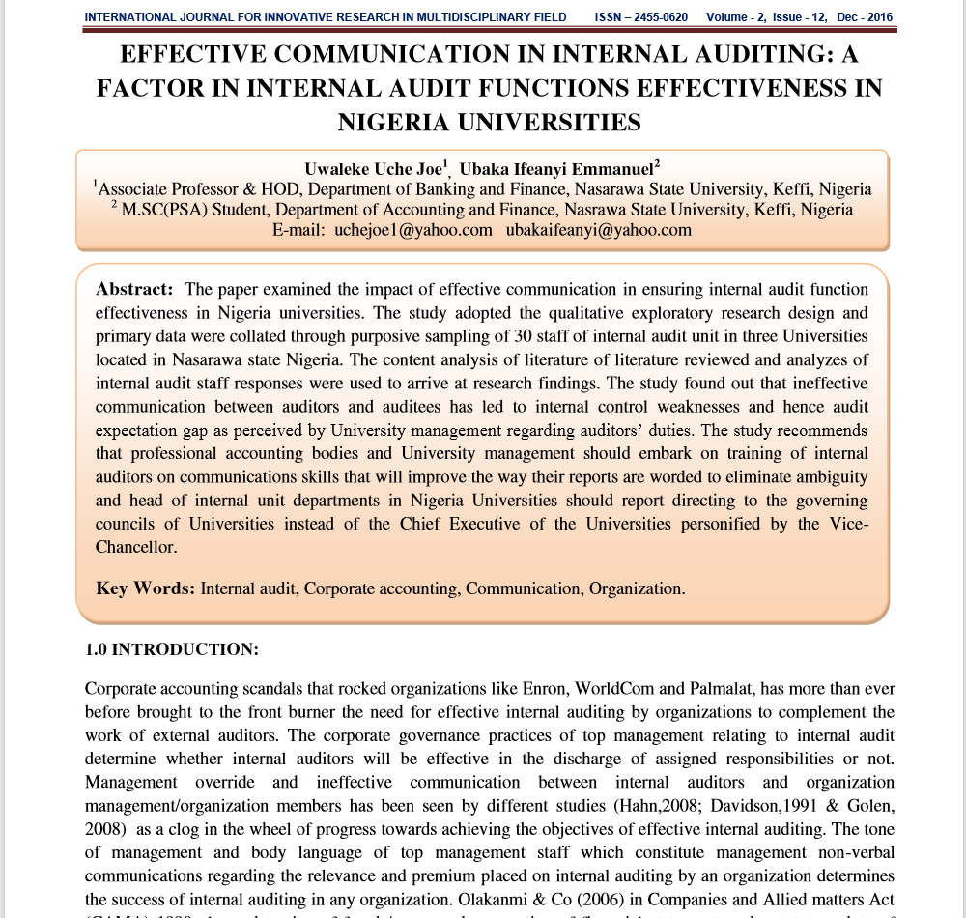
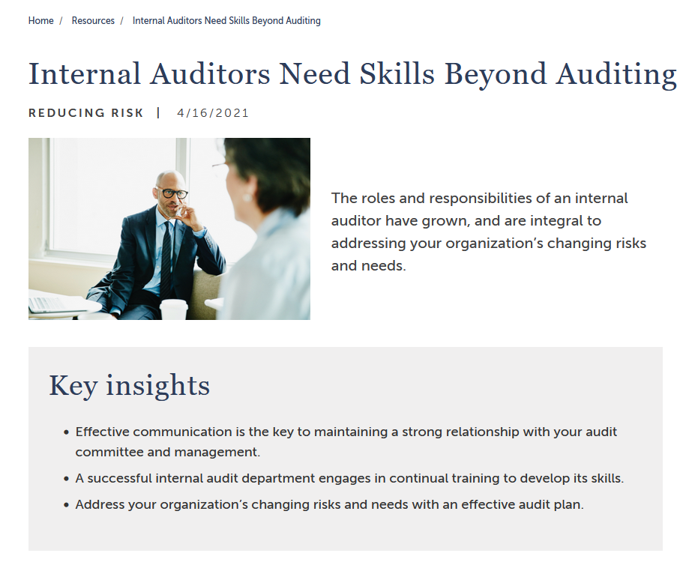
Current Environment

Slide 10
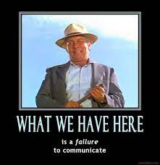
Current Environment
Commonly Cited Causes for Poor Communication Skills
Technology
Social Media
Generational differences
Schooling
  K through 12
  College / University
Pandemic

Slide 11
Current Environment
Poor communication skills lead to….
Less effective internal auditors
Less effective internal auditing
Reduced value-enhancing engagements
Reduced reputation for the IA function and its members
And ultimately an ineffective internal audit function….

Slide 12
Current Environment
How is it that we haven’t resolved the communication skill deficiency?
We identified the problem.
We think we’ve identified root causes.
We have a plethora of proposed solutions.
Why can’t we just get this right? And….
How do we fix it?

Slide 13
Polling Question #1
Which of the following commonly cited causes for poor communication skills do you find the most convincing?
Technology
Social Media
Generational Differences
Schooling / Education
Pandemic

Slide 14
Technical Aspects

Slide 15
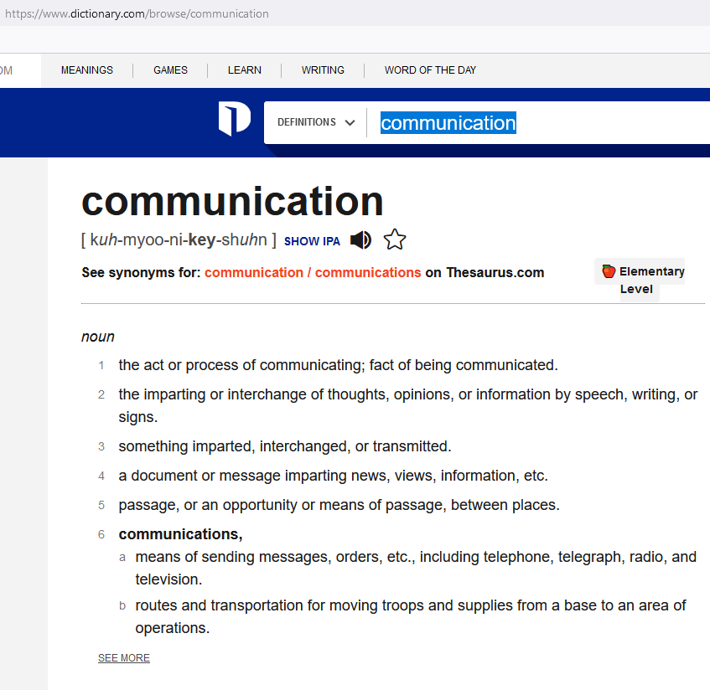
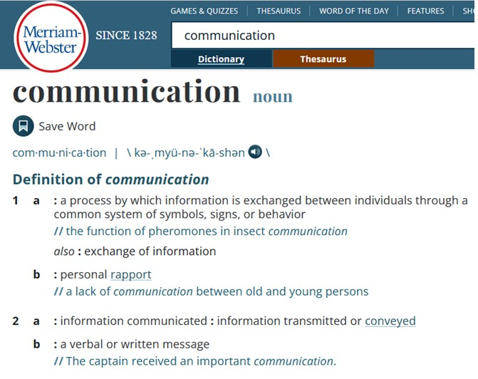
Technical Aspects
What is communication?

Slide 16
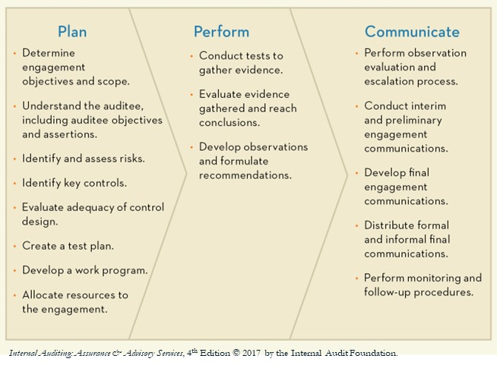
Technical Aspects
Internal Audit Process
Perform observation evaluation and escalation,
Conduct interim and preliminary engagement communications,
Develop final engagement communications,
Distribute formal and informal final communications, and
Perform monitoring and follow-up procedures.

Slide 17
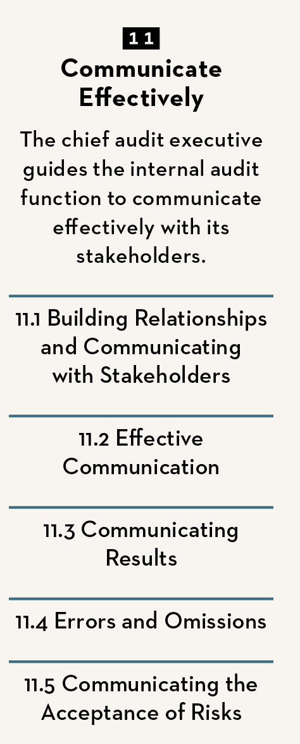
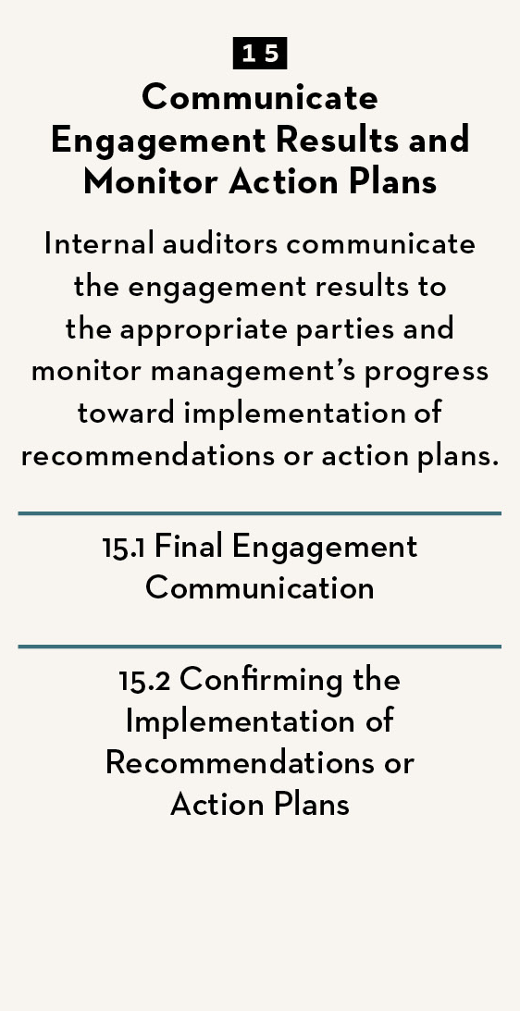
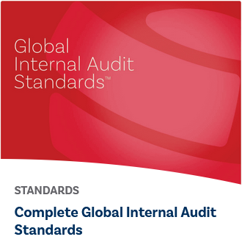
Technical Aspects
The Standards and Communication

Slide 18
Technical Aspects
The Standards and Communication
Principle 11: Communicate Effectively
The chief audit executive guides the internal audit function to communicate effectively with its stakeholders.
Relationship building
Ongoing engagement
Formal oversight communication
Value delivery

Slide 19
Technical Aspects
The Standards and Communication
Standard 11.1 Building Relationships and Communicating with Stakeholders | Standard 11.2 Effective Communication
The CAE must develop an approach for building relationships with stakeholders. The CAE must promote formal and informal communication with stakeholders. Organizational interests and concerns, including regulatory requirements Approaches for risk identification, management, and assurance Roles and responsibilities Significant organizational processes | The chief audit executive must establish and implement methodologies to promote accurate, objective, clear, concise, constructive, complete, and timely internal audit communications.

Slide 20
Technical Aspects
The Standards and Communication
Standard 11.3 Communicating Results | Standard 11.4 Errors or Omissions
The CAE must communicate the results of internal audit services to the board and senior management periodically, as appropriate. Results include: Engagement conclusions Themes such as effective practices or root causes Conclusions at the level of the business unit or organization | If a final engagement communication contains a significant error or omission, the chief audit executive must communicate corrected information promptly to all parties who received the original communication. Significance is determined according to criteria agreed upon with the board.

Slide 21

Technical Aspects
The Standards and Communication
Standard 11.5 Communicating the Acceptance of Risks
The CAE must communicate unacceptable levels of risk. When the CAE concludes that management has accepted a level of risk that exceeds the organization’s risk appetite or risk tolerance, the matter must be discussed with senior management. If the CAE determines that the matter has not been resolved by senior management, the matter must be escalated to the board. It is not the responsibility of the CAE to resolve the risk.

Slide 22
Technical Aspects
The Standards and Communication
Principle 15: Communicate Engagement Results and Monitor Action Plans
Internal auditors communicate the engagement results to the appropriate parties and monitor management’s progress toward the implementation of recommendations or action plans.
Internal auditors are responsible for issuing final communication and communicating the results to management.
Internal auditors confirm that action plans are implemented.

Slide 23
Technical Aspects
The Standards and Communication
Standard 15.1 Final Engagement Communication
For each engagement, internal auditors must develop a final communication that includes the engagement’s objectives, scope, recommendations and/or action plans if applicable, and conclusions. The final communication for assurance engagements also must include: The findings and their significance and prioritization. An explanation of scope limitations, if any. A conclusion regarding the effectiveness of the governance, risk management, and control processes of the activity reviewed. The final communication must specify the individuals responsible for addressing the findings and the planned date by which the actions should be completed. The final communication must specify the individuals responsible for addressing the findings and the planned date by which the actions should be completed.

Slide 24
Technical Aspects
The Standards and Communication
Standard 15.1 Final Engagement Communication, Continued
When internal auditors become aware that management has initiated or completed actions to address a finding before the final communication, the actions must be acknowledged in the communication. The final communication must be accurate, objective, clear, concise, constructive, complete, and timely. Internal auditors must ensure the final communication is reviewed and approved by the CAE before it is issued. The CAE must disseminate the final communication to parties who can ensure that the results are given due consideration. If the engagement is not conducted in conformance with the Standards, the final engagement communication must disclose the following details about the nonconformance: Standard(s) with which conformance was not achieved. Reason(s) for nonconformance. Impact of nonconformance on the engagement findings and conclusions.

Slide 25
Technical Aspects
The Standards and Communication
Standard 15.2 Confirming the Implementation of Recommendations or Action Plans
Internal auditors must confirm that management has implemented internal auditors’ recommendations or management’s action plans following an established methodology, which includes: Inquiring about progress on the implementation. Performing follow-up assessments using a risk-based approach. Updating the status of management’s actions in a tracking system. The extent of these procedures must consider the significance of the finding. If management has not progressed in implementing the actions according to the established completion dates, internal auditors must obtain and document an explanation from management and discuss the issue with the CAE.

Slide 26
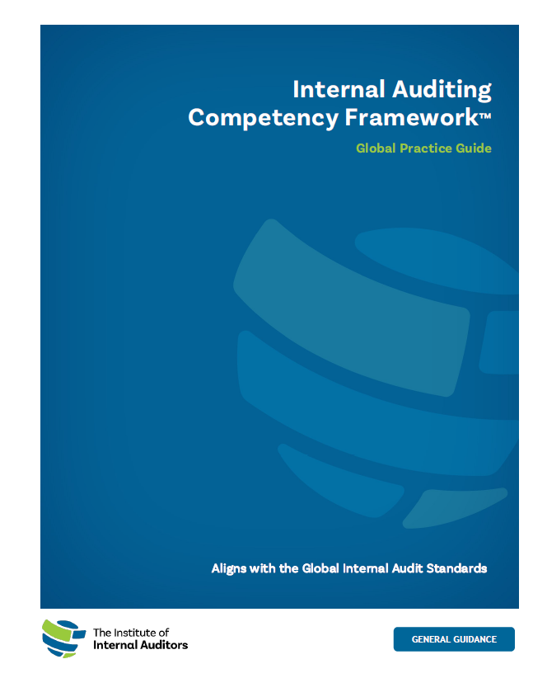
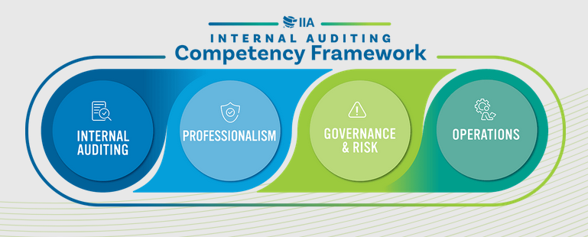
Technical Aspects
The IIA Competency Framework
https://www.theiia.org/en/standards/internal-audit-competency-framework/

Slide 27
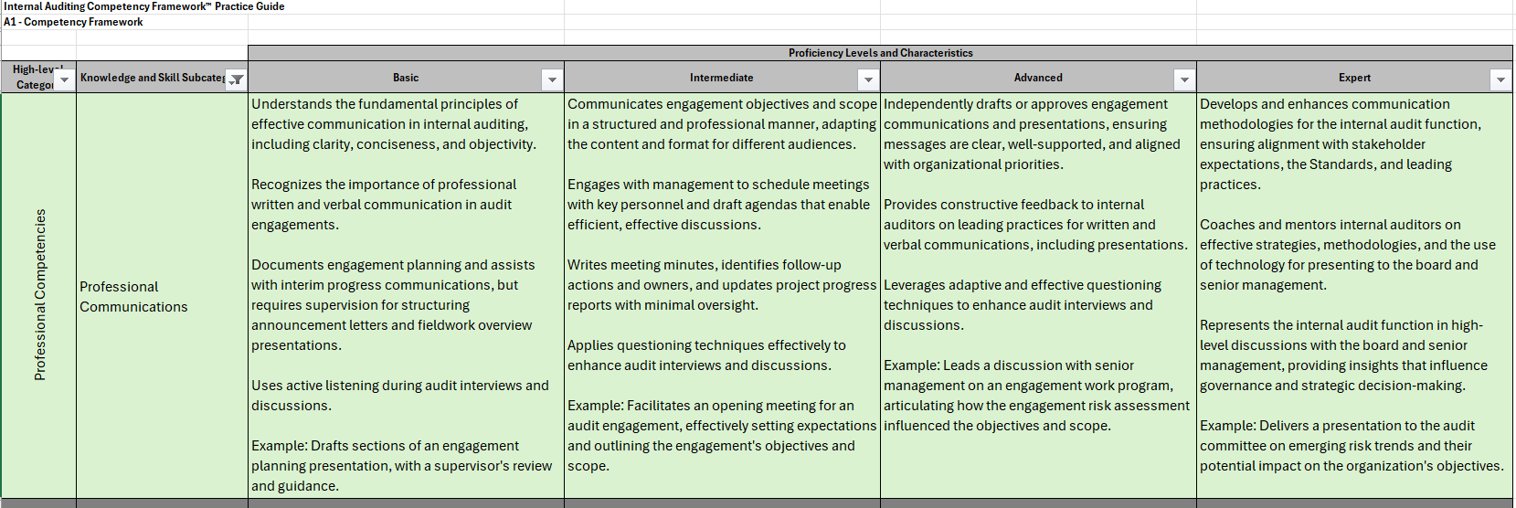
Technical Aspects
The IIA Competency Framework
https://www.theiia.org/en/standards/internal-audit-competency-framework/

Slide 28
Polling Question #2
Which of the standards / guidance do you believe is the most practical with regards to internal audit communication skills?
Principle 11 Communicate Effectively
Principle 15 Communicate Engagement Results and Monitor Action Plans
IIA Internal Audit Competency Framework
None of the above (that’s why I’m here)

Slide 29
Traits of Effective Communication

Slide 30
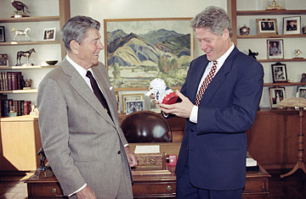
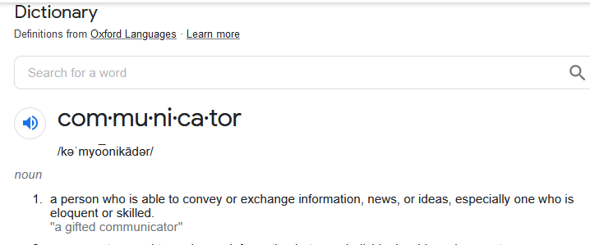
Traits of Effective Communication
First things first, we need to distinguish between…..
Communication, and
The Communicator
http://content.time.com/time/nation/article/0,8599,2112249,00.html

Slide 31
Traits of Effective Communication
Traits of Effective Communicators
Listening
Relates to Others
Simplifies the Complex
Knowing When to Speak Up
Availability
Exudes confidence
Specificity
Focuses on the interaction
Asks questions
Recognizes non-verbal cues

Slide 32
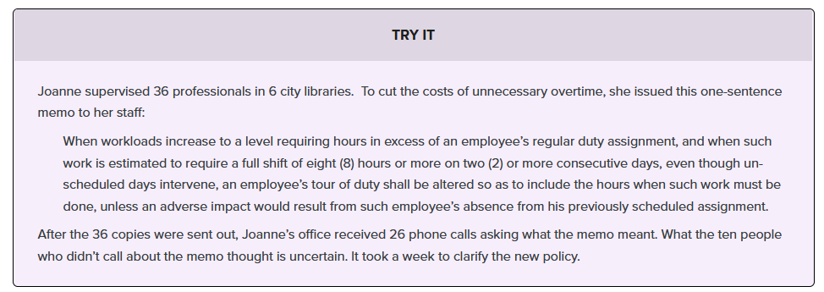
Traits of Effective Communication
Traits of Effective Communication: The 7 C’s
Clear
Concise
Concrete
Correct
Coherent
Complete
Courteous
https://courses.lumenlearning.com/suny-esc-communicationforprofessionals/chapter/characteristics-of-effective-professional-communication/

Slide 33
Polling Question #3
Are great communicators born or made?
Born
Made
If B, then A

Slide 34
Communications Mindset

Slide 35

Communications Mindset
So how do I develop my communications skills to succeed in the profession?

Slide 36
Communications Mindset
Relevant Communication Skills to Pursue
Writing
Public speaking
Relationship building
Empathy
Persuasion
Influence
Conflict Management
Adaptability
Leadership
Visualization

Slide 37

Communications Mindset
Common Approaches to Skills Development
Why do these approaches fail?
Focuses either on the communication or the communicator but rarely both.
Focuses more on technical writing
Standards focus – which is inherently technical
Hones the inherent skills of the introvert…..

Slide 38

Communications Mindset
Practical Approaches to Developing Communication Skills
We need a solution that encompasses:
A dual focus on the nature of the communication and the communicator
Adherence to the Standards
Balance of adhering to the standards with a value proposition for stakeholders
Recognition that this is a continuous improvement effort

Slide 39

Communications Mindset
Practical Approach: Executing the IA Communication
Identify the objective
Know thyself
Non-verbal cues
Ask questions
Seek first to understand then be understood
Deletions, distortions, and generalizations
Awareness

Slide 40

Communications Mindset
Practical Approach: Become a Better Communicator
Must-Do’s
A sense of self-worth
Plan ahead
Know your audience
Find the “neutral zone”
Active listening
Embrace the ambiguity

Slide 41
Polling Question #4
Which communication / communicator skillset or trait below do you believe you need to address personally for professional development?
Report writing
Active listening
Planning
Embracing the ambiguity

Slide 42
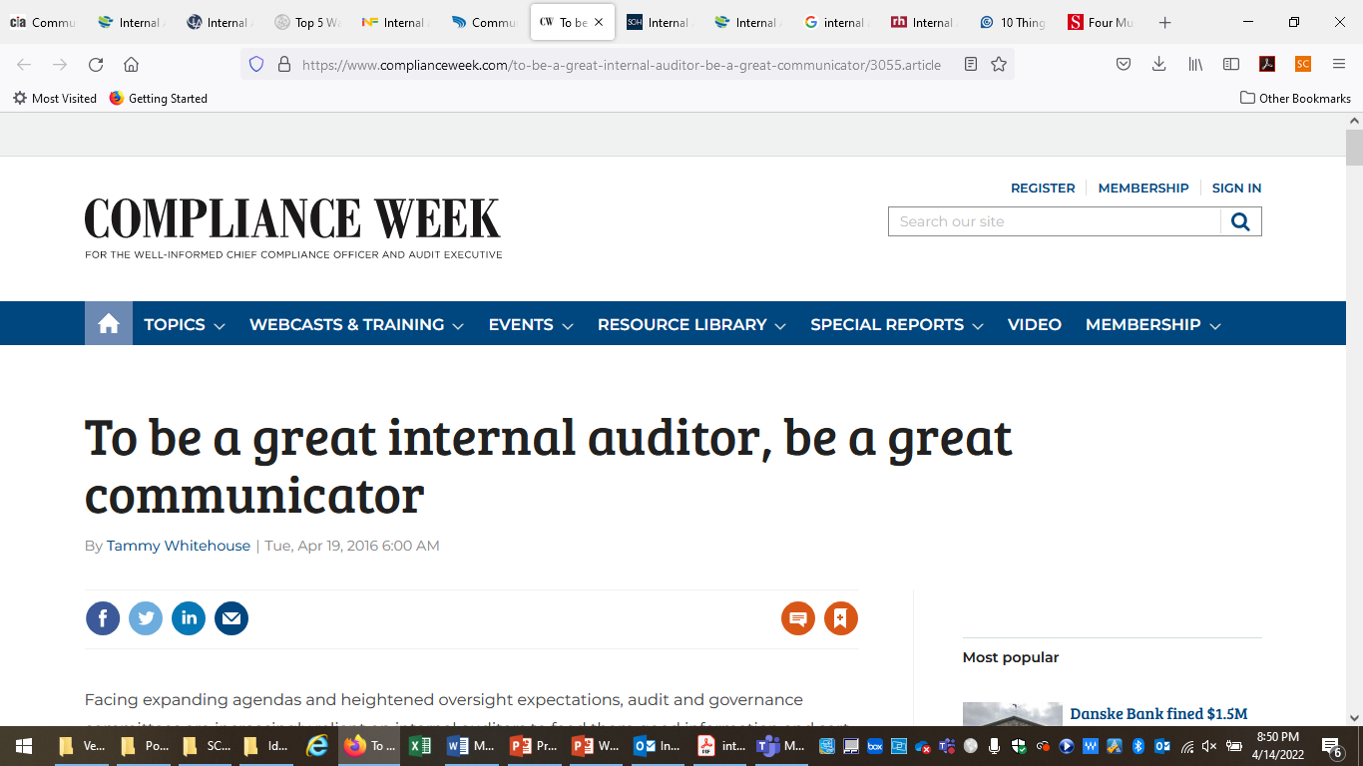
Conclusion
Parting Thoughts
The importance of distinguishing between the quality of the communication and communicator’s quality.
Requires different training and development.
Good communicators, like good communications, are not born, they are made.

Slide 43
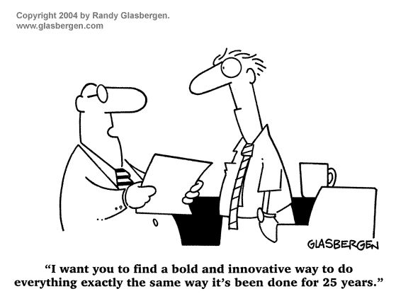
Conclusion

Slide 44
Questions / Contact Information
Joseph Mauriello, PhD
Director, Center for Internal Auditing Excellence
Jindal School of Management
The University of Texas at Dallas
(972) 883-4729
joseph.mauriello@utdallas.edu

