Slide 1
Notes:
Good morning, I’m John McDaniel. Today’s focus is how auditors can win stakeholder buy-in like Matlock — underestimated but unshakable.

Slide 2
Underestimated and Unshakable: Winning Stakeholder Buy-In Like Matlock
AUCA Annual Conference – September 18, 2025
9:00 AM – 9:50 AM EST
Notes:
By the end, you’ll understand the Matlock archetype, explore communication theories, apply them to real personas, and practice usable tools.

Slide 3
Express Evaluation Code
BB9D
A link to the Express Evaluation is located at ACUA.org.
Under the Training & Events menu, select Event Evaluator. An ACUA login is required to access the session evaluations.
Codes are unique to each session and are required for access.
Notes:
Matlock was underestimated, but won through empathy, preparation, and communication. That’s our model as auditors.

Slide 4
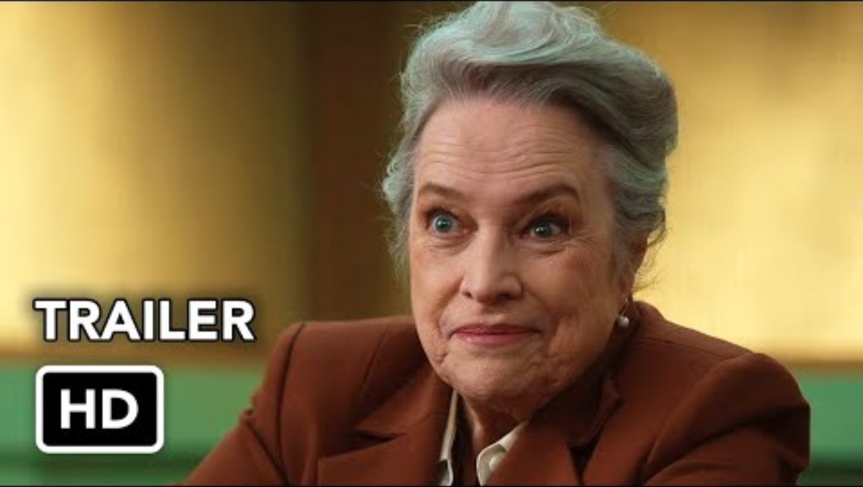

Slide 5
Session Objectives
- Apply communication theory to improve stakeholder engagement
- Increase auditor visibility, influence, and trust
- Use framing, listening, and positioning to gain traction
Notes:
Adjust your dial (pace, channel, detail, formality). With faculty, explain in research terms; with athletics, go straight to recruiting impacts. Avoid over-accommodating.

Slide 6
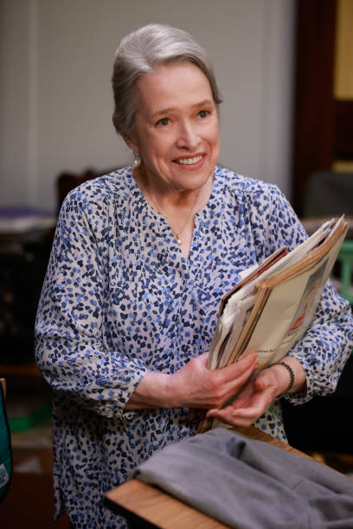
The Matlock Archetype: The Underestimated Expert
- Matty Matlock: underestimated, strategic, emotionally intelligent
- Auditors: often overlooked, but can influence through communication
Notes:
Match persuasion path to the person. Executives: visuals and analogies. Technical staff: detail and logic. Blend both when needed.

Slide 7
Communication Theory Tie-Ins
- Expectancy Violations Theory
- Impression Management
- Framing Theory
- Elaboration Likelihood Model
- Communication Accommodation Theory
Notes:
Frame findings as mission > mandate. Use Cialdini’s ethical principles (reciprocity, authority, consistency, liking, consensus).

Slide 8
Persuasion & Leadership Theories
- Cialdini’s Principles of Persuasion
- Transformational & Servant Leadership
- Tuckman’s Team Development Model
- Leader-Member Exchange (LMX) Theory
Notes:
Inside the audit team, servant leadership and LMX set the tone. How we treat each other influences credibility outside.

Slide 9
The Matlock Method Framework
Get in
Get in the Room – Impression Management
Communication Accommodation Theory
Build
Build Trust – Social Penetration
Navigate
Navigate Conflict – ELM & Servant Leadership
Prove
Prove Value – LMX & Team Development
Cement
Cement Alliance – Transformational Leadership
Notes:
Apply theories to real-world personas: faculty PI, athletics coach, provost, advancement, finance. Each requires a tailored dial and frame.

Slide 10
The Matlock Method (Audit Edition)
1) Get in the Room: impression, credibility cues, clarity of role.
2) Build Trust: small commitments, reliable follow-through.
3) Navigate Conflict: separate interests from positions; find the third option.
4) Prove Value: quick wins; stakeholder-specific metrics.
5) Cement Alliance: co-own the solution; public credit.
Notes:
Listening Lab (SOAR in pairs), Framing Flip (policy violation → protecting mission). These reinforce application.

Slide 11
Cold Open: Underestimated ≠ Unprepared
Matlock archetype: underestimated expert who wins by reading the room.
Auditors: often outnumbered, time-boxed, misunderstood—so communication is leverage.
Goal today: practical moves to earn trust and yeses without sacrificing independence.
Notes:
Capstone tool: Before meetings, ask: Who am I meeting? What dial? How protect agency? What mission frame? What’s my one clear ask?

Slide 12
Outcome Targets
Increase stakeholder trust, clarity, and uptake of recommendations.
Leave with a playbook: listen → frame → position → close.
Measure: faster cycles, fewer escalations, clearer decisions.
Notes:
Final takeaways: adjust your dial, match persuasion path, frame mission not mandate, protect agency, and always have one clear ask.

Slide 13
Applying Communication Theory to Stakeholders
Notes:
Now that we’ve explored Communication Accommodation Theory (CAT), let’s see how it applies to real-world personas — for example, faculty PIs and athletics coaches.

Slide 14
Communication Accommodation Theory (CAT)
We adjust our communication style—pace, tone, vocabulary, formality—to better connect with others.
Example:
With Athletics, an auditor uses short, direct updates. With Research, they slow down and cite sponsor guidance. The message is tuned like a dial.

Slide 15
Adjust Your Dial (CAT)
Definition: Adjust so people can hear you—without dumbing it down
Pace: slow for decisions; fast for updates
Channel: email for heads-up; in-person for commitment
Detail: headline first; appendix later
Tone: confident + curious

Slide 16
Impression Management
We all manage how others see us—through our words, tone, appearance, and behavior.
Example:
When presenting to senior leadership, an auditor dresses professionally, speaks clearly, and references strategic goals to signal credibility and alignment.

Slide 17
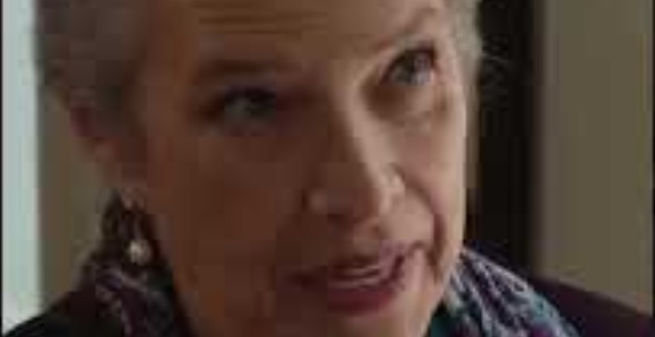

Slide 18
CAT – Scene: Soft Entry, Hard Finish
Matty opens with an unthreatening, grandmotherly style
She listens, mirrors wording, and lowers defenses
When it matters, she pivots to crisp, lawyerly asks

Slide 19
CAT – Why it Works
Convergence signals empathy → people talk more
Strategic divergence signals authority when presenting fixes

Slide 20
CAT – Auditor Moves (Faculty & Researchers)
Open with their goals (grants, student success)
Mirror their jargon: effort, IRB, cost share, subawards
Pivot to two plain‑English controls and next step

Slide 21
CAT – Auditor Moves (Athletics & Operations)
Lead
Lead with outcomes they value (time saved, no NCAA hits)
Translate
Translate to a 2‑bullet control ask
Script
Script: “We’ll cut card recon time so coaches coach.”

Slide 22
Framing Theory
How you present information—what you emphasize or downplay—shapes how others interpret it.
Example:
Instead of saying 'policy violation', an auditor says 'this control helps protect grant eligibility', reframing the issue from punishment to protection.

Slide 23
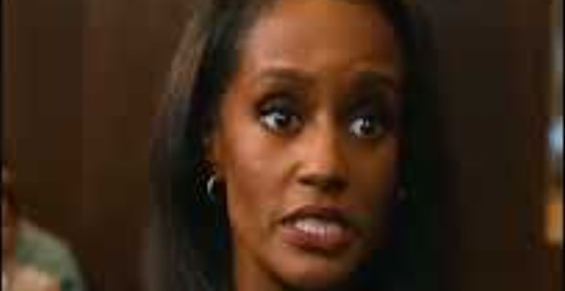

Slide 24
ELM – Scene: Central Route
Evidence chain, hidden witness, 911 call → tight case
Heavy facts, clear logic, disciplined narrative

Slide 25
ELM – Scene: Peripheral Cues
Likeability, humility, confidence on her feet
Jury stays open to her arguments

Slide 26
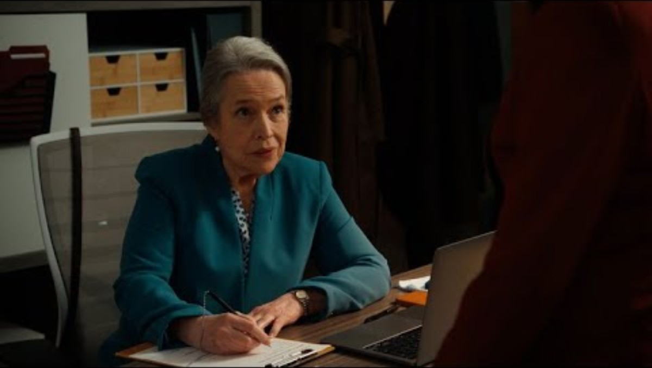
Notes:
Agency: Give A/B choices. Empathy: Listen with SOAR (Summarize, Open, Affirm, Reframe). Preserves dignity and builds trust.

Slide 27
ELM – Auditor Moves (Executives)
Central first: risk quant, loss scenarios, peer benchmarks
Peripheral support: one‑page cover with 3 wins & a timeline

Slide 28
Agency & Empathy
Agency: offer choices (A/B), co-author timelines, co-own next steps.
Empathy: name the tension—validate constraints without conceding risks.
Facework: protect status; credit their constraints and wins.

Slide 29
Expectancy Violations Theory (EVT)
People have expectations about how others will communicate. When those expectations are violated—positively or negatively—it affects how they perceive the communicator.
Example:
An auditor opens a meeting with empathy and options instead of rigid compliance language. This unexpected warmth builds trust and shifts perception from 'enforcer' to 'partner'.

Slide 30
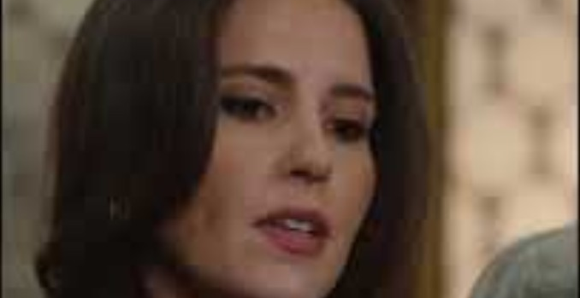

Slide 31
Cialdini: Ethical Influence
Reciprocity: share a quick win or template first.
Commitment/Consistency: confirm small agreements in writing.
Authority + Liking: borrow credible voices; show up human.
Social Proof: 'Peer schools solved this with X.'
Unity: 'Same team: student success/compliance.'

Slide 32
Cialdini’s Principles of Persuasion
Persuasion is driven by principles like reciprocity, authority, consistency, liking, scarcity, and social proof.
Example:
An auditor builds rapport (liking), cites policy (authority), and shows peer adoption (social proof) to encourage compliance with a new control.

Slide 33
Active Listening: S.O.A.R.
S: Signal attention (nonverbal, brief encouragers).
O: Open probes (What would success look like for you?).
A: Acknowledge/reflect (So the concern is X, not Y).
R: Recap/route (Here’s what I heard; options A/B/C).

Slide 34
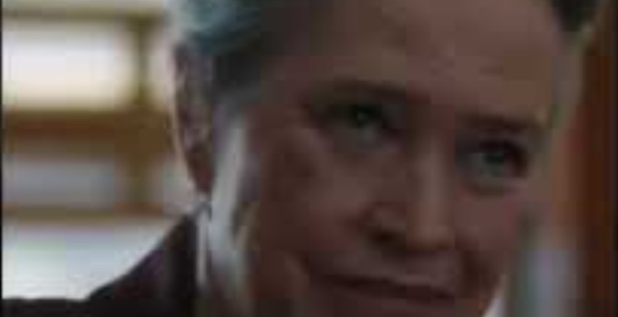

Slide 35
ELM: Match the Path to the Person
Central route (data-first): CFO, Controller—lead with tables and controls map.
Peripheral route (story-first): Coach, Dean—lead with mission/athlete safety, peer examples.
Blend when in doubt: one chart + one story.

Slide 36
Framing: Mission > Mandate
Translate
Translate risk language into mission language (students, research integrity, athletes’ welfare).
Convert
Convert 'no' to 'yes-if' (conditions under which it can work).
Close
Close with a clear, shared next step.

Slide 37
LMX & Servant Leadership (Inside the Audit Team)
Invest in high-leverage relationships; maintain fairness.
Serve stakeholders’ legitimate aims without surrendering independence.
Use relational equity to speed decisions post-report.

Slide 38
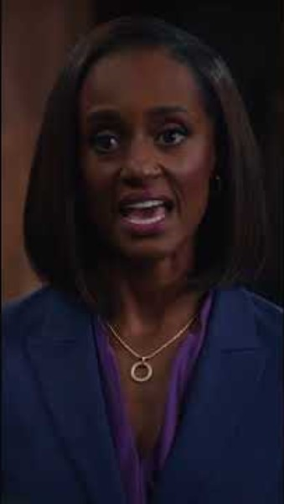

Slide 39
Persona: Faculty PI / Research
Concerns: autonomy, timelines, sponsor nuance.
Accommodate: slower pace; cite sponsor guidance; A/B compliant paths.
Script: 'With your R01 deadline, here are two compliant options. Which preserves milestones best?'

Slide 40
Persona: Senior Leadership (Provost/CFO/AD)
Concerns: reputational risk, speed, optics.
Accommodate: one-pager; heat map; clear decision asks.
Script: 'Two paths: low cost/medium risk vs. moderate cost/low risk—preference?'

Slide 41
Persona: Student Life
Concerns: student experience, incident response.
Accommodate: student-impact narrative; simple checklists.
Script: 'Here’s a 5-minute intake checklist that cuts incidents by 30% at peers.'

Slide 42
Persona: Advancement
Concerns: donor intent, stewardship optics, speed.
Accommodate: donor language; sample thank-you verbiage; batching approvals.
Script: 'We can preserve donor intent and speed acknowledgments by batching approvals each Friday.'

Slide 43
Persona: Finance & Accounting
Concerns: internal controls, close deadlines.
Accommodate: tables, flowcharts, JE examples.
Script: 'Here’s a JE control matrix; can we pilot these two checks this month?'

Slide 44
Persona: Athletics Coach / Ops
Concerns: recruiting windows, eligibility, urgency.
Accommodate: BLUF (BOTTO LINE UP FRONT) first; safety & eligibility framing; 15-minute huddles.
Script: 'To keep athletes eligible, here’s a 3-step fix that won’t touch practice time.'

Slide 45
Exercise: Listening Lab (Pairs – 8 Minutes)
Prompt A (PI): 'Month-end clashes with grant reporting; audit asks feel unrealistic.'
Prompt B (Coach): 'Travel advances delay recruiting.'
Task: Partner A vents (60s); Partner B uses S.O.A.R.; swap.
Debrief: What word signaled the real issue? What reframe helped?

Slide 46
Micro-Activity: Framing Flip Cards (2 Minutes)
Turn 'Policy violation' → 'Protecting funding so your lab doesn’t get frozen.'
Turn 'Unallowable expense' → 'Let’s use a fund that does allow it so you’re covered.'
Turn 'We can’t' → 'Yes—if we add X control by Y date.'

Slide 47
Your First 7-Day Experiment
Pick one tough stakeholder.
Use the prep card + S.O.A.R.; send a BLUF summary email.
Track a signal: trust, speed, or clarity improved?

Slide 48
Close & Commit: The 5-Question Prep Card
1) Who am I meeting, and what do they value?
2) What accommodation dial (pace, channel, detail, formality) will I set?
3) How will I protect their agency (A/B choices)?
4) What frame ties this to mission?
5) What’s my one clear ask and next step?

Slide 50

Appendix / Supplemental Tools

Slide 51
CAT: Signals and Fixes for Over-Accommodation
🚩 Signals You're Over-Accommodating:
- Re-explaining after accurate paraphrasing
- Avoiding precise terms, making controls vague
- Using overly casual or cutesy tone
🛠️ Fixes: How to Right-Size Communication:
- Calibrate: “Quick check—how deep should we go on AppWorx details?”
- Teach-back: “Could you walk me through your approval steps?”
- Name standards plainly: “Uniform Guidance requires a second review.”
- Critique process, not people
🎓 Higher-Ed Audit Example:
Faculty Department Admins:
- ❌ “I’ll skip the policy talk; it’s probably confusing.”
- ✅ “Two quick policy points matter here—5 minutes max—then we’ll jump to your process.”

Slide 52
Elaboration Likelihood Model (ELM)
People process information in two ways: central route (logical, data-driven) and peripheral route (emotional, story-driven).
Example:
A CFO prefers spreadsheets and risk maps (central route), while a Dean responds better to peer comparisons and student impact stories (peripheral route).

Slide 53
Visual Aids You Can Steal
Stakeholder map: influence vs. openness; color-code accommodation strategy.
Accommodation dial: pace, channel, detail, formality sliders.
Quick-win tracker: 30/60/90-day small wins per unit.

Slide 54
Message Templates You Can Steal
BLUF email: Risk • Impact • Ask (+ one attachment).
SBI feedback: Situation – Behavior – Impact – Ask.
Yes-if clause: 'Yes, if we add X control by Y date.'
Meeting close: 'I heard A/B/C; next steps: me (X), you (Y), by (Z).'

Slide 55
Communication Accommodation Theory (CAT): The Dial
Converge thoughtfully: jargon, pace, channel, visuals.
Avoid over-accommodation: don’t talk down or over-translate.
Map needs: time, face-saving, data depth, decision style.

