Slide 2
Changes in the Federal Research Policy Landscape and their Impact on Institutes of Higher Education, including Internal Audit Plans
Presenters:
Cynthia Hope, Director for Costing and Financial Compliance, Council on Governmental Relations (COGR)
Beth Harry, Internal Audit Manager, OHIA, JHU
Session Overview:
This session will provide an overview of federal research policy changes under the new administration and COGR’s advocacy efforts to advance effective research policy on a range of issues affecting research institutions and their ability to perform federally funded research. COGR’s continued efforts to reduce red tape encumbering federally sponsored research will also be discussed. An Audit Manager from Johns Hopkins University will share how they have responded to these changes and complex challenges with broad implications to researchers, students, revenue, etc., including how they have been considered in their risk assessment processes involving stakeholders across the institutions, as well as integrated into testing strategies within planned audits.
Learning Objectives:
Provide audience with a high-level overview of federal research policy changes under the new administration and the COGR’s advocacy efforts to advance effective research policy on a range of issues affecting research institutions.
Share audit approaches to incorporate these changes into risk assessment processes and planned audits.
September 17, 2025

Slide 3
Agenda
Speaker Introductions
Overview of federal research policy changes under the new administration
Significant risks impacting colleges and universities due to changes in Federal priorities
Consideration of federal transition risks in the risk assessment and audit plan development processes
Proposed testing strategy to assess institutional compliance with applicable termination clauses in grant agreements terminated by the federal government.

Slide 4
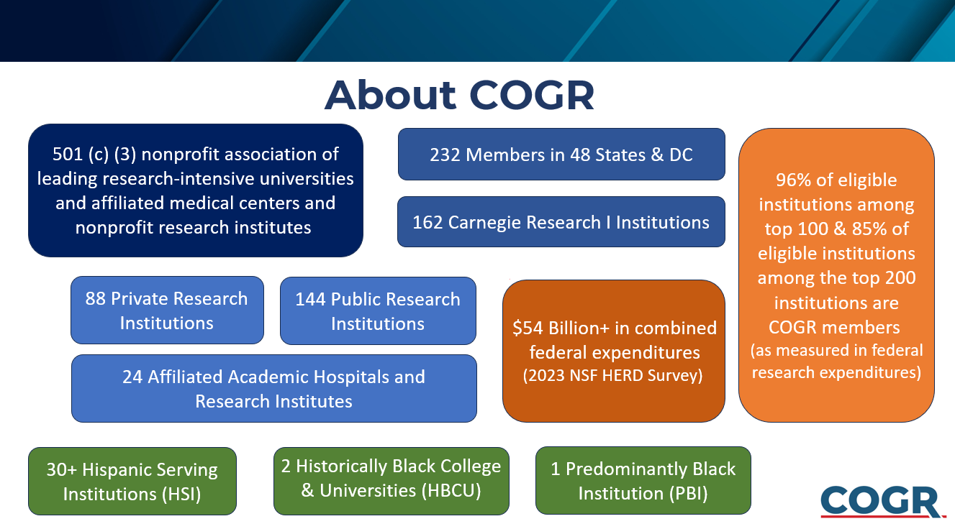

Slide 5
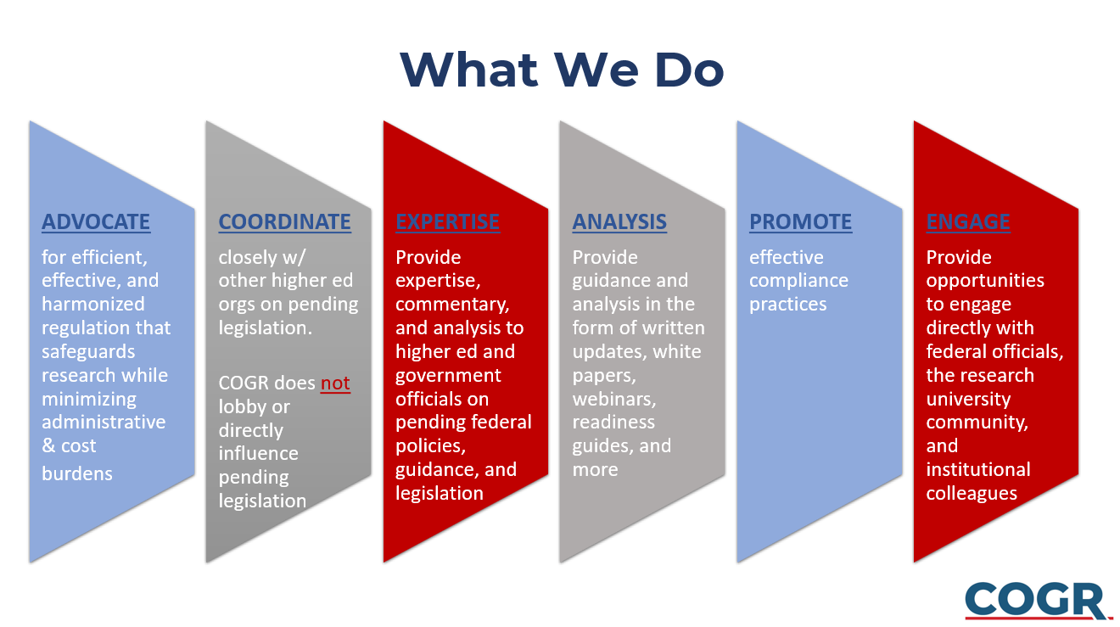

Slide 6
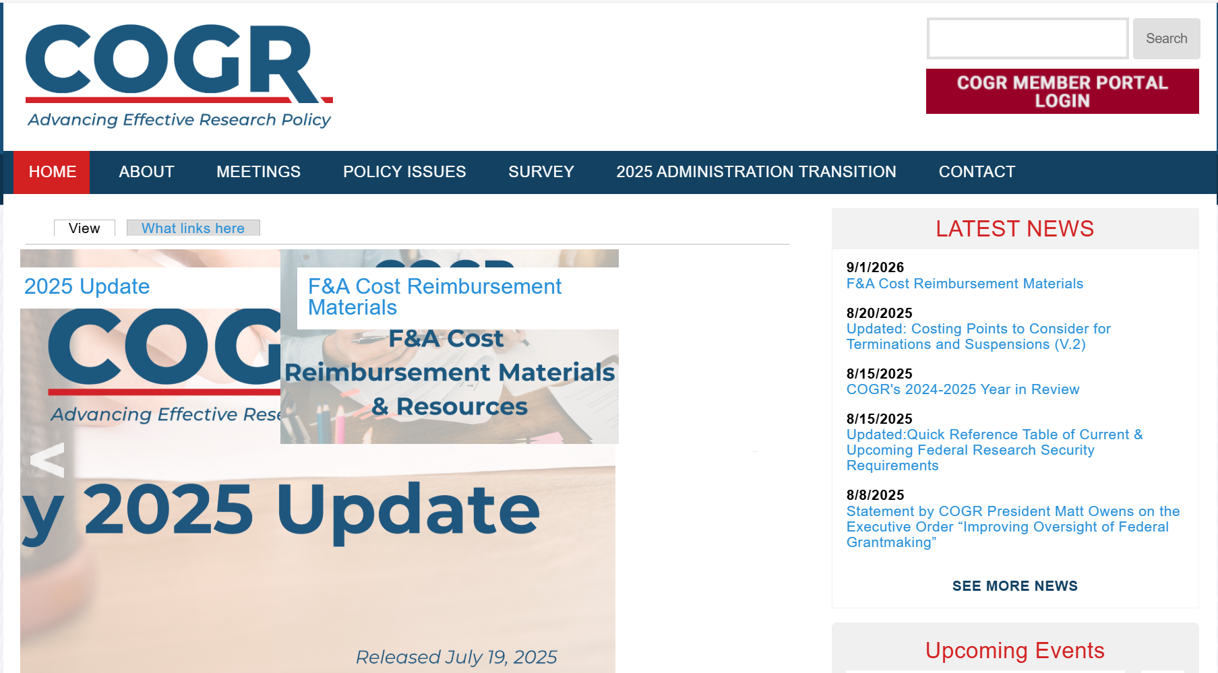
COGR Website (https://www.cogr.edu)
Click to sign-up for portal

Slide 7


COGR Topics for Today
Litigation Status
Points to Consider for Reimbursement of Expenses Under Active Grants and Defend the Spend
Costing Points to Consider for Terminations and Suspensions
Identifying Practical Direct Charging Methods for FAIR Model
Additional Questions and Discussion

Slide 8



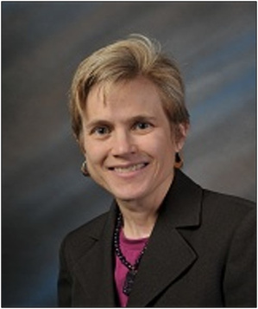



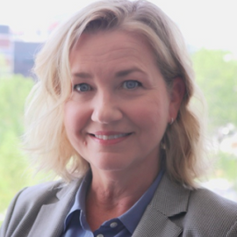

How We Do It – COGR Committees
Contracts & Grants
Administration (CGA)
Research Ethics & Compliance (REC)
Deborah Motton, Executive Director, Research Policy & Analysis & Compliance, University of California (Chair)
Kristin West, Director, Research Ethics & Compliance,
COGR
Lisa Mosley, Executive Director, Sponsored Projects Administration, Yale University (Chair)
Krystal Toups, Director, Contracts & Grants Administration, COGR
Costing & Financial
Compliance (CFC)
Research Security & Intellectual Property (RSIP)
Jennifer Ponting, Assoc. Vice President for Research Administration, University of Chicago (Chair)
Kevin Wozniak, Director, Research Security & IP, COGR
Jeremy Forsberg, Associate Vice President for Research, University of Texas at Arlington (Chair)
Cindy Hope, Director, Costing and Financial Compliance, COGR
Notes:
This is where the leveraging happens – COGR’s Committees.
COGR origins as a committee is critical to who we are today.
COGR’s Committee are the horsepower of the staff engine that leads COGR
Our committees consist of ~48 committee members who are VERY engaged
As this slide indicates we have 4 committees organized into key issue areas. Also form/use of working groups that tap individuals beyond the committees
Some overlap at times on cross cutting issues such as Research Security, Uniform Guidance

Slide 9
Status of Major Court Cases re. Research Funding
Grant Termination Cases
Grants terminated because of Executive Orders on DEI – Agency and grant specific cases. U.S. Supreme Court has raised issue of whether subject matter jurisdiction for these cases is in U.S. District Courts or U.S. Court of Federal Claims (see, CA v. Dept. of Education). Some plaintiffs successful in getting Preliminary Injunctions, only to have them stayed while government appeals.
Grants termination for DEI and/or Other Reasons (e.g., no longer effectuate agency priorities, Covid pandemic over) – Many plaintiffs have been successful in getting Preliminary Injunctions or final judgements vacating specified directives and grant terminations but appellate courts often stay these Preliminary Injunctions or judgements while the case is being appealed.
  Key Consolidated Cases: American Public Health Assoc. v. NIH and MA v. RFK, Jr.
    Final judgement entered vacating specified grant terminations as to the plaintiffs in the case. Court of Appeals denied stay of judgement pending appeal, and the government appealed to the U.S. Supreme Court. The Supreme Court held that subject matter jurisdiction for grant termination claims was in the U.S. Court of Federal Claims and stayed the portion of the District Court’s order set aside the grant termination.
Harvard Cases –The District Court held that it did not have subject matter jurisdiction over claims that grant terminations were arbitrary and capricious, but it did have jurisdiction over plaintiffs’ 1st Amendment and Title VI challenges to the Freeze Orders and Termination Letters and vacated them and enjoined the government from issuing any other terminations/freezes on funding to Harvard in retaliation for its exercise of 1st Amendment rights or on purported grounds of discrimination under Title VI.
University of California System Case – Class action. Court vacated terminations with respect to class of plaintiffs that had grants terminated by form notice and enjoined government from giving effect to terminations pursuant to DEI EOs. The government has appealed to the 9th Circuit based on the Supreme Court’s decision in American Public Health Assoc. v. NIH.

Slide 10
Status of Major Court Cases re. Research Funding
Cases on 15% Indirect Cost Cap
DOD Rate Cap – AAU v. DOD: Preliminary Injunction in effect with regard to plaintiff universities and members of organizational plaintiffs, and their subawardees. However, Court asked for briefs on effect of Supreme Court decision in American Public Health Assoc. v. NIH. A hearing on summary judgement motions held on Sept. 5, but no decision has yet been issued.
NSF Rate Cap
  AAU v. NSF: Summary judgement in favor of plaintiffs vacating rate cap. Government appealed to 1st Circuit
  State of NY v. NSF: Court denied motion for Preliminary Injunction and held that it did not have subject matter jurisdiction over termination claims. Plaintiffs voluntarily dismissed their suit.
DOE Rate Cap – AAU v. DOE: Court enters final judgement vacating DOE policy imposing 15% rate cap. Government had until Aug. 30 to appeal.
NIH Rate Cap
  AAMC v. NIH
  AAU v. NIH
  Mass. v. NIH
Cases consolidated. Final judgement entering Permanent Injunction on rate cap nationwide. Government has appealed decision to 1st Circuit Court of Appeals. Oral arguments set for Nov. 5.

Slide 11
What is COGR doing?
COGR Litigation Tracker: Tracks cases of importance to academic research institutions. Updated frequently!
Analysis: Litigation updates and analysis as part of COGR Forums, COGR updates, and membership meetings.
Filing of Amicus Briefs in Select Cases: Joined with other associations to file amicus briefs. Briefs filed in four cases thus far.

Slide 12
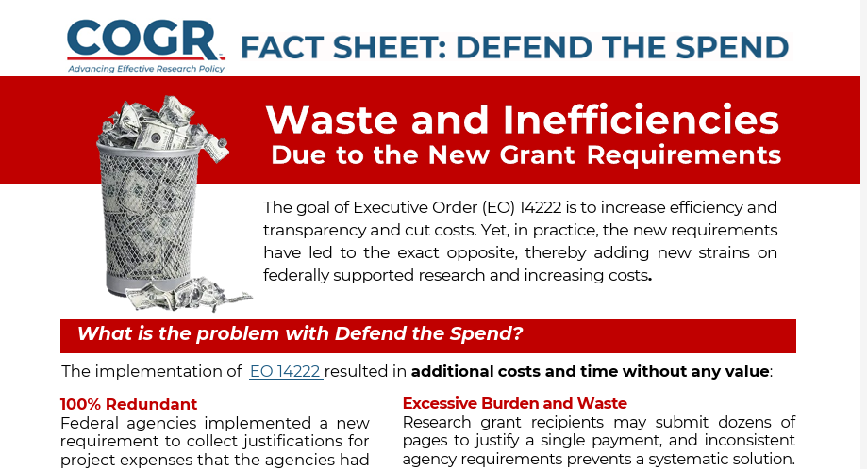
Points to Consider for Reimbursement of Expenses Under Active Grants and Defend the Spend
Also see COGR's Fact Sheet,
https://www.cogr.edu/fact-sheet-1-defend-spend

Slide 13
Points to Consider for Reimbursement of Expenses Under Active Grants and Defend the Spend
Framework for Navigating the 2025 Administration Transition
  Points to Consider for Reimbursement of Expenses Under Active Grants (Updated August 5, 2025)
And then…
  Executive Order - Improving Oversight of Federal Grantmaking (August 7, 2025)
Notes:
Jeremy, Krystina, Nate

Slide 14
E.O. Improving Oversight of Federal Grantmaking Key Financial Takeaways
Regarding Reimbursement: “(c) To the extent practicable and consistent with applicable law, agency heads shall insert in future discretionary grant agreements terms and conditions that:
(i) prohibit recipients from directly drawing down general grant funds for specific projects without the affirmative authorization of the agency; and
(ii) require grantees to provide written explanations or support, with specificity, for requests for each drawdown.”
Plus…
Directs Each Agency to Revise T&Cs to Permit Termination for Convenience, and more.

Slide 15
Costing Points to Consider for Terminations and Suspensions
Framework for Navigating the 2025 Administration Transition
  Costing Points to Consider for Terminations and Suspensions (V. 2, Released August 20, 2025)

Slide 16

Indirect Costs

Slide 17
Executive Order - Improving Oversight of Federal Grantmaking (August 7, 2025)
Indirect Costs: The EO specifically targets indirect costs in a few ways:
  First, it claims that “[a] substantial portion of many Federal grants for university-led research goes not to scientific project applicants or groundbreaking research, but to university facilities and administrative costs.” (Sec 1)
  Second, it directs all agencies to ensure, when assessing grant proposals, “[a]ll else being equal, preference for discretionary awards should be given to institutions with lower indirect cost rate.” (Sec 4(b)(iii))
  Third, it directs the OMB Director to revise the Uniform Guidance to “appropriately limit the use of discretionary grant funds for costs related to facilities and administration.” (Sec 5(b))
Notes:
Jeremy

Slide 18
Joint Associations Group (JAG) on Indirect Costs
Formed in response to renewed attacks on federal reimbursement of indirect cost
Ten national organization representing universities and other non-profit research organizations (AAU, APLU, AAMC, COGR...)
Announced initiative, gathered SMEs, proposed models
  Financial Accountability in Research (FAIR)
https://linktr.ee/JAGTownHall
Notes:
Cindy – COGR doesn't own the initiative

Slide 19
FAIR Model - Structure
Three overarching categories for expenses:
Research Performance Costs (RPC) – Expenses classified currently as direct costs.
Essential Research Performance Support (ERPS) – Expenses generally classified currently as indirect costs but that could, absent current restrictions, be allocated directly to awards.
General Research Operations (GRO) – Expenses generally classified currently as indirect costs and that continue to be impractical to allocate directly to awards.
Notes:
Cindy - I won’t go into details. GRO 15%

Slide 20
FAIR Model – Basic or Expanded
Difference - Essential Research Performance Support (ERPS)
Regulatory Compliance (RC)
Award Monitoring, Oversight and Reporting (AMOR)
Research Information Services (RIS)
Essential Research Performance Facilities (ERPF)
Option to Calculate Charge for Basic and Expanded
Option to Calculate Charge for Expanded Only
Basic = 10% TC
Notes:
So, really the only difference between Basic and Expanded is Essential Research Performance Support, and there it is really only two subcategories. Clarify ERPS Research Compliance vs GRO RC

Slide 21
FAIR Model - Structure
To receive ERPS > 10% Total Cost
  Recharge Centers* for Research Compliance, Award Monitoring and/or Research Information Services
    *Is there another method for more precisely allocating?
    More precise cost allocation, but challenging
  Space Survey or other reasonable method required for facilities related costs
    Current Simplified Method in 2 CFR 200 Appendix III?
Notes:
Understand 10% is low - look at facilities component now

Slide 22
COGR Response – Explore Cost Allocation Strategies
Starting with Essential Research Performance Support
Essential Research Performance Facilities (ERPF)
Regulatory Costs
Research Information Services (RIS)
Award Monitoring, Oversight, and Reporting (AMOR)
Notes:
I think we can all agree that basic allocability requirements will never go away. (i.e. The research community didn't just make up cost accounting and there are foundational principles we have to adhere to, unless perhaps the government is willing to move to fixed amount awards). With that in mind the Costing committee has divided into four subgroups and invited to join each several other experts in this profession, to dig in on the four categories of FAIR model Essential Research Performance Support.

Slide 23
COGR Response – Explore Cost Allocation Strategies
Next Steps
  Refining ERPS Categories
  Assessing GRO vs ERPS
  Assessing Risk and Emphasizing Strategy
  2 CFR 200 Revisions
  Keep advocating for practical solutions!

Slide 24
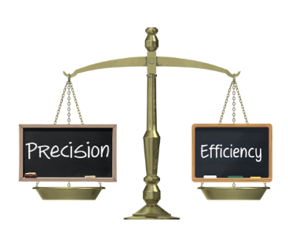
Closing Thoughts
Micro vs Macro impact on research funding
JAG continuing to receive feedback from community
  https://linktr.ee/JAGTownHall
Technical ideas to COGR!
  chope@cogr.edu
Notes:
If implemented as proposed, for a particular project with a budget cap, there may be less budget for direct costs. Or if there is as much for direct cost, there could be fewer funded projects. But there is no reason to think an institution is going to subsidize less in total than it does now. Federal data show that colleges and universities pay for 25% of total academic R&D expenditures from their own funds. In FY23, this institutional contribution to pay for the R&D they perform amounted to $27.7 billion, including $6.8 billion in unreimbursed F&A costs
Fed $s for research + Inst $s for research = 1 big pie. There will be reslicing but the model doesn't change the size of the pie.

Slide 25

Other Key Issues
Research Security
  NIH (NOT-OD-25-133), Effective 10/1/25
  NSF Important Notice No. 149
  USDA Research Security Memorandum
Public Access to the Results of Federally Funded Research
  Maximizing Research Funds by Limiting Allowable Publishing Costs (NOT-OD-25-138)
  NIH (NOT-OD-25-101), Effective 7/1/25
  FY26 NIH Announces Crackdown on Publisher Fees
Uniform Grant Guidance ~ OMB’s Guidance on Federal Financial Assistance
Facilities & Administration Costs Reimbursement
Research Misconduct
Intellectual Property Issues
Conflicts of Interest and Conflicts of Commitment
Animal Subjects
Human Subjects
  NIH and USDA Notices Requiring Reporting of “Dangerous Gain of Function” (DGOF) Research

Slide 26
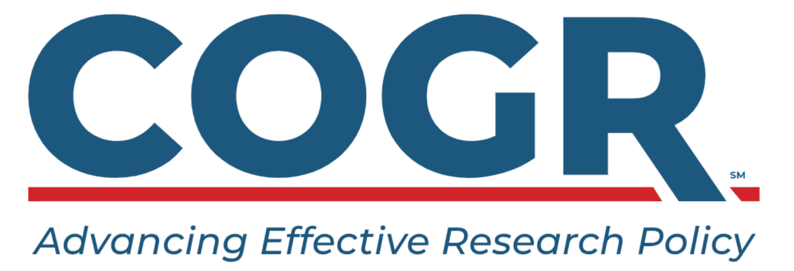

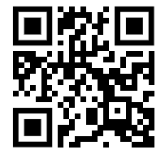
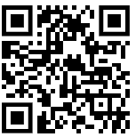

Title
Date
Thank You!
www.cogr.edu
www.linkedin.com/
company/cogr

Slide 27



Slide 28
Significant Risks Impacting Colleges and Universities due to Changes in Federal Priorities
Key Risks
Immigration Policies and Visa Restrictions
Federal Funding Cuts
Free Speech and Campus Safety
Diversity and Inclusion Initiatives
Increased Costs to the Institution
Antisemitism
Impact
Decline in international student enrollment and faculty diversity
Loss of tuition revenue from international students
Reductions in research grants and student aid
Grant terminations
Low volume of approvals and continuations of federal grants
Changes in Federal Funding Priorities
Loss of critical research collaborations and resources
Capping of indirect cost recoveries
Increased tensions and potential liability from protests
Navigating free speech while ensuring campus safety
Increased scrutiny of diversity efforts leading to fines, loss of program funding, and potential litigation
Risks to equitable educational environments
Severance payments for layoffs
Increased operating and capital costs due to tariffs
Threats to tax-exempt status
Hostile environment for Jewish students, impacting their mental health
Increased polarization and tensions
Investigations or lawsuits against the institution

Slide 29
A Closer Look at the Impacts from Federal Research Funding Cuts – The Johns Hopkins University
Sponsored Revenue – FY2024 vs FY2025 (3.3% Decrease - Federal)
New Awards – Funded Amounts (56% Decrease - Federal)

Slide 30
A Closer Look at the Impacts from Research Funding Cuts – The Johns Hopkins University (cont’d)
Comparison of Proposals Submitted to Awards Received July 2024 vs July 2025
Sponsor Type | Proposals Submitted |  | Awards Received
 | Jul 24 | Jul 25 | Jul 24 | Jul 25
Federal | 257 | 222 | 65 | 46
Federal Pass-Through | 147 | 110 | 57 | 23
Non-Federal | 277 | 364 | 189 | 131
Total | 681 | 696 | 311 | 200

Slide 31
Consideration of Federal Transition Risks in the Risk Assessment and Audit Plan Development Processes
Key Risks
Immigration Policies and Visa Restrictions
Federal Funding Cuts
Free Speech and Campus Safety
Diversity and Inclusion Initiatives
Increased Costs to the Institution
Antisemitism
Auditable Entities
Visa Sponsorship Process
Office of International Services
Federal Cost Compliance
Grant Terminations
Field Office Closures
Indirect Costs
University wide events, including student protests
Campus Physical Access Controls and Surveillance
Title VI Compliance
Assessment of Institutional/Divisional Policies/Programs/Websites for DEI/Discrimination
Termination Processes
Supply Chain
Compliance with Cost Control Initiatives, Including Compliance with Laws and Regulations Regarding Potential Layoffs
Title VI Compliance
Campus Climate Assessment

Slide 32
Consideration of Federal Transition Risks in the Risk Assessment and Audit Plan Development Processes (cont’d)
Topics included in the FY2026 internal audit plan for Johns Hopkins University to assess the impact of the socio-political climate and government actions on areas of institutional risk:
Sponsored Research Compliance
Federal Reimbursement Compliance
Title VI Considerations, in coordination with General Counsel
Human Resources Operations & Regulatory Compliance
Execution of Human Resources Actions:
International Operations
Office of International Services
Other
Termination/Off Boarding
Financial Sustainability Plans
Federal and State Compliance including WARN Act Requirements
International Field Office Closures, including:
Award Close-Out Processes for Terminated Grants and Contracts
Evaluation of Risk Mitigation Strategies Related to Indirect Cost Rate Reductions
Accuracy of Severance Payments
Equipment Disposition
Assessment of Impacts to JHU related to Immigration Enforcement, Supply Chain Impacts and Tax-Exempt Status
Record Retention
Compliance with Local Laws

Slide 33
Proposed Testing Strategy – Grant Terminations
Audit Objective:
To assess institutional compliance with applicable termination clauses in grant agreements terminated by the federal government, and to evaluate the adequacy of internal controls in the termination process.
Scope: Grants terminated by federal sponsors (e.g., NIH, NSF, DoD) from January 2025 onward.
Review of documentation and controls related to:
Notification of termination
Allowable costs post-termination
Final reporting (financial, technical, and property)
Disposition of unused funds and equipment
Risks:
Financial penalties or disallowed costs from improper post-termination spending
Loss of future funding due to noncompliance
Reputational risk with federal agencies
Review Steps for Sampled Grants:
  Termination Notices: Check for proper authorization and compliance with federal grant agreements.
  Notification: Confirm timely notification to the Sponsored Programs Office.
  Acknowledgment: Ensure formal acknowledgment of termination by grantee.
  Financial Obligations:
    Validate obligations incurred pre-termination against 2 CFR 200.1 definitions.
    Assess efforts to minimize obligations and consistency with policy.
  Post-Termination Costs:
    Identify and assess allowable costs incurred post-termination as per 2 CFR 200.472.
    Ensure necessary closeout costs are documented.
  Closeout Procedures: Evaluate effectiveness of closeout procedures and ensure standard costs are reasonable and documented.
  Final Draw and FFR:
    Validate accuracy of final draw inclusive of relevant expenses.
    Review documentation and reconcile if multiple requests.
  Unallowable Costs: Verify that no unallowable costs were charged post-termination.
  Timeliness: Confirm adherence to closeout timelines and timely submission of final reports.
  Unspent Balances: Assess need to return unspent balances and obtain documentation for returned funds.
  Equipment Management:
    Confirm equipment is recorded in the institution’s asset system and verify ownership per grant terms.
    Ensure proper return or disposition based on ownership.

