Slide 2
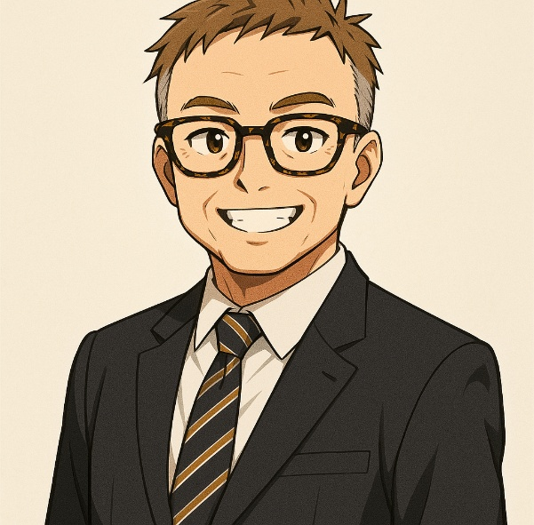
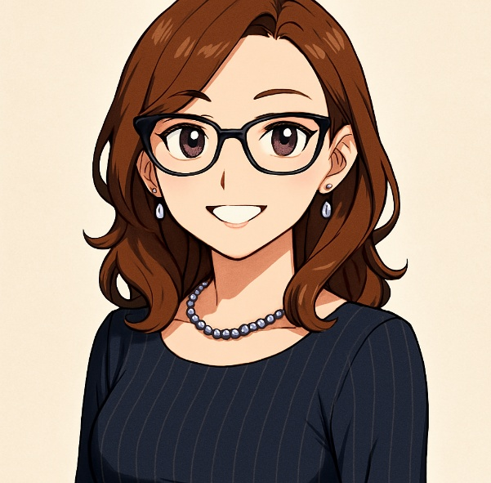
So You Want To Be A CAE: Essential Skills for The Bold And The Brave
Robert Taft
CIA, CCSA, CRMA, CIG, SFC
Chief Audit Executive
University of Central Florida
Robert.Taft@ucf.edu
Agnessa Vartanova
CPA, CIA, CFE, CISA, CRMA
Associate Vice President, Internal Audit
University of Colorado
Agnessa.Vartanova@cu.edu

Slide 3
Start With (Y)OUR Why
Set your intention for the session
Understand how to position yourself to become a CAE
What to consider when you get the job to not only survive but thrive – practical tips and insights
Other?

Slide 4
Session Objectives
Project Economics: establish and execute your vision of balancing the tradeoff between timeliness and quality of project execution
Emerging Risks: stay attuned to your organization and the broader higher education sector to provide insight to your stakeholders
Lead Through Ambiguity: navigate the future of the profession, plan strategically, and maintain relevance as a trusted advisor
Culture, Motivation, and Brand: build, develop, and motivate your team to empower them to become a well-organized and high-performing tour de force
Winning the First Three to Six Months: get off to a hot start and build momentum for sustainable success

Slide 5

A responsive audience is the best encouragement an actor can have.
Al Jolson

Slide 6
Polling Question
Which statement best describes your professional audit experience?
Bright-eyed and bushy-tailed – I am an audit staff member with less than 3 years of experience
Been around the block a couple of times – I am an audit staff/senior with 3-6 years of experience
Experienced and not afraid to show it – I am an audit manager/senior manager with 6-10 years of experience
Mic drop – I’m a CAE

Slide 7
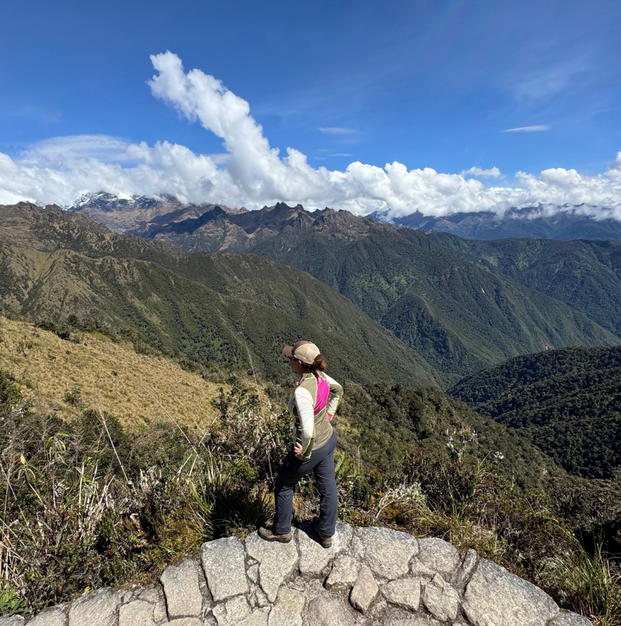
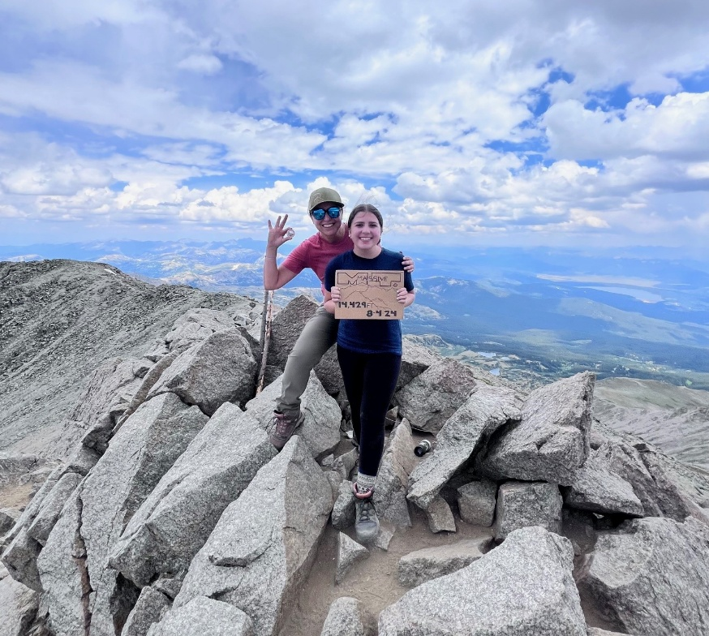
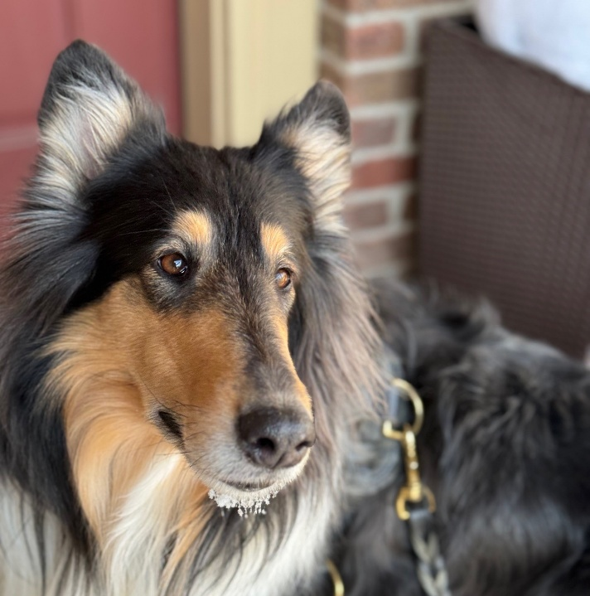
About Me: Agnessa Vartanova

Slide 8
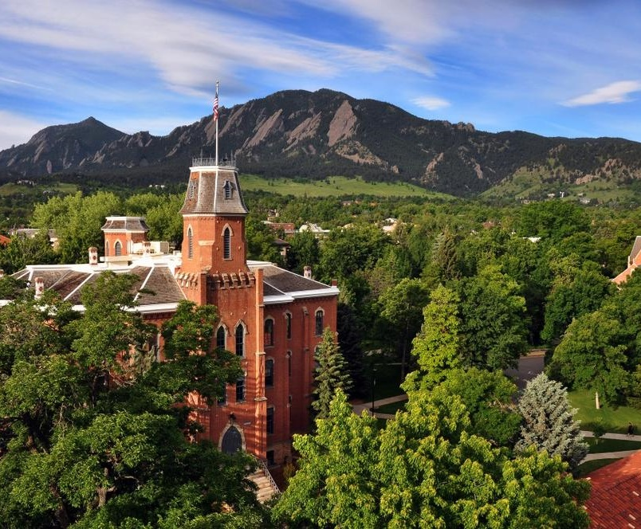

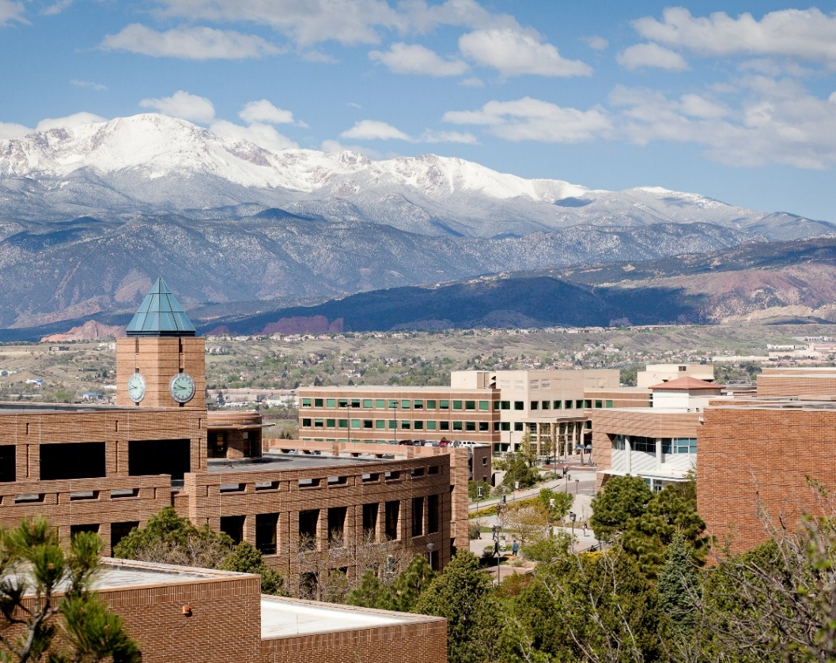

University of Colorado Quick Facts
Established in 1876
Governed by the elected, nine-member Board of Regents
A system of four public institutions
67,708 students
$1.7B in sponsored research
17,805 degree recipients (2023-2024)
Third-largest employer in the state
$6.3 billion FY25 operating budget

Slide 9
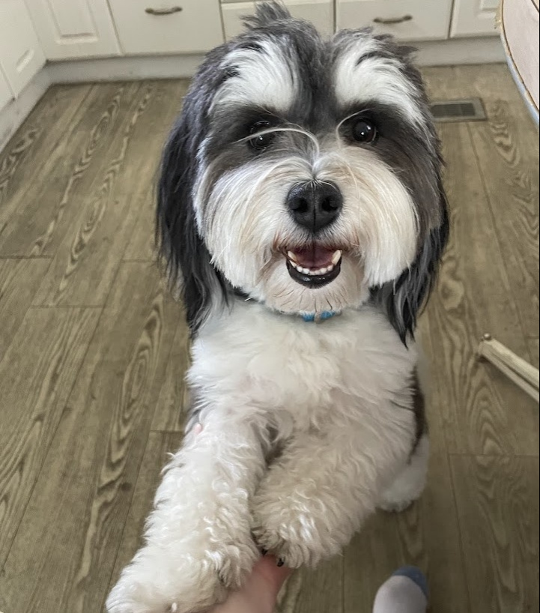
About Me: Robert Taft

Slide 10
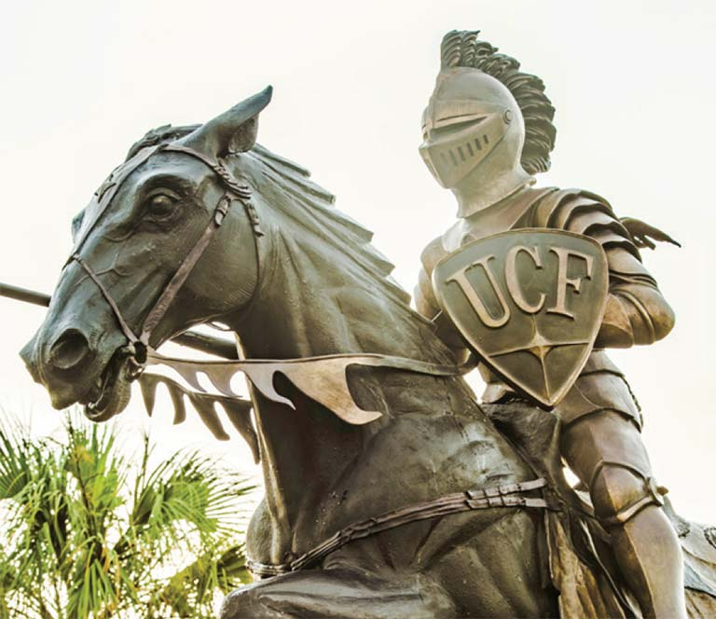
University of Central Florida Quick Facts
Established in 1963 (Original name-Florida Technological University)
177k of 368k alumni live in Central Florida region
Over 69k students (no longer in all-out growth mode)
13k faculty and staff
Strengths: Perceived Value, Research Growth, FL Economy & Demographics, Online Learning Strategy, Programs and Technology, Improving National Rankings and Brand Recognition
Challenges: Hiring and Retention, Deferred Maintenance, Tuition Freezes, Graduation Rate, Athletics, Fundraising

Slide 11
Manager to Leader
Growing Decision-Makers
Cultivating Success
Building Scalable Processes
Becoming a boss is like getting arrested. Everything you say or do can and will be used against you.
Kim Scott “Radical Candor”

Slide 12



Why/How Did We Choose This Topic?

Slide 13

We Asked Our Peers…
50 respondents
84% of respondents were CAEs at higher education institutions
Average of 12 years served as a CAE
98% had at least one professional certification
Average of 15 years of audit experience prior to becoming a CAE
Average tenure of 7 years in current CAE role
Internal promotion vs. external hire: 50/50!

Slide 14
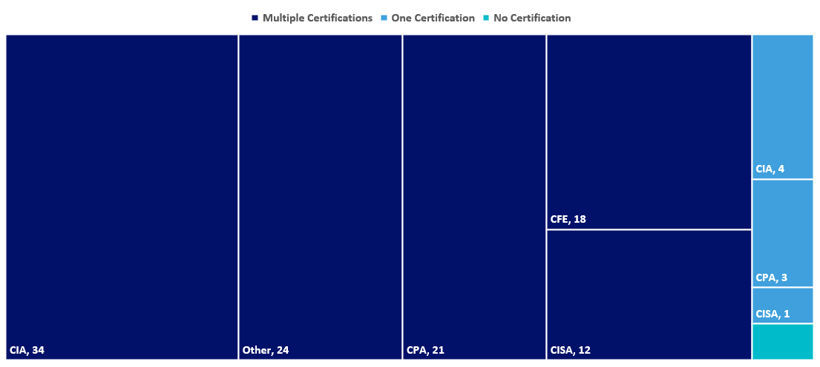
Professional Certifications
81% of respondents felt that having a professional certification was influential in getting the CAE job
42% of respondents obtained a professional certification after getting the job

Slide 15
Motivation To Become A CAE
Natural Career Progression
Stepped Up To The Challenge
Higher Salary
Prestige
Increased Speaking Engagement Opportunities
Other

Slide 16
CAE Success Factors
Culture, Motivation, and Brand
Staying Attuned to Emerging Risks
Understanding Project Economics
Leading Through Ambiguity
Winning The First 3-6 Months

Slide 17
Culture, Motivation, and Brand
Build, develop, and motivate your team to empower them to become a well-organized and high-performing tour de force

Slide 18
Your Team In Focus
How would you want others to describe your team?
Can everyone on your team articulate your team’s purpose?
What is your team’s shared vision?
How can you define and embody your team’s values?
Who is responsible for creating your team’s culture?
Everyone is watching you, but that doesn’t mean it’s all about you.
Kim Scott “Radical Candor”

Slide 19
Your Stakeholder Perception is Their Reality
Understand the perception of the department (48% of the survey respondents listed this as a top 3 challenge)
Is Internal Audit a destination location, talent training ground, or a glidepath to retirement?
Consider a new department name and/or a reorganization?

Slide 20
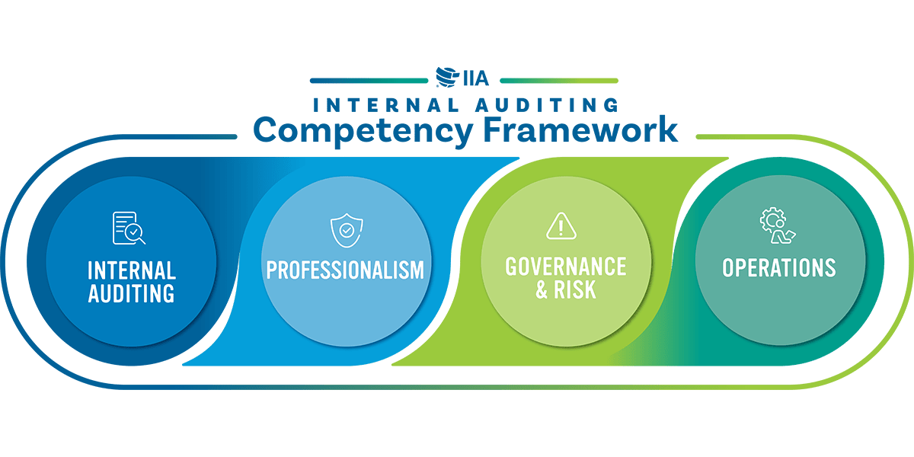
Building The Team
“Getting to know my team” was listed by 40% as a top 3 challenge
What’s in the org chart?
In-house/co-source/outsource?
Creating and maintaining team culture in the world of hybrid modalities
Skill evaluation: experience or fit?
Hiring process: who’s on first?
How do you build a team... really...
“Match quality” is a term economists use to describe the degree of fit between the work someone does and who they are – their abilities and proclivities.
David Epstein “Range”

Slide 21
Motivating Service Excellence
Define your leadership style
Develop your team’s shared vision, purpose, and values
Create a common language to talk about the work you do
Provide powerful coaching: If most people who come to me for coaching or want my advice do not see the world the same way as me, how can I help them walk in their shoes?
Build efficient and effective internal processes: Lean/Six Sigma, Kanban, Toyota Management System, Value Stream Mapping

Slide 22

Mentoring and Succession Planning
ACUA is commonly mentioned as a peer support group along with the former CAE, other executives, and peer CAEs.
General agreement with the value of having a mentor
60% of survey respondents are actively mentoring someone on their team as a successor

Slide 23
Emerging Risks
Stay attuned to your organization and the broader higher education sector to provide insight to your stakeholders

Slide 24
Emerging Risks
Understand the organization (56% had this as a top 3 challenge)
Understand the current risk assessment process
Will you own ERM or need to work with someone who does?
Are you learning the industry and speaking the client’s language?
Reading
Networking—the power of KIT meetings
Social Media (LinkedIn, Reddit, Community Boards)

Slide 25
Project Economics
Establish and execute your vision of balancing the tradeoff between timeliness and quality of project execution

Slide 26
Project Economics
No better time to ask for budget, technology and other resources than when you’re new!
Can you demonstrate how these investments will lead to better results? (28% of survey respondents had this as a top 3 challenge)
Are you fully leveraging the current audit management software and technology? (44% of survey respondents had this as a top 3 challenge)
Is the existing audit plan and backlog sacred? (28% of survey respondents had this as a top 3 challenge)
Should you jump in if deadlines and budgets start to slip?

Slide 27
Thou Shalt…
The IIA Global Internal Audit Standards contain 80 “CAE must” statements
CAEs are accountable for modernizing Internal Audit
CAEs are expected to perform more relevant projects to the organization (leverage strategic plan) and provide management information to enhance their decision-making capabilities
CAEs are hired to make Internal Audit a better partner to the organization
CAEs are expected to transform Internal Audit into a catalyst of aligned assurance, improved risk reporting, and identification of cost reduction

Slide 28
The Balance of Quality, Timeliness, and Value
Excellence is never an accident. It is the result of high intention, sincere effort, and intelligent execution. It represents the wisest option among many alternatives. Choice, not chance, determines your destiny, dreams, and values.
Aristotle (or Instagram)
New goals don’t deliver new results. New lifestyles do. And a lifestyle is a process, not an outcome. For this reason, all of your energy should go into building better habits, not chasing better results.
James Clear, Atomic Habits
Dig deep enough and any quote can make us better internal auditors.
Mike Jacka

Slide 29

The Art & Science of Audit Plan Management
Know your team’s capacity
Be prepared to be surprised (aka have a strong ‘b’ list)
Account for the unexpected
Project and reflect
Define and visualize success
Monitor and communicate

Slide 30
Lead Through Ambiguity
Navigate the future of the profession, plan strategically, and maintain relevance as a trusted advisor

Slide 31
Other “Top 3 Challenges”
“Getting to know my staff”
“Getting the board to understand internal audit”
“The demands on my time”
“Competing stakeholders’ expectations”
“Taking over in a downsizing environment”
“Transaction to an executive role”
“Access to information”
“Incorporating professional standards, including no charter or prior quality assurance review”
“Hiring and salary challenges”
“Stepping into a Workday ERP implementation”
“The previous CAE was still on campus and well respected”

Slide 32
Internal Audit & Beyond
Higher Education in flux: reputational, demographic, and financial challenges
NCAA new paradigm: impact of changes in college athletics
Future of internal audit: new IIA Standards, management expectations and willingness to invest and support
Value proposition: promoting and extending the value of internal audit beyond "organizational police"
Blurred lines: reporting structure and consolidation of the “Three Lines”
Aligned assurance: intersection of ERM, compliance, and audit

Slide 33
What Got You Here Won’t Get You There
Curate a cross-disciplinary toolkit by learning outside your domain. Diversify your cognitive portfolio.
Practice pattern recognition by identifying echoes across industries. What works in retail might inspire something in healthcare.
Use AI as an amplifier, not a crutch. Let automation handle the narrow tasks, while you focus on big-picture thinking.
Tell a story that makes sense. Frame your broad background as a narrative of adaptability, strategic thinking and value creation.

Slide 34
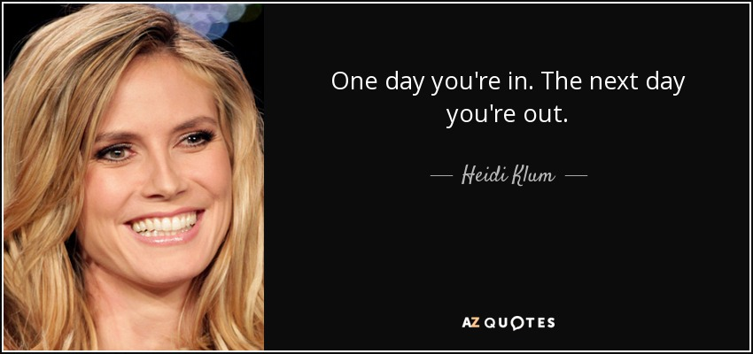
Navigating Organizational & Regulatory Politics (and the related pressures)

Slide 35
What About AI?
Research
Stakeholder messaging
Scenario planning and forecasting
Meeting notes and transcripts
AI governance
Using and auditing AI agents and models
Monitoring for AI deepfakes and fraud
AI programs and courses
In terms of AI, I hear a lot of experts trying to soothe people’s anxiety about the pace of technological change by offering platitudes like, What makes us human will ensure our relevance.
This is dangerous simply because, right now, we’re not especially good at what makes us human. We’re not hardwired for this level of uncertainty, and many of us feel as if the constant need to self-protect is driving the humanity right out of us.
This is why organizational transformation today must foster deep connection, deep thinking, and deep collaboration. We need the courage to lead people in a way that honors and protects the wisdom of the human spirit.
Brené Brown

Slide 36
Winning the First 3-6 Months
Get off to a hot start and build momentum for sustainable success

Slide 37
Your Map to Success
Leveling Up Your Team
Leveling Up Technology
Leading AI Initiatives
Driving Connected Risk
Leveling Up Yourself
Strategic Visibility

Slide 38

Winning the First 3-6 Months
You never get a second chance to make a first impression!
Strategic plan details and flexibility
“Smile, listen, and learn”

Slide 39

Thinking (and Doing) Fast and Slow
“Resist the need to make some big stamp, focus on listening and learning how things fit together”
“Try to take on smaller, more tactical audit projects. Gain some quick successes early and learn the organization before taking on larger, more complex audits”
“Complete several projects in high risk or high concern areas, forming partnerships with leaders in the respective areas throughout the projects”
“I wish I had been able to assign audits when I arrived, instead of inheriting a team that was in the process of audits that may not have been appropriate for their level of understanding. Additionally, I should have allowed them to complete their audits before changing testing protocols, etc.”
“Dealt with culture and performance issues in the department sooner”
“I don't have anything that I wish I had done differently”

Slide 40
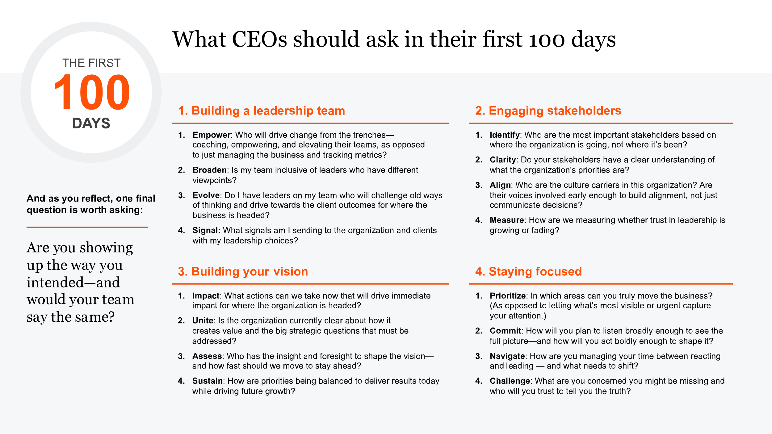
Think Like a CEO For Your First 100 days! https://www.pwc.com/us/en/about-us/newsroom/press-releases/100-days-questions-ceo.html
https://hbr.org/2025/08/what-new-ceos-should-ask-themselves-in-their-first-100-days

Slide 41
Polling Question
Based on where you are in your career, where do you need to focus your professional development to get to the next step?
Culture, Motivation, and Brand
Emerging Risks
Project Economics
Leading Through Ambiguity
Winning the First 3-6 Months
Other

Slide 42
Bonus: Executive Presence...
… that certain "je ne sais quoi" that sets you apart from the rest

Slide 43
Win The Room Every Time
Confidence without arrogance
Competence
Poise through non-verbal communication
Verbal communication
Mindfulness
Authenticity

Slide 44





Five Types of Overcommunicating Leaders
The Straight Shooter
The Idea Generator
The Anxious Communicator
The TMI Leader
The Detailed Over-Explainer

Slide 45
Practical Communication Tips
What you say carries weight
Clarify your audience and outcome
Prepare or pause
Frame your message strategically
Pressure-test your communication

Slide 46
Know Before You Say “Yes”
Who is on the search committee? Who are you scheduled to interview with?
Speed and quality of the recruiting and hiring process?
Financial and regulatory position of the organization
Reporting relationship
Turnover
Shift from outsourcing/co-sourcing/in-house model
Physical office location/proximity to key stakeholders/quality of space
Budget (training, more staff/funds to promote, use of specialists and cutting-edge technology)
Perception of the department
Expectations for “hands-on” work
Control over the audit plan– any potential restrictions?

Slide 47


Managing Stakeholder Expectations
Transforming
Stick to the status quo
Stick to the stuff you know, it is better by far to keep things as they are, don’t mess with the flow. Stick to the status quo.

Slide 48
Advice From The CAEs
Develop meaningful relationships: Have a relationship management strategy for your team and your stakeholders. Listen, learn, understand, leverage, and build forward pragmatically unless you are hired to fix a crisis. Seek input from all stakeholders including executive leadership, the audit committee, the board and your employees. The first 3-6 months isn't about what audits you produce, it is what relationships you build. You are only new and first once. Use it to build network and relationships.
Be patient: Always keep progressing. It takes time to establish a reputation as a trusted advisor.
Leverage connections and resources: Create peer relationships you can lean on. Know what ACUA can offer.
Understand the organization and stakeholders you serve: Put yourself in your clients' positions, anticipate their questions and needs. Ask about their prior experience with Internal Audit and the team’s reputation. What needs to be addressed? Learn how the audit plan aligns with the university's goals. Be open to new ideas and focus on the most important areas.
Establish your own leadership strategy: Learn from others; develop your mission and vision, not just statements, but really think about what you want to do, how to do it and set a plan into motion.

Slide 49
Advice from the CAEs (cont.)
Follow-through with quick wins: Do what you say. Develop your plan and execute. Gain some quick successes early and learn the organization before taking on larger, more complex audits. Complete several projects in high risk or high concern areas, forming partnerships with leaders in the respective areas throughout the projects. This will build confidence and trust in your expertise.
Have confidence in yourself: There is a reason you were hired and not someone else.
Resist the need to make some big stamp: Focus on listening and learning how things fit together.
Pick your battles: Discern when to solicit feedback from others and when to make the call yourself.
Know your team: Learn capabilities of staff and the things at which they excel. Who are your rockstars and who are your superstars? Find easy wins – ask your team for the things that they hope you change.

Slide 50
Polling Question
After this presentation, how likely are you to pursue a CAE role?
Super excited! Where do I sign up?
Not sure, I think I need to learn more.
Love that journey for someone else. I’m out.

Slide 51


Resources
A Great Place to Work For All, Michael C. Bush and the Great Place to Work Research Team
Range, David Epstein
What Got You Here Won’t Get You There, Marshall Goldsmith
Blindspotting: How to See What’s Holding You Back as a Leader, Martin Dubin
Radical Candor, Kim Scott
Dare to Lead, Brené Brown
Value Stream Mapping: How to Visualize Work and Align Leadership for Organizational Transformation, Karen Martin and Mike Osterling
The Mentorship Edge, Deborah Heiser
The Generalist Advantage, Mansoor Soomro
Presence, Amy Cuddy
The Leadership Challenge, James M. Kouzes, Barry Z. Posner
Embrace Candor Over Compliments – Chief Executive Magazine, July 2025 (Kelly and Marshall Goldsmith)
Navigating the Jump from Manager to Executive – Harvard Business Review, June 2025 (Melody Wilding)
Who Gets into the C-Suite? – Chicago Booth Review, June 2016 (Amy Merrick)
The Rise Of The Generalist: Why Versatility Beats Specialization – Forbes, July 2025 (Mani Padisetti)
How internal audit can adapt to AI – EY, March 2025 (Jessica Rodgers, William Thomas)
32% admit they cannot recognize AI generated fake receipts – Accounting Today (Chris Gaetano)
These workers don’t fear artificial intelligence. They’re getting degrees in it. – Washington Post, August 2025 (Danielle Abril)
The Best Leaders Edit What They Say Before They Say It – Harvard Business Review, August 2025 (Jordan Stark and Tutti Taygerly)

Slide 52
Thank you!

