Slide 2
Connected Risk and the Power of Alignment: Driving Value Through Audit, Risk, and Compliance
Monday, September 15, 2025
3:15-4:30PM

Slide 3



Introduction
Sharon Kurek
Vice President for Audit, Risk and Compliance and Chief Risk Officer
Virginia Tech
Brian Daniels
Chief Audit and Compliance Officer
University of Tennessee System
Jake Braunsdorf
Senior Manager
Deloitte

Slide 4
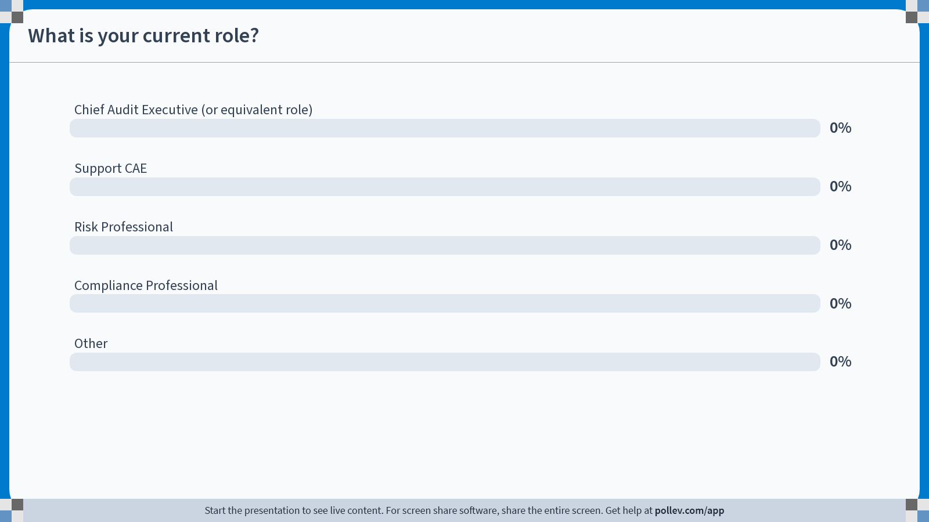
Poll Everywhere multiple choice poll activity Activity Title: What is your current role? Slide 6
Notes:
Do not modify the notes in this section to avoid tampering with the Poll Everywhere activity. More info at polleverywhere.com/support What is your current role? https://www.polleverywhere.com/multiple_choice_polls/ZoJZKcYGXNSz58quwB08o?state=opened&flow=Default&onscreen=persist

Slide 5
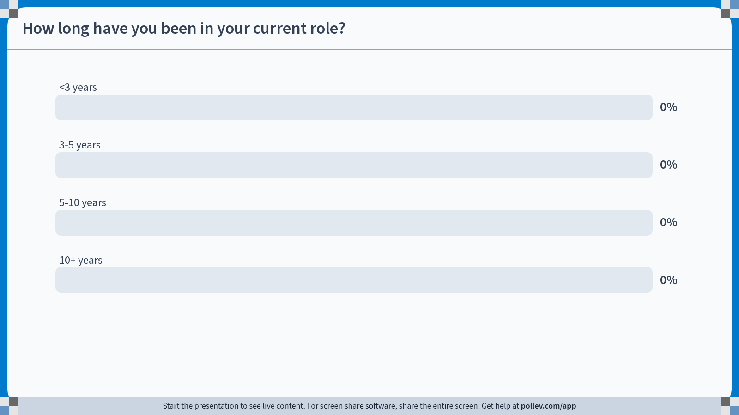
Poll Everywhere multiple choice poll activity Activity Title: How long have you been in your current role? Slide 7
Notes:
Do not modify the notes in this section to avoid tampering with the Poll Everywhere activity. More info at polleverywhere.com/support How long have you been in your current role? https://www.polleverywhere.com/multiple_choice_polls/Zek2TIzKesAYZOEh3PF6x?state=opened&flow=Default&onscreen=persist

Slide 6
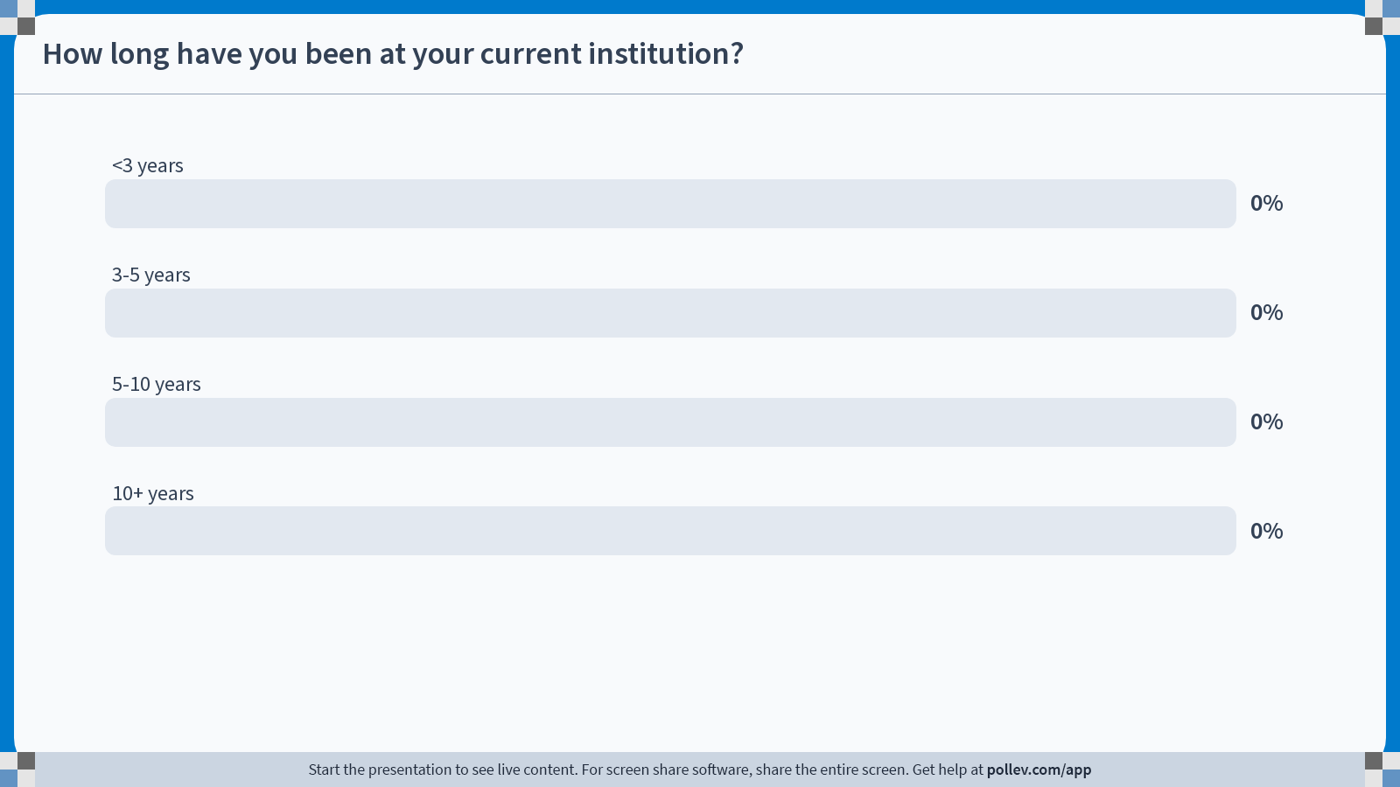
Poll Everywhere multiple choice poll activity Activity Title: How long have you been at your current institution? Slide 8
Notes:
Do not modify the notes in this section to avoid tampering with the Poll Everywhere activity. More info at polleverywhere.com/support How long have you been at your current institution? https://www.polleverywhere.com/multiple_choice_polls/Uyu9eRNIok875DyapPX5Y?state=opened&flow=Default&onscreen=persist

Slide 7
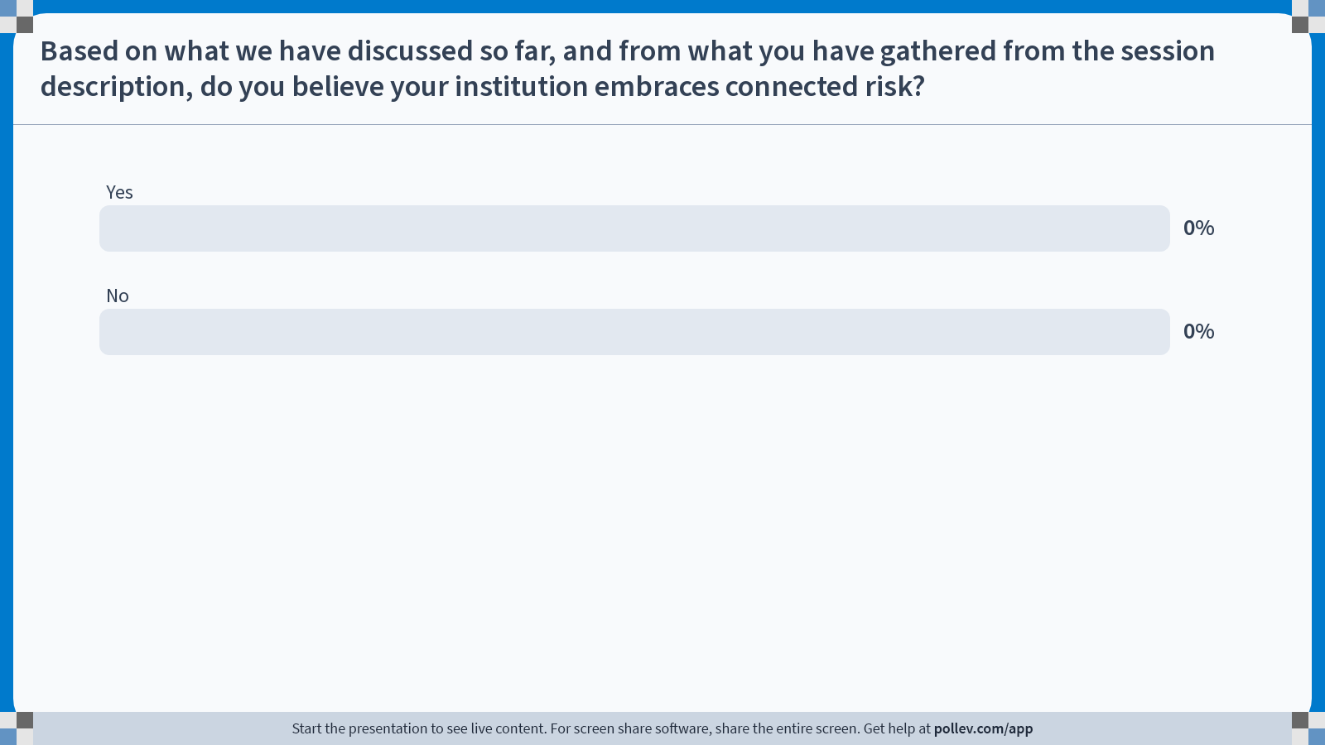
Poll Everywhere multiple choice poll activity Activity Title: Based on what we have discussed so far, and from what you have gathered from the session description, do you believe your institution embraces connected risk? Slide 9
Notes:
Do not modify the notes in this section to avoid tampering with the Poll Everywhere activity. More info at polleverywhere.com/support Based on what we have discussed so far, and from what you have gathered from the session description, do you believe your institution embraces connected risk? https://www.polleverywhere.com/multiple_choice_polls/Rj8XNBP3sgKOc5p0LG9f2?state=opened&flow=Default&onscreen=persist

Slide 8
Embracing Connected Risk
An integrated framework uniting risk, compliance, and audit - provides a holistic view of the institution’s risk landscape. This approach enables better-informed decisions, more effective resource use, and enhanced resilience, all without compromising the independence of any function.
Risk
Audit
Compliance
Notes:
SMK notes on connected risk model:
While ERM, compliance, and internal audit share commonalities in their focus on risk management, organizational objectives and governance, they differ in scope, purpose, orientation, and the timing of their activities. Integrating these functions in a Connected Risk Model can enhance overall risk governance and provide a more comprehensive approach to managing an organization's risks.
Synergies:
Risk Focus: ERM, compliance, and internal audit all share a common focus on identifying and managing risks within an organization.
ERM – the comprehensive management of risks
Compliance – risks associated with regulatory requirements, legal standards, and organizational policies
Audits – often prioritized based on the assessment of risks
Objective Alignment: All three functions aim to enhance and protect organizational value by helping it achieve its objectives.
Governance Integration: All three functions being integrated into the governance structure of an organization is critical for ensuring that risk considerations are embedded throughout management processes and our activities add value and improve operations.
Differences:
Scope and Purpose:
ERM is broader in scope, encompassing the identification and management of all risks that could impact an organization's objectives. It goes beyond compliance and internal audit, addressing strategic, operational, financial, and other forms of risk.
Proactive vs. Reactive:
ERM is a proactive process that involves identifying and addressing risks before they materialize, with a focus on preventing potential negative impacts.
In contrast, compliance and internal audit may have a more reactive element, ensuring that policies and procedures are adhered to and evaluating past performance.
Independence and Assurance:
ERM and Compliance do not have the same “independence” requirements as Internal Audit, although they are assurance functions.

Slide 9
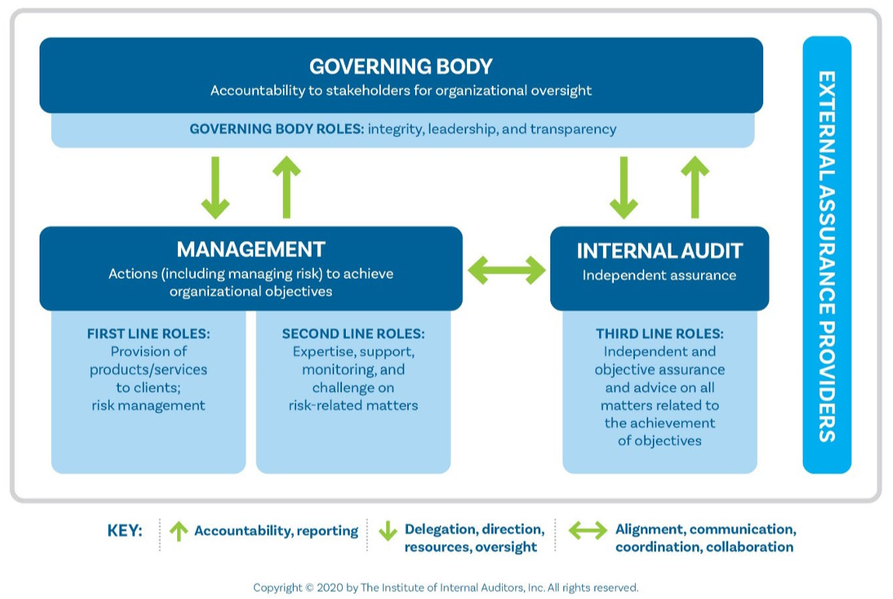
Connected Risk – The IAA’s Three Lines Model
Highlights connectivity
Defines roles
Governance emphasis

Slide 10

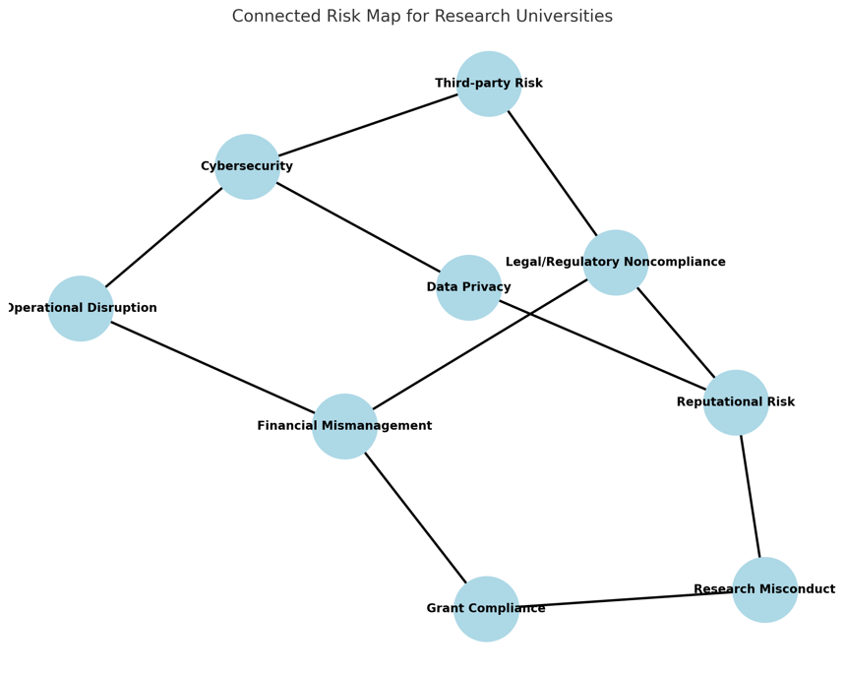
Connected Risks
Aligned Assurance
Connected Risk Map for Research Universities
Coordination
Clarity of roles
Risk-based focus
Information sharing
Holistic view

Slide 11



Alignment Success Stories
Seat at the table for ERM
Senior leadership – risk nomenclature (Appetite vs. Tolerance)
All Cabinet Meeting

Slide 12



VT OARC’s Support of Research Initiatives
Risk
Compliance
Audit
Collaborating with risk owners to proactively monitor and mitigate risks, including planning research security programs
Leading the COI/C Taskforce
Benchmarking practices against industry peers
Tracking federal regulatory changes in research security
Coordinating with institutional compliance teams on protocols, such as animal safety inspections
Building data analytics to identify common external audit findings
Expanding audits to cover frequent research compliance issues
Notes:
Current focus is on Research: Competitive Growth risk - Grow and diversify the research portfolio by prioritizing strengths and under-leveraged areas…in alignment with shifting federal funding opportunities

Slide 13
Defining Enterprise Risk
Establishing a standardized definition of risk and a comprehensive risk taxonomy creates a common language across the institution, enabling more consistent risk identification, assessment, and reporting.
Risk vs. Risk Driver
Risk Taxonomy
Risk is defined as a state of uncertainty where the answer to “Did the risk occur?” can be a binary yes or no, with some possibilities being undesirable outcomes.
Risk drivers can either be:
Continuous factors, often referred to as “trends,” that influence the likelihood or impact of a risk
A risk that could influence another risk’s likelihood or impact
All risks can be risk drivers, but not all risk drivers can be risks
A taxonomy is a structured system for classifying risks, enabling a common understanding and consistent grouping of risks and related data across the institution.
Level 1
Category
Operations
Finance
Compliance
Technology
Level 2
Sub-Category
Human Resources
Business Model
Higher Ed Regulations
Tools and Systems
Level 3
Risks
Key Person Risk
Affiliate Financial Sustainability
Loss of Tax-Exempt Status
Business-Critical System Failure

Slide 14
Top Risks in Higher Education
Institutions face a rapidly evolving risk landscape that challenges financial stability, operational resilience, and institutional reputation. Proactive risk management is essential to safeguard student success and institutional sustainability.
Risk of Cyber Breaches
Faculty and Staff Attrition
Student Activism Risks
Cyberattacks can compromise sensitive data, disrupt operations, and damage reputation, requiring robust cybersecurity and vigilance.
High turnover disrupts continuity, impacts student outcomes, and challenges strategic initiatives.
Escalated activism can disrupt operations, create safety concerns, and harm institutional reputation.
Natural Disaster Risks
Instability of Federal Funding
Classification of Student-Athletes as Employees
Natural disasters threaten safety, disrupt operations, and can cause significant financial and reputational damage.
Unpredictable federal funding creates budget uncertainty, complicates planning, and may disrupt research, programs, and student support.
Employee status for student-athletes could increase costs, compliance obligations, and operational complexity.

Slide 15
Evolving Risks
Institutions face a rapidly evolving risk landscape that challenges financial stability, operational resilience, and institutional reputation.
Proactive risk management is essential to safeguard student success and institutional sustainability.
DEI & DOJ
Higher Education Value Proposition
State and Federal guidance surrounding DEI activities at universities, as well as issues of discrimination.
Decreasing public trust in the value and transformative impact of education on individuals and society.
Research Security
Athletics
Increased and evolving regulatory scrutiny at universities across the country.
Navigate the increasingly complex and high-profile landscape of intercollegiate athletics amid rapid industry transformation.
Notes:
SMK suggest replacing slide 12 with this one…

Slide 16
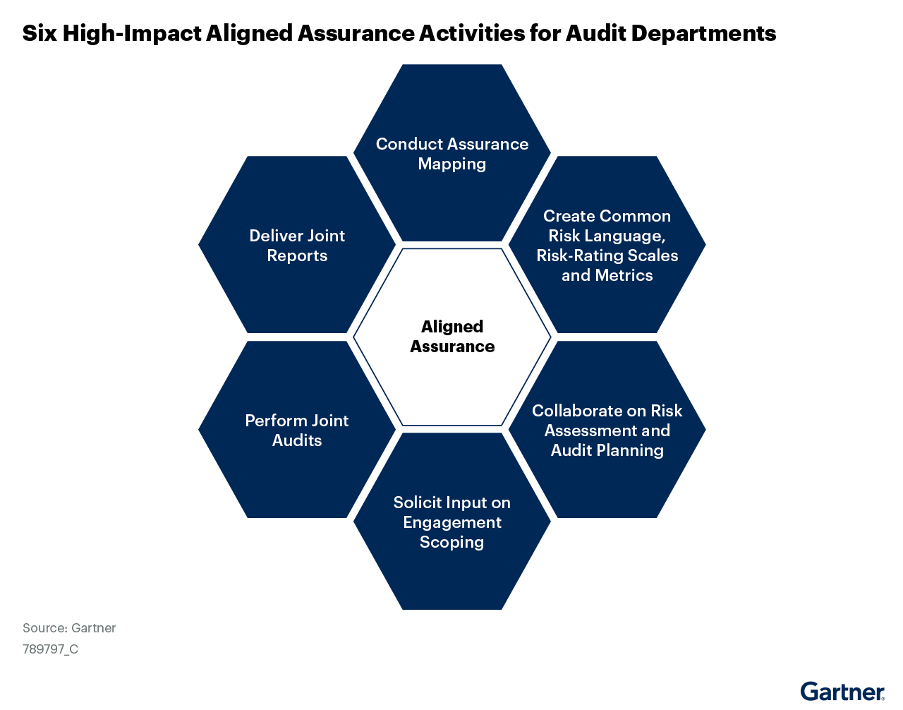
CAE’s Role
Six High-Impact Aligned Assurance Activities for Audit Departments
Notes:
To ensure efficient and effective risk coverage by coordinating activities with other assurance functions, chief audit executives (CAEs) should:
Improve cross-functional visibility into risk and assurance activities by building an assurance map.
Streamline the communication of assurance findings by creating a common risk language, risk-rating scales and metrics.
Identify priorities in audit plans by collaborating on risk assessment and audit planning.
Adapt the scope of audit engagements to better target key risks by soliciting input from other assurance functions.
Deepen assurance coverage by performing joint audits with other assurance functions, which leverages specialized knowledge and reduces assurance fatigue among business partners.
Provide a holistic view of risk across the organization by delivering joint reports to the board and audit committee.

