Slide 2
Ripped from the Headlines: Healthcare & University IT Risk in 2025
Today’s Speakers:
Terry Corcoran, CHIAP, CISA, CRMA
Director, Protiviti
Kevin Valade, MS, MBA
Manager, Protiviti

Slide 3
Course Objectives
Build awareness for real-life IT risk events
Understand how to identify and assess IT risk in your organization
Work internally in your organization to evaluate and mitigate IT risk

Slide 4
Top Healthcare & University IT Risks in 2025
Topics | Description
1. Cybersecurity Threats | Healthcare & University organizations face significant risks from cyberattacks, including ransomware, data breaches, and phishing attacks, due to the sensitive nature of patient data.
2. Completeness and Accuracy of IT Asset Inventories | Inaccurate or incomplete IT asset inventories can lead to gaps in security, making systems vulnerable to attacks.
3. Dispersed IT Lacking Standardized Controls | When IT systems are dispersed and lack standardized controls, it can lead to increased spending, difficulties in maintenance, upgrade, and retirement of systems.
4. Aged Equipment in Healthcare Environments | Outdated equipment may lack the latest security features, making them more susceptible to breaches and failures, which can impact patient care and data security.
5. Third-Party Risk Management | Many healthcare organizations rely on third-party vendors for critical services, making them vulnerable to risks associated with these vendors' security practices and data management. Breaches often occur through third parties, not just those related to IT.
6. Data Privacy and Compliance | Ensuring compliance with regulations like HIPAA in the U.S., GDPR in Europe, and other local data protection laws is a constant challenge as these regulations evolve.
7. Technology Integration and Interoperability | Integrating new technologies with existing healthcare IT systems without disrupting operations or compromising data integrity poses a significant challenge.
8. Password Vulnerabilities | Weak or poorly managed passwords can provide an easy entry point for unauthorized individuals, leading to potential data breaches and system disruptions.

Slide 5
Target: University / Higher Education
Cyber Attacks Surge in Higher Education
Why Higher Education is a Target
Notable 2024 Cyber Attacks
Reports highlight a 70% increase in ransomware attacks in 2023.
In the UK, 97% of higher education institutions identified a breach or cyber attack in the past year.
Universities hold valuable sensitive data, like student records and research info, attractive to cybercriminals.
Tight budgets often prevent institutions from investing in strong cybersecurity measures.
Students and faculty lack extensive cybersecurity training, making them susceptible to phishing and social engineering.
Open networks and diverse connected devices increase the attack surface.
Kansas State University: Attack disrupted IT infrastructure, including email and wireless networks, causing a spike in help desk requests.
University of Winnipeg: Cyber attack led to delayed exams, canceled classes, and stolen data from 2003.
Frankfurt University of Applied Sciences: IT system shutdown, affecting campus facilities like elevators.
https://www.cloudrangecyber.com/news/higher-education-faces-rising-cyber-attacks-in-2024?utm_source=chatgpt.com

Slide 6
Health Care Cyber-Attacks in 2024:
386 cyber-attacks reported in 2024, with ransomware and data-theft crimes continuing at high rates from 2023, which was the worst year for breaches in health care.
The scope of breaches in 2024 has been more profound.
Ransomware Attacks as Threats to Life:
Ransomware attacks are not just IT issues; they disrupt vital systems, delaying patient care, and have widespread impacts on communities and hospitals.
These attacks create a “blast radius,” affecting every hospital, clinic, and emergency department in the surrounding region.
Rising Attacks on Third-Party Providers:
Attacks on third-party health care service providers rose by 287% from 2022 to 2023.
Health care organizations need to prepare for potential future cyberattacks that could result in the loss of services.
Emerging Threats: Nation-State Collaboration:
International cooperation between nation-state hackers and ransomware groups is on the rise.
In August 2024, Iranian cyber actors facilitated ransomware attacks on U.S. organizations, including health care institutions, in collaboration with Russian-affiliated ransomware gangs.
Geopolitical Risks:
Ransomware attacks are typically linked to countries like Russia, China, North Korea, and Iran, often with tacit government approval.
Hospitals need support from the federal government, including proactive defense strategies, threat intelligence dissemination, and coordinated response efforts.
Healthcare

Slide 7
Cyberattacks and ransomware in Healthcare
Ascension Health (2024) - $1.8 Billion Operating Loss
Change Healthcare (2024) - ~$872 Million - $1.6 Billion expected
CrowdStrike (2024) – Loss of $25 Billion in market cap
Case Study
FBI’s Internet Crime Complaint Center (IC3) – Healthcare hit with Ransomware most often
Ransomware Average Cost in Healthcare
$9.77 Million per IBM in 2023
Industry Trends
IT and Service Outages, Lost Data, Data Integrity, Patient Safety
Lawsuits
Enforcement Penalties
Impacts
7

Slide 8
Key Responsibilities
1
Protect Yourself: Protect your data, enroll in identity protection insurance
2
Create Strong Passwords: Use passphrases, use MFA, don’t reuse passwords
3
Technology Protection: Don’t connect unknown devices, don’t hide approved devices, follow correct purchasing and review processes
4
See Something, Say Something: Report questionable actions, “Phish Alert,” call your security team
5
Downtime Awareness – Be Ready: Know how to act when your systems are unavailable, downtime forms, reports
6
Perform Controls: Where you are responsible, make sure timely action is taken, alert of terminations, return equipment, notify of lost devices, remove access
7
Understand – You Are A Critical Piece of the Security Team

Slide 9
Change Healthcare Cyberattack
February 21, 2024

Slide 10
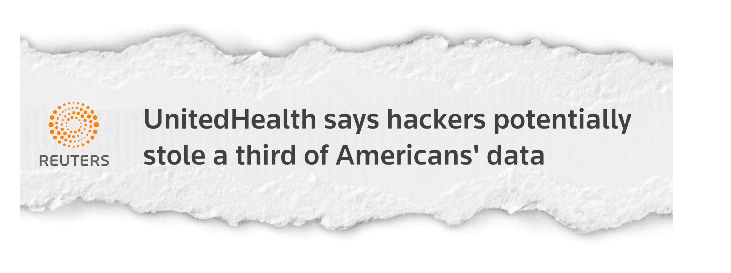
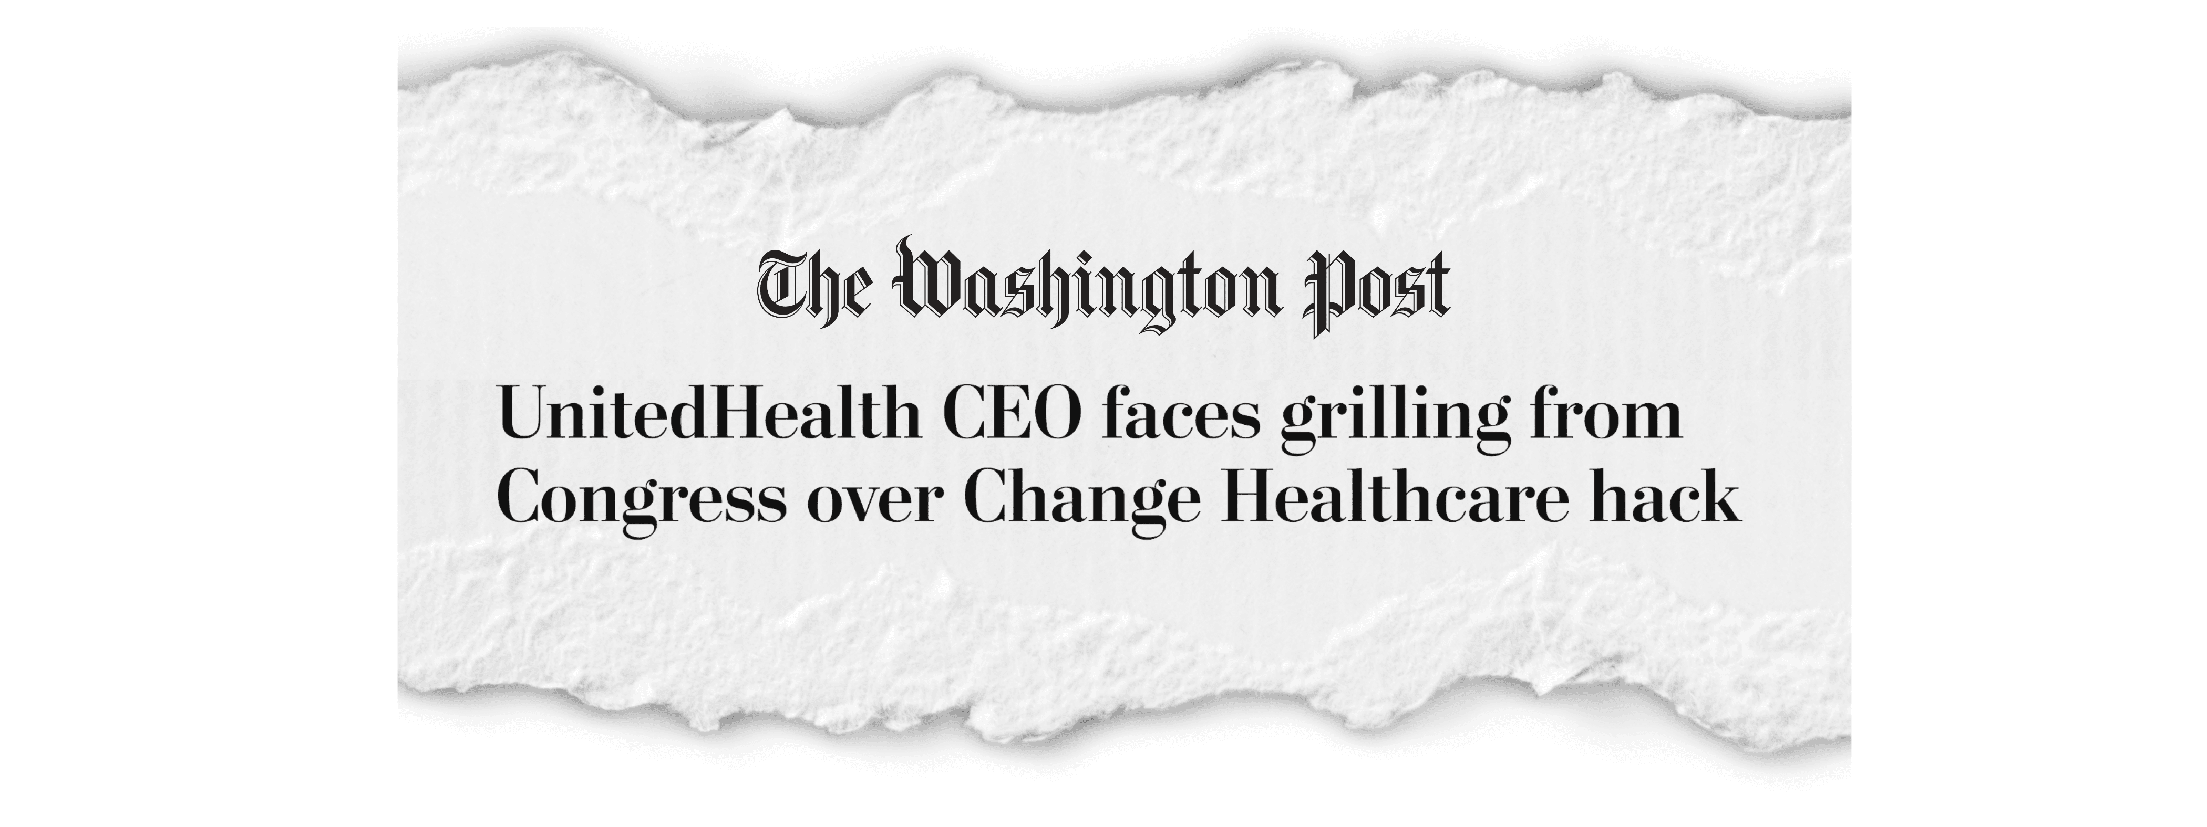
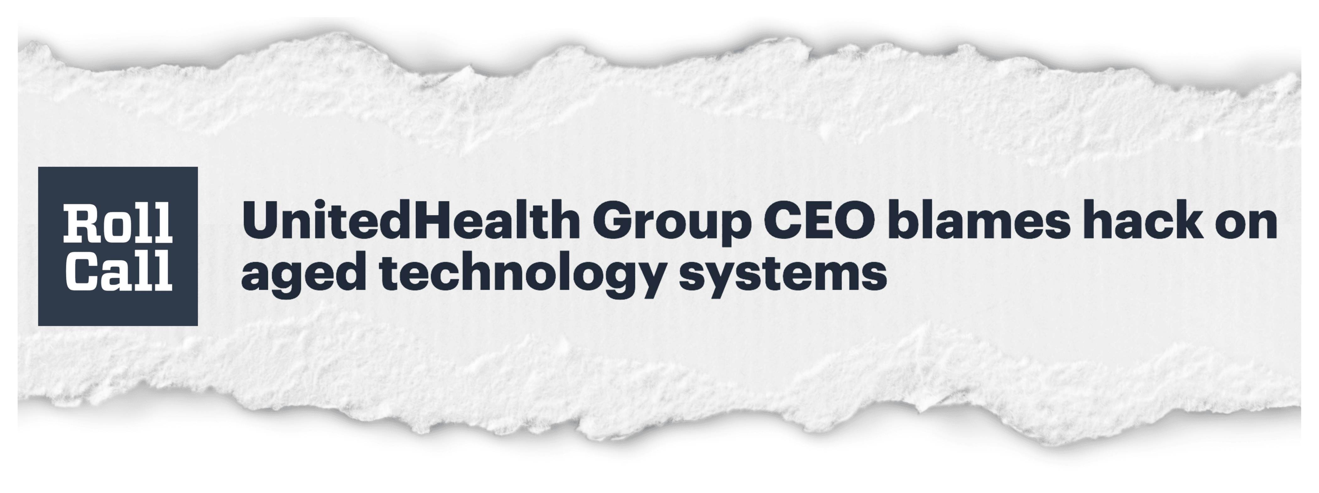
Change Healthcare Cyberattack
Change Healthcare cyberattack was due to a lack of multifactor authentication, UnitedHealth CEO says (youtube.com)

Slide 11
About Change Healthcare
Backbone for defining eligibility so providers can get paid
Major portion of US healthcare infrastructure – the healthcare equivalent of the US power grid
By the numbers:
Process 15 billion claims per year (40% of all claims)
$1.5 trillion in claims annually
Touch 1/3 of all US patient records
Clears eligibility transactions for over 67,000 pharmacies in the US
During this 50-min presentation, they would normally process over 1.4 million claims for over $142,000,000

Slide 12
About the Change Healthcare Cyberattack
Attack occurred on February 21, 2024
MFA was not installed on one key system + a password was compromised
Hackers were in the Change Healthcare network for 9 days before systems were shut down
The most significant attack on that healthcare power grid that we’ve ever seen
Ultimately, $22mm was paid to the hackers
Rippling, crippling impact across the US healthcare system

Slide 13
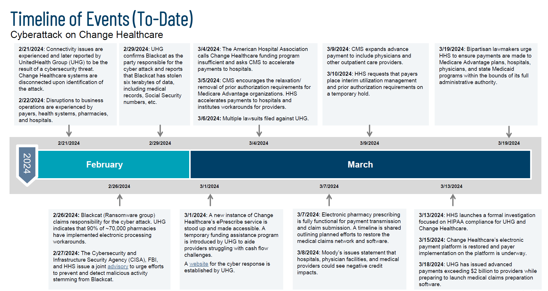
3/3/2024 – Blackcat received a bitcoin payment over $20M
3/5/2024 – Blackcat closed shop and did not pay hacker
4/8/2024 – RansomHub claims to have 4Tb of CH data and demands payment (extortion)
Notes:
Developers – Create and sell malware/ransomware executables
Victim Data and Leaked Site – Sell information

Slide 14
Impact of the Change Healthcare Cyberattack
Impact on Patients
Can’t get prescriptions
Can’t get pre-authorizations for surgeries – which were delayed as providers worked to determine patient eligibility.
PHI for potentially more than 100 million people may have been leaked on the dark web
Impact on Providers
Financial strain due to delays in receiving payments for services
Impact on Change Healthcare
Financially significant
Reputation damage

Slide 15
Lessons Learned from the Change Healthcare Cyberattack
Do not be complacent about cybersecurity hygiene – no matter the size of your organization. You are a target..
Cyber incident planning & response is critical
Vendor redundancy and flexibility is increasing important and should be explored, where possible
Organizations must be thoughtful and vigilant when onboarding new systems, applications, vendors – or anything introducing IT risk to your organization
The impact is real! More than 90% of hospitals said the cyberattack affected their cash flow, and of those, nearly 60% report that the impact to revenue is $1 million per day or more.

Slide 16
What can Internal Audit do?
Evaluate your Third Party Risk Management program
Evaluate your organization’s process for on-boarding new IT assets – acquired entities, third parties, applications, etc.
Confirm MFA is enabled throughout your organization
Understand and evaluate your Cyber Incident Planning & Response program
Identify cybersecurity controls and validate their effectiveness

Slide 17
CrowdStrike Outage
July 19, 2024

Slide 18
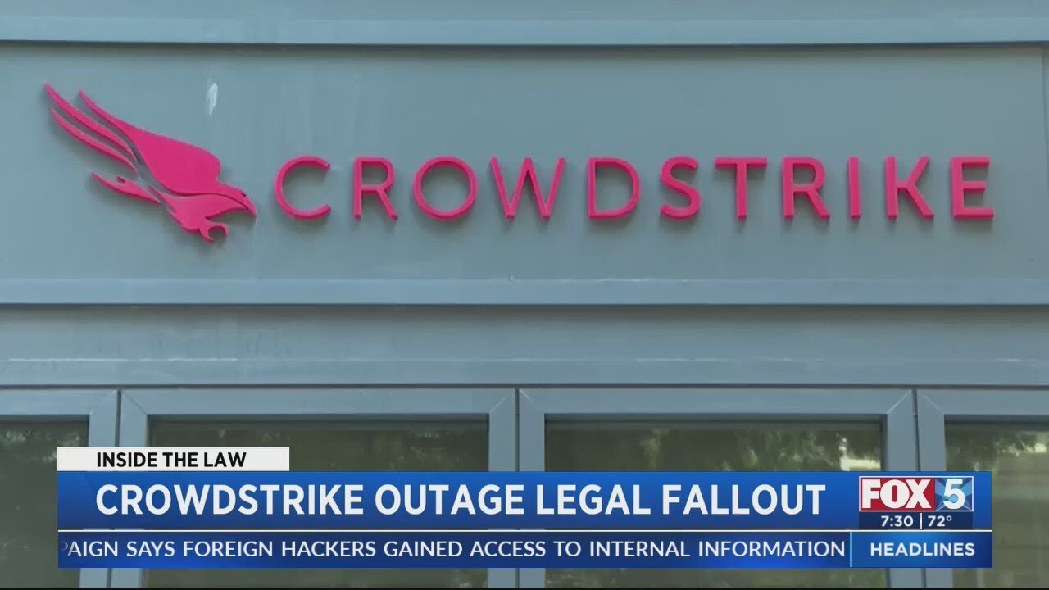
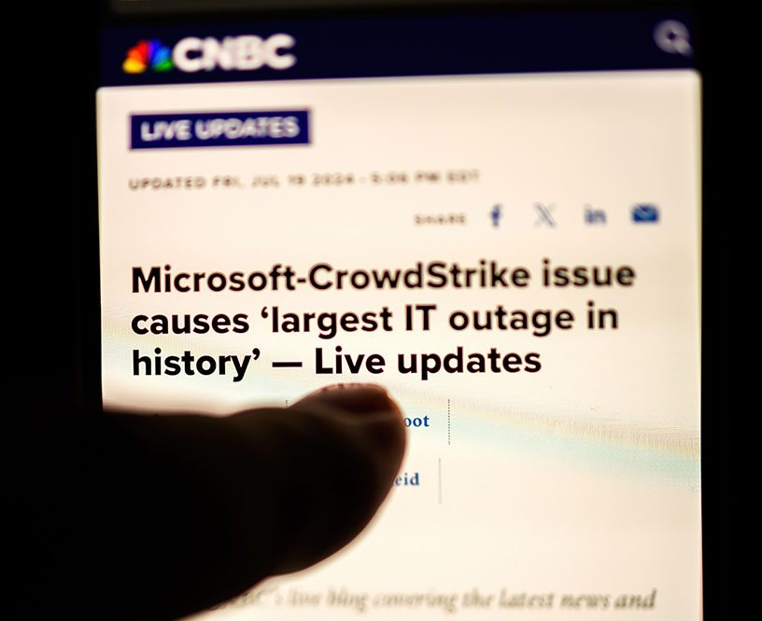
Crowdstrike Outage
The Microsoft Outage Explained: How it Happened

Slide 19
About Crowdstrike
Global leader in the business of endpoint security, the company has played a prominent role in fighting against cyberattacks
Often an organization’s single vendor for identifying and addressing cyber threats
By the numbers:
29,000 customers with a subscription
300 of the Fortune 500

Slide 20
About the CrowdStrike Outage
Outage occurred on July 19, 2024
Not a malicious cyberattack, BUT…
Botched update for the cybersecurity company’s anti-ransomware software (“Falcon”)
Not a security incident or cyberattack
Windows “blue screen of death”
CrowdStrike's misstep triggered a spectacular global tech outage
Affected 8.5 million Windows machines (~1% of all Windows machines)
Global impact– including on the US healthcare system

Slide 21
Impact of the CrowdStrike Outage
Impact on Customers
Systems down or inaccessible
Flights delayed or cancelled
Example: Delta Air Lines noted the disruption cost the airline $500m, including lost revenue and compensation to passengers
Impact on Crowdstrike
Stock price dropped 20% initially, and 32% overall in the 12 days after the incident
Equated to a loss of $25bb in market cap
Shareholder lawsuit
Reputation damage

Slide 22
Lessons Learned from the Crowdstrike Outage
Even a seemingly minor vendor incident can have global impacts
Backup Plan for Unexpected Disruptions
(Again) Vendor redundancy and flexibility is increasing important and should be explored, where possible
Be Transparent with Stakeholders When Issues Arise

Slide 23
What can Internal Audit do?
Identify scenarios your organization might face
Assess likelihood, prioritize, and assess readiness
Execute tabletop exercises
Understand key vendors’ processes for rolling out updates
Understand what levers your organization may be able to pull to hold the vendor accountable
In the event of an outage, understand what was learned and what the organization may be able to do to mitigate risk in the future

Slide 24
Arup Deep Fake Scam
July 19, 2024

Slide 25
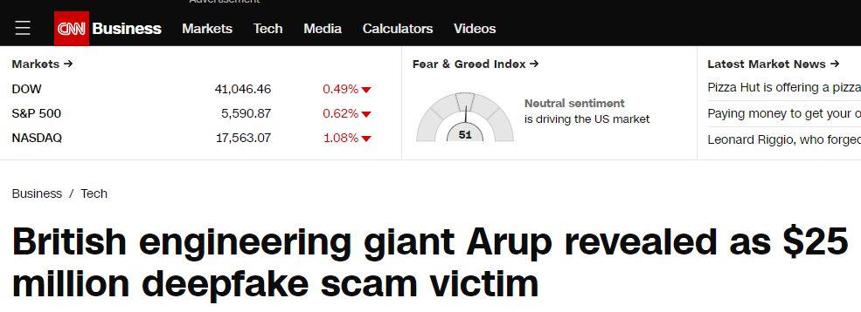
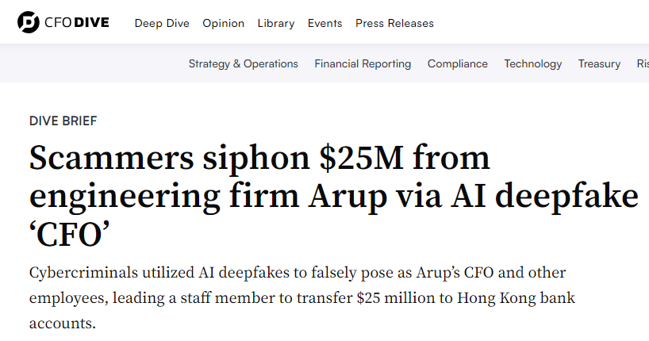
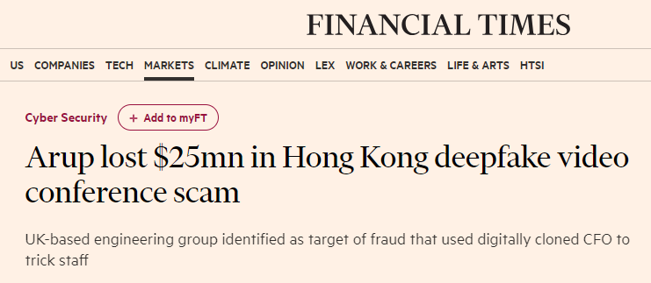
About Arup Deep Fake Scam
Artificial intelligence used in $35M deep fake scam | Finance clerk scammed (youtube.com)

Slide 26
About Arup
Global collective of designers, engineers and technical experts
Privately held
$2.85bb organization

Slide 27
About the Arup Deep Fake Scam
Occurred in early 2024
Lost ~$25mm after scammers used AI-manipulated “deepfakes”
Video conference with the false CFO and other AI-generated employees
Scam reported to authorities – no arrests have been made

Slide 28
Lessons Learned from the Arup Deep Fake Scam
Trust, but verify
Trust your instincts
No industry – even healthcare – is immune
A single point of failure, or a single point of authorization is more easily exposed

Slide 29
What can Internal Audit do?
Revisit your internal fraud controls
Revisit your financial controls
Build awareness related to deep fake scenarios (similar to what has been done with phishing) – requesting money, passwords, access to PHI
Build awareness on how to spot a deep fake:
Choppy sentences.
Varying tone inflection in speech.
Phrasing: Would the speaker say it that way?
Contextual clues: Are background sounds consistent with the speaker’s presumed location?

Slide 30
Kansas State Cyberattack
January 24, 2024

Slide 32
About Kansas State Cyberattack
January 14, 2024
Disrupted multiple network services, including VPN, email, Canvas, and Mediasite
Affected students, faculty, and staff access to critical academic platforms
University-wide password reset mandated on January 23, 2024
Services such as VPN, authenticated Wi-Fi, printing, shared drives, and mailing list management services (Listservs)
Hired a third-party IT forensic expert to help during the investigation
2024 IT Cybersecurity Incident Response and Investigation

Slide 33
Ascension Health Cyberattack
September 17, 2024

Slide 34
About Ascension Health Cyberattack
https://www.youtube.com/watch?v=3Od6M6kBiFw

Slide 35
About Ascension Health
Healthcare network serving 19 states and over 140 hospitals
Non-for profit organization.
$27 billion organization
Offerings include but not limited to:
Hospital Care - Emergency, surgery, maternity, and specialized treatments.
Outpatient Care - urgent care, physical therapy, and diagnostic imaging.
Primary Care & Specialty Care - cardiology, oncology, orthopedics, and more.
Senior Living Communities, Home Health Services, Telehealth & Pharmacy Services

Slide 36
About the Ascension Health Cyberattack
Ransomware attack Occurred in May 2024
Resulted in $1.8 Billion Operating Loss
Affected 5.6 million patients, senior living residents, and employees
Data potentially stolen:
Personal information – Name, address, date of birth
Medical information – Medical record number, date(s) of service, type(s) of lab tests, procedure codes
Payment information – Credit card information, bank account number
Insurance information – Medicaid/Medicare ID, policy number, insurance claim
Government identification – Social Security number, tax identification number, driver’s license number, passport number

Slide 37
Impact of the Ascension Health Cyberattack
Operational Impacts:
Forced to divert ambulances, close pharmacies, take critical IT systems offline and resort to pen and paper to record patient information.
Took Ascension around 6 weeks to restore access to its electronic medical record system and resume normal operations
Delays in revenue cycle processes, claims submission, and payment processing, in addition to significant remediation costs.
Facility volumes dropped by 8%-12% during May and June compared to the previous year mostly because of the need to delay or reschedule medical procedures due to systems being taken offline due to the ransomware attack.
Additional Expenses incurred:
Notification: Letters are being mailed to affected individuals, with delivery expected over the next two to three weeks
Monitoring: Offering a new credit monitoring package for two years from the enrollment date
Collaborating with third-party cybersecurity experts to assess the breach and enhance security measures

Slide 38
Texas Tech Cyberattack
May 8, 2024

Slide 40
About Texas Tech Cyberattack
Texas Tech University Health Sciences Center (TTUHSC) is an academic health institution and medical school of Texas Tech University
Attack occurred from September 17 to September 29, 2024
The Interlock ransomware group claimed responsibility for the attack and added Texas Tech University Health Sciences Center to its data leak site in October.
The ransom was not paid, so Interlock uploaded the stolen data to its data leak site – 2.6 TB, including 2,102,989 files in 100,882 folders – remains available for download.
Note*: A similarly sized data breach was reported by Texas Tech University Health Sciences Center in 2022. In that incident, which occurred through its electronic medical record vendor Eye Care Leaders, the ePHI of 1,290,104 patients was compromised.

Slide 41
Impact of the Texas Tech Cyberattack
Approximately 1.4 million patients across TTUHSC's centers in Lubbock and El Paso
Compromised Data:
Personal information (e.g., names, addresses, dates of birth, Social Security numbers),
Medical information (e.g., medical record numbers, billing/claims data, diagnosis and treatment information)
Health insurance details
Financial account information
Computer systems and applications at both the Lubbock and El Paso centers were disrupted

Slide 42
Confidant Health Data Leak
August 2024

Slide 44
About Confidant Health Data Leak
Confidant Health is a telehealth-based company leveraging an AI powered platform to connect patients with therapists, psychiatrists, and providers of addiction treatment services.
The company serves individuals in the states of Connecticut, Florida, New Hampshire, Texas, and Virginia.
In August 2024, A cybersecurity Researcher identified 126,000 files and 1.7 million records through an exposed healthcare database that could be accessed via the Internet without a password. The database included:
Names & addresses,
driver’s license information
Medicaid cards, Prescription medications, Medical record requests, Drug test results.
Audio recordings of sessions and text transcripts

Slide 45
Lessons Learned & Internal Audit’s Role

Slide 46
Lessons Learned – Password Management / Vulnerability
Weak Passwords Still Pose a Major Risk
Many breaches occur due to easily guessed or weak passwords, such as “password123” or default credentials.
Attackers use brute force or credential stuffing to exploit these weaknesses.
Reused Passwords Amplify the Risk
Employees often reuse passwords across multiple accounts, allowing attackers to use credentials leaked from one breach to access healthcare systems.
Phishing and Social Engineering are Primary Entry Points
Attackers often trick employees into revealing their credentials through phishing emails, malicious websites, or fake login pages.
The 2015 Anthem breach (80M+ records exposed) started with stolen credentials via phishing.
Lack of Multi-Factor Authentication (MFA) Increases Risk
Many healthcare institutions fail to enforce MFA, making it easier for attackers to use stolen passwords without additional verification.
MFA could have prevented major breaches, such as the 2017 Deloitte attack, where weak passwords provided access to sensitive emails and client data.

Slide 47
MFA Attacks

Slide 48
Password Management – What can we do?
Enforce Strong Password Policies
Require complex passwords (minimum 12-16 characters, mix of uppercase, lowercase, numbers, and symbols).
Implement password managers to reduce the burden of remembering unique credentials.
Require Multi-Factor Authentication (MFA) Everywhere
Implement MFA for all privileged accounts, remote access, and patient record systems.
Use phishing-resistant MFA (e.g., FIDO2, hardware security keys) instead of SMS-based 2FA.
Regularly Test for Credential Leaks
Monitor the dark web for stolen credentials.
Use automated tools to check if employee credentials have been exposed in previous breaches.
Implement Zero Trust & Least Privilege Access
Ensure employees only have access to what is necessary for their role.
Disable unused accounts and regularly audit access permissions.
Conduct Ongoing Security Awareness Training
Train staff on phishing tactics, credential stuffing attacks, and proper password management.
Simulate phishing campaigns to test employee readiness.
Enforce Automated Password Rotation for Shared Accounts
Use privileged access management (PAM) solutions to manage and rotate administrative passwords dynamically.

Slide 49
Lessons Learned – Dispersed IT Controls
Dispersed IT Controls can result in:
Different departments or campuses may have varying cybersecurity maturity levels.
Older systems may remain unpatched, creating security vulnerabilities.
Lack of visibility into all deployed hardware and software assets.
No centralized threat detection leads to delayed responses to cyber incidents.
Integration of new technologies becomes complex and costly.
Inconsistent data protection policies increase legal liability.
Higher risk of data breaches and regulatory penalties.
Difficulty ensuring audit trails for compliance reporting.
Dispersed IT without standardized security controls can lead to HIPAA violations.

Slide 50
What can we do – Dispersed IT Controls
Implement centralized IT governance to enforce security policies consistently.
Conduct regular audits and patch management enforcement across all departments.
Implement an IT asset management (ITAM) system to track infrastructure lifecycles.
Establish a standardized decommissioning policy for retiring outdated systems.
Implement a centralized IT helpdesk and monitoring system.
Ensure a single incident response framework across all departments.

Slide 51
Lessons Learned – 3rd Party Risk Management
Third-Party Access Must Be Strictly Controlled
Least-privilege access (LPA) should be enforced—vendors should only have access to the data and systems necessary for their function.
Continuous Vendor Security Monitoring is Essential
One-time security assessments are not enough—organizations must conduct continuous risk monitoring of vendors.
Third-Party Software Should Be Regularly Patched
Unpatched software in vendor systems is a major attack vector—outdated APIs and legacy apps increase breach risks.
Vendor Contracts Must Include Cybersecurity Requirements
Contracts should hold vendors accountable for security incidents, compliance failures, and breach notification timelines.
Vendor Security Should Be Assessed Before Onboarding
Many organizations fail to conduct thorough security due diligence before signing vendor agreements.
Supply Chain Attacks Require a Rapid Incident Response Plan
Organizations need a predefined response plan for third-party security incidents.

Slide 52
What can we do – 3rd Party Risk Management
Thorough Due Diligence: Conducting comprehensive due diligence on all third parties, including suppliers, partners, and contractors, is crucial. This should cover financial health, compliance with relevant laws and regulations, reputation, and operational stability.
Continuous Monitoring: Third-party relationships should not be set-and-forget. Continuous monitoring of third-party performance, compliance, and risk exposure is essential. This helps in identifying and mitigating risks early before they escalate into more significant problems.
Clear Contracts and SLAs: Clearly defined contracts and Service Level Agreements (SLAs) are vital. These documents should outline the expectations, responsibilities, and consequences of non-compliance for both parties. They serve as a legal safeguard and ensure clarity in the partnership.
Risk Assessment Frameworks: Implementing a robust risk assessment framework helps in categorizing and prioritizing third parties based on the level of risk they pose. This framework should be revisited regularly to adjust for changes in the business environment or in the third parties’ operations.
Integration of Risk Management into Business Processes: Integrating risk management strategies directly into business processes ensures that risk considerations are part of decision making at every level. This proactive approach can significantly mitigate potential risks from third-party interactions.
Training and Awareness: Regular training and awareness programs for employees involved in managing third-party relationships are essential. These programs should focus on the importance of compliance, understanding of the risk landscape, and ways to identify and report potential risks.
Developing a Response Strategy: Having a predefined incident response strategy for dealing with third-party failures or breaches is crucial. This includes steps for containment, investigation, remediation, and communication with stakeholders.
Leveraging Technology: Utilizing technology solutions can enhance the ability to monitor and manage third-party risks. Tools like automated due diligence platforms, continuous monitoring software, and contract management systems can provide real-time insights and streamline processes.
Building Strong Relationships: Finally, cultivating strong relationships with third parties based on trust and mutual benefits can lead to better collaboration and risk management. Open communication channels and regular reviews can help align third-party practices with organizational goals.

Slide 53
Lessons Learned – Cyber Security and Data Privacy
Importance of Strong Cybersecurity Measures
Institutions must implement robust security protocols to protect sensitive patient data.
Regular security audits and penetration testing can help identify vulnerabilities.
Need for Advanced Threat Detection
Early detection and response mechanisms could minimize damage and data loss.
AI-driven threat monitoring and real-time alerts can help prevent unauthorized access.
Data Encryption & Access Controls
Encrypting sensitive patient data could reduce the impact of breaches.
Limiting access to critical data based on user roles can prevent unauthorized access.
Incident Response Preparedness
Organizations must have a well-defined incident response plan to mitigate damage.
Faster response times could reduce operational downtime and financial losses.
Transparency & Communication
Timely disclosure of breaches helps affected individuals take precautionary measures.
Providing credit monitoring services can help build trust with patients.
Financial & Operational Costs of Cyberattacks
The attack resulted in over $2 million in direct costs, highlighting the financial impact of breaches.
Proactive cybersecurity investments can prevent larger losses in the future.

Slide 54
What can we do – Cyber Security and Data Privacy
Risk Assessment & Identification
Conduct regular cybersecurity risk assessments to identify vulnerabilities.
Evaluate the effectiveness of current security policies and controls.
Compliance & Policy Enforcement
Ensure the organization complies with industry regulations (e.g., HIPAA, FERPA, NIST).
Verify adherence to data protection policies and security best practices.
Monitoring & Internal Controls
Review user access controls and ensure sensitive data is restricted to authorized personnel.
Evaluate multi-factor authentication (MFA) and encryption measures.
Incident Response & Preparedness
Assess the organization’s incident response plan and recommend improvements.
Conduct tabletop exercises to simulate cyberattack scenarios and test response effectiveness.
Audit of Third-Party Vendors
Review security measures taken by third-party service providers handling sensitive data.
Ensure contracts include cybersecurity clauses and incident reporting requirements.
Training & Awareness Programs
Promote cybersecurity awareness among employees and stakeholders.
Advocate for phishing simulation tests and employee training to prevent human errors.
Post-Breach Analysis & Continuous Improvement
Conduct forensic audits after an attack to identify root causes and control failures.
Recommend enhancements to cybersecurity frameworks based on audit findings.

Slide 55
Question everything asking for data
WiFi Prompts - https://www.youtube.com/watch?v=CV39QzFpJx4

Slide 56
Questions
Terry.Corcoran@Protiviti.com
Kevin.Valade@Protiviti.com

