Slide 2
MAINTAINING THE CONNECTION
Eulonda Whitmore
Wayne State University
Office of Internal Audit
Fannie Moore
Wayne State University
Office of Internal Audit

Slide 3
Eulonda Whitmore, CIA, CFE, CRMA, CCA
Associate Vice President & Chief Audit Executive, Wayne State University (WSU) Office of Internal Audit
Part-time Faculty of Accounting – WSU Mike Ilitch School of Business
Internal Audit (21 years) and External Audit (6 years)
Owner, Positive Outcomes with Eulonda, LLC
Treasurer, Association of College and University Auditors
State of Michigan Board of Accountancy
Michigan First Credit Union Supervisory Committee
The Institute of Internal Auditors Central 1 District Representative
The Institute of Internal Auditors Training Facilitator
Speaker, author, inspirational leader
Enjoys cookies, pizza, helping others, and giving back to the profession

Slide 4
Fannie Moore, CFE, CICA
Forensic Audit Director, Wayne State University (WSU) Office of Internal Audit
Certified Fraud Examiner (18 years)
Internal Audit (14 years)
Vice President – Association of Certified Fraud Examiners Southeast Michigan Chapter
Association of College and University Auditors Member
Member – The Institute of Internal Auditors - Detroit Chapter
Enjoys traveling, nature walks, giving back to the profession, serving in the community

Slide 5
Objectives:
This session will cover:
Collaborating with audit clients during the audit engagement
Demonstrating independence and objectivity while maintaining client relationships
Building upon and maintaining established relationships
Handling difficult conversations

Slide 6
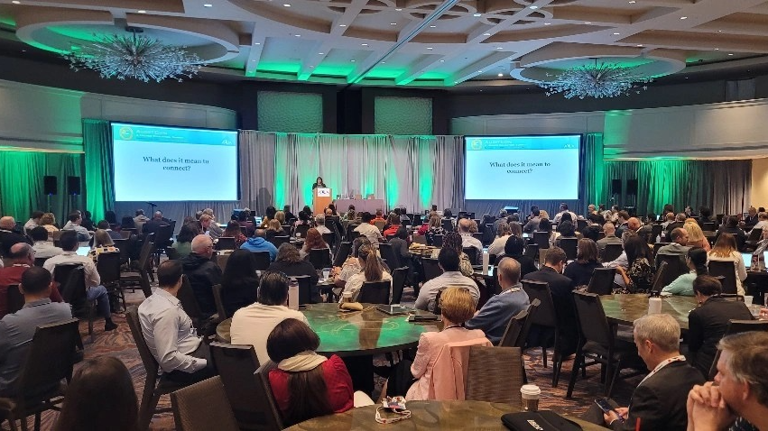
ACUA AuditCon 2024
Connecting with Others

Slide 7
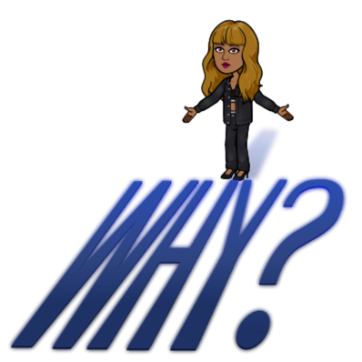
Human Nature
Connection is essential for emotional well-being.
Benefits of Connecting
Increased happiness
Enhanced collaboration and teamwork
Increased retention
Accomplish goals
Communicate audit results
Improves work culture
Evaluate governance, risks, and controls

Slide 8
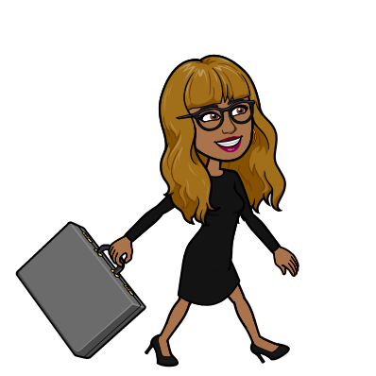
Build Relationship
Maintain Relationship
“Coming together is a beginning; keeping together is progress; working together is success.” Henry Ford

Slide 9
Why Maintain the Relationship?
Serve as a trusted advisor
To have a resource
Future engagements
IIA Global Internal Audit Standards
“Leadership is about empathy. It is about having the ability to relate to and connect with people for the purpose of inspiring and empowering their lives.” Oprah Winfrey

Slide 10
Maintaining the Relationship
Collaboration
Sharing information
Participating on committees
Invite client to a team meeting
Audit engagements
Engagement scope
Risk assessment
Throughout engagements

Slide 11
Maintaining the Relationship
Touchpoint Meetings
Say “hello”
Share insights
CAE meets with leaders:
Introductory meetings with new leaders
Touchpoint meetings with management and Audit Committee Chair

Slide 12
Maintaining the Relationship
Trust and Credibility
Transparency
Honesty
Your word
Consistency
Confidentiality
Competence

Slide 13
Maintaining the Relationship
Promote Internal Audit Brand
Newsletters
Email blasts
Open house
Awareness trainings
Engagements
Show up!
Internal Audit Rocks

Slide 14
Maintaining the Relationship
Be committed
Communicate regularly
Make client feel needed
Follow-up
Understand needs
Be Proactive
Listen
No surprises

Slide 15
Manage the relationship

Slide 16
Maintaining Independence and Objectivity
Clear reporting lines
Be unbiased and free of conflicts of interest
Don’t cross that line
Monitor and assess relationships

Slide 17
Uh oh…difficult matters

Slide 18
Think of a difficult conversation.
Personal
Professional

Slide 19
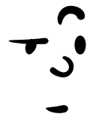
How would you describe the exchange?

Slide 20
What was the situation?
What went well?
What would you do differently?

Slide 21
Difficult conversations are inevitable.

Slide 22
Having a difficult conversation is a process so…
Allow time to process
Take it one step at a time
Deliver the message
Pause…allow the person time absorb the message
Help the other person process
Guide them to acceptance and a more positive place

Slide 23
Expect a reaction
Don’t rush to solutions
Be compassionate
Know what they need

Slide 24
People react in different ways..
Get visibly upset
Go quiet and retreat
Verbal attacks
Move into action

Slide 25
DISCONNECTED
Self Assessment
Did you prepare?
Did you make assumptions ?
What was your attitude?
Were you triggered?
What did you contribute?

Slide 26
Causes for Disconnection
Interruptions
Defensiveness
Personal attacks
Judgmental
Critical
Non-verbal
DISCONNECTED

Slide 27
Success is contingent upon YOU…
What you say
Your emotions

Slide 28
Recognizing and acknowledging your emotions before engaging in any conversation is important. They convey important messages that may encourage or discourage open channels of communication.
Tone of Voice
Facial Expressions
Gestures

Slide 29
Stay Connected
Focus on active listening
Use "I" statements to express feeling
Maintain empathy
Acknowledge others perspective
Take a break
Plan suitable time and place
Compromise
Non-verbal communication

Slide 30
CONNECTED
Stay in charge
Inquire
Acknowledge
Advocate
Build a solution
Stay Connected
Don’t take verbal attacks personal or make assumptions.

Slide 31
CONNECTED
Put yourself in “their” shoes
Manage emotions
Ask opened ended questions
Seek common ground
Set boundaries
Stay Connected

Slide 32
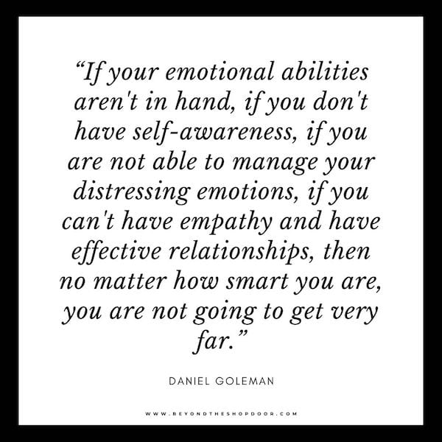

Slide 33
Don’t try to prevent, control or manage the emotions of others. Instead, acknowledge the emotions, react compassionately and try to master your reactions to other people’s emotions versus the emotions themselves.

Slide 34
Connect with Others
Build and maintain the relationship
Be independent and objective
Manage emotions during disruption
Wrap Up

Slide 35
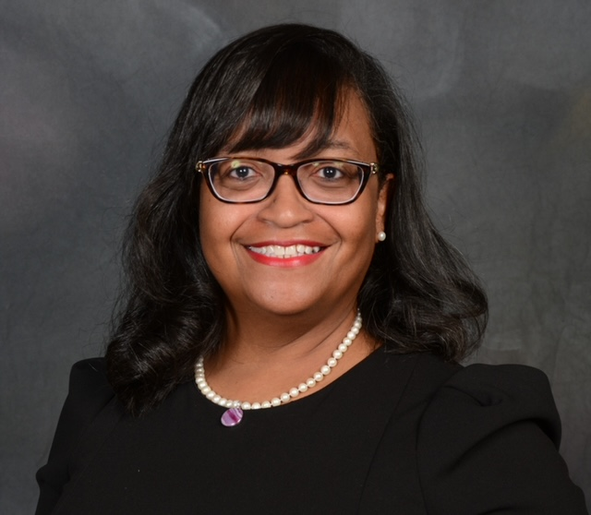
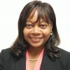
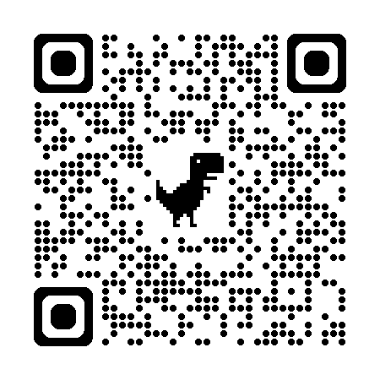
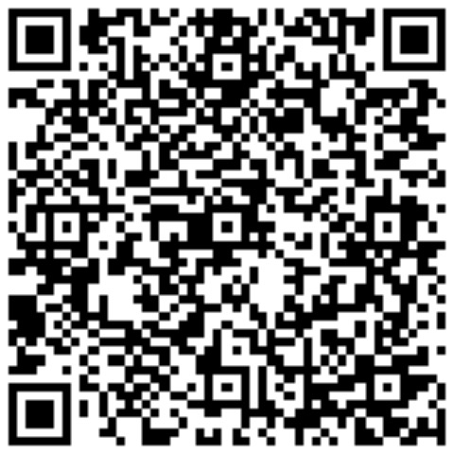
Thank You!
Feel free to connect on LinkedIn
Eulonda Whitmore
Fannie Moore

Slide 36
References
https://www.radicalcandor.com
Navigating Stormy Waters: Using Human-Centered Principles in Difficult Conversations | The International Educator (TIE Online)
How to have Difficult Conversations at Work

