Slide 2
Identifying and Mitigating Bias in Internal Auditing
Notes:
Anta start with opening remarks - Welcome and Overview (10 minutes)
Scenario 1 (35 minutes)
Break (10 minutes)
Scenario (35 minutes)
Wrap Up (10 minutes)

Slide 3
Learning Objectives
Recognize Different Types of Bias
Evaluate Emotional Influences
Implement Creative Solutions
Assess Risks and Consequences
Participants will identify various forms of bias that can affect auditing decisions, including confirmation bias and implicit bias.
Attendees will develop innovative strategies for reducing bias in audit processes, fostering a more inclusive and objective approach.
Attendees will explore how personal emotions and experiences can shape their auditing perspectives and decision-making
Participants will analyze case studies to understand the potential risks associated with bias in auditing and discuss strategies to mitigate these risks.

Slide 4
Why Bias Matters in Internal Auditing
Core Principles at Risk: Bias undermines objectivity and independence.
Decision-Making Impact: Distorted findings lead to flawed organizational decisions.
Stakeholder Confidence: Trust in audit results and recommendations.
Notes:
Scott to start here

Slide 5
Polling Question #1
Which Type of bias do you believe most often impacts the internal audit process?
Confirmation Bias (favoring information that supports preconceived beliefs
Anchoring Bias (relying too heavily on initial information)
Availability Bias (relying on readily available information or examples)
Overconfidence Bias (placing too much trust in one's own knowledge or judgment)
None of the Above

Slide 6
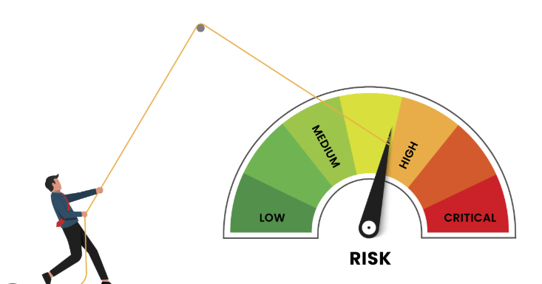
Key Risks of Bias
Inaccurate Assessments: Overlooking or misjudging risks.
Unfair Treatment: Disproportionate scrutiny of certain departments or individuals.
Reputational Damage: Loss of trust from stakeholders and regulatory bodies.

Slide 7
Scenario 1
The Athletics Department, a major financial contributor to the university, is now under audit due to concerns about its fund allocation, including scholarships, travel budgets, and equipment expenditures. The Internal Audit team, representing a variety of viewpoints on collegiate sports, is leading the review. Given some team members’ previous conflicts with the department, the audit leader is mindful of any potential biases that could affect the process. The focus of the audit will be to determine if the department’s financial practices are in line with the university’s values, particularly regarding the fair distribution of scholarships and resources for student-athletes.

Slide 8
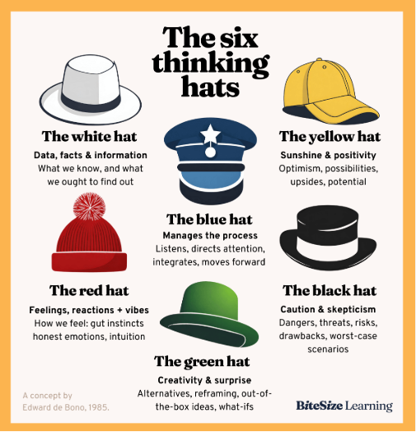
Approach to Scenario Evaluation
The 6 Thinking Hats technique, developed by Edward de Bono, is a structured method for group discussion and individual thinking.
It involves six metaphorical hats, each representing a different type of thinking. Each hat has a different color to help you remember the type of thinking involved.

Slide 9
Put on your thinking hats…….
White Hat: What are the financial records for the athletics department? How are scholarships, travel budgets, and equipment allocations documented? What data is available to show financial fairness or inequality?
Red Hat: How might the auditors feel about auditing a department they may have personal biases toward? How might athletes feel about the distribution of resources?
Black Hat: What are the risks of inequitable fund allocation? How could financial mismanagement affect the university’s reputation?
Yellow Hat: What positive changes could the athletics department make to ensure fairer resource allocation? How might this improve the university’s image?
Green Hat: What creative solutions could the audit team propose to make financial practices more transparent and inclusive? How can they engage the department in the audit process?
Blue Hat: What steps should the audit team take to ensure objectivity and fairness in the audit process, despite the team’s varying backgrounds and biases?

Slide 10
Polling Question #2
How confident are you in your ability to identify bias in your own internal audit work?
Very Confident
Somewhat Confident
Not Very Confident
Not Confident at All

Slide 11
Debrief….
Each group presents its findings from the perspective of their assigned Thinking Hat.
Keep in mind…………………………………………………………
What should be prioritized in the audit?
How can biases be managed?
What steps should be taken to ensure fair financial practices that align with the institution’s core values?

Slide 12
Polling Question #3
Do you feel that your audit team actively discusses and addresses potential biases during audits?
Yes, regularly
Sometimes, when noticed
Rarely, if ever
No, never
Notes:
Amaya to start here

Slide 13
Scenario 2
The university has implemented new hiring policies across departments to create a more representative workforce, with a focus on veterans and individuals with disabilities. These policies include mandatory implicit bias training for hiring committees, guidelines for fair candidate evaluations, and requirements to advertise positions broadly to attract applicants from these groups. The audit team is tasked with reviewing several departments to ensure compliance with these practices and to assess their effectiveness.
The audit team quickly discovers that departments vary widely in their adherence to the policies. Some have fully embraced the practices, while others are minimally compliant. Additionally, there is internal disagreement among the auditors: one team member believes strict adherence is necessary to meet the goals of supporting veterans and people with disabilities, while another feels that overly strict audits could discourage departments from genuinely engaging with these initiatives.

Slide 14
Put on your thinking hats…….
White Hat: What data is available to assess compliance with the inclusive hiring policies? How can the audit team measure the effectiveness of implicit bias training and equitable candidate evaluations?
Red Hat: What are the emotional responses from the audit team members regarding the flexibility of the audit process? How might department heads feel about being scrutinized for compliance?
Black Hat: What potential risks exist in being too strict in the audit? Could overly strict audits alienate departments this initiative? What are the risks of being too lenient in the audit process?
Yellow Hat: How might the hiring policies be improved to be more inclusive and engaging? What potential benefits could come from a more comprehensive implementation across departments?
Green Hat: What creative audit approaches could balance strictness with encouraging genuine engagement in inclusive hiring practices? How can departments be motivated to embrace inclusivity rather than merely comply?
Blue Hat: What audit methodology should the team adopt to ensure that they remain impartial and objective, despite internal disagreements about the degree of compliance needed? How can they foster collaboration within the audit team?

Slide 15
Debrief….
Each group presents its findings from the perspective of their assigned Thinking Hat.
Keep in mind…………………………………………………………
What should be prioritized in the audit?
How can biases be managed?
What steps should be taken to ensure fair financial practices that align with institutional values?

Slide 16
Reflection
How did the Six Thinking Hats help you explore these complex audit challenges?
What did you learn from applying this methodology?
How can insights from the workshop be applied in your own audit practices?
Notes:
Create handouts to email

Slide 17
Polling Question #4
After this session, what is the most important step you will take to reduce bias in your audit process?
Incorporate structure decision-making tools or checklist
Engage in peer reviews or second opinions to challenge my findings
Seek out diverse perspectives before finalizing audit conclusions
Educate myself and my team on the different types of biases
Other

Slide 18
Key Takeaways
The Six Thinking Hats can facilitate balanced, objective decision-making in complex audits.
It is important to manage personal biases, especially when auditing emotionally charged or high-profile areas.
.

Slide 19
Additional Resources
De Bono, E. (1985) Six Thinking Hats. Little, Brown and Company.
Chin, A.K.Y (2022). Recognizing and Mitigating Cognitive Biases. Internal Audit Foundation.

Slide 20
University of Oregon
Anta Coulibaly
Yale University
Scott Ngo
University of Tennessee
Amaya Beck
Questions and Thank you!

