Slide 2
Continuous Audit is Dead... Long Live Collaborative Analytics!

Slide 3
Today’s Presenter
Morgan Page, CIA
Partner-in-Charge, Digital Transformation and Automation Services
13+ years of experience working with organizations at all stages of their digital transformation journey defining and delivering results that are sustainable, scalable and aligned with the needs of the organization.
Programs in multiple languages and has an in-depth knowledge of accounting and operations, which provides unique insights for his clients.

Slide 4
Today’s Agenda
A Brief History of Continuous Analytics
What is the Pot at the End of the Rainbow?
Why have Analytics Failed in the Past?
What are Collaborative Analytics… and What is Different?
What has made Collaborative Analytics Possible?

Slide 5
A Brief History of Continuous Analytics

Slide 6
A Brief History of Continuous Analytics
Early Adoption: 1980s-1990s
Emergence of basic computer-assisted audit tools (CAATs)
Use of spreadsheets for data analysis
Initial focus on data sampling
In 1985 a tool was created that brought analytics to the world… Excel!

Slide 7
A Brief History of Continuous Analytics
Development Phase: 2000s
Introduction of more sophisticated auditing software
Increased use of data analytics for fraud detection
Integration of data analytics into audit planning

Slide 8
A Brief History of Continuous Analytics
Modern Era: 2010s-Present
Adoption of continuous auditing and monitoring techniques
Real-time data analytics and big data integration
Artificial intelligence and machine learning in audit processes

Slide 9
What is the Pot at the End of the Rainbow?

Slide 10
The Analytics Awesomeness
Enhanced Risk Identification and Management
Proactive identification of emerging risks
Continuous monitoring of key risk indicators
Improved Audit Efficiency
Streamlined audit processes
Reduced time and effort for data collection
Real-Time Insights and Decision Making
Real-time data analysis
Faster identification of anomalies and issues

Slide 11
A Case In Action
General Ledger Error Modeling
A Machine Learning Model trained on historical errors
Evaluated posted entries weekly
Identified high-likelihood error entries for review
Duplicates Analysis and Vendor Integrity
Identifies potential duplicate transactions outside of the standard application controls
Identifies data-import control circumventions
Identifies operationally unused vendors
Identifies statistically significant item level spend
One client saved over $500,000 of duplicate payments in a 3 year period.

Slide 12
Why have Analytics Failed in the Past?

Slide 13
The Analytics Awesomeness
Lack of Clear Objectives and Scope
Undefined Goals: Programs often fail due to the absence of clear and specific objectives.
Misaligned Scope: If the scope is too broad or not well-defined, it can lead to inefficiencies and missed targets.
Insufficient Stakeholder Engagement
Lack of Collaboration: Failing to engage key stakeholders, including business owners and IT, can result in misaligned priorities and lack of support.
Poor Communication: Inadequate communication channels can lead to misunderstandings and resistance.

Slide 14
The Analytics Awesomeness
Inadequate Technology and Data Infrastructure
Outdated Tools: Using outdated or inappropriate tools can hinder the efficiency and effectiveness of the program.
Data Quality Issues: Poor data quality and integration problems can lead to inaccurate analysis and insights.
Insufficient Expertise and Training
Lack of Skilled Personnel: The absence of team members with the necessary skills to manage and analyze data can cripple the program.
Inadequate Training: Failing to provide continuous training and development can result in skill gaps.

Slide 15
The Analytics Awesomeness
Resistance to Change and Organizational Culture
Change Management Issues: Resistance from staff due to fear of change or lack of understanding can impede program implementation.
Cultural Barriers: An organizational culture that is not supportive of continuous auditing can lead to failure.

Slide 16
What are Collaborative Analytics… and What is Different?

Slide 17
What are Collaborative Analytics?
Collaborative analytics are analytics that align and support the business process objectives through the use of descriptive, predictive, or proscriptive analytics and also serve to enhance the operation or visibility of the control environment.

Slide 18
What are Collaborative Analytics?
How is this different than what we did before?
Historically continuous analytics or continuous audit were performed to the auditee, not with them.
This process also engages the organic knowledge of the business rather than the academic knowledge of the audit shop.
Collaborative analytics are different because they (or their boss) cares about the results being generated.

Slide 19
How do you find them?
Nearly every organization has some digital project, your goal is to identify:
Who is upgrading / implementing an analytics platform
Who is looking at KPI’s and how to better monitor them
Who has difficulty filling FTE’s
Who is on a modernization journey

Slide 20
How do you build them?
Step 1: Identify key stakeholders
Not just executives, but the people who do the processing
Step 2: Define objectives and expectations
Align both business AND internal audit objectives
Step 3: Establish clear communication channels
Development is a process, every mistake does not need to wind up at the executive table

Slide 21
What has made Collaborative Analytics Possible?

Slide 22
What is changing?
Technology Supplemented Work
Technology is Where Work is Done
Technology Does the Work
The Drive for AI has created an ecosystem of technology that not only supports analytics but demands it!

Slide 23
What IS AI (in General)?
AI is a decisioning feature focused on returning results positively inclined toward an objective that uses three primary avenues to perform its functional operation including:
A set of “guiding principals” or foundational decisions
A historical context of processed data
A heuristic relational evaluation function

Slide 24
Let’s Break It Down
AI is a decisioning feature focused on returning results positively inclined toward an objective that uses three primary avenues to perform its functional operation including:
A set of “guiding principals” or foundational decisions
A historical context of processed data
A heuristic relational evaluation function
Feature – AI is a component, not an end in and of itself.
Positively Inclined – It is never certain, but is as certain as the threshold you assign.
Guiding Principals – Like the speedlimit… you generally stay near it.
Historical Context – Telling it times where it worked or didn’t … this is a plane, this is not.
Heuristic Relational Evaluation Function – You didn’t tell me this, but when Billy wears a yellow tie, he orders 10% extra.

Slide 25
AI (and analytics) Kryptonite Is Data!
CURATED DATA
DATA LITERACY
DATA CONSISTENCY
AI requires a curated data set that limits “null” values or values outside of the expected parameters.
Quantity can make up for quality by allowing you to throw out transactions not to specification.
AI requires people with knowledge of the data story at least initially.
More than knowing what the data says, these people have to explain what that means to the transactional process.
Changes in data collapse model capability.
Integration methodologies must adapt to embed consistency checks within the process.

Slide 26
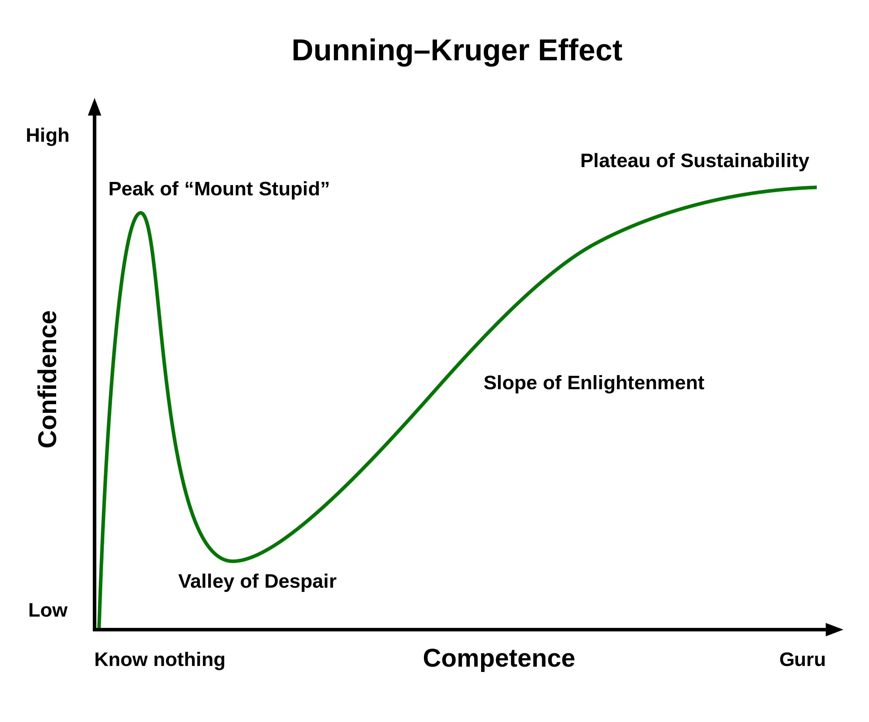
AI Adapts While Not Adapting
AI implementation increases organizational agility but decreases process adaptability.
AI provides better insights, lets you operate faster, helps adapt decisioning to a near real time cadence.
You cannot change the foundational processes without significant reinvestment in the AI support.
The development of an AI solution follows the same developmental path as a person including the Dunning-Kruger Effect.

Slide 27
Morgan Page, CIA
Partner-in-Charge, Digital Transformation & Automation

