Slide 2
Copy Here
Agriculturally Speaking

Slide 3
Copy Here
Agriculturally Speaking
Objectives:
Develop a risk profile for agriculture operations.
Develop audit procedures to address those risks.
Develop recommendations to add value while respecting the industry differences and the ultimate goal of student success.

Slide 4
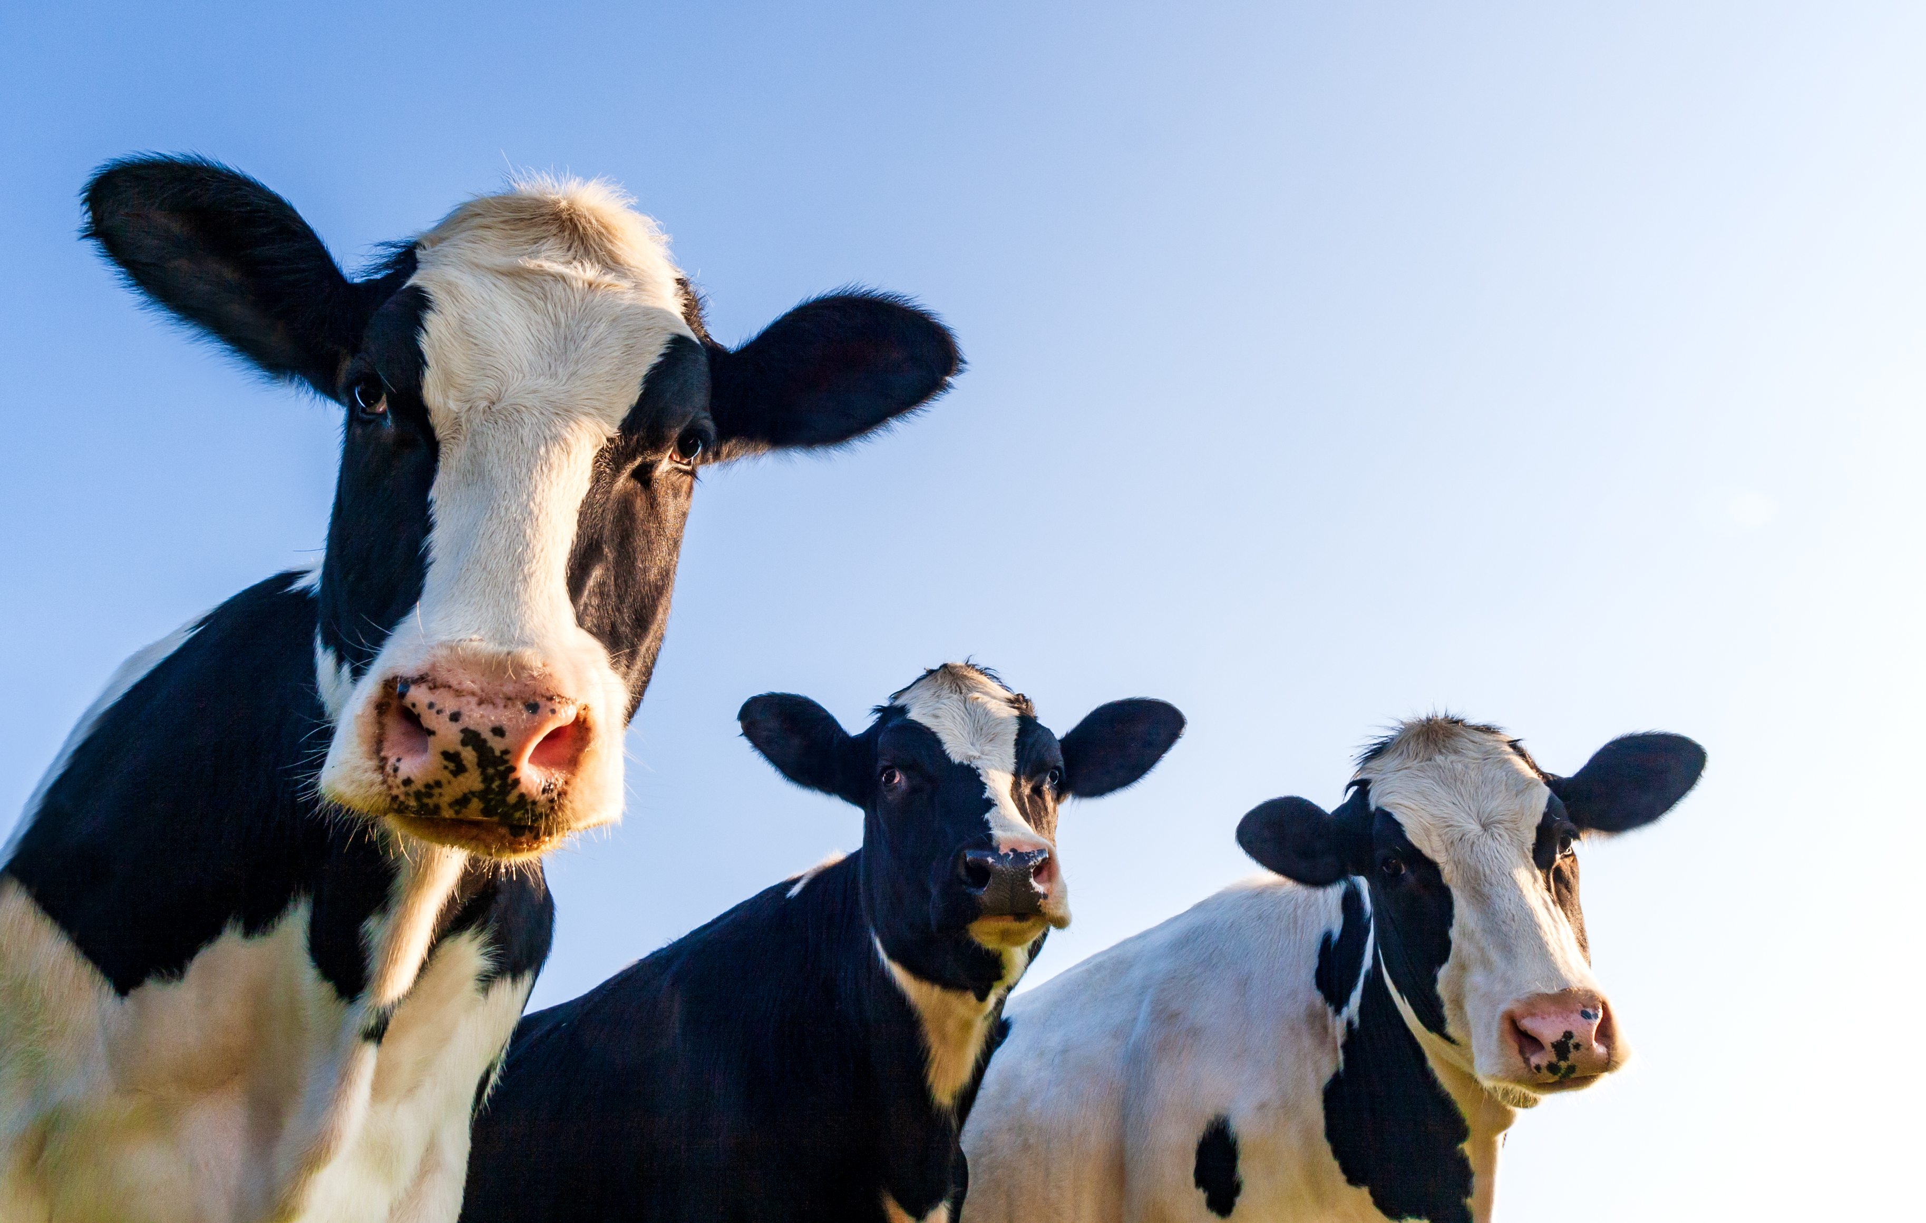
Understanding the industry

Slide 5
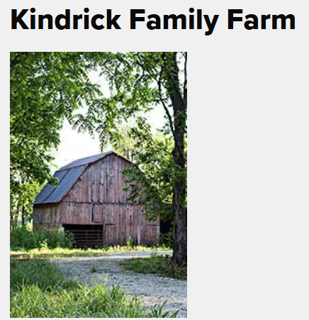
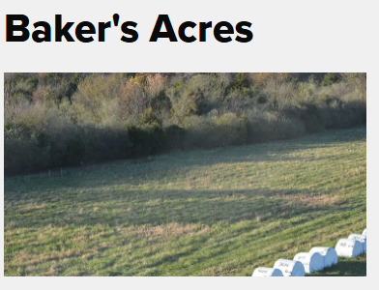

Slide 6
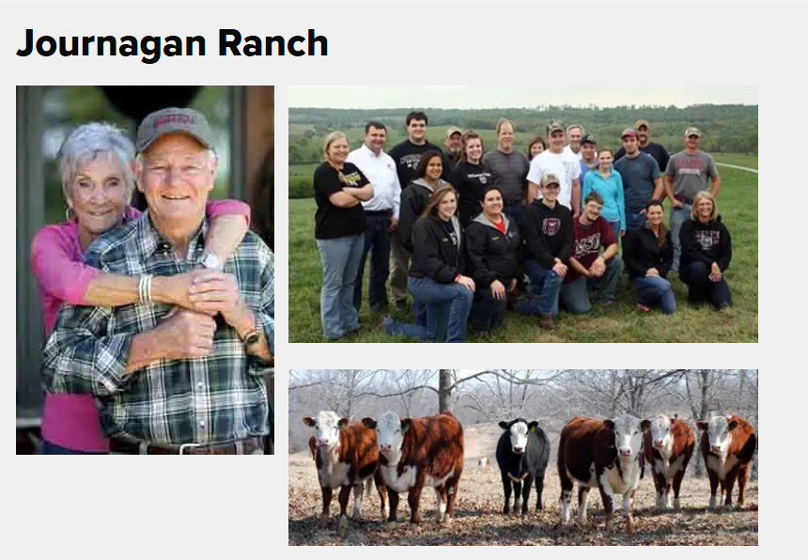

Slide 7
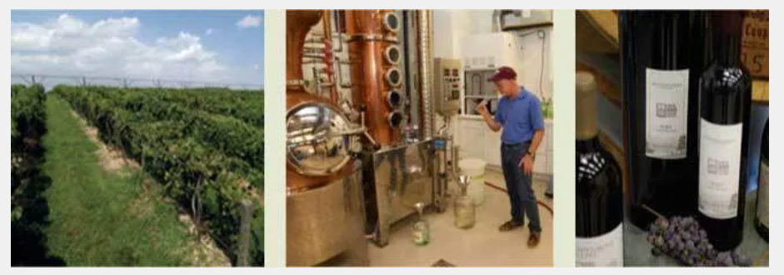

Slide 9
Building a Risk Profile

Slide 10
Sale of agricultural products
Cash controls
Inventory
Revenues/Expense/Payroll Procedures
Nepotism/Conflicts of Interest
Budgets & Financial Statements
Compliance with university policies and procedures
Compliance with local, state, and federal law/regulations

Slide 11
Information Technology/Services
Control Environment/Culture
Use of Assets (land, buildings, equipment, etc.)
Deferred Maintenance
Safety of employees, animals, and others
Planning (Strategic, Facilities, Technology, etc.)

Slide 12
Audit Procedures Applied

Slide 13
Sale of Agricultural Products
Identify products sold
Identify methods of sales used
Determine marketing strategies
Determine how goods are priced
Ask about sales to employees
Contracts?
Discounts?
Policy?

Slide 14
Cash Controls
Surprise Cash Count
Issuance of receipt slips
Endorsement of checks
Use of point-of-sale system
Timeliness of deposits
Separation of duties
Security of cash assets
Proper use of change fund
Proper use of petty cash
Online storefront processing

Slide 15
Inventory
Procedures for receiving
Procedures for spoilage
Procedures for surplus
Procedures for physical inventory
Procedures for out of date
Security of inventory
Separation of duties
Consignment?

Slide 16
Revenues/Expense/Payroll Procedures
Revenues | Expenses | Payroll
Appropriate fund for financial statement preparation | Appropriate fund for financial statement preparation | Appropriate fund for financial statement preparation
Accounts receivable | Accounts Payable | Timekeeping
Periodic reconciliations | Periodic reconciliations | Periodic reconciliations
Record retention/supporting documentation | Record retention/supporting documentation | Record retention/supporting documentation
Separation of duties | Separation of duties | Separation of duties
Conflict of interest | Conflict of interest | Nepotism

Slide 17
Budgets & Financial Statements
Budgets
Involvement of key stakeholders in budget process
Budgets for all funds
Monitoring procedures to ensure budgets are not exceeded
Financial Statements
Development of meaningful financial statements
Timeliness of financial statements
Use in planning and management decision making
Valuation of assets

Slide 18
Compliance
University policies
Food safety regulations
Fair Labor Standards Act
Various Product Labeling and Marketing regulations
Occupational Safety and Health Administration (OSHA)
Department of Natural Resources (DNR)
U.S. Environmental Protection Agency (EPA)
Institutional Animal Care and Use Committee (IACUC)

Slide 19
Information Technology/Services
Asset listings
Asset controls (user IDs, passwords, etc.)
Asset security (environmental, physical, etc.)
Window 10 end-of-life
Technology plans
Backup procedures
Third-party service providers
Third-party use of network
Transfer of restricted data to third-parties

Slide 20
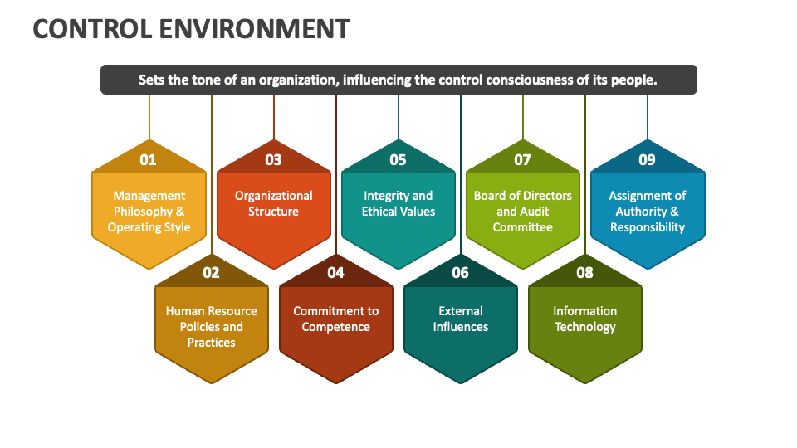
Control Environment

Slide 21
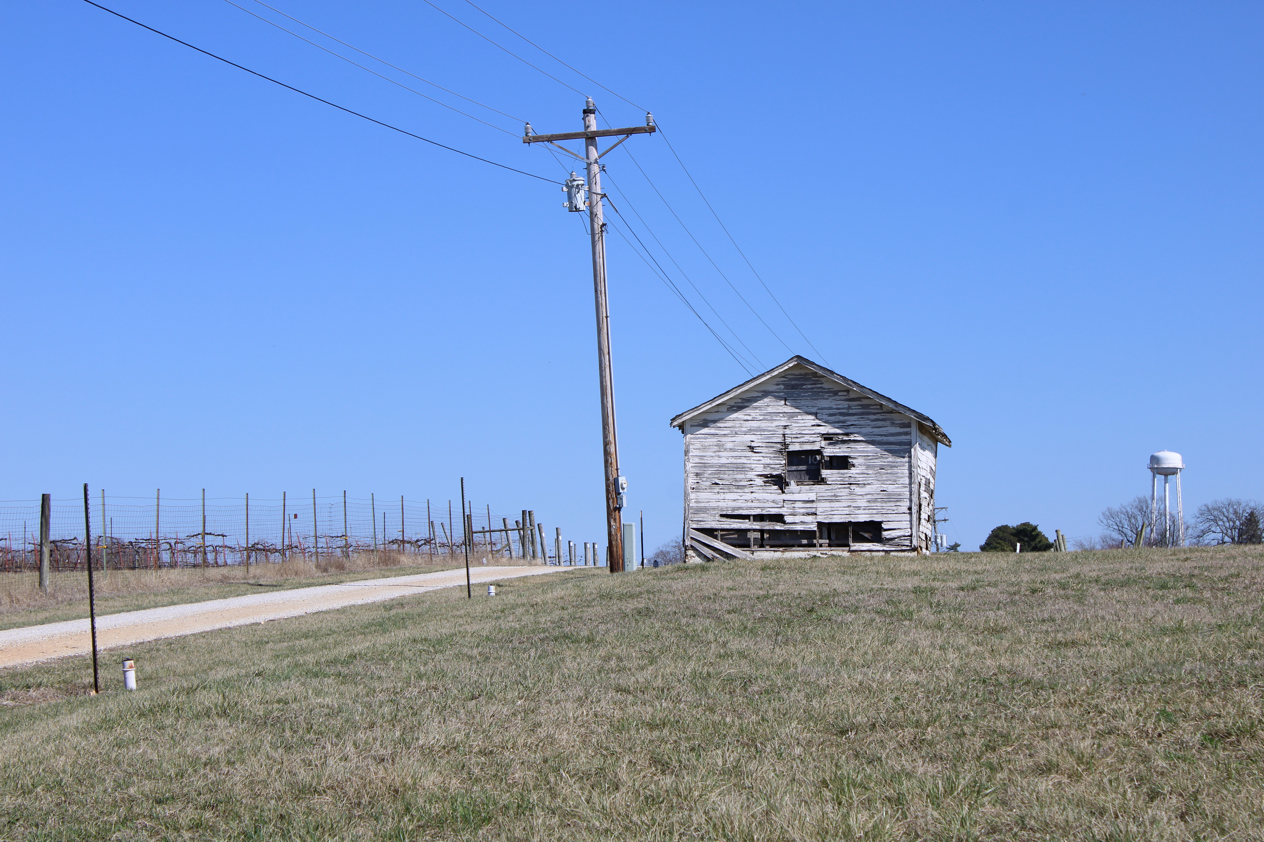
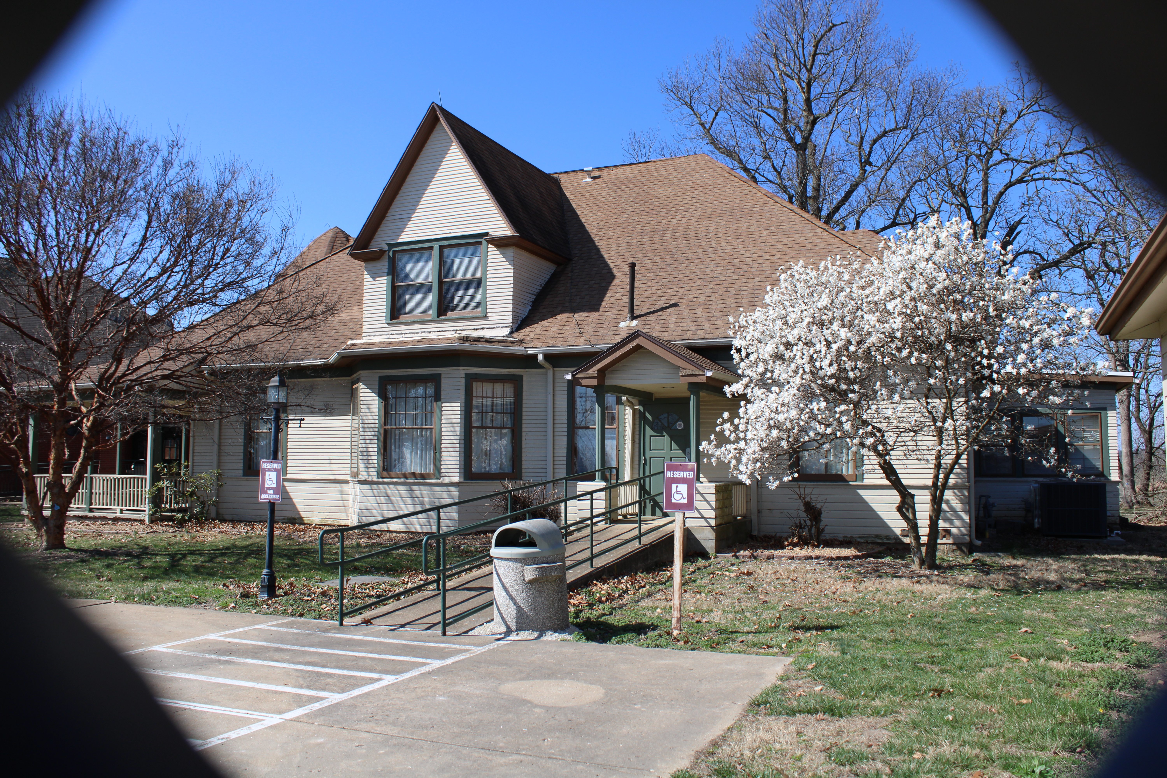
Use of Assets/Safety
Use of Space
Use of Equipment
Access to Space and Equipment
Deferred Maintenance
Facility Planning
Third-Party use
Policies

Slide 22
Recommendations

Slide 23
Reporting
Pick the appropriate reporting method and audience.
Ensure open communication has occurred throughout the audit. No surprises.
Start with why.
Focus on the people.
Give credit where credit is due (reported or presented).
Recommendations must be direct. Anything not written likely won’t happen.

Slide 24
Natalie B. McNish, CFE, CGAP
Missouri State University – www.missouristate.edu
Missouri State University – West Plains – www.wp.missouristate.edu
901 S. National Ave.
Springfield, MO 65897
NatalieMcNish@MissouriState.edu
(417) 836-5110 phone

