Slide 2
Decoding the Business of Higher Education:
Insights for Auditors
Sandy Jansen, CIA Kim Turner, CPA
Chief Audit Executive Chief Audit Executive
The University of Texas at Austin Texas Tech University System

Slide 3
Learning Objectives
Evaluate various organizational structures, including governance models and administrative hierarchies.
Navigate and address the unique challenges of the higher education environment.
Recognize and analyze both existing and emerging risks specific to the higher education sector, enhancing their risk assessment skills.

Slide 4
The Higher Education Landscape

Slide 5
Higher Education Models
Public vs. private
Independent vs. system
For-profit vs. Not-for-Profit
Carnegie classification
R1 – Doctoral/very high research
R2 – Doctoral/high research
Many others by size/focus
Military academies and colleges
Land grants
Health-related institutions
Historically Black/Tribal/Hispanic Serving
Liberal arts colleges
Community colleges/Technical schools
Notes:
Kim
Carnegie Classifications – Very high research = $50M in TRE and 70 doctoral degrees. High research = $5M and 20 doctoral degrees.
Military academies – college institutions that train students for military service.
5 US Military Academies: USMA at West Point, NY, US Naval Academy in Annapolis, MD; USAF in Co Springs; US Coast Guard Academy in New London, CN; US Merchant Marine Academy in Kings Pt, NY.
Other Military Colleges – TAMU, Virginia Tech, Virginia Military Institute, Norwich University, The Citadel, Univ of N. Ga.
Land grants – in the 1800s, the federal govt granted federal land to states; the states then used proceeds from selling portions of the land to establish public colleges. The original mission of these colleges was to teach agriculture, military tactics, and “the mechanic arts” aka engineering – plus liberal arts – so members of the working class could gain a practical education. These universities had to establish an ag experiment station program, which is jointly funded by the feds and each state.
HRIs – health related with medical, nursing, pharmacy, health professions, etc.
HBU/Tribal/Hisp-serving – originally defined by the communities they served, which were not otherwise served by early colleges/universities.
Liberal arts colleges – broad education focusing on arts, sciences, humanities, and social sciences.

Slide 6
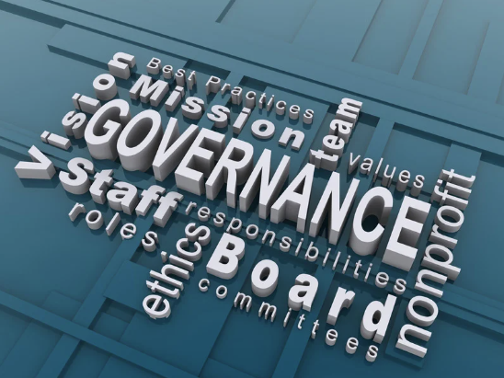
Governance
Board (of Regents/Trustees/ Directors/Visitors/Curators/ Overseers/etc.)
Public – appointed or elected
Private – chosen by existing board, foundation board, alums, or a governing council
Chancellor/President
Vice chancellors/VPs
Provost, Dean, Chair
The Academy (aka faculty)
Shared governance
Faculty Senate
Notes:
Kim
Board – public boards may be appointed by the governor, state legislature, or elected by the state’s voters.
Old criteria said ideal board members have 2 of 3: Work, Wisdom, Wealth (or Time, Talent, and Treasure)
New criteria include those 3 plus Witness (help integrate core values in setting policies and talk up the org) and Wallop (what one thing could my position and network accomplish that no one’s else can?)
CEO – different states/orgs use different terms.
Cabinet – hard for me to adjust to these weird titles when I first came into higher ed.
Academic positions: What the heck is a Provost?
Shared governance – AGB says “Shared governance is foundational tenet of higher education. It acknowledges the final institutional authority of governing boards and distributed authority to the administration and faculty. Traditionally, governing boards delegate the responsibility of strategic planning and daily management to presidents, while faculty lead educational delivery. Delegation of authority between key constituents on campus strengthens institutions by championing meaningful engagement and inclusive, transparent decision-making.”

Slide 7
Academic Concepts
Tenure and promotion
Academic freedom
Academic workload
Faculty development leave
Adjunct faculty/professors of practice
Principal Investigator
Notes:
Kim
Tenure and promotion – TTU: Tenure is designed to assure the faculty freedom in teaching, research, opinion, and full participation as citizens in the community. The purpose of academic tenure is also to retain a body of faculty best qualified to help develop and execute the core university mission of advancing knowledge and educating students. The purpose of promotion at TTU is to recognize and reward faculty with records of sustained professional accomplishment that contribute to that mission. Tenure aims at the retention, encouragement, and promotion of the ablest and most promising faculty.
Involves a probationary period – often 6 years
Evaluation of work product by tenured faculty in dept, approval by college, and faculty vote
After tenure – periodic reviews to ensure continued work product, service, etc.
Academic freedom – TTU: “A university is a community of scholars whose members are engaged in the discovery, evaluation, transmission, and extension of knowledge. As such, they must be free to search for and express the truth as they find it, whether in the classroom, research/creative activity, or service as members of the community, and regardless of their tenure status. They must also be free from undue constraints, whether imposed from inside or outside the university.”
Academic workload – differs by university and even by school (i.e., SON, SOM, SOHP, etc.) but typically has an expectation of a combination of components including teaching, research, and service with complicated formulas for tradeoffs (e.g., serving as a chair/associate dean/etc. may replace most teaching requirements.)
Faculty development leave – leave for study, research, writing, field observations, or other suitable purposes. Usually paid but may be unpaid or supplemented by grants.
Adjunct faculty/prof of practice – typically hired for their extensive experience or expertise in business, government, etc. Primary responsibility is usually teaching.
Principal Investigator – term for faculty performing funded research.

Slide 8
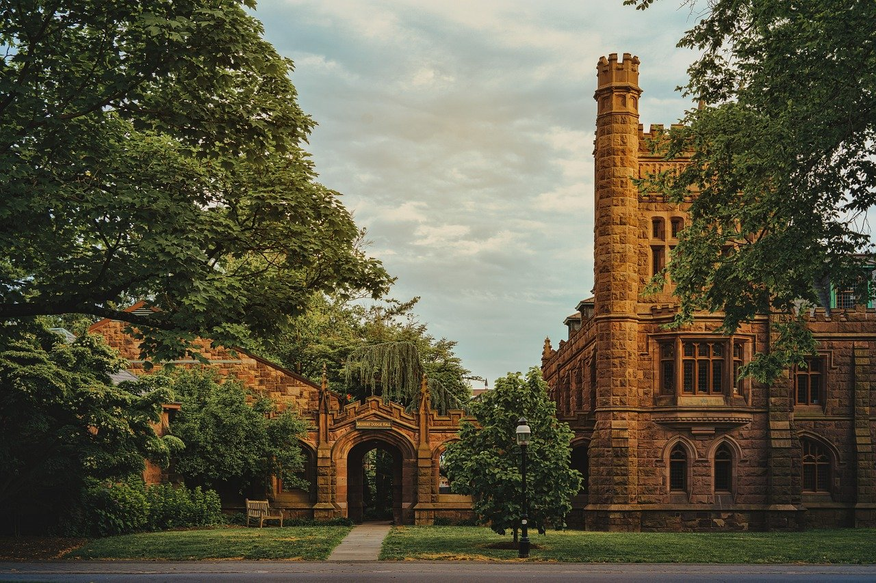
Oldest Colleges
In America
Notes:
Fun Quiz on the 10 oldest colleges in America. (10 minutes)
Don’t look at phones… This is a quiz. Working with your tablemates, prepare a list of the 5 oldest schools in the US. And what year the school was founded within 10 years.
5 oldest schools, what year founded.
Debrief.
Bonus—Who claims to be the oldest public university in the US? What school is the birthplace of PUBLIC Higher Education in America: University of Georgia was chartered by the state of Georgia in 1785. University of North Carolina was the first public university to graduate students. College of William and Mary was a private institution for over 200 years until 1906.

Slide 9
Key Historical Events
1862: The Morrill Act
1890: Second Morrill Act
1944: The GI Bill
1958: National Defense Education Act
1965: Higher Education Act
1972: Title IX amendment to the Higher Education Act
1989: University of Phoenix offers the first fully online degree
1996: First online university
2010: 21 million enrolled in US colleges and universities
2014: More US women earning bachelor’s degrees than men.
2022: The CHIPS Act
Notes:
Sandy – Key historical events that have had an impact on higher education!
1862: The Morrill Act. Granted public land to states to establish colleges and universities. Proposed in 1857 by Rep. Justin Morrill. The act laid the foundation for a national system of state colleges and universities.
1890: Second Morrill Act. Established separate land-grant institutions for black students. Historically black universities and colleges.
1944: The servicemen’s readjustment act—The GI Bill of Rights, provided to WWII Veterans. FDR signed into law June 22, 1944. It put higher education within the reach of millions of veterans of WWII and later military conflicts.
1958: National Defense Education Act.
1965: Higher Education Act.. Title IV—authorized financial aid to students (Pell, loans, work-study).
1972: Title IX amendment to the higher education act
1989: University of Phoenix offers the first fully online degree
1996: First online university
2010: Enrollment reached 21 million. All time high.
2014: First time that women earning bachelor’s degrees exceeded men in US.
2022: Creating Helpful Incentives to Produce Semiconductors for America Act (CHIPS) and Science Act of 2022
Sputnik
The launch of Sputnik that focused the nation on science education and encouraged students to pursue science and engineering

Slide 10
Landscape at a glance
Financial matters
Information technology
Regulatory requirements
Safety and security
Research
Social and cultural
People
Notes:
Sandy
HIGH LEVEL HERE
We will delve into each of these – both from an operational standpoint and to examine current events and emerging risks related to them. Break out after each 2 risk areas.

Slide 11
Operational aspects – Financial Matters
Financial control
Moderately --> highly decentralized
Organizational differences
Deferred maintenance costs
Space utilization
Notes:
SANDY
Financial control usually ranges from moderately centralized to highly decentralized. Some funds are normally controlled by President/CFO/Provost; each college/dean usually controls some funds; department chairs may or may not control funding, but are normally involved in financial decisions; sometimes individual faculty members may control some institutional funds in addition to any grant funds they’re PI for. Strong Provost/Weak Dean | CFO-controlled vs. Provost-controlled
Decentralized control structure. Example: 19 colleges and schools with deans, with a number of departments within each department. 1 college, Liberal Arts has 25 departments.. All with their own departmental controls and structures.
There are differences in organizational structures for where specific departments/areas report – example: SFA may report to CFO, student affairs, or provost. Physical plant may report to CFO, FP&C, or COO. Or be a VP themselves
Deferred maintenance – huge cost, why are we so far behind? It’s like the national debt – just keeps building. At UT Austin--$2Billion. Other large publics in the same exact boat.
P3s and the future of P3s on infrastructure.
Space utilization – as campuses grow student bodies, they try to do more with existing resources. State institutions require reporting and may not approve new buildings if existing spaces aren’t utilized fully. COVID impacts to space utilization.

Slide 12
Current events & emerging risks –
Financial Matters
Declining state support
Declining federal grant funding
Enrollments
Tuition and fees
Increased reliance on “outside” income
Student options to finance education
Demonstration of economic impact
Lack of investment in infrastructure
Endowment taxes
Notes:
SANDY
Reductions in state support, federal grant funds
Declining enrollments—enrollments were declining until fall 2024, now back to pre-pandemic levels.
Higher tuition/fees (leads to demands for accountability in spending, questions about the value of degrees, more dual enrollment coursework) BUT WAIT… many schools are experiencing tuition freezes since the pandemic!
Increased reliance on “outside income” – endowment earnings, grant funding, donations, business enterprises (e.g., athletics), public private partnerships
Student options – universities starting to focus on student debt impacts—schools offering “free” tuition to certain groups under $. Last dollar scholarships.
Demonstration of economic impact to stakeholders – including feds, state (for publics), students/parents—and demonstrating that careers will cover debt for college.
Lack of investment in infrastructure. Buildings. IT. Other.

Slide 13
Operational aspects – Information Technology
Involvement in University strategic planning
Centralization/decentralization
ERP systems
IT security
Third-party and IT procurement
Cloud computing
Notes:
SANDY
Ranges from almost complete control (centralization of all major systems and IT input to those owned/managed by others) to a small central IT function to manage enterprise resource planning (ERP) systems (HR, student, financial), central email, the network, and other centralized technology solutions with all other IT decentralized.
Part of the confidential reporting packet that Cam (ISO) provides to the audit committee: On average, UT Austin experiences 15 million attacks each day.

Slide 14
Current events & emerging risks – Information Technology
Artificial Intelligence
Data analytics
CISO reporting lines
Device management
Breach prevention and response
Security and Privacy training
Notes:
SANDY
“Securing the human” (© SANS Institute)

Slide 15
Breakout Discussion
What audits could you conduct to address these financial or IT-related risks?
Notes:
STOP FOR BREAKOUT –
STOP FOR BREAKOUT – WHAT AUDITS COULD YOU DO THAT WOULD ADDRESS THESE FINANCIAL OR IT-RELATED RISKS?

Slide 16
Operational aspects – Compliance
Federal regulatory and funding agencies
State statutes
Accreditation bodies
Information technology/cybersecurity
Donors and grant providers
Bond covenants
NCAA (Hello…Bueller…??)
Notes:
KIM
Compliance: Significant regulatory requirements from many sources: federal regulatory or funding agencies (OCR, DOL, DHHS, IRS, Depts of Ag, Energy, Defense, Education, Homeland Security, HUD, Transportation, VA, the Interior, etc.), state agencies/legislative bodies, grantors, donors, accreditation bodies, hospitals, etc. Related to HR, student affairs, research, athletics, investigations, health care, privacy/security, IT resources, bond compliance, investments, other business activities (which may be taxable).
Resource: Catholic University’s compliance universe

Slide 17
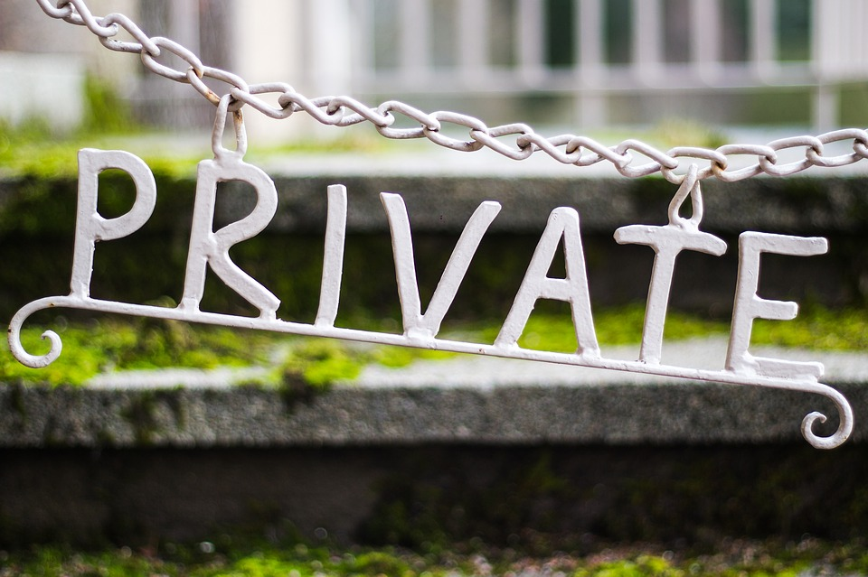
Current events & emerging risks – Compliance
President Trump’s Executive Orders
Foreign influence – state and federal regs
College athletics
Privacy regs – federal, state, international
DEI/DEIA – federal/state
Notes:
KIM
Trump’s Exec Orders: A lot of these impact higher education! Title IX, funding for scientific research, DEI prohibitions, foreign influence, immigration and international students,
Foreign influence, including CMMC requirements.
College athletics
The House Settlement and Biden’s last minute exec order stating funding from NIL and even from revenue distribution must be distributed in accordance with Title IX.
Since football and men’s basketball (and occasionally baseball and women’s basketball) provide funding for all other sports, this requirement could inadvertently cause the loss of most women’s and Olympic sport programs currently in existence.
Privacy - GDPR (Europe) and CCCP (California) both have worldwide implications. FERPA, HIPAA (PHI), GLBA (banking info),
WHAT OTHER COMPLIANCE ISSUES ARE YOU DEALING WITH?
STOP – WHAT AUDITS COULD YOU DO THAT WOULD ADDRESS THESE RISKS?

Slide 18
Operational aspects – Safety and Security
Campus fire and police
Event management (including “unplanned” events)
Campus living communities
Emergency response plans
Traffic/pedestrians
Golf carts, rental scooters
Notes:
KIM
Campus PD and fire
Clery Act and relationships with City PD/Fire
Emergency planning
Notifications
Assessments and drills
Event management – games, concerts, graduations, PROTESTS
Campus living – fire safety, food safety, security of entrances
Emergency response plans –
TTU Shooting of Officer East
DPS safety review
CS Gold audit
Lockdown capability
Traffic/pedestrians – ASU considering closing a city street through campus. Working with City.
Golf carts, scooters

Slide 19
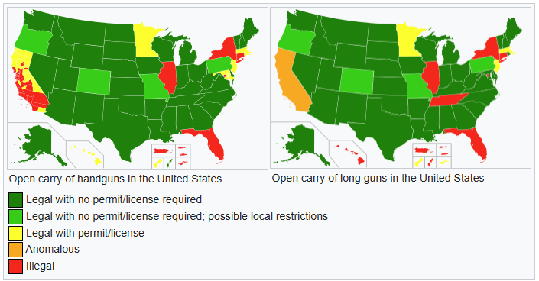
Current events & emerging risks –
Safety and Security
First amendment rights
Protesters on campus
Clery Act
Campus carry
Scooter/bike programs
Notes:
KIM
First amendment rights – TX changes in free speech laws (SB 18) – 16 other states have adopted or are considering similar laws:
Requires public colleges and universities in Texas to follow stricter, more uniform policies regarding free speech on campus.
TX universities can’t decide whether or not to schedule a speaker based on “any anticipated controversy related to the event” — though they can consider security needs.
Can’t limit free speech to certain zones on campus. Instead, all common outdoor areas will be treated as “traditional public forums.”
There will also be a new process for complaints of potential free speech violations. And Texas higher education institutions will have to submit reports to lawmakers on how they’ve followed the new free speech rules.
Protesters on campus
Clery Act – in 2024, DOE assessed the highest Clery fine ever - $14M (previous highest $4.5M) to Liberty University for failures on multiple levels. Didn’t help victims, didn’t properly investigate crimes, didn’t disclose information to protect the campus community, created a “culture of silence.”
Campus carry – whose campus allows? Proposed federal legislation National Constitutional Carry Act would allow open carry in every state. Most states already allow open carry
Scooter/bike programs – UT has a geofence to slow down scooters after 2 student deaths (RIGHT?) – Sandy to discuss?

Slide 20
Operational aspects – Research
Proposal development and submission
Award management
Research compliance
Campus-level collaborative research
Commercialization
Research Integrity Officer
Notes:
Sandy
Proposal Development and Submission
Award Management-Post Award/ Sponsored Projects
Research Compliance—Key Committees/Processes
the Institutional Review Board (IRB), Institutional Animal Care and Use Committee (IACUC), Institutional Biosafety Committee (IBC), and Conflict of Interest (COI) sections. ensure that all research conducted on campus complies with all applicable laws, regulations, and University policies.
Campus-level collaborative research
Commercialization –This team/office helps employees protect and commercialize the universities’ inventions that are patentable or copyrightable. Many faculty have
Research Integrity

Slide 21
Current events & emerging risks –
Research
Changes in federal science agencies
Changes in DEI and DEIA laws
Research integrity issues
Transfer of grants
Notes:
Sandy
NIH Freezes
Ex Order “Ending illegal Discrimination and restoring merit-based opportunity” Jan 21, 2025
Tranferring grants as high performing faculty are recruited.
Increase in research integrity issues.

Slide 22
Breakout Discussion
What audits could you conduct to address these compliance, safety, security or research risks?
Notes:
STOP FOR BREAKOUT –
STOP FOR BREAKOUT – WHAT AUDITS COULD YOU DO THAT WOULD ADDRESS THESE COMPLIANCE, SAFETY, & SECURITY RISKS?

Slide 23
Operational aspects – Social and Cultural
Online presence
Athletics
Greek system
Student organizations
Museums, art, music, theatre
Notes:
SANDY
Online presence that is controlled by University
Who can access?
How monitored?
Outdated websites – risk for recruiting best students
Athletics is often the front door to the univ – especially for D-1 schools
Greek – pros and cons
Public perception of negatives – alcohol, hazing
Positives – big donors, higher grades than non-Greeks, students more engaged on campus, leadership training
Student organizations – can generate controversy
Artistic endeavors
Lot of outside visitors
Protection of collections – fire, burglary, weather

Slide 24
Current events & emerging risks – Social and Cultural
Post-pandemic presence
Greater diversity than ever
Town/gown relationships
Social media
Protesters
Politics
Notes:
SANDY
Post pandemic presence: Impacts to student learning.
Social and cultural
Greater diversity than ever– multi-generational with more ‘non-traditional’ students, high number of first gen students, international students – especially graduate, women/men almost equal. Trying to meet the needs of all groups.
Town/gown – Clash of cultures between campus and the city or state
Social media OUTSIDE of univ control – positive aspects mean instant marketing directly to consumers; negative aspects mean bad news (real or fake) travels instantaneously across the US and the world.
Politics are intensified on a college campus. Polarizing opinions, underdeveloped brains, lack of world experience
STOP – WHAT AUDITS COULD YOU DO THAT WOULD ADDRESS THESE RISKS?

Slide 25
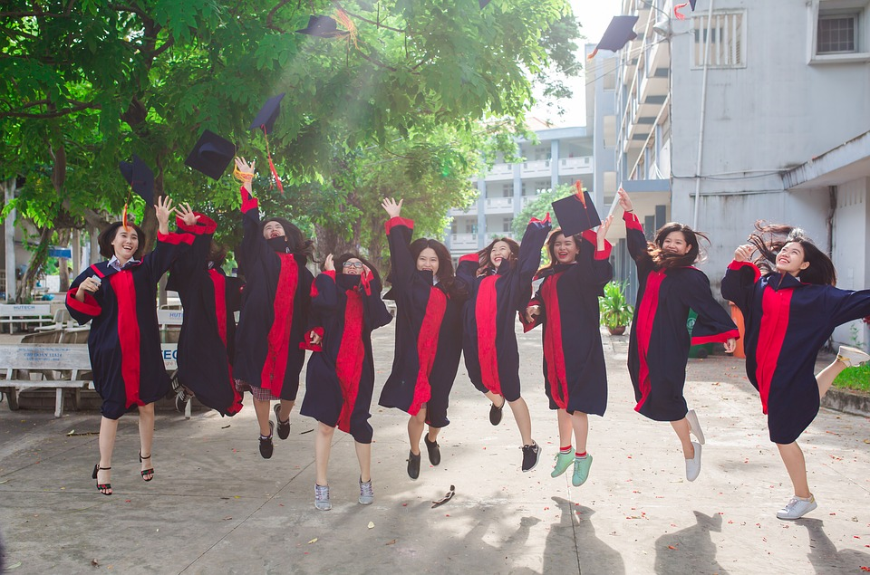
Operational aspects – People
Faculty, staff, and students
Unions
Interrelationships on campus
External constituents
Alumni
Visitors
Parents
Notes:
Kim
Faculty – includes PIs
Student government
Interrelationships on campus
Academics and student affairs
Athletics and academics
Faculty and administration

Slide 26
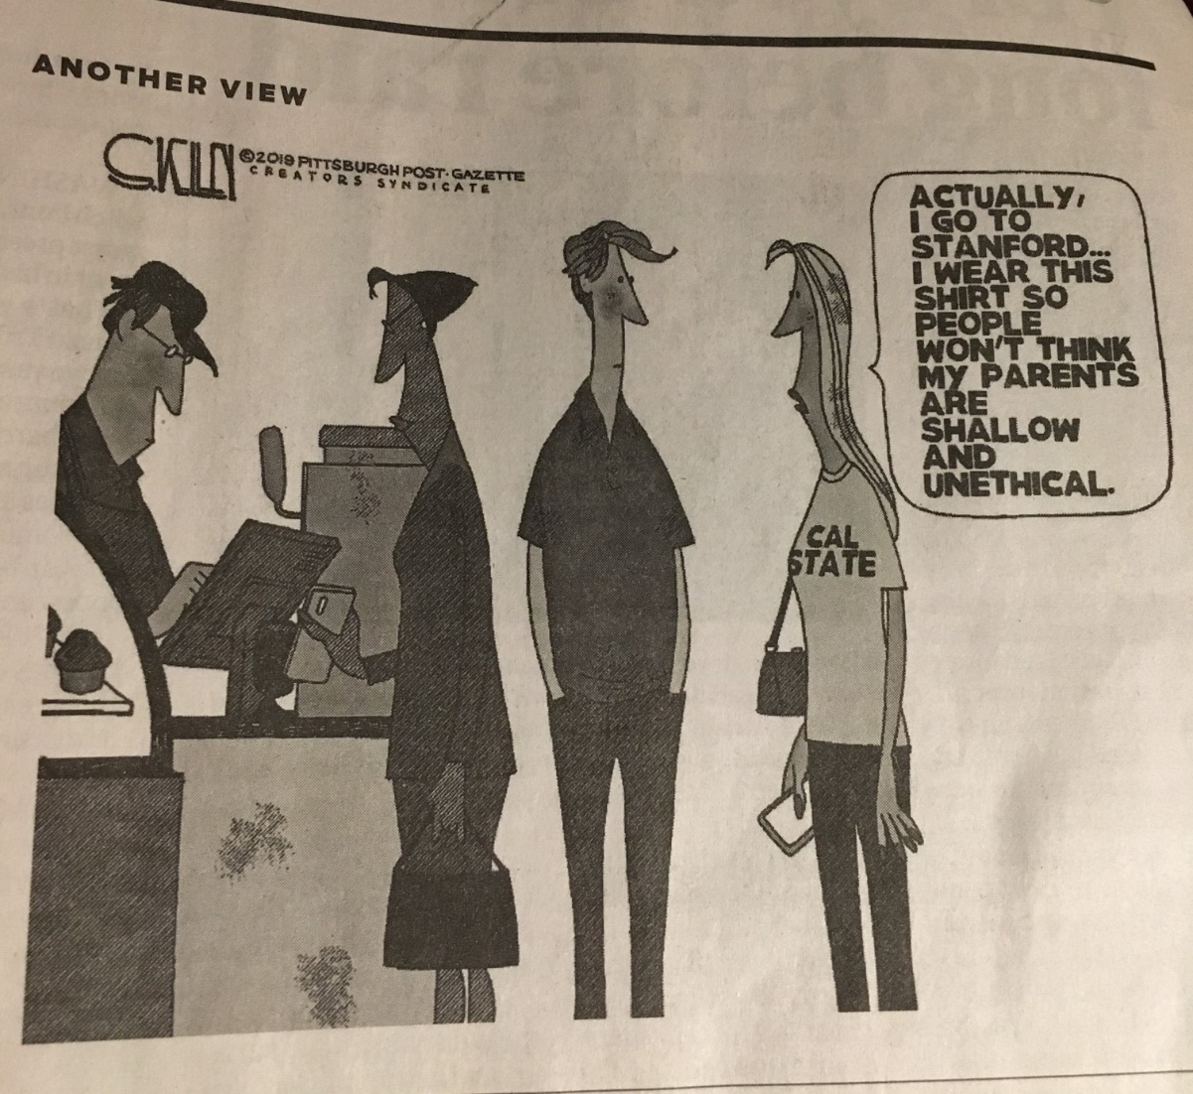
Current events & emerging risks – People
Campus protests
International faculty/staff/students from adversary countries
Enrollment “cliff”
Mental health challenges
The future of tenure and academic freedom
“Churn” of presidents/senior leaders
Tailored programs for specific student groups
Notes:
Kim
Protests on campus – balancing first amendment rights with the need for all campus constituents to feel safe. student safety (perception and reality)
International faculty/staff/students from adversary countries – balancing foreign influence risks with human rights
Enrollment “cliff” and how to combat shrinking enrollments. TTU has a new degree program for people with SOME college hours – to fasttrack them toward a degree.
Mental health – more students than ever come to college with mental health issues.
The future of tenure – who thinks tenure will end in your lifetime?
Academic freedom – what it means/doesn’t mean. Some states are introducing legislation that impact teaching critical race theory or other controversial topics
Online program impacts – some univ may go out of business, student interaction with others changes
“Churn” – average time for college presidents is declining; some high profile very public resignations over handling of protests
Tailored programs – veterans, international, HSI, first gen

Slide 27
Breakout Discussion
What engagements could you conduct to address these social, culture, and people-related risks?
Notes:
STOP FOR BREAKOUT –
STOP FOR BREAKOUT – WHAT AUDITS COULD YOU DO THAT WOULD ADDRESS THESE SOCIAL, CULTURE, AND PEOPLE-RELATED RISKS?

Slide 28
The Future of Higher Education
Changing political landscape
Value proposition
Workforce development
Certificate programs
Non-traditional students
Legislation: The Chips Act
Notes:
Sandy to Prep/Kim to edit—both to comment on this slide
Political landscape –
Value proposition – is Higher edu worth it?
Data decisions? Male enrollment declining. 40.5% of undergrad students. (Chronicle),
Technical degrees. Trade school. Workforce development.
Certificate Programs.
Non-traditional students: Attracting nontraditional students with different degree programs.
Gearing toward some college education who want to finish. Degree completion.
New Approaches to get students out quicker and cheaper.
Schools like Western Governors
The Chips Act—expected to be a game-changer.

Slide 29
Culture and Ethics in Higher Education
Notes:
Abuse of faculty privilege and uncivil treatment of people at lower ranks in the campus hierarchy

Slide 30
Notes:
Sandy and Kim
Many of these reflect the expectation that high profile individuals MUST represent their employer 100% of the time. They don’t get to take a day off…or an hour….
Chris Beard/UT
UT Letter to Chris Beard:
UT is terminating your employment, effective Jan 5, 2023, pursuant to section 7A12 of your employment contract, Suspension or termination by the University for Cause.
Excerpts from UT Letter to Coach Beard’s lawyer:
“Being a head coach at UT Austin is about more than winning games. The privilege of coaching comes with a great responsibility that goes beyond just avoiding improper conduct. A coach is a leader – a leader who develops student athletes’ positive character, supports their education, prepares them for success in lives after graduation, and represents the University of Texas with honor and respect. A coach’s influence is effected through both professional and personal interactions.
“Chris Beard engaged in unacceptable behavior that makes him unfit to serve as head coach at our university. Instead of immediately terminating Mr. Beard the university exercised thoughtful restraint to allow time for additional material facts to emerge Mr. Del Conte supported Mr. Beard and the program by supporting this pause before action and by presuming his innocence while the facts unfolded but that support was not a determination regarding Mr. Beard's conduct. It is his actual behavior that we consider not whether some acts also constitute a crime. Whether or not the district attorney ultimately charges Mr. Beard is not a determination of whether he engaged in conduct unbecoming a head coach at our university there seems to be an incorrect underlying assumption that the criminal process outcome dictates Mr. Beard's employment outcome. But these are different processes where different decision makers are weighing different factors.
“Your letter this morning reveals that Mr. Beard does not understand the significance of the behavior he knows he engaged in or the ensuing events that impair his ability to effectively lead our program. This lack of self-awareness is yet another failure of judgment that makes Mr. Beard unfit to serve as a head coach at our university.”
Presidents of Columbia, Harvard, and Penn all resigned after backlash over Congressional testimony about on-campus protests related to Israel and Gaza.
Wisconsin Chancellor Interview – he did nothing wrong. “It was legal”
Sasse Univ of Florida president – spending in his first year went from $5.6M by the former president to $17.3M. A majority of the spending surge was driven by lucrative contracts with big-name consulting firms and high-salaried, remote positions for Sasse’s former U.S. Senate staff and Republican officials. Sasse’s consulting contracts have been kept largely under wraps, leaving the public in the dark about what the contracted firms did to earn their fees. The university also declined to clarify specific duties carried out by Sasse’s ex-Senate staff, several of whom were salaried as presidential advisers.
TTU Rodeo Coach – fired after 2 audits and an IACUC investigation. HUGE uproar in the rodeo community.

Slide 31
Notes:
Glossary that might be helpful:

