Slide 2
Auditing Social Media
ACUA Distance Learning Topic
Felicia Best
Market Development Consultant, TeamMate
Wolters Kluwer, Tax & Accounting

Slide 3
WEBINAR MODERATOR
ACUA Distance Learning Director
Jana Clark
Senior Internal Auditor
Kansas State University
Don’t forget to connect with us on social media!

Slide 4
TODAY’S PRESENTER
Felicia Best
Market Development Consultant, TeamMate
888-400-2864
Felicia.Best@wolterskluwer.com

Slide 5
Objectives
Understand the impact of social media as an element of reputational risk to your organization
Discover and discuss options for addressing and minimizing social media risk within your organization
Gain a better understanding of social media and the business risks associated with it

Slide 6
Agenda
Social Media Defined
Benefits of Social Media
Risks of Social Media
Strategies for Risk Management
Final Thoughts

Slide 7
Social Media Defined
Put simply, social media is a collection of websites and applications that enable users to create and share content or to participate in social networking.
It is a collection of online communication channels dedicated to community-based input, interaction, content-sharing and collaboration.

Slide 8
Prominent Examples
Notes:
FaceBook – FREE social networking; Most popular
Twitter – FREE microblogging with short ‘tweets’ and followers
Instagram – FREE photo and video sharing
Google+ - FREE, interest-based social networking
Wikipedia – FREE open content ‘online encyclopedia’
Linkedin – FREE, designed for business community
Reddit – FREE social news website, user-submitted content
Pinterest – FREE social curation for sharing and categorizing images
YouTube – FREE video-sharing website

Slide 9
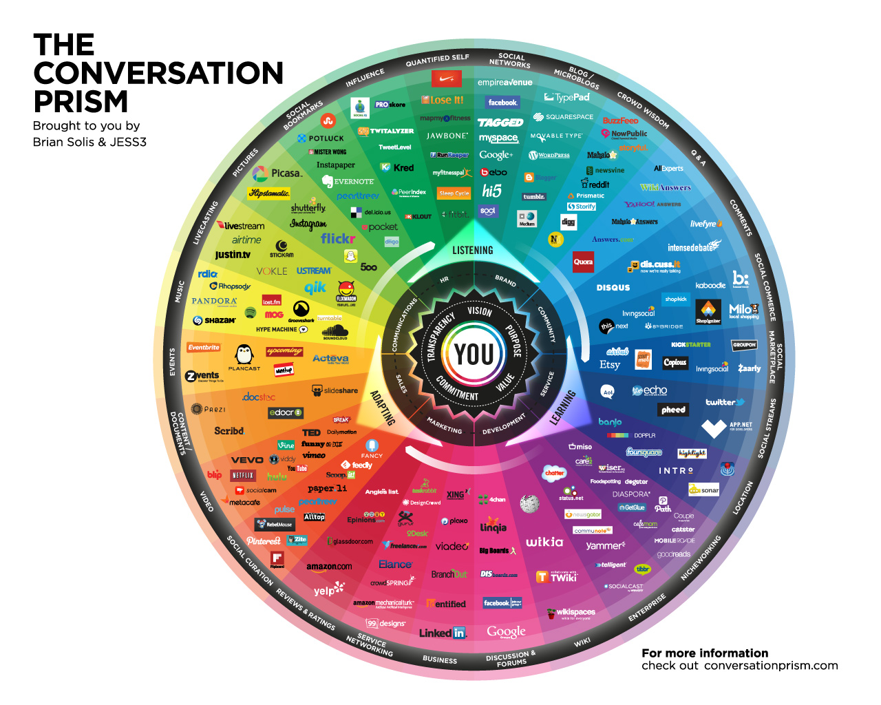
Notes:
Developed in 2008 by Brian Solis, The Conversation Prism is a visual map of the social media landscape. It’s an ongoing study in digital ethnography that tracks dominant and promising social networks and organizes them by how they’re used in everyday life.

Slide 10
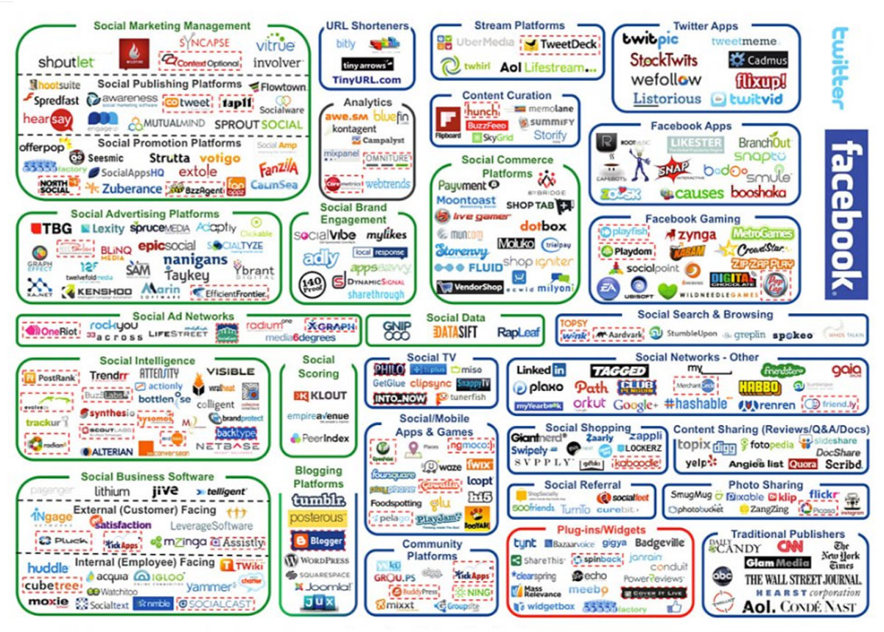

Slide 11
How many times have you accessed a social media site today?
0
1 – 5
5+

Slide 12
Social Media Demographic Statistics
22% of the world’s total population uses Facebook and 62.1% of North America
LinkedIn has more than 450 million user profiles
YouTube reaches more 18-45 year-olds than any cable network in the U.S.
Over 2.5 billion people have social media accounts
Nearly 1.8 billion people have active social media accounts

Slide 13
500 million
4.5 billion on Facebook
95 million uploaded to
https://blog.hootsuite.com/social-media-for-business/

Slide 14
What’s In It For You?
Brand Recognition
Product and Customer Feedback
Content Positioning
Talent Search
Online Training
Social Responsibility Efforts

Slide 15
Brand Recognition

Slide 16
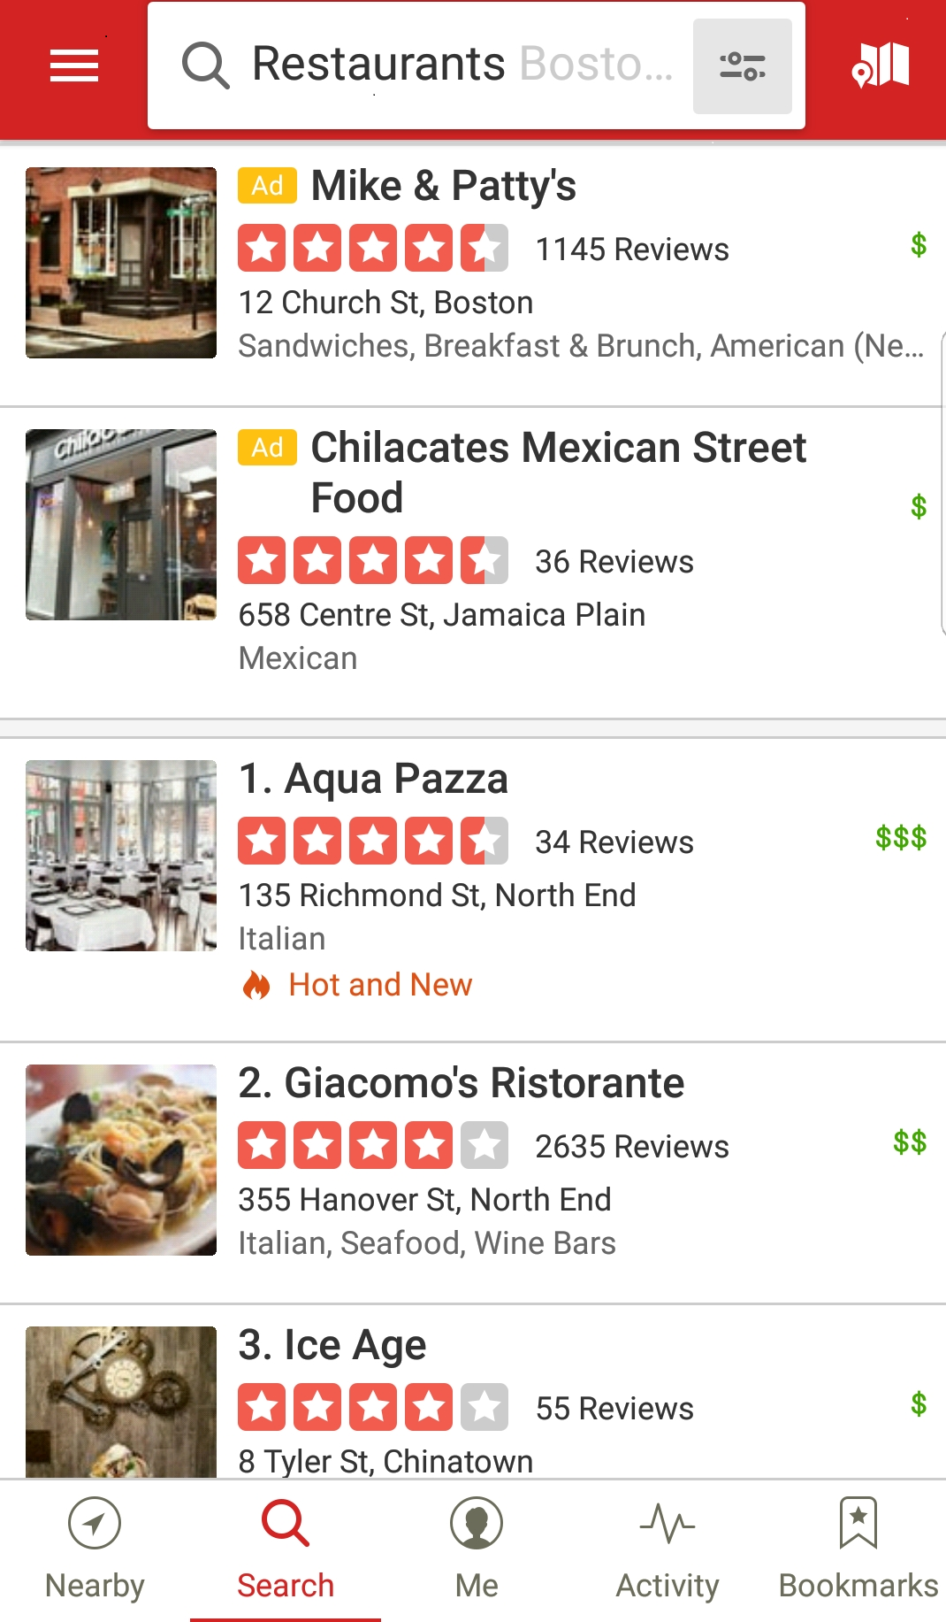
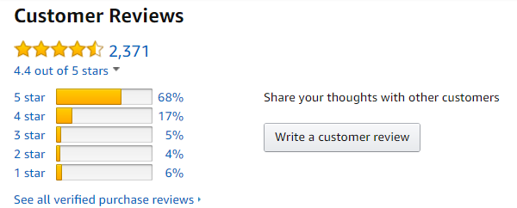
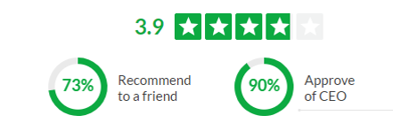
Product and Customer Feedback
Notes:
Yelp
Amazon
Glassdoor

Slide 17
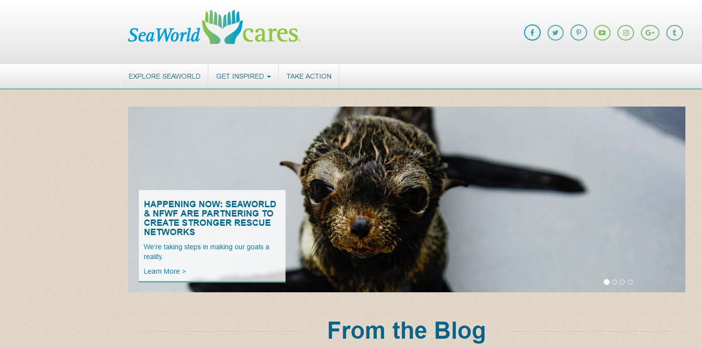
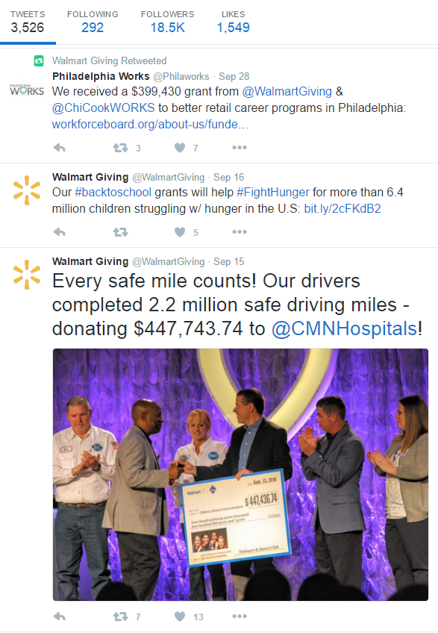
Social Responsibility Efforts

Slide 18
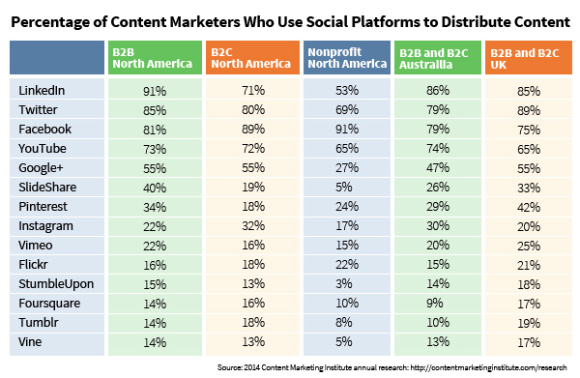
Content Positioning

Slide 19
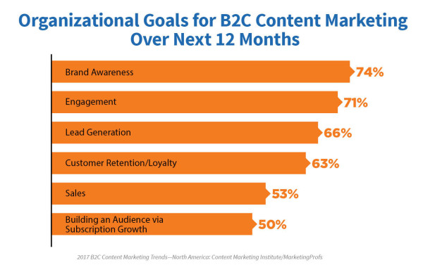
Key Factors in Using Content for Brand Recognition
Notes:
74% of B2C marketers report having a content marketing strategy (40% said it’s documented and another 34% have a verbal strategy).
76% of B2C marketers who have a strategy said it includes a plan to operate content marketing as an ongoing business process, not simply as a campaign.
78% of B2C marketers agree they can demonstrate, with metrics, how content marketing has increased audience engagement (that’s encouraging news, as brand awareness and engagement are cited as B2C organizations’ top two goals for content marketing over the next 12 months).

Slide 20
Talent Search
92%
Recruiters use social media in their process
79%
Job seekers use social media in their search
1 in 5
Applicants applied for jobs found on social media

Slide 21
Where’s the Talent?
According to the Pew Research Center, LinkedIn usage is especially high among the educated and high earners
LinkedIn is the only social networking site measured that showed higher usage among 50-64 year olds than among those 18-29
Notes:
Educated = Bachelor’s degree holders and up
High Earners = Making $75,000 or more

Slide 22
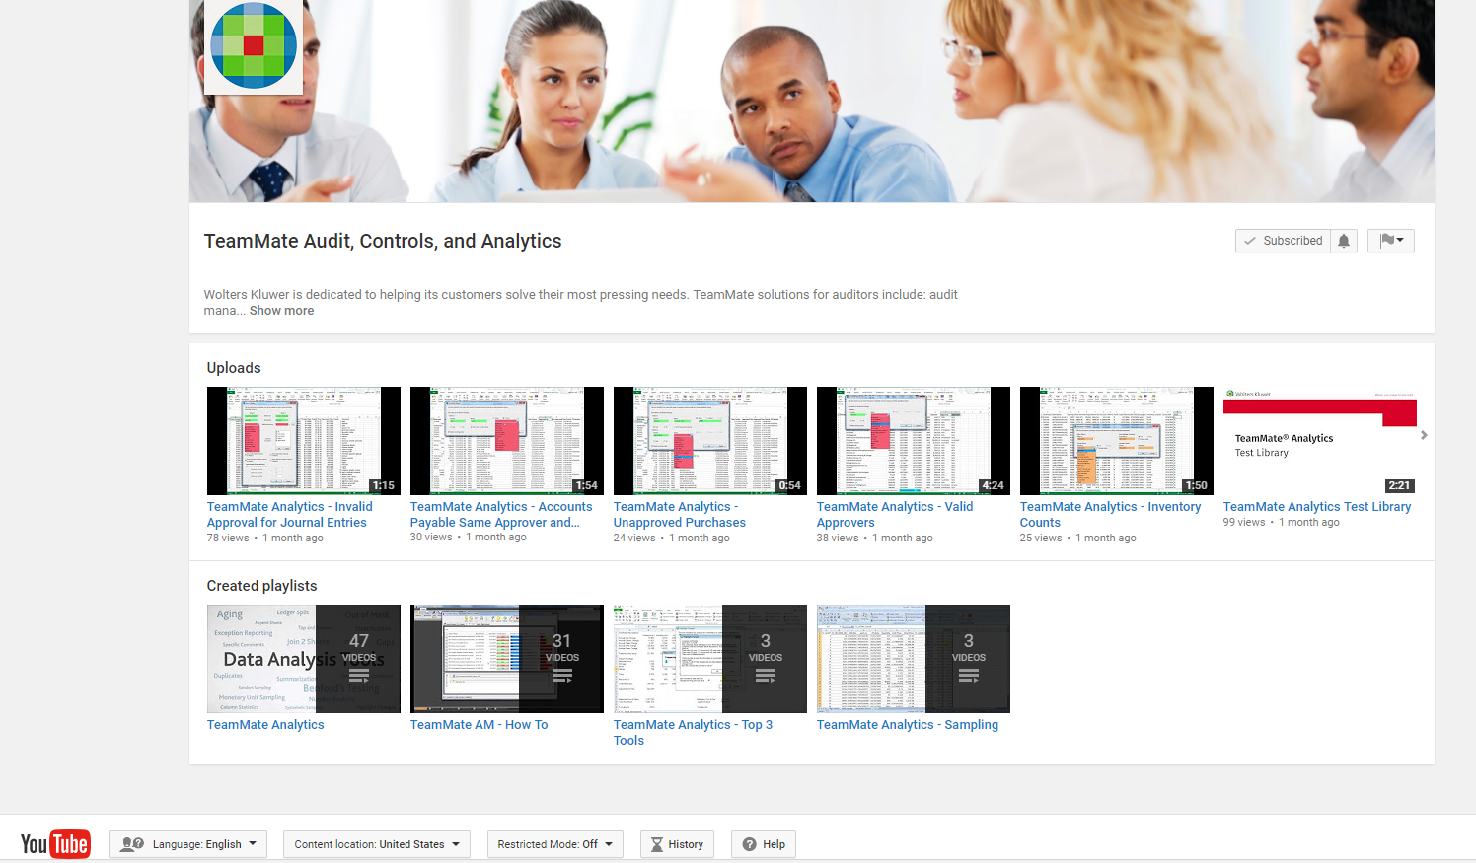
Online Training

Slide 23
The Downside…
Data Privacy Concerns
Reputation
Security

Slide 24
Consumer Privacy Concerns
Customers are constantly faced with choices of providing their personal information to companies they do business with, as well as for social purposes
Benefits provided, and risks faced are the key determining factors in deciding whether to provide personal information
54% - OK with company installing surveillance
47% - OK with retail company loyalty cards

Slide 25
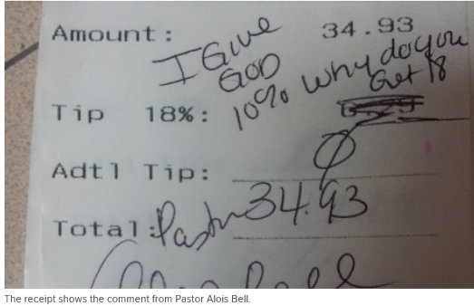
What Are the Questions?
What’s in it for me?
Do I trust the company?
What are they going to do with my information?
Does this cross my line of comfort?

Slide 26
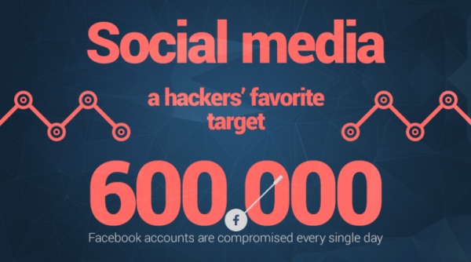
Security Concerns

Slide 27
Notes:
There was a time when data leaks were best prevented by keeping all information within the firewall. Cloud-based technology and social media have totally disrupted this. Data leaks can be a result of hacking, malicious insiders, or sometimes even by mistake.
We’ve all heard the horror stories of people making posts that they later regret. But, the damage can have a huge impact on businesses as well.
There are even examples of military personnel disclosing details of submarines, sensitive visits, or even videos posted of locations and equipment

Slide 28
What is Reputational Risk?
The potential that negative publicity regarding an institution’s business practices, whether true or not, will cause a decline in the customer base, costly litigation or revenue reductions.
- U.S. Federal Reserve - 1995

Slide 29
What is Reputational Risk?
According to a 2015 survey, damage to reputation and/or brand was considered to be the most significant risk to the enterprise.
Potentially impacting:
Customer Base
Finances and valuation of the business
Ability to hire & retain good talent
Other less easily classified areas

Slide 30
Where do the threats come from?
Threats can be segregated into 4 main categories:
Risk to reputation stemming from employment activities
Risk to reputation coming from product or customer issues
Risk to reputation derived from governance
Other less easily classified areas

Slide 31
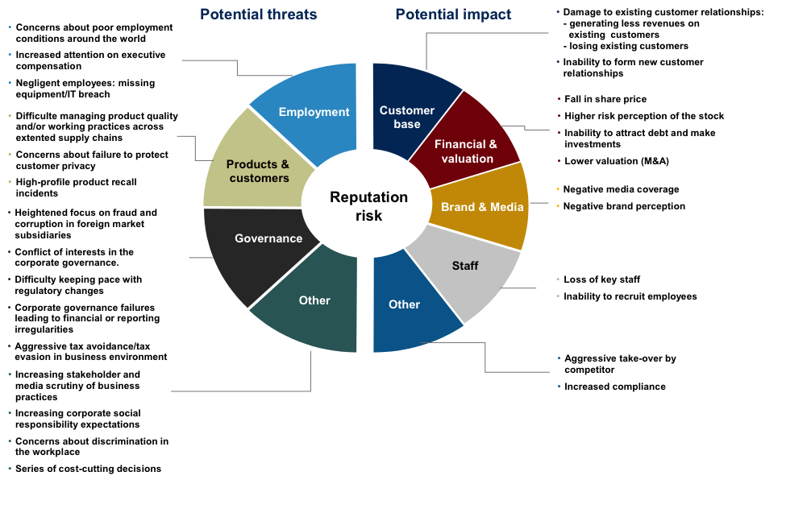

Slide 32
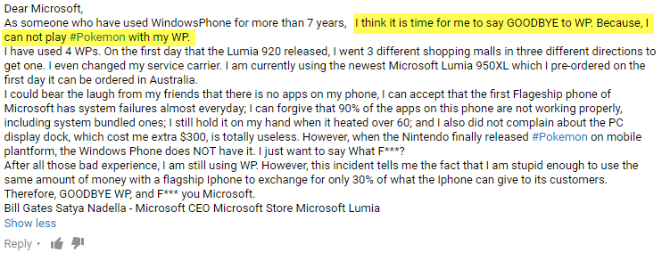
Product / Customer Issues

Slide 33
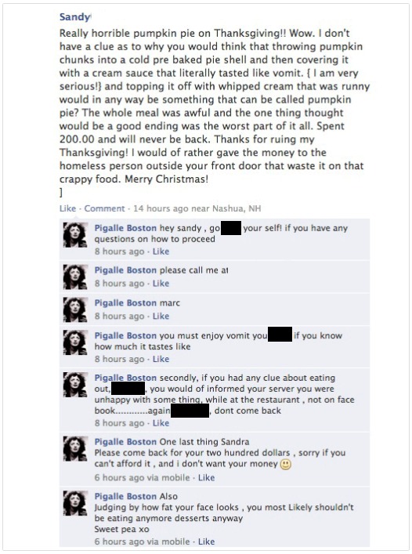
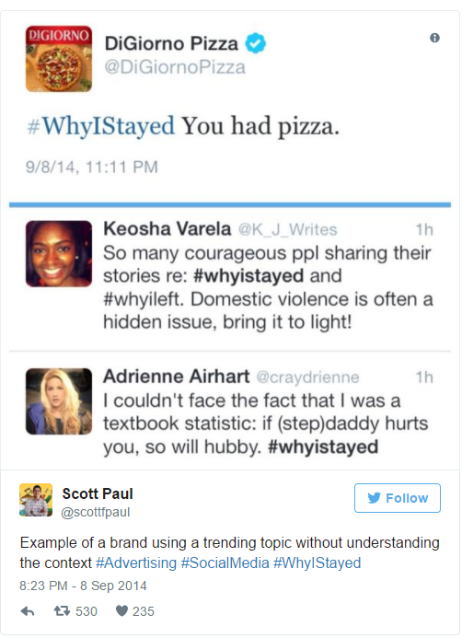
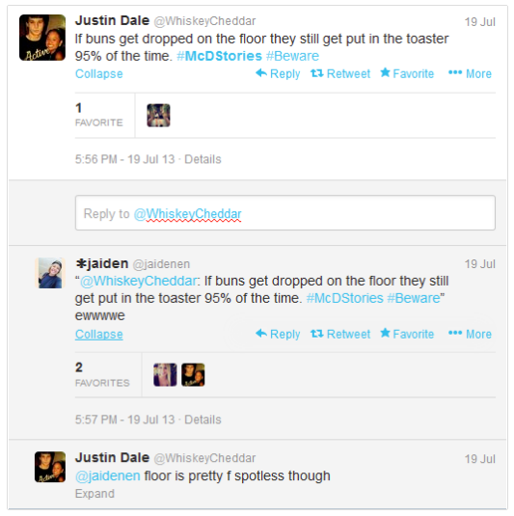
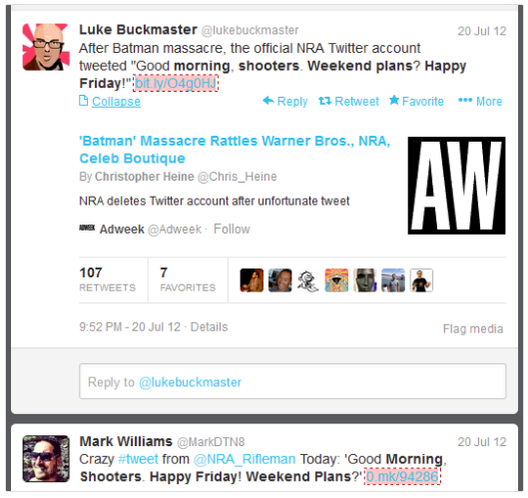
Social Media Gone Wrong

Slide 34
What Can We Do?
Assess Social Media Risk
Establish and distribute a social media policy
Incorporate social media expected behaviors and repercussions in employee handbook
Train all employees at all levels of the organization on the impact of social media
Monitor and audit your social media footprint
Audit compliance with policies and weight findings

Slide 35
What Can We Do?
Have a solid content marketing process, that includes:
A content hub
Adequate resources to keep up consistent presence
A content plan

Slide 36
Social Media Policy
The organization may not have a clear social media strategy
Establish and distribute a social media policy
Has social media been aligned to support the organization's overall strategy?
Does the policy cover official and unofficial use of social media, repercussions for damaging internal postings, and procedures for responding to negative postings?

Slide 37
Does your company have a social media policy?
Yes
No
I’m not sure

Slide 38
Set Expectations for Employees
Employees may not be aware of social media expectations
Incorporate social media expected behaviors and repercussions in employee handbook
Does the organizational culture support the proper use of social media?
Are managers taking appropriate action when employees engage in unsanctioned posting that can damage the brand?

Slide 39
Social Media Policy - Expectations
Establish & distribute a social media policy, including:
Requiring company credentials are different from personal credentials
Clarity on what employees can and cannot share about the business
Monitoring to ensure no sensitive information is shared

Slide 40
Is your company planning a social media audit this year?
Yes
No
I’m not sure

Slide 41
Train Employees
Employees may not be aware of the impact of posting to social media
Train all employees at all levels of the organization on the impact of social media
Has the organization provided clear, ongoing education on the social media strategy, the impact of damaging posts, and the potential repercussions?

Slide 42
Monitor Social Media
Damaging posts can be initiated by anyone on any social media outlet
Monitor and audit your social media footprint
Are all feasible actions taken to monitor social media outlets and to respond to potentially damaging posts?

Slide 43
Do you think companies should be able to fire employees for things posted on their personal social media accounts?
Yes
No
Only if it’s company related

Slide 44
Don’t Violate Your Employees
While you should have a social media policy in place, going to far may be just as damaging
Firing employees for social media posts
Using social media in the hiring process
Employees posting inappropriate content on company platforms
Befriending and following employees
Failing to preserve evidence

Slide 45
What Does This Look Like?
Risks | Controls | Tests
The organization may not have a clear social media strategy | Establish and distribute a social media policy | Has the social media been aligned to support the organization's overall strategy? Does the policy cover official and unofficial use of social media, repercussions for damaging internal postings, and procedures for responding to negative postings?
Employees may not be aware of social media expectations | Incorporate social media expected behaviors and repercussions in employee handbook | Does the organizational culture support the proper use of social media? Are managers taking appropriate action when employees engage in unsanctioned posting that can damage the brand?
Employees may not be aware of the impact of posting to social media | Train all employees at all levels of the organization on the impact of social media | Has the organization provided clear, ongoing education on the social media strategy, the impact of damaging posts, and the potential repercussions?
Damaging posts can be initiated by anyone on any social media outlet | Monitor and audit your social media footprint | Are all feasible actions taken to monitor social media outlets and to respond to potentially damaging posts?

Slide 46
Final Thoughts?

Slide 47
References
https://conversationprism.com
http://contentmarketinginstitute.com
http://www.pewinternet.org/2016/01/14/privacy-and-information-sharing/
http://www.pewinternet.org/2016/01/14/the-state-of-privacy/
http://www.law360.com/articles/761008/5-ways-social-media-can-land-employers-in-court
http://www.law360.com/articles/684280/corporate-reputation-management-vs-employee-privacy?article_related_content=1
https://blog.kissmetrics.com/social-media-can-destroy/
http://www.aon.com/2015GlobalRisk/
https://iapp.org/news/a/a-balancing-act-how-to-protect-your-business-while-respecting-employees-privacy-rights/
https://www.tracx.com/resources/blog/social-media-demographics-2017-marketers/

Slide 48
For more information: www.teammatesolutions.com

Slide 49
Contact Information
Felicia Best
Market Development Consultant, TeamMate
888-400-2864
Felicia.Best@wolterskluwer.com

Slide 50
ASK NOT WHAT YOU CAN DO FOR ACUA BUT WHAT ACUA CAN DO FOR YOU!
Stay up to Date
News relevant to Higher Ed internal audit is posted on the front page. Articles are also archived for your reference under the Resources/ACUA News.
The College and University Auditor is ACUA's official journal. Current and past issues are posted on the ACUA website.
WWW.ACUA.ORG
Connect with Colleagues
Subscribe to one or more Forums on the Connect ACUA to obtain feedback and share your insights on topics of concern to higher education internal auditors.
Search the Membership Directory to connect with your peers.
Share, Like, Tweet & Connect on social media.
Get Educated
Take advantage of the several FREE webinars held throughout the year.
Attend one of our upcoming conferences:
Midyear - March 18-21, 2018 Hyatt Regency Hotel, Louisville, KY
Annual - September 9-13, 2018 New Orleans Marriott, New Orleans, LA
Contact ACUA Faculty for training needs.
Get Involved
The latest Volunteer openings are posted on the front page of the website.
Visit the listing of Committee Chairs to learn about the various areas where you might participate.
Nominate one of your colleagues for an ACUA annual award.
Submit a proposal for the conference.
Write an article for the C&U Auditor.
Solve Problems
Discounts and special offers from ACUA's Strategic Partners
Risk Dictionary
NCAA Guides
Resource Library
Vendor Directory
Governmental Affairs Updates
Survey Results
Career Center......and much more.

Slide 51
UPCOMING ACUA EVENTS
December 19, 2017 – EU General Data Protection Regulations Impacting U.S. Institutions (Mark Bednarz and Ian Singer, PKF O’Connor Davies)
February 7, 2018 – Construction Auditing (Asel Solovyeva (Univ of Michigan) and Robert Zellmer (Baker Tilly))
March 18-21, 2018 – ACUA Mid-Year Conference in Louisville, KY

