Slide 1
Internal Audit Process
Pre-Audit Presentation

Slide 2
Objectives of Presentation
Provide a basic understanding of internal audit
Provide a basic awareness of the principles of internal controls so:
You have an understanding of what we’re looking for as we conduct the audit
You can help us identify risks (potential problems) that warrant attention

Slide 3
What is Internal Audit?
Internal auditing is an independent, objective assurance and consulting activity designed to add value and improve an organization's operations. It helps an organization accomplish its objectives by bringing a systematic, disciplined approach to evaluate and improve the effectiveness of risk management, control, and governance processes. – Institute of Internal Auditor

Slide 4
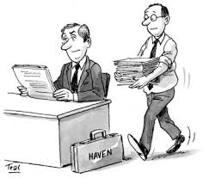
What does Internal Audit do?
We examine how University departments and processes operate.
Our emphasis is on evaluating internal controls.

Slide 5
university Audit Process
Prepare annual audit plan
Conduct internal audit planning and opening meeting
Perform audit fieldwork
Conduct preliminary closing meeting
Obtain management responses
Draft audit report & distribute
Conduct closing meeting
Disseminate final report
Perform audit follow up

Slide 6
Internal Audit Reporting Lines
President
Board of Regents
Internal Auditor

Slide 7
What are Internal Controls?
A process effected by an organization’s people, designed to provide reasonable assurance in the following categories:
Effectiveness and efficiency of operations
Reliability of financial reporting
Compliance with laws and regulations
COSO definition – COSO- Committee of Sponsoring Organizations of the Treadway Commission

Slide 8
What are Internal Controls?
Internal Controls are People Dependent
Internal Controls
Are developed by people
Guide people
Provide accountability to people
Are carried out by people

Slide 9
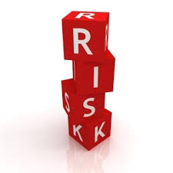
What are Internal Controls?
Reasonable Assurance??
Too little control presents undue risk
Excessive Controls are costly and counterproductive

Slide 10
Undue Risk / Excessive Controls
Undue Risks Cause:
Loss of Assets, Donors or Grants
Poor Business Decisions
Noncompliance
Increased Regulations
Public Scandals
Excessive Controls Cause:
Increased Bureaucracy
Reduced Productivity
Increased Complexity
Increased Cycle Time
Increase of No-Value Activities

Slide 11
Three Control Categories
Effectiveness and efficiency of operations
Processes run smoothly and help us meet our objectives
Reliability of financial reporting
Numbers are accurate and are an aid to decision-making
Compliance with laws and regulations
Stay out of trouble

Slide 12
Too Simplify:
“Internal controls can be defined as those processes that management relies on to make sure things don’t get goofed up.”
Paul Kanneman

Slide 13
Internal Controls from Everyday Life

Slide 14
You are practicing good internal controls when you
Study for a test
Make a grocery list
Lock your car doors
Set your alarm clock
See your dentist for your annual checkup
Stop home delivery of your mail or newspaper when you’re away

Slide 15
Before we proceed:
Who is responsible for the University’s internal controls?
Everyone including You

Slide 16
Five Interrelated Components of Internal Control
Control Environment
Risk Assessment
Control Activities
Information and Communication
Monitoring

Slide 17
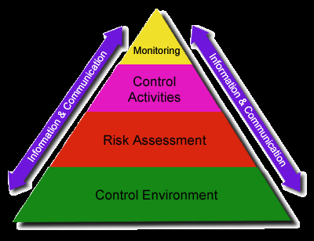
Internal Control Pyramid

Slide 18
Internal Control Pyramid
Internal controls are not something that are simply laid on top of the organization
Internal controls must permeate the organization

Slide 19
Control Environment
The “tone at the top” provides the foundation.
Includes the following elements:
Demonstrates commitment to integrity and ethics
Exercises oversight responsibility
Establishes structure, authority, and responsibility
Demonstrates commitment to competence
Enforces accountability

Slide 20
Risk Assessment
Recognizing potential problems and ensuring there are procedures to deal with them.
Four Steps to Risk Assessment
Establish objectives
What do you want to achieve?
Identify risks
What can happen?
Plan risk management
What is our response?
Plan for change
Implement control activities

Slide 21
Internal Risk Factors
New personnel
Change in management responsibilities
Revamped information systems
New programs
Communication
Student needs or expectations

Slide 22
External Risk Factors
Economic environment
New legislation or regulations
New technology
Natural disasters, criminal or terrorist actions
Community needs or expectations
Vendor/Contractor performance and reliability

Slide 23
Control Activities
Preventative
Approval
Authorization
Security
Segregation of duties
Detective
Verification
Reconciliation
Review

Slide 24
For the following problem
Identify the risk(s) and
A control activity that could have reduce the risk

Slide 25
Problem
Because of the time the department secretary has spent reconstructing the department chair’s research, other tasks are low priority. The secretary keeps cash receipts (cash and checks) in an unlocked desk drawer. The drawer contains $2000 in cash and 40 checks totaling $3000. Some checks are more than six months old. Some have not been endorsed and other have been endorsed “University name.”

Slide 26
Problem - Risks
Lost or stolen cash and checks
Stale checks
Budget shortfall

Slide 27
Problem – Control Activities
Restrictive endorsements
Secure location
Cash receipts journal
Frequent deposits
Verify deposits
Department head review

Slide 28
Information & Communication
Systems or processes that support the identification, capture, and exchange of information in a form and time frame that enable people to carry out their responsibilities.

Slide 29
Monitoring
Processes used to assess the quality of internal performance over time. Ongoing monitoring occurs in the ordinary course of operations, and includes regular management and supervisory activities.

Slide 30
Thank You

